Slide 1
Poster Presentation
Module name: Marketing Management
Module code: LCMB7024_BIRM
Lecturer name: Taonga Kaonga Sobere-Snithers
Student Name: Diana Olimpia Mekker
Student ID: 2122278

Slide 2
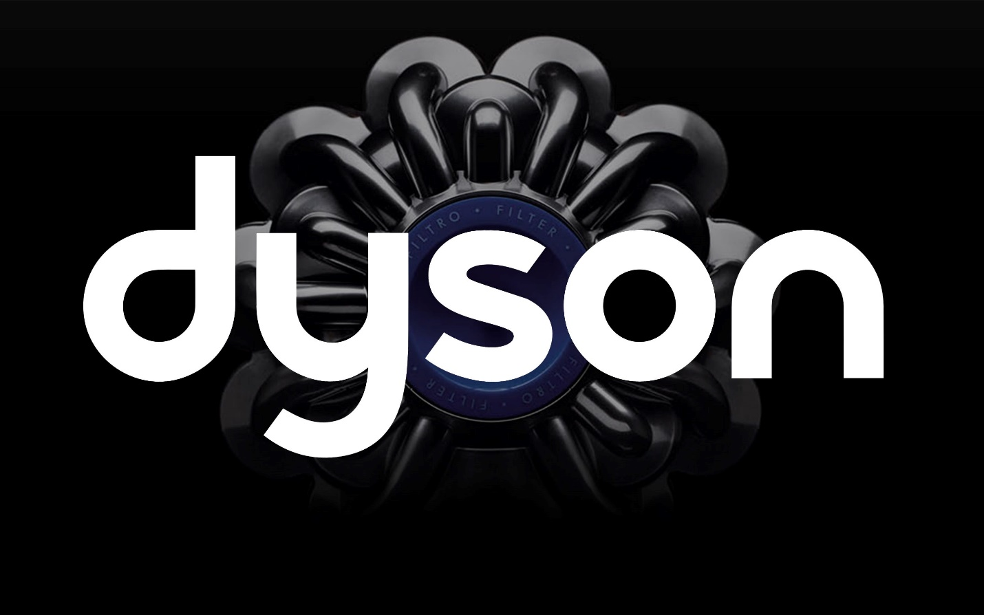
Brand Extension
Dyson
Brand Extension Overview
Dyson is a well-known company that is working as an innovative director of home appliances. This company is working on the extension of air purifiers with smartphone technology. The benefits that can be seen in their new product line are not only in terms of air quality, but also in terms of environmental issues, it will be able to maintain customer service very well, as well as maintain a comfortable room.
Appeal to the Market
This brand extension will attract environmentally conscious customers in the current market and will also be able to provide effective services by maintaining the quality of air in the environment. All the tech-savvy homeowners will be interested in using such innovative technology. By creating new technology lines in the market and by producing such products very easily, the company will also be able to gain a competitive advantage in the business field.
Alignment with Sustainability Goals
Various goals have been set for the creation of this new air purifier by using energy efficiency and environmentally friendly materials. So that a user can reduce the level of environmental pollution after use, a lot of importance is given to that issue. It is aimed at all those consumers who are aware of sustainability and environmental friendliness, and it can help the organization's progress in a highly effective way.

