Slide 1
War – what is it good for?
Profit or Justice?

Slide 2


Introduction
Profit or justice?
The goal
Some context
Notes:
Are modern conflicts especially civil wars motivated by economic interest or social injustice?
In this presentation we are going to review whether war occurs due to its profitability or if it occurs to right moral ambiguity in a state.
Throughout this powerpoint I will apply the conflict theory of Greed v Grievance through a lens of Civil war but will make some reference to interstate wars too.

Slide 3
Conflict theory
"Rebellion may be motivated by greed or by grievance"
Collier and Hoeffler 'Greed and grievance in Civil War' (2004)
Notes:
Paul Collier and Ank Hoeffler developed the greed and grievance model. The greed and grievance model aimed to explain the disparity between stable and unstable states.
Draining on dozens of conflicts occurring from the 1960s to the 1990s they sought to use economic analysis as to pertain the reason for ongoing conflicts.
In their paper 'Greed and grievance in Civil war' in the Oxford economic paper 2004) they discussed whether social injustice and ethnic division was paramount to continued conflict or whether the economic feasibility was more important.
They argued that Greed or 'the financial viability if a rebel organization" us more important as this means a conflict can become profitable.

Slide 4
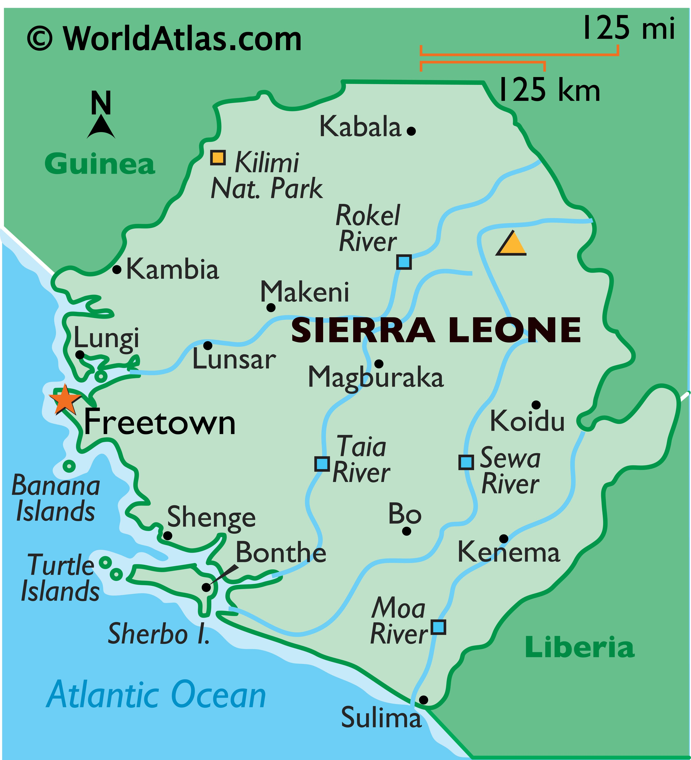
Conflict theory
"Rebellion may be motivated by greed or by grievance"
Collier and Hoeffler 'Greed and grievance in Civil War' (2004)
Notes:
One conflict they used to discuss this was Sierra Leone. The Sierra Leone conflict demonstrated that greed and economic feasibility is a huge factor in conflict.
Collier stated in 2000 in an article for the world bank " The rebellion in Sierra Leone was motivated by the opportunity to capture and exploit diamond resources'.
In the Sierra Leone conflict, the Revolutionary United front (RUF) financed the rebellion through 'blood diamonds'. Collier proposed that the war persisted because the diamond trade made the fight economically sustainable.

Slide 5
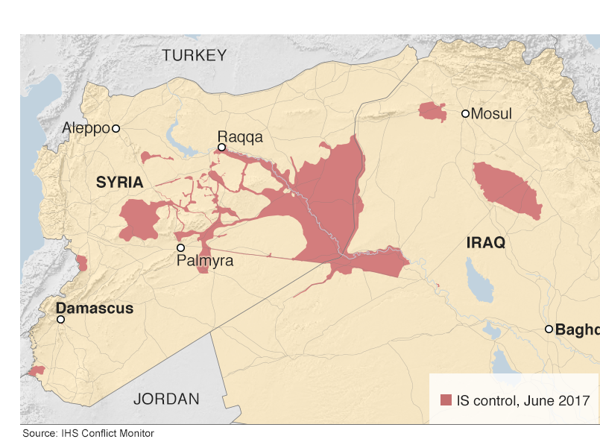
Conflict theory
"Rebellion may be motivated by greed or by grievance"
Collier and Hoeffler 'Greed and grievance in Civil War' (2004)
Notes:
Another Greed case was ISIS and the Syrian-Iraqi conflict. ISIS was able to generate revenue through oil smuggling and taxation effectively earning millions every day.
ISIS were able to use religion to sell the war but the war allowed them control over financial resources that they would not have been able to do if in the conflict ended.

Slide 6
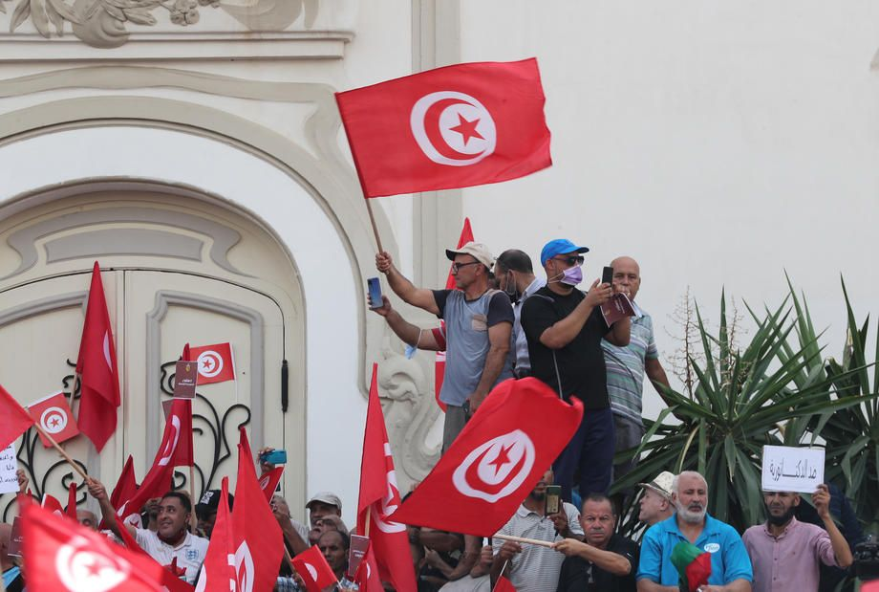
Conflict theory
"Rebellion may be motivated by greed or by grievance"
Collier and Hoeffler 'Greed and grievance in Civil War' (2004)
Notes:
The other half of this theory is grievance, whether historical grievance or modern.
For example, the Arab spring in 2011/2012.
Across North Africa and the middle east – people were frustrated with their leaders and political repression, This lead to uprisings all over the region.
Tunisia for example occurred due to Mohammed Bouazizi who set himself on fire in the middle of a Tunisian marketplace due to harassment that was done by Tunisian officials.
Finally the Irish troubles, this occurred because of the ethno-political conflicts between catholic nationalists and protestant unionists, It was a conflict rooted in historical discrimination.

Slide 7
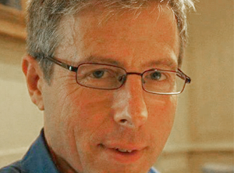
Critiques
"The war in Sierra Leone can not be understood simply as a breakdown of order: it also represented the creation of a new order"
Keen, D Conflict and collusion in Sierra Leone. James Currey P.11)
Notes:
Whilst Collier and Hoefflers theory does have its merits it would be remiss of me to not include the fact it has been critiqued by other conflict theorists.
David Keen, discussed how Sierra Leone as not just about money but that it also allowed war to occur because the state was de-legitimized through political collusion.
Keen theorized that the conflict as originally 'Motivated by deep seated grievance' but was 'sustained by economic opportunities'. This demonstrated that both sides of the theory can be important and that quite often they will overlap and become the root cause together.

Slide 8
Critiques
"The notion of greed should not obscure the political and social context"
Berdal and Malone, Greed and Grievance: Economic agendas in Civil wars (2000)
Notes:
Berdal and Malone also argue that the two are not mutually exclusive and that in fact neither replaces the other but both interact dynamically to create a bridge.
Berdal and Malone explain that "Econonomic agendas are not necessarily incompatible with political or social objectives" This adds more weight to the idea that both coexist. Often meaning that economic agendas exist within the political or social objectives. We can relate this to the current American political climate in response to Cuba. Whilst the US frame its current sanctions against Cuba purely as political reform it does allow the US government to exert some strategic and economic control in the geographic region.
Cuba demonstrates this by framing their struggle as a resistance to American imperialism but by doing so it keeps its name in the national headlines and gains public notoriety for standing up to Trump therefore increasing its tourism and potential foreign investment.

Slide 9
COnclusion
Does the theory work?
Could the theory be improved?
Notes:
AS the evidence has show there is a case to make for all sides of this debate. It would be easy to say that the theory is correct as it can be used to explain many wars both modern and historical however, Berdal and Malone and Keen make it distinctly clear that whilst they don’t disagree entirely with the theory they don’t believe it is fully intact. The evidence presented by the critiques point towards it being a good theory but in need of some restructuring. Berdal and Malone's point about the dynamics needing each other for a conflict to be sustainable is especially important.
This doesn't disprove the theory but instead increases it viability by building on the theory to include the point that greed AND grievnce are responsible not just one or the other.

Slide 10
Bibliography
Berdal, Mats, and Malone, David, Greed and Grievance: economic agendas in civil wars (Boulder, CO: Lynne Rienner Publishers, 2000)
Collier, Paul, Economic Causes of Civil Conflict and Their Implications For Policy (Washington, DC: World Bank, 2000)
Collier, Paul and Hoeffler, Anke, Greed and Grievance in Civil war, (Oxford Economic papers, 56.4, 2004) Pp563-595
Keen, David , Conflict and Collusion in Sierra Leone (Oxford: James Currey, 2005)
Napoleoni, Loretta, Merchants of men: How jihadists and ISIS turned kidnapping and refugee trafficking into a multi-billion-dollar Business (New York: Seven Stories Press, 2016)

