Slide 1
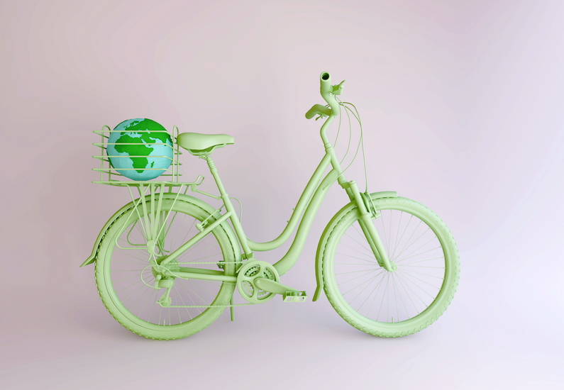
Journey to Sustainability and Beyond
Pauline Conaghan
Student No 1805438
Management Practice:
A Critical Perspective
Module BMSP7002D
Assessment 3, July 2019
Photo source: Shutterstock

Slide 2



Down to Earth Values and a Minimalistic Lifestyle
My journey to Sustainability began before moving to the UAE from Scotland in 2000. Paper recycling was a regular habit, I didn’t splurge on fast fashion as I didn’t need it nor could afford it and you could buy jackets and vintage fashion from stores like the Army & Navy Store.
Photos source: Shutterstock
The tap water in Glasgow is soft and in my opinion one of the best in the world so witnessing people buy plastic bottles of French water seemed like people were only following the latest trends. Soft drinks were also available in refundable glass bottles and it wasn’t so long since milk was delivered in glass returnable milk bottles as part of a circular economy.

Slide 3
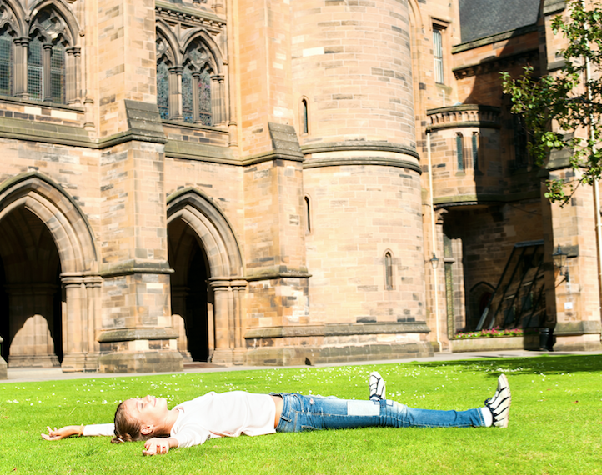
A Simpler Life
Anything I owned generally lasted until it could no longer be used and very few things even made it to the charity shop. In fact, I wore the same gym kit for 5 years while I worked at the University of Glasgow and this seemed the norm as people would even show up in pyjama bottoms to work out.
It was a culture around less superficial values or materialism and more about taking care of your well-being, being involved and being part of a community.
Photo source: Shutterstock
Photo courtesy of Shutterstock: University of Glasgow

Slide 4
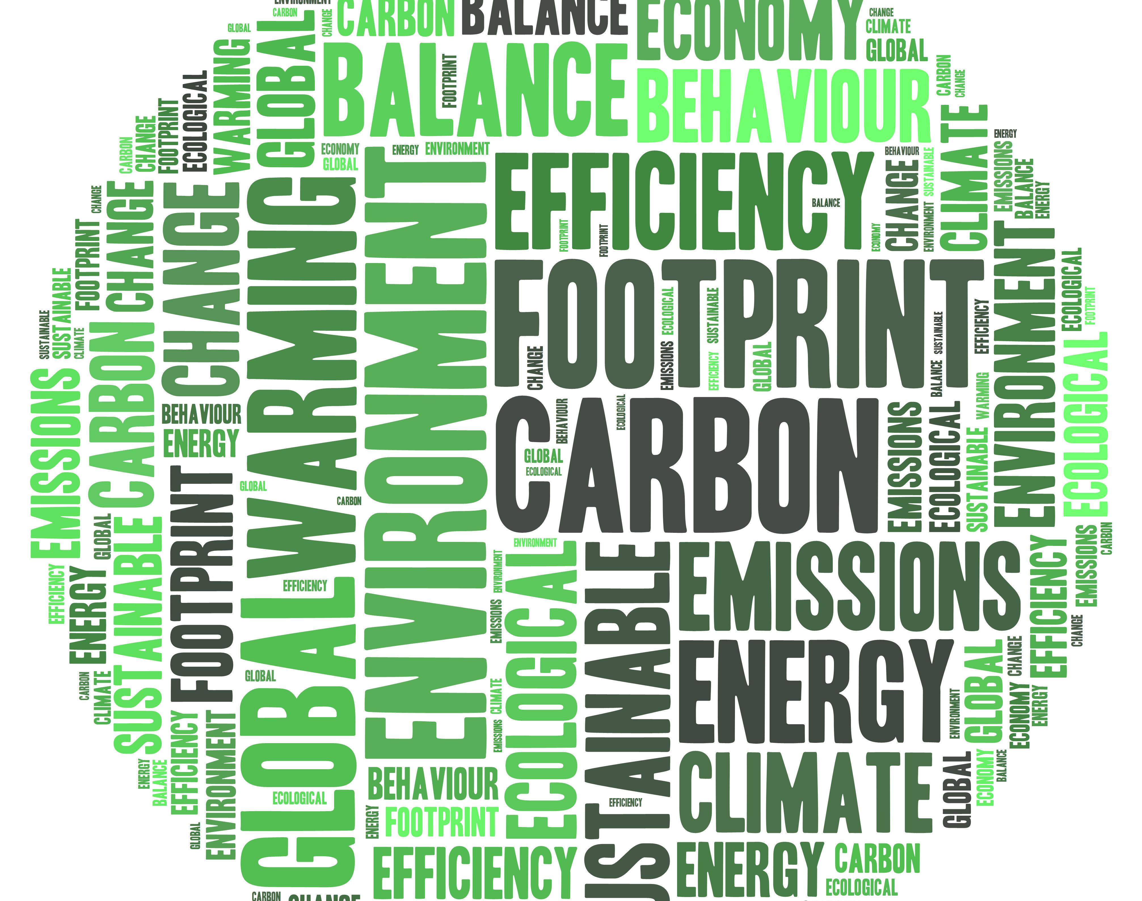
And as I look back, I am also proud of my carbon footprint - a term that was not very well known at the time and was derived from ecological footprint, coined by Professor William Rees in a 1992 paper published in the journal, Environment and Urbanization.
Rees described the balance that exists between what people take and use from the environment versus the availability of nature's resources to continue to provide them.
(Green Living 2019)
Image source: Shutterstock
My own carbon footprint measure included not owning a car, using public transport, borrowing a bike from community friends or walking endlessly and I didn’t get the chance to travel other than once a year on holiday ‘abroad’ if I was lucky.

Slide 5

Photo source: projecthotmess.com
In addition to my relatively small carbon footprint, overall, I would say I had a fairly healthy lifestyle checking off good health and well-being from a lack of clutter, overwhelming-ness as well as a less negative impact on the environment and my aim is try to go back to many aspects of this for future well-being.

Slide 6

Vegetarianism
But even before this, in 1993, I became vegetarian for reasons of animal welfare and since then very rarely use leather products opting instead for canvas shoes and bags and furniture made from more textured, natural materials.
And from recent literature (ADEME 2018), the French Environment and Energy Management published evidence that continues to influence my current position in a study that evaluated diet-related environmental impacts. Compared with diets that include meat, the study found vegetarian and/or vegan diets:
            Produced 49.6% fewer greenhouse gas emissions
            Needed 26.9% less energy for food production, and
            Had a 41.5% smaller environmental footprint compared to diets that included meat
Photo source: Shutterstock

Slide 7

Al Ain, Community and Managing Modern Society
For 10 years from 2000, I lived mostly in Al Ain in the desert and heartland of the UAE. People from this close-knit expat community seemed more down to earth, consumerism was harder to immediately come by and I would say community life could be described as a resilient interconnected economy away from today’s modern influences such as online shopping.
This was in some ways like Totnes, a small UK town following their Transition Movement back to these values and to connecting to each other with a sense of community spirit. (Totnes 2012)
Photo source: Shutterstock

Slide 8
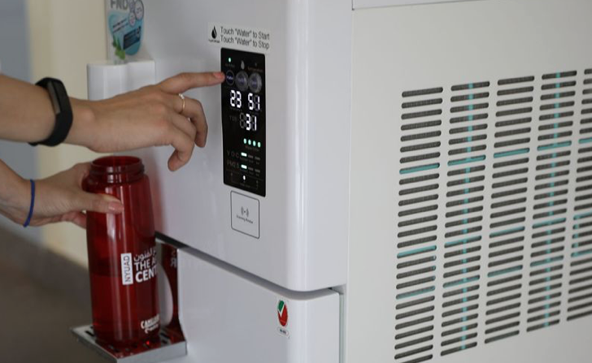
Abu Dhabi and Today
Since 2010, I have worked at NYU Abu Dhabi joining during its start-up phase. We have achieved incredible success in so many ways but in my opinion, the earlier years of any start-up don’t always allow the luxury of time to make informed decisions and I would highlight over-consumerism as one area we could have done better in but have since remedied.
Emerging from this period, the University is focusing on affirmative action towards ensuring better Sustainability, as well as to strengthen the integration of sustainability into its operations and business processes.
Initiatives include developing policies and strategies to remove single use plastic from our campus and we have introduced atmospheric water generators as an alternative.
Photo source: NYUAD

Slide 9
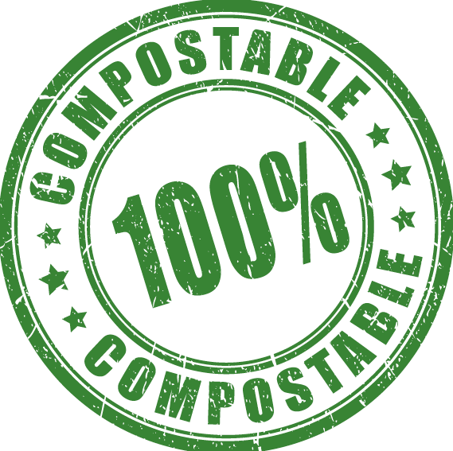
And recently the University added a campus food digester that turns food into usable compost, which is then used on campus plants. (nyuad.com 2019)
Image source: Shutterstock

Slide 10
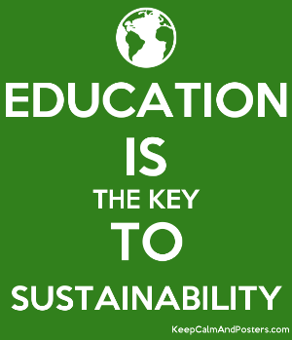
Sustainability Leadership and Education
With a strong interest in the environment and undertaking an MBA in Sustainability Leadership, I believe I am able to make a difference and every step we all take can have a positive impact no matter how large or small. It is everyone’s world and we all need to develop perhaps more courageous efforts if we want to secure the future of our planet. For me, this would entail:
          Resilience to be prepared to fail and never give up
          Creativity to come up with new and different solutions
          Being a Connector in connecting sustainability to business and society as well as to colleagues with different functions
Of course, we can’t always make decisions for our organization but in gaining the skills, knowledge, passion as well as ingenuity, we can be more effective in helping to make the changes necessary for progress to happen.
Image source: keepcalmandposters.com

Slide 11

Influencers, Awareness and Communication
Personally I look to the most inspiring and influential leaders to see what they are focusing on and learn from them. Today's world is filled with such visionaries and through following the right influencers you can also influence your own network.
My journey is to not only increase my own awareness but to communicate this through work, my community and social media on what’s trending from the World Economic Forum for example which: “engages the foremost political, business and other leaders of society to shape global, regional and industry agendas, and believes that progress happens by bringing together people from all walks of life who have the drive and the influence to make positive change.”
Finding a positive and optimistic way to be heard is also essential as often your
voice can be the minority and it’s not about how many likes you get but who’s
reading the stories. My own posts are often picked up by our University Head
of Research and Civil Engineering faculty and that’s progress.

Slide 12
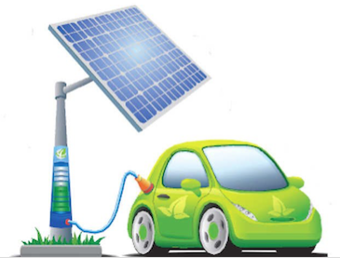
Influencers and Green Incentives
My inspiring influencers from the course have included Faris Saaed from The Sustainable City Dubai, and who has also accepted my invite to be connected on LinkedIn in order that I don’t miss a beat. One such inspiration and initiative from The Sustainable City Dubai is their incentive program for residents who are offered large subsidies for having greener electric cars. Dubai is also embracing incentive programs and electric car owners are able to receive the following incentives:
free public charging
free parking
free Salik (toll) tags and
free EV registration
(Gulf News 2019)
Image source: economitimes.com

Slide 13
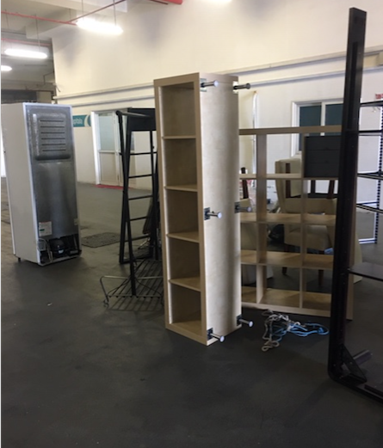
Circular Economy
In my own attempt to go back to my minimalistic life, this summer I embraced the circular economy, an alternative to a traditional linear economy - make, use, dispose - these normally unwanted resources that can be reused, are actually being used. (wrap.org.uk).
I followed up with Take My Junk UAE to collect my old fridge and some furniture I no longer needed from downsizing and minimizing my life and clutter. They came as arranged, will repair the door on the fridge, donate or sell these items for a small amount to low income families keeping them away from the landfill, taking the stress of re-selling and giving them a new lease of life.
Photo from own collection

Slide 14
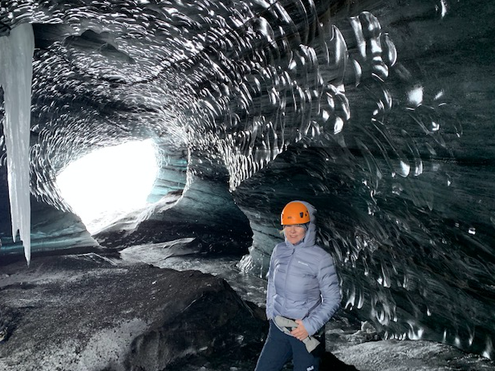
Climate Change
Whilst there are many positive initiatives to reduce our CO₂ emissions with less fast fashion from leading brands, Glastonbury this year being completely plastic free and according to the European Commission: Slovenia could become ‘regional catalyst’ for renewable energy (Emerging Europe 2019), Climate Change remains a critical issue for our planet.
On a visit to Iceland in February, I was able to witness firsthand the effects of Climate Change. Whilst in awe of the magnificent and totally breathtaking Jökulsárlón Glacier Lagoon and ice caves, these are literally melting in front of your eyes and according to Lagoon’s ranger, the cave pictured here could easily collapse and no longer exist after this summer.
Photo from own collection

Slide 15
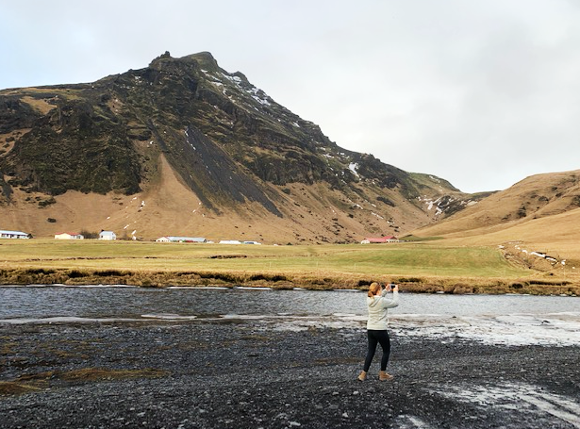
And here is further evidence of a ‘green’ Iceland in February 2019 …
Photo from own collection

Slide 16
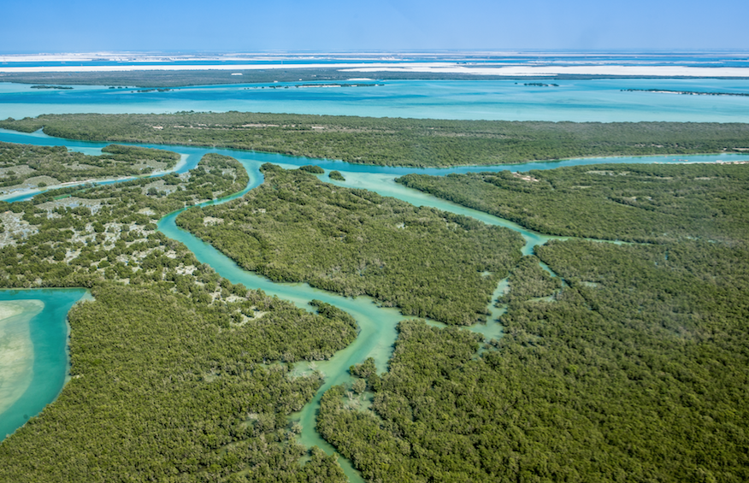
Priority Solutions
In addition, with Europe’s latest heatwave, droughts in India and cyclones in Mozambique, Mami Mizutori, the UN secretary-general’s special representative on disaster risk reduction said:
“This is not about the future, this is about today … Estimates put the cost of climate-related disasters at $520bn a year, while the additional cost of building infrastructure that is resistant to the effects of global heating is only about 3%, or $2.7tn in total over the next 20 years. In addition: “Nature-based solutions”, such as mangrove swamps, forests and wetlands which could form natural barriers to flooding should be a priority.
(The Guardian 2019)
Photo from Shutterstock

Slide 17
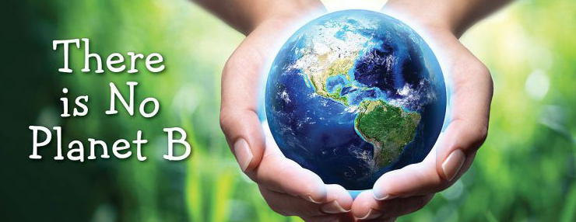
The future is indeed now and all the more reason to continue this journey to become influential Sustainability Leaders and Connectors to ensure we encourage as many people as we can reach globally to take action to reduce their carbon footprint and plundering of this great planet as …
Photo source: rainforest.org

