Slide 1
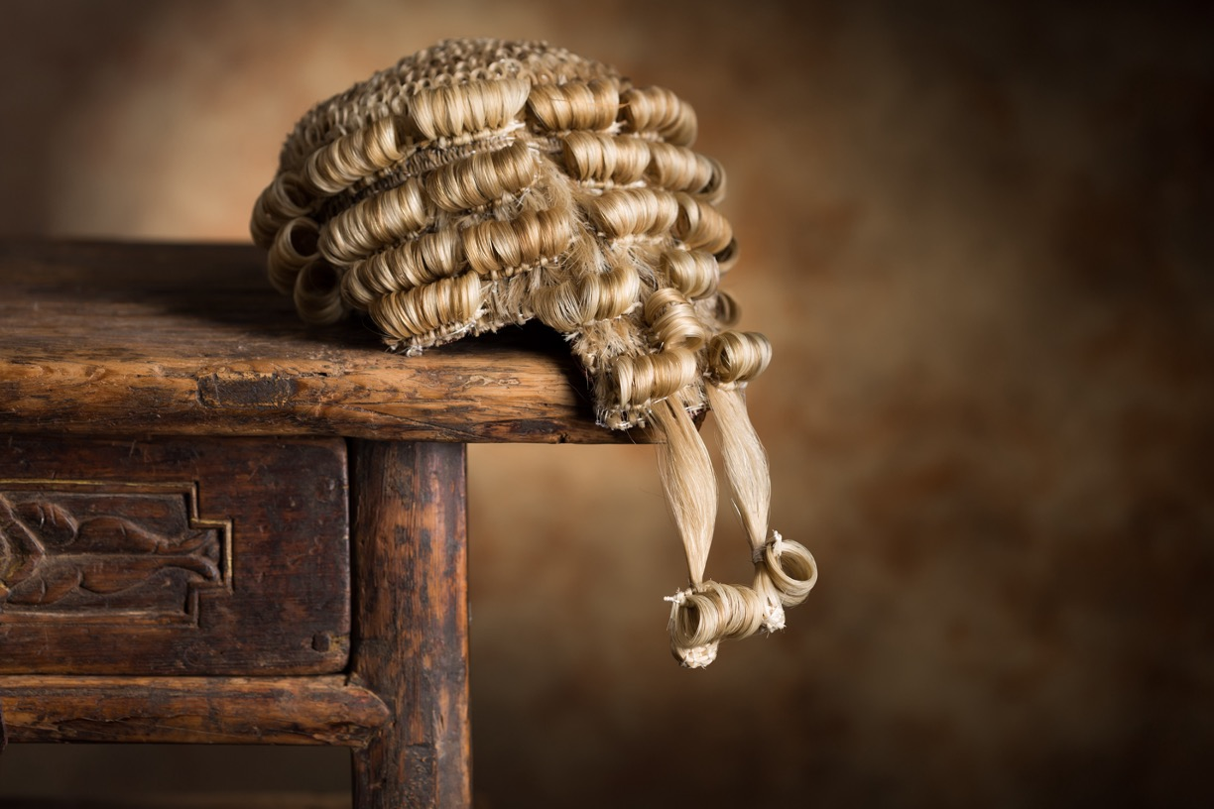

Unit 3:
PERSONNEL OF THE LEGAL SYSTEM
BMCX3000: LEGAL SYSTEM

Slide 2
LEARNING OUTCOMES
Describe the role of chartered legal executives, including qualification and areas of work
Describe the role of solicitors, including qualification and areas of work
Describe the role of barristers, including qualification and areas of work
Describe the constitutional role of the Secretary of State for Justice/Lord Chancellor
Identify the categories of judges and describe their work
Explain the role of magistrates in the court system, and
Explain the role of juries in the court system.

Slide 3
CONTENT
- Personnel of the legal system
- Solicitors
- Barrister
- Activities
- Summary
- Thank you, any questions?

Slide 4
Three Branches
Chartered Legal Executives
Barristers
Solicitors
Notes:
It is not uncommon for lawyers to be divided into separate categories in other countries, but it is important to realise that the divisions in England and Wales largely reflect historical developments.
each branch has its own system of regulation and representative body, there are overlaps in the types of legal work carried out.
E&W system is not unique – however other jurisdictions do not necessarily have the same differentiation, e.g. think of the US law dramas

Slide 5
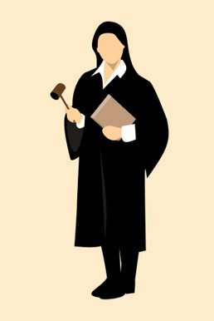
WHAT IS A CHARTERED LEGAL EXECUTIVE?
Represented and regulated by CILEX.
Different routes.
  Complete all legal training through CILEX
  Use CILEX to top up Law degree (gap fill)
  CILEX Professional Qualification.
Work in organisations which are regulated by CILEX.
Work in a wide variety of areas.
Partners and/or employees
Fee earner or non-fee earner?
Notes:
There are approximately 20,000 chartered legal executives who work mainly in law firms, as well as in local government and a wide variety of other organisations.
They have to complete a rigorous qualification route and develop high levels of professional expertise in their chosen specialist areas of practice.
They are represented by the Chartered Institute of Legal Executives (CILEX)
Ther are a number of different entry points to cilex. Students are able to complete all their legal studies through the CILEX route or to fill in the remaining gaps after studying for a law degree or other qualifications.
This flexibility has been hugely valuable to many mature students balancing family and work commitments which make traditional law degrees less viable.
The qualification framework for chartered legal executives is the CILEX Professional Qualification (CPQ). There are three stages of qualification: CPQ Foundation, CPQ Advanced and CPQ Professional. Qualification is competency based, and at each stage trainees are required to evidence both theoretical understanding of the law and practical application of their knowledge in a professional setting.
The CPQ is structured to enable trainees to specialise by completing modules in the following Pathway practice areas:
Dispute Resolution and Litigation;
Criminal Litigation;
Residential Conveyancing;
Commercial Conveyancing;
Employment Law;
Business and Commercial Law;
Family Litigation;
Wills, Probate and Private Client;
Immigration Law.
One of the key features of the qualification is the emphasis placed on ethics and professional responsibility.
Trainees are required to complete modules covering the regulatory structure of the legal profession and the CILEX Code of Conduct, as well as other compliance responsibilities in areas such as money laundering and client due diligence. Case studies are used to enable students to apply these ethical and regulatory principles to practical situations.

Slide 6
COMMON PRACTICE AREAS
The main types of work carried out by chartered legal executives (including trainee legal executives) are:
  conveyancing – buying and selling houses and flats and commercial property (e.g. shops and offices);
  litigation – this includes completing court procedures and forms as well as representing clients in court hearings;
  wills and probate – drafting wills and winding up the financial affairs of people who have died;
  family – divorces and disputes involving children and finances when relationships break up, including representing clients in court hearings; and
  employment – disputes between employers and employees, including representing clients in court and tribunal hearings.
  In addition, some chartered legal executives work in other areas such as criminal litigation and company law.
Notes:
17k Legal Ex working mainly in law firms but also local gov and other orgs
They have to complete a rigorous qualification route and develop high levels of professional expertise in their chosen specialist areas of practice.
Different entry routes into CILEX
Three stages of qualification:
Foundation
Advance
Professional
Qualification is competency based, and at each stage trainees are required to evidence both theoretical understanding of the law and practical application of their knowledge in a professional setting.
CILEX option to specialise – choice of modules
Strong emphasis on professional ethics and regulatory requirements
Most CILEX work in law firms as partners or employees, working with solicitors, paralegals and support staff. They work directly with clients as fee earners using their professional skills to advise a wide variety of clients, including individuals, companies and other organisations. Other chartered legal executives work in legal departments of companies, local councils, central government and other organisations.
More senior chartered legal executives have management responsibilities, including supervising junior staff and developing their firm’s marketing strategy through social media.

Slide 7
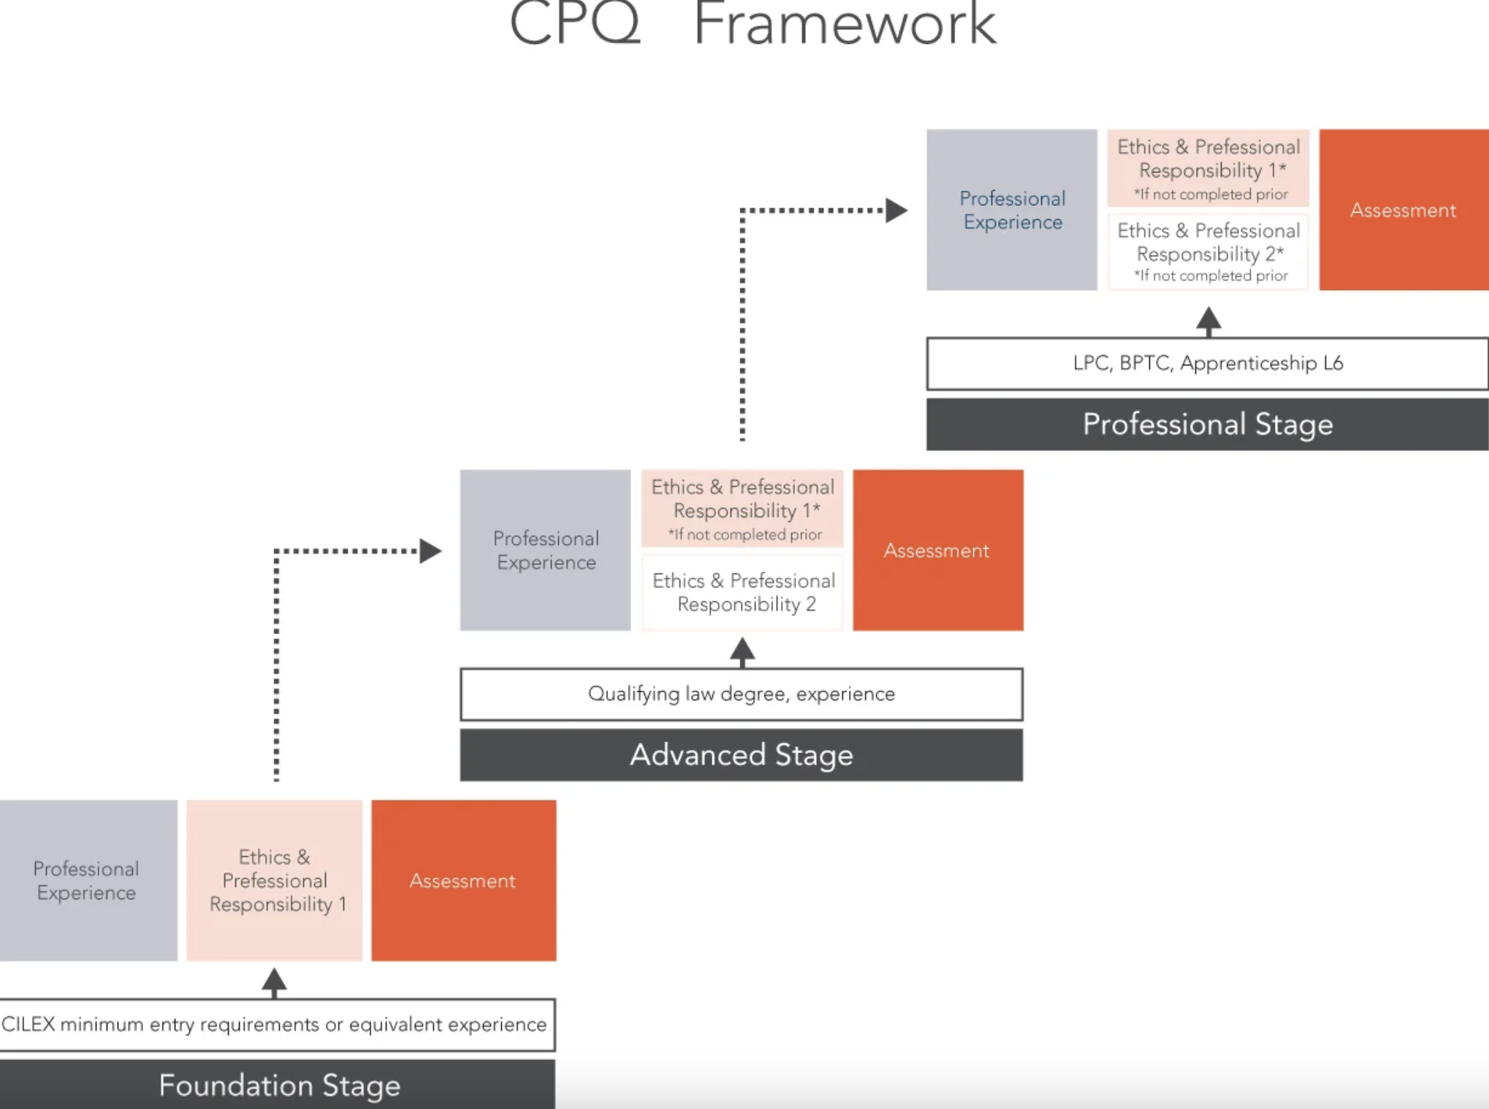
CPQ FRAMEWORK
Notes:
The majority of chartered legal executives work in law firms as partners or employees, working with solicitors, paralegals and support staff. They work directly with clients as fee earners using their professional skills to advise a wide variety of clients, including individuals, companies and other organisations. Other chartered legal executives work in legal departments of companies, local councils, central government and other organisations.
More senior chartered legal executives have management responsibilities, including supervising junior staff and developing their firm’s marketing strategy through social media.
The main types of work carried out by chartered legal executives (including trainee legal executives) are:
conveyancing – buying and selling houses and flats and commercial property (e.g. shops and offices);
litigation – this includes completing court procedures and forms as well as representing clients in court hearings;
wills and probate – drafting wills and winding up the financial affairs of people who have died;
family – divorces and disputes involving children and finances when relationships break up, including representing clients in court ­hearings; and
employment – disputes between employers and employees, including representing clients in court and tribunal hearings.
In addition, some chartered legal executives work in other areas such as criminal litigation and company law.
Chartered legal executives working in organisations which are regulated by CILEX Regulation are required to comply with its Accounts Rules which highlight the importance of keeping clients’ money separate (in a “client account”) from the firm’s own money – see https://cilexregulation.org.uk/entity/rules/.
Similar rules apply to all staff working in law firms which are regulated by the Solicitors Regulation Authority.

Slide 8
RIGHTS OF AUDIENCE
2) Criminal litigation
On completing an additional criminal proceedings advocacy skills course, chartered legal executives who have completed the Criminal Litigation Pathway in the CPQ qualification are able to represent clients in the following courts:
  Magistrates’ Courts;
  Youth Courts;
  Crown Court or High Court - chambers hearings for bail applications;
  appeals to the Crown Court or committals for sentencing in the Crown Court;
  Coroners’ Courts.
(3) Family litigation
On completing an additional family proceedings advocacy skills course, chartered legal executives who have completed the Family Litigation Pathway in the CPQ qualification are able to represent clients in the Family Court.
(1) Civil litigation
All chartered legal executives who have completed the Civil Litigation Pathway in the CPQ qualification are entitled to represent clients in chambers (uncontested hearings) in the County Court and High Court. On completing an additional civil proceedings advocacy skills course, they can represent clients in the following courts and tribunals:
  open County Court hearings;
  Magistrates’ Court - all civil and enforcement cases;
  Tribunal hearings; and
  the Coroner’s Court.
Notes:
Civil Litigation
All chartered legal executives who have completed the Civil Litigation Pathway in the CPQ qualification are entitled to represent clients in chambers (uncontested hearings) in the County Court and High Court. On completing an additional civil proceedings advocacy skills course, they can represent clients in the following courts and tribunals:
open County Court hearings;
Magistrates’ Court - all civil and enforcement cases;
Tribunal hearings; and
the Coroner’s Court.
(2) Criminal Litigation
On completing an additional criminal proceedings advocacy skills course, chartered legal executives who have completed the Criminal Litigation Pathway in the CPQ qualification are able to represent clients in the following courts:
Magistrates’ Courts;
Youth Courts;
Crown Court or High Court - chambers hearings for bail applications;
appeals to the Crown Court or committals for sentencing in the Crown Court;
Coroners’ Courts.
(3) Family Litigation
On completing an additional family proceedings advocacy skills course, chartered legal executives who have completed the Family Litigation Pathway in the CPQ qualification are able to represent clients in the Family Court.

Slide 9
SOLICITORS
Now can qualify using the SQE.
Now compulsory
Start with a degree- any degree.
Then SQE1
Then SQE2
Qualifying Training- a total of 2 years.
Work in law firms.
Rights of audience in Magistrates, County, intellectual property enterprise court, Family court, Tribunals and the coroner's court.
Can apply for rights of audience.
Notes:
Students are now able to qualify using a new route by completing the Solicitors Qualifying Examination (SQE). The route will be compulsory for all students completing their legal studies after autumn 2021 onwards.
(1) Degree (or equivalent qualification or work experience)
The degree may be in any subject.
(2) SQE1 assessment (functioning legal knowledge and practical legal skills assessment)
The SQE1 assessment is centrally set and administered on behalf of the SRA, rather than by individual universities or other course providers. There will be several opportunities to sit it each year. It will consist of three multiple choice exams which will cover the following topics:
a) law and procedural topics currently taught on law degree and LPC courses;
(b) application of fundamental legal principles; and
(c) legal research and writing skills.
(3) SQE2 assessment (practical legal skills assessment)
SQE2 may only be attempted after SQE1 has been passed. ­Students will be tested on:
(a) client interviewing;
(b) advocacy;
(c) case analysis; and
(d) legal research and written advice.
(4) Qualifying work experience
Students must have at least two years’ qualifying work experience. As well as including the traditional period of recognised training as a trainee with a law firm, a wider range of experience, including as a paralegal, will be accepted.
(5) Admission as a solicitor
On completion of the training contract, the trainee will be admitted as a solicitor. The trainee’s name will be added to the solicitors’ roll (a register of all qualified solicitors).
The majority of solicitors work in partnerships (also known as firms). The partners in the firm own the business and their personal incomes depend on the profits generated by the business. The firms will employ professional lawyers, including chartered legal executives, assistant solicitors, paralegals and support staff.
Solicitors are also able, subject to certain conditions, to practise in limited companies and limited liability partnerships (LLPs). These types of organisations provide greater financial protection for the solicitors owning the business in the event of commercial failure.
Solicitors are able to work with non-lawyers in organisations called alternative business structures (ABSs) to provide legal services. ABSs include multi-disciplinary practices (MDPs) in which legal services are provided with other professional services, such as accountancy. There are a number of commercial advantages for ABSs over traditional partnerships: it can be easier to raise outside capital to fund an expansion of the business, and clients may welcome “one-stop shops” where they can get a number of different legal and non-legal services from the same organisation.
Some solicitors continue to work as sole practitioners running their own business and taking all the financial risks (and profits) themselves. In rural areas, many firms operate with a number of branches in different locations. These firms will often specialise in areas such as conveyancing, wills and probate and family law. Firms working in the inner-city areas may specialise in criminal work, although cuts to legal aid have made this work increasingly unprofitable.
Many large firms use the internet and call centre arrangements to seek clients from across the country, especially in areas such as personal injury litigation and conveyancing. Other large firms, based in the City of London, carry out commercial work for very large companies, including multi-nationals
All solicitors are able to represent their clients in Magistrates’ Courts, the County Court, the Family Court, the Intellectual Property Enterprise Court, tribunals (a more informal type of court) and Coroner’s Courts (which determine the cause of a person’s death).
Solicitors who specialise in litigation may choose to obtain the Higher Rights of Audience Qualification and become solicitor advocates. Two assessments (one written and one practical) must be completed in either civil or criminal advocacy. The assessments cover evidence, procedure and ethics. Training courses are provided by various institutions.
Solicitor advocates are able to represent clients in the Crown Court, High Court, Court of Appeal and Supreme Court.

Slide 10
BARRISTERS
Independent
Advocacy
5 Stages ;
2) admission to an Inn of Court;
3) the vocational stage;
4) the call to the Bar; and
Pupillage'.
Self employed
Full rights of audience
1) the academic stage;
Notes:
Smallest group 16k – focused on advocacy: written or oral
(1) Academic stage of training
All students must complete either a qualifying law degree or a degree in another subject followed by the Graduate Diploma in Law/Common Professional Examination. The degree classification must be at least a 2(ii).
Some students undertake an optional one- or two-week mini-­pupillage during this stage which gives them useful work experience with a barrister.
(2) Admission to an Inn of Court
There are four Inns of Court: Middle Temple, Inner Temple, Gray’s Inn and Lincoln’s Inn. Inns of Court are non-academic societies which provide educational activities and support for barristers and student barristers. They all provide the use of a library, lunching and dining facilities, common rooms and gardens.
(3) Vocational stage
Students must apply for a vocational course at one of the universities and institutions accredited by the Bar Standards Board (Authorised Education and Training Organisations). These courses may be full-time or part-time. The courses include training in important skills, including advocacy, written skills and legal research.
At the same time, students are required to complete 12 qualifying sessions at their Inn of Court. These consist of a variety of educational and social activities, including dinners with legal talks and other events also attended by qualified barristers.
(4) Call to the Bar
Students who have passed the vocational stage will attend a ceremony at their Inn of Court in which they will be formally called to the Bar. At this point they will be entitled to call themselves a barrister.
(5) Pupillage
In order to be able to practise, every barrister must then complete a year of pupillage (practical training) under the supervision of an experienced barrister known as a pupil supervisor. The first six months are non-practising – the pupil “shadows” their pupil supervisor. During the second six months, the pupil may, with the permission of their pupil supervisor, provide legal services and appear in court.
Further information about qualifying as a barrister is available at https://www.barstandardsboard.org.uk/training-qualification.html.
3.2.3.2 The work of barristers
The majority of barristers are self-employed but share offices, known as chambers, in London and other major cities. Office expenses and support services are shared, as are the costs of the barristers’ clerk who is responsible for allocating work and negotiating fees on behalf of the barristers. Their work consists of advocacy – speaking in court in a wig and gown on behalf of their client. In addition, they will carry out legal research on complex points of law and prepare written opinions, applying their research to the circumstances of their clients. Sometimes barristers will advise the clients in person – in conference. Barristers will usually specialise in one or more areas of law.
Barristers working in chambers have traditionally received work in the form of instructions from law firms. Individuals and organisations are now also able to instruct barristers directly (not via a law firm) under a public access scheme. Only barristers who have completed a training course and met other Bar Council requirements can accept instructions under this scheme.
Barristers are also employed by the Crown Prosecution Service, local government and industry and commerce. They are able to work with other lawyers and non-legal professionals in organisations established under the Legal Services Act 2007 known as legal disciplinary practices and alternative business structures.
Experienced barristers are able to apply for appointment as King’s Counsel (KC). They are also referred to as “silks” because they wear silk gowns. (Barristers who are not KCs may be referred to in court as “juniors” – even though they may be very experienced.)
3.2.3.3 Rights of audience
Barristers have full rights of audience in all the courts of England and Wales.

Slide 11
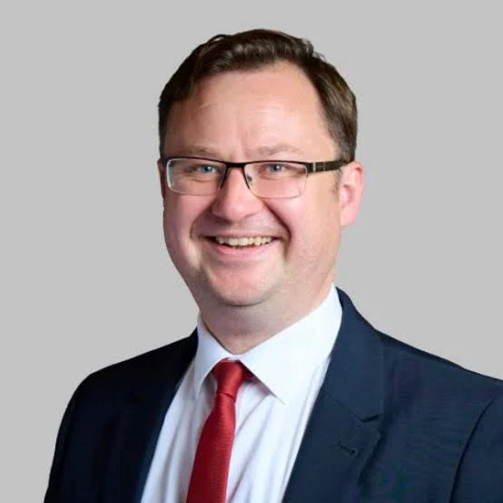
SECRETARY OF STATE FOR JUSTICE / LORD CHANCELLOR
Is responsible for:
  statutory responsibilities for upholding the rule of law (s1 Constitutional Reform Act 2005);
  protecting the independence of the judiciary (s3 Constitutional Reform Act); and
  a limited role in the appointment of justices of the Supreme Court.
Does not hear cases anymore.
Minister in Cabinet (MP)
Notes:
You may remember reference to the Lord Chancellor from week 1 – anyone remember? Equity
We have discussed how the principles of equity developed during the Middle Ages in the Court of Chancery. This court was headed by the Lord Chancellor, a role which combined a judicial function with considerable power as a minister of the Crown.
The post of Lord Chancellor has evolved over the centuries and is now held by a government minister who is also Secretary of State for Justice. The Lord Chancellor no longer hears cases, but does have various functions which relate to the judiciary, including:
statutory responsibilities for upholding the rule of law (s1 Constitutional Reform Act 2005);
protecting the independence of the judiciary (s3 Constitutional Reform Act); and
a limited role in the appointment of justices of the Supreme Court.
The Lord Chancellor also has overall responsibility for strategy on criminal justice reform
and human rights,
and is responsible for the Ministry of Justice, which oversees the courts (HM Courts and Tribunals Service), prisons and probation (HM Prison and Probation Service) and legal aid (Legal Aid Agency).

Slide 12
JUDGES
Different judges sit in different courts
Judicial Appointments Commission – Constitutional Reform Act 2005- to make appointment fairer and more diverse.
Notes:
Civil law system (European countries) common for judiciary to be an independent profession with own training scheme.
Common law system not the case. Rather a form of career progression from the professions.
Recruited from experienced members of the profession
Judiciary categorised by seniority: different types of judges can sit in higher and lower courts, and will hear cases which various enormously
Some judges only hear specific cases, others will hear civil and criminal – this allows broader perspective of the law and its function and development, but can limit expertise
Judicial appointments
The Judicial Appointments Commission was established under the Constitutional Reform Act 2005 to address criticisms that the judges were still predominantly male, upper-class and middle-aged, with very few members of ethnic minorities. It has introduced a formal system for applications and has attempted to increase the diversity of the judiciary by making the application process more transparent and fair.
The selection process involves
online multiple-choice question (MCQ) tests;
telephone assessments;
selection days which include an interview, presentation and role plays;
consultations with existing judges; and
good character checks.
Chartered legal executives who have met the judicial-appointment eligibility condition for five years are eligible to apply to become junior judges, including:
District Judges (Magistrates’ Courts);
District Judges;
Deputy District Judges (Magistrates’ Courts); and
Deputy District Judges.

Slide 13
Reflection
Look at the case studies of CILEX judges at Judges Case Studies (https://www.cilex.org.uk/membership/career_progression/cilex-judges/our_cilex_judges)
. Do you think they have increased the diversity of the judiciary?

Slide 14
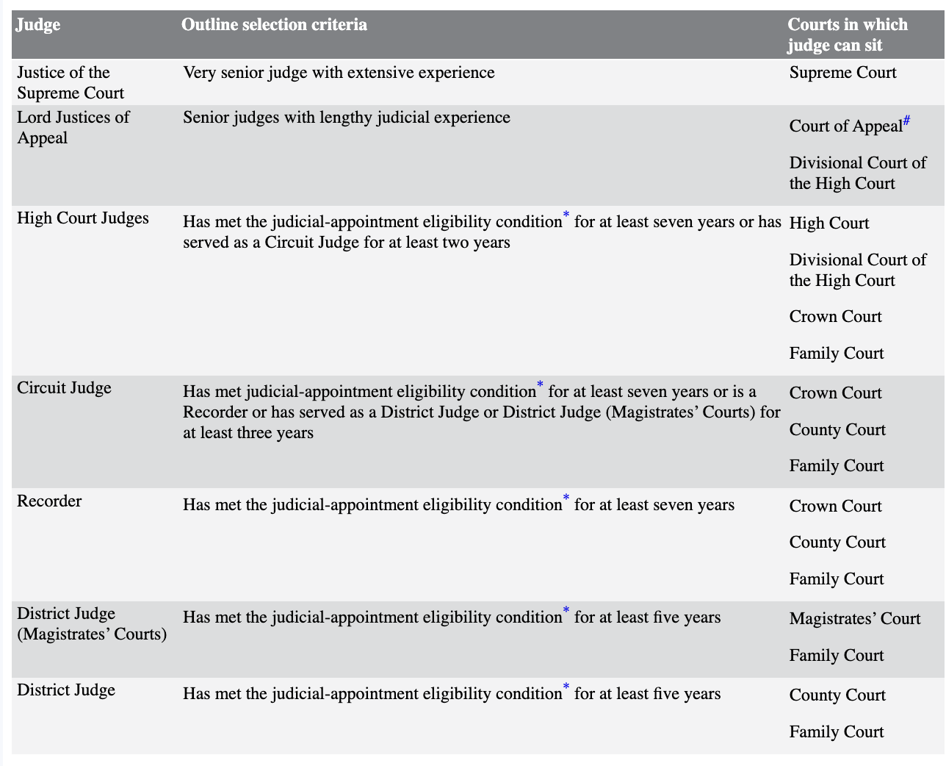
CATEGORIES OF JUDGE
Is it a strength or a weakness that judges may hear cases from a range of different specialisms?
Notes:
This table sets out the main types of judges in England and Wales, together with the eligibility criteria, and the courts in which each category of judge may serve. The Table is set out in order of decreasing seniority.
s3 Courts and Tribunals (Judiciary and Functions of Staff) Act 2018 provides for authorised staff and tribunal staff to provide legal advice to judges in the Family Court and to magistrates.
More controversially, it also provides for authorised staff to exercise judicial functions subject to the relevant procedure rules.

Slide 15
LAY MAGISTRATES
- Lay magistrates – not legally qualified
- 26 half day sittings a year
- Local people/ Knowledge
- Not legally trained.
Criminal court
Family court
Notes:
One of the more unusual features of the legal system of England and Wales is the prominent role which is given to non-legally qualified (lay) magistrates (though they do receive some training). There are approximately 15,000 magistrates who are also known as Justices of the Peace (JPs).
People who wish to become magistrates must have the following qualities:
good character;
understanding and communication skills;
social awareness;
maturity and sound judgment; and
commitment and reliability.
Members of certain occupations are excluded, including police officers and CPS lawyers.
Magistrates are aged between 18 and 70 years (no applications are permitted by candidates aged over 65 years). Applications are made to the local advisory committee which assesses and interviews candidates. Candidates who are approved are formally appointed by the Lord Chief Justice who delegates the task to the Senior Presiding Judge of England and Wales.
Most of a magistrate’s work takes place in the Magistrates’ Courts where they hear lower level criminal cases – approximately 95 per cent. Magistrates normally work in groups of three, known as a bench, and are given impartial legal advice on the law and sentencing options by a legal advisor who will record the decisions in each case and ensure that the court administration works smoothly. Legal advisors may sometimes advise the magistrates in private in the retiring room.
Legally qualified justices’ clerks (also known as court legal advisors) carry out various management functions within the Magistrates’ Court but will also advise magistrates more generally on changes to the law and sentencing etc.
Magistrates are expected to take part in 26 half-day sittings each year. They are unpaid but receive expenses.
NB Magistrates will also deal with some civil matters in the Most of a magistrate’s work takes place in the Magistrates’ Courts where they hear lower level criminal cases – approximately 95 per cent. Magistrates normally work in groups of three, known as a bench, and are given impartial legal advice on the law and sentencing options by a legal advisor who will record the decisions in each case and ensure that the court administration works smoothly. Legal advisors may sometimes advise the magistrates in private in the retiring room.
Legally qualified justices’ clerks (also known as court legal advisors) carry out various management functions within the Magistrates’ Court but will also advise magistrates more generally on changes to the law and sentencing etc.
Magistrates are expected to take part in 26 half-day sittings each year. They are unpaid but receive expenses.
NB Magistrates will also deal with some civil matters in the Magistrates Court for example council tax arrears.
Magistrates with specialist training carry out some limited functions in the Family Court.
The advantages include:
cost – they are considerably cheaper, even including the costs of legal advisors, than an equivalent number of paid judges;
community justice – they are drawn from their local communities and their local knowledge gives them greater credibility;
local knowledge – they are expected to live within 15 miles of their courts; and
greater diversity – there are far more women and members of ethnic communities than among the professional judges, particularly in the higher courts.
Disadvantages include:
poor and inadequate legal training can lead to bad decisions;
lack of legal knowledge can lead to inappropriate reliance on legal advisors;
there is still a middle-class bias with few young magistrates;
they are too ready to believe the police and convict defendants; and
they become case-hardened.

Slide 16
ACTIVITY
Read the guidance for becoming a magistrate at Becoming a magistrate: guidance for applicants.
What questions are prospective candidates advised to ask themselves before applying?
What are some advantages and disadvantages of magistrates?
Notes:
The advantages include:
cost – they are considerably cheaper, even including the costs of legal advisors, than an equivalent number of paid judges;
community justice – they are drawn from their local communities and their local knowledge gives them greater credibility;
local knowledge – they are expected to live within 15 miles of their courts; and
greater diversity – there are far more women and members of ethnic communities than among the professional judges, particularly in the higher courts.
Disadvantages include:
poor and inadequate legal training can lead to bad decisions;
lack of legal knowledge can lead to inappropriate reliance on legal advisors;
there is still a middle-class bias with few young magistrates;
they are too ready to believe the police and convict defendants; and
they become case-hardened.

Slide 17
JURIES
12 People
Who sit in on a Criminal Case in the Crown Court.
Decision is based on facts.
S.44 of the Criminal Justice Act 2004- reasons why juries would not sit.
S.1 of the Juries Act 1974- Selection process.
Can be disqualified from jury service.
Notes:
Criminal: Crown court only – decide on Guilt or innocence - nothing else. Unanimous verdict or majority (10 or more)
Can rarely have in High Court civil cases: but less often – defamation.
Criminal Justice Act 2003, s44 can have juryless trial (judge only), e.g. complexity of case, or high risk of tampering.
Who can be a juror?
s1 Juries Act 1974 states that a person may be selected as a juror who:
is aged 18–75;
is on the electoral register (entitled to vote in local and parliamentary elections); and
has been resident in the UK since the age of 13 for at least five years.
In addition, a juror will be disqualified if:
he or she is detained under the Mental Health Act 1983 or has lost mental capacity;
he or she has ever served a prison sentence of five or more years; or
in the past 10 years:
has been imprisoned (for any length of time);
has served a suspended prison sentence (a form of punishment in the community where failure to comply with certain conditions means a prison sentence will apply); or
has received a community punishment order.
NB Jury service is a compulsory civic duty but it can be deferred (postponed) once if the juror has a good reason (e.g. a hospital operation or an important work commitment). Jurors are not paid but receive expenses, including for loss of earnings.
Before a case starts a panel of potential jurors is formed. It consists of eligible people randomly selected by computer from the electoral register.
On the day of the trial, the Crown Court clerk will select, by ballot, 12 people to form the jury for that trial. Before each juror is formally sworn in, the prosecution and the defence have the opportunity to make a challenge for cause. This means that the juror has been disqualified or there is a risk of bias in this particular case.
The prosecution also has the opportunity at this stage to ask a juror to stand by, which results in the juror returning to the panel.
The prosecution or the defence can challenge the whole jury panel if it believes that there is a reasonable suspicion of bias by the court official summoning it.
A judge has the additional power to remove a juror who may not be able to act effectively because of physical or mental incapacity.
is nothing to prevent a police officer or CPS lawyer serving on a jury, although in Abdroikof; Green; Williamson [2007] the House of Lords held that if the presence of such a juror was perceived to give the appearance of bias, the defendant’s conviction was quashed.

Slide 18
JURY SECRECY
To be fair, long-standing rule that discussions should be kept secret
Seen as important to encourage free and open discussion among juror members when deciding cases
And also fear of juror intimidation later
Individual jurors who reveal discussions, may be guilty of an offence: Juries Act 1974
Some exceptions, e.g. can reveal concerns to judge or member of the court, such as of contempt of court
Juries and the internet:
Notes:
There is a very important principle in criminal law requiring jurors to make their decisions using only evidence at the trial itself.
One of the most important reasons for this rule is that juries should not be influenced by knowledge that a defendant has been convicted of other crimes. (The fact that a defendant has committed a previous crime does not mean that he or she has committed this crime.)
There have been a number of recent cases where jurors have been unable to resist the temptation to seek further information about the defendant and the circumstances of the case on the internet.
In Attorney-General v Fraill and Another; Knox [2011] a juror was held to be in contempt of court for communicating via Facebook with a defendant, and the trial had to be halted at vast public expense.

Slide 19
ACTIVITY
Can you identify some advantages and disadvantages of Juries?
Read the following BBC report on jurors using the internet for research https://www.bbc.co.uk/news/uk-22550323 - BBC News. How realistic is it to expect jurors not to use the internet? What dangers do you think could arise if they do?
Should juries be abolished? Remember to back up your answers
Notes:
Advantages include:
independence – jurors are not employees of the state and are seen as a constitutional protection against abuse by the police and prosecution authorities;
trial by your peers (equals) – this is a fundamental right;
involvement of ordinary people in the criminal justice system – this gives ordinary people greater confidence that the law is fair and reflects the values of their local communities;
confidence in jury system by legal professionals – generally, judges and lawyers working in the Crown Court are still strongly in favour of retaining the jury system; and
occasionally, juries will acquit a person who has been charged with a crime where the law seems to be particularly harsh, despite clear evidence (and instructions from the judge) pointing to a guilty verdict. Such a verdict may sometimes lead to a change in the criminal law. In Ponting [1985] a civil servant was charged with “leaking” official secrets under the Official Secrets Act 1911. The jury acquitted him, despite strong evidence that he had, in fact, disclosed details about the controversial sinking of the Argentinian ship, General Belgrano, during the Falklands War. The jury appears to have believed that it was important that the public were aware of the true facts about the sinking. NB Of course, some people may not consider the law applying to the crime in question to be particularly harsh – in their view the willingness of a jury to acquit in these controversial circumstances would be a disadvantage of the jury system.
Disadvantages include:
cost – jury trials can be extremely expensive. Trials before a single judge may be shorter and therefore require less time spent by expensive barristers and a judge;
domination of jury discussions by one or two articulate (or bossy) individuals – the danger here is that they may unduly influence the decision. Permitting legal professionals to act as jurors has increased this risk as their legal knowledge may give them additional influence;
inappropriate waste of time of skilled professionals – although jury service is a public duty, it may not be the best use of time for a skilled surgeon who could otherwise be operating to save patients’ lives;
difficulties understanding complex technical facts or legal issues – this has been a particular concern in relation to major fraud trials where jurors are expected to make decisions based on large amounts of complex financial information;
publicity – jurors may be influenced by information in the media about a case, particularly those involving celebrities or horrific details. Some jurors have been unwilling to follow very clear instructions not to use the internet to find out further information;
secrecy of jury discussions – the restrictions imposed by ss20D–20G Juries Act 1974 have caused difficulties for researchers investigating the competence of juries; and
risk of jury-tampering – occasionally, there have been cases where jurors or their families have been threatened or bribed. Judge-only trials were introduced in Northern Ireland in 1972 for terrorism offences to minimise this problem.
NB There is no clear evidence to indicate that juries are more (or less) likely than judges to acquit defendants who are, in fact, guilty, or to convict innocent defendants. All types of criminal trials can result in the “wrong” verdict, and the experience in Northern Ireland judge-only cases has shown that errors have also been made by these judges.

Slide 20
KNOWLEDGE CHECK (1):
Which of the following are the responsibilities of the Secretary of State for Justice/Lord Chancellor?
(Select 2 correct answers)
Ensuring that judges comply with government policy
Protecting the independence of the judiciary
Upholding the rule of law
Supporting the police in the fight against crime
Notes:
B and c
The Secretary of State for Justice/Lord Chancellor is responsible for protecting the independence of judges and upholding the rule of law. He is not required to ensure that judges comply with government policy.
The Home Secretary is responsible for supporting and holding the police accountable.

Slide 21
KNOWLEDGE CHECK (2):
Match the following professional bodies with their regulators
1) Solicitors
2) Barristers
3) Chartered legal executives
Law Society
Bar Standards Board
Solicitors Regulatory Authority
CILEX Regulation
E) Bar Council
Notes:
1 C
2 B
C D
A and E are representative bodies and not regulators

Slide 22
KNOWLEDGE CHECK (3):
Lay magistrates only sit in the lower Criminal courts
TRUE
FALSE
Notes:
False – they do not only deal in criminal court - they also hear some family law cases

Slide 23
KNOWLEDGE CHECK (4):
Which of the following statements are true about juries?
A) Jurors can research cases independently online
B) Jurors can be aged 18-80
C) Jurors must be on the electoral register
D) Jury duty is optional
E) Jurors are sworn to secrecy
Notes:
(B FALSE – 18 – 75)
True are
C
E

Slide 24
SUMMARY
Chartered legal executives.
Solicitors.
Barristers
Judges
Secretary of State
Juries

Slide 25
THANK YOU!
Any Questions?

