Slide 1
BMSW5103
Understanding and Engaging in the
Customer Experience
Week 8
CRM Models

Slide 2
Learning Objectives
Understand the customer relationship process.
Know the evolution, current status, and categories of the customer relationship management (CRM) system.
Understand the components and architecture of CRM systems.
Examine the CRM life cycle and its relationship with other enterprise software.
Examine the impact of CRM on an organization.

Slide 3
CRM Models
IDIC Model
QCI Model
Payne’s 5 Process Model
CRM Value Chain

Slide 4
IDIC Model
I – Identify
D – Differentiate
I – Interact
C – Customise

Slide 5
Identify
The first step is to identify your customers, which businesses can accomplish by collecting information like the customer’s name, address, and purchase history at each point of contact across the company.
The goal is to collect as much information or data as you can on each customer in order to better understand their needs, wants, and purchase behaviors.

Slide 6
Differentiate
The next step is to differentiate or segment your customers based on their current and projected lifetime value. Remember: Not all customers will have the same value to the business.
By differentiating your customers based on their value to the company, you can prioritize your customer relationship efforts on the most valuable clients and tailor your interactions to best fit each segment for optimal profitability.

Slide 7
Interact
The third stage is where you get to apply your CRM plans for interacting with your customers. Once your customers are analyzed and categorized, you can develop customized interactions—for example, for valued customers, you might offer loyalty benefits or rewards to encourage retention and continued spending.
Keep in mind, you should be learning from each interaction to continually improve future interactions.

Slide 8
Customize
After you have documented your customer interactions, you can then analyze them to develop more customized one-to-one service. The goal is to ensure that your customers’ needs and expectations are met and that you have pinpointed them individually (or very narrowly).

Slide 9
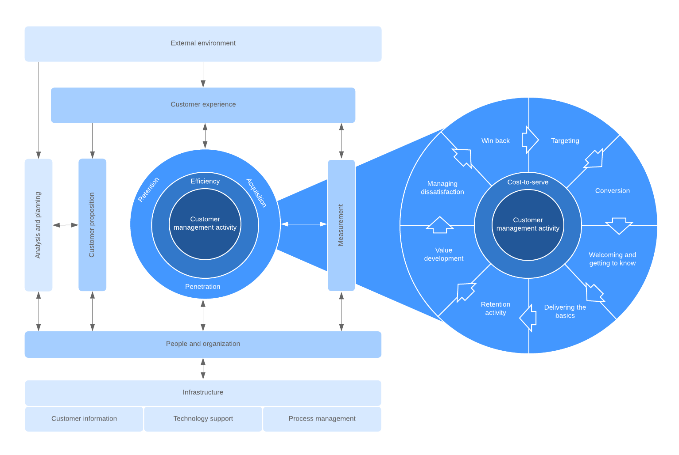
IDIC

Slide 10
QCI
Quality Competitive index

Slide 11
QCI Quality competitive index
The model focuses on three main activities:
Acquisition
Retention
Penetration.

Slide 12
QCI
The QCI model starts with the customer’s external environment at the top—their pain points, business goals, and other factors will affect whether they are ready to buy or interact with your sales team, which in turn impacts the customer experience. The customer experience then affects customer proposition (what you offer the customer) and customer management activities.

Slide 13
QCI
As you can see from the magnified version of the inner circle, many activities are involved to acquire and retain customers.
The QCI model also considers the people and technology involved with keeping this whole system going. Although QCI has replaced the word “relationship” in CRM, this model still starts and ends with people.

Slide 14
Payne’s Five Process model
The Five Process CRM model was developed by Adrian Payne and Pennie Frow. This model emphasizes a cross-functional approach for effective CRM processes.
There are two main components to the model: cross-functional CRM processes and key elements of CRM implementation.

Slide 15
Payne’s model outlines five processes:
Strategy development
Value creation
Multichannel integration
Information management
Performance assessment

Slide 16
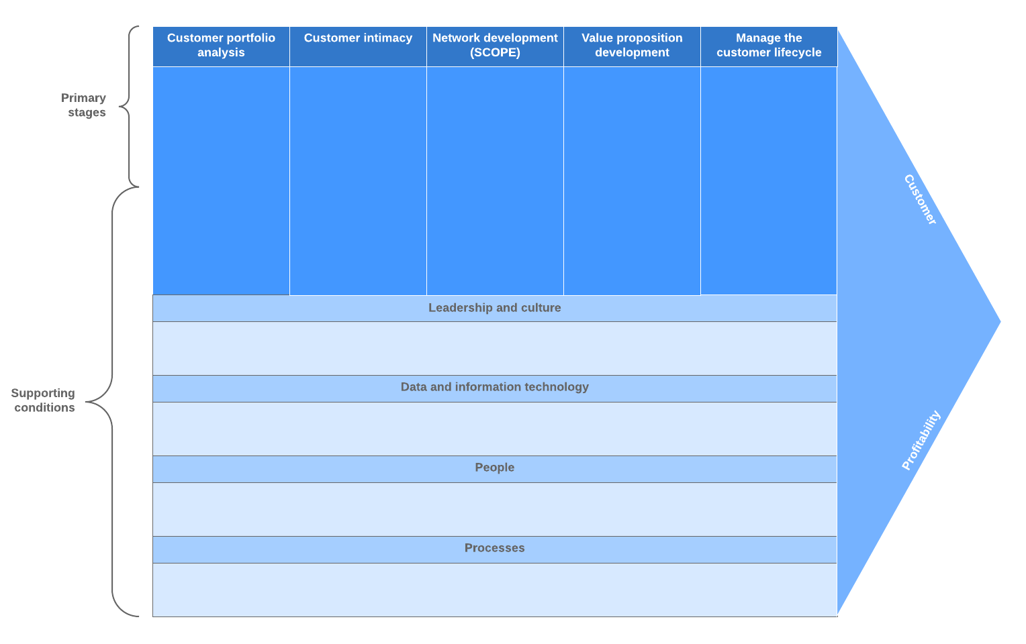
Payne’s 5 Process model

Slide 17
CRM Value chain
A value chain is a high-level model developed by Michael Porter that identifies the processes a business uses to develop an end product or service for the customer. The goal of the value chain model is to identify and prioritize the most valuable activities to the company and improve processes to gain a competitive advantage.

Slide 18
CRM Value chain
The CRM value chain model applies this principle to customer relationships. This CRM model observes all the stages and activities required to build a relationship with a customer.
These activities are divided into two stages: primary and support.

Slide 19
Customer portfolio analysis
Similar to the IDIC model, the first step of the value chain model is to analyze your customers to identify your SSCs (a.k.a. the customers who create the most value for the company). This analysis stage helps companies understand their customers so they can better address their needs and expectations and develop strategies to maximize their lifetime value.

Slide 20
Customer intimacy
The next step is to engage with the customer and build on the original database of information. At each touchpoint, companies should be collecting data on the interaction in order to better understand and serve their customer. The better you know your customer (and adjust your service accordingly), the more likely you are to retain their business over the long term.

Slide 21
Network development
A business’s network includes all people and entities involved in the value chain, including partners, suppliers, customer service, investors, etc. The goal is to use your customer data to inform the processes at each level of your network so that the entire system works together to optimize your customer’s experience.

Slide 22
Value proposition development
Armed with your customer information and interaction data, you can create value for your target customers. The idea is to shift the focus from the product to your service and to reduce process costs to create more value for the customer.

Slide 23
Relationship management
The last stage of the value chain model is to manage your customer lifecycle. This process involves evaluating your business processes and organizational structure to manage acquisition, retention, and customer development.

Slide 24
Support stage
There are five supporting conditions necessary in order to effectively implement the strategic processes of the primary stage:
Leadership and culture
Procurement processes
HR management processes
IT/data management processes
Organization design
Creating and developing these underlying conditions will support a successful CRM value chain implementation.

Slide 25

Any Questions?
Thank You ☺

Slide 26
Sources:
Motiwalla, L F. & Thompson, J., 2012. Enterprise Systems for Management. 2 ed. Harlow: Pearson.
Baltzan, P. & Philips, A., 2012. M: Information Systems. 1 ed. Boston: McGraw Hill Higher Education.
Buttle, F. & Maklan, S., 2015. Customer Relationship Management/ models: Concepts and Technologies. 3 ed. Abingdon, Oxon: Routledge.
Peelen, E. & Beltman, R., 2013. Customer Relationship Management. 2 ed. Harlow: Pearson Education Limited.

