Slide 1
Research Methods
Qualitative Approaches

Slide 2
Aims of Session
To explore different research methods
Notes:
Two aims:
Focusing on qualitative, namely because Christine intends to focus on quantitative, but when considering qualitative we also need to compare it with quantitative research. So not exclusively qualitative.
The second aim: we will l begin to look at some approaches that are used in work based-learning research.
Reflection is key when undertaking this Pof Doc.
It is equally important from a research perspective. This is a them e through all three of the sessions I am undertaking with you. We will all come to research with different perspectives., knowledge and experience, Therefore it is important that we discuss and critically reflect on our positions. So that this can help us in designing research that is appropriate and “fit for purpose”.
I would very much like you all to share your experiences were appropriate and also to question and disagree if you want…, One of the main premises of research is that it is complex and is fundamentally about philoshical debate. That’s what makes it interesting.

Slide 3
Research Design
Figure 1
Practical Considerations
Ethics
Methodology
Research Design
Context
Philosophy
Methods
Values
Theory
Notes:
Some of things I feel are important to consider,
There are more..
One issue comes to mind that I have not included?
Is there anything here you would include ?

Slide 4
Methodology vs. Method
Methodology
The theoretical framework that outlines the rules (axioms ) to follow in a study.
Method
The actual tools/steps taken by which you conduct research into a subject or a topic.

Slide 5
Methodology
Research methodology: what do we need to consider?
What are the options?

Slide 6
Methods of Data Collection
Qualitative Examples
Case Study
Multiple methods of data collection
Interviews
Documents
Questionnaires
Observations
Ethnography
Participant observation
Phenomenology
In-depth-Interviews
Grounded Theory
In-depth Interviews
Participant Observation

Slide 7
Methods of Data Collection
Qualitative Examples
Action and applied research
Within an organisation / practice
Documents
Interviews
Participant observation
Participatory research
Multimethods of data collection
Creative inclusive approaches

Slide 8
Quantitative Examples
Surveys:
Requires large sample sizes for statistical analysis
Experimental designs :
Requires a control group

Slide 9
Research Methods
The prime criterion for choosing a particular data gathering method in research is whether it is anticipated that the method will give useful information about the practice under study and fits with research design strategy for inquiry chosen.
Are you interested in any particular methods?

Slide 10
Qualitative Research Methods
Interviews
Participant Observation (Reflections on your own observations).
Documentary analysis
Reflective Diaries
Questionnaires (open ended)
Focus Groups

Slide 11
Examples
What are the key things to consider when designing questions for a qualitative study.

Slide 12
Research Methods and Analysis
Qualitative flexible designs:
open ended questions, that you then look for themes to analyse.
Quantitative fixed designs :
highly structured closed questions that can be given a numerical value and analysed numerically.
e.g likert scale choose 1-5
Mixed methods
adopt both open and closed questions

Slide 13
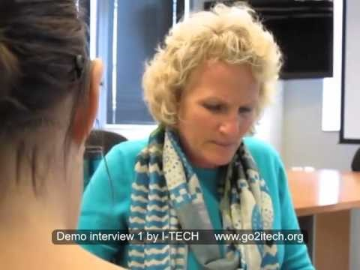
Examples
Interviews :
Can you spot at least 10 mistakes made by this interviewer?

Slide 14

Interviews
How it should be done:
https://youtu.be/eNMTJTnrTQQ

Slide 15

Focus Groups :
https://youtu.be/ZLw0YXcseG0

Slide 16
Qualitative Interviews
In your groups design a very short interviews schedule
Choose a format
Structured
Semi Structured
Unstructured

Slide 17
Ethics
What do we need to include when carrying out data collection?

Slide 18
Informed Consent
SEE EXAMPLES ON MOODLE

Slide 19
Theory and Practice of Research: Action Planning
Planning research is vital to its success,
Having realistic expectations in relation to your:
    FOCUS
    RESOURCES
    TIME
    ETHICAL CONSIDERATIONS

Slide 20
Directed Study
Research the different methods available and consider which best fits your research design.
Review the videos under the TILE: RESEARCH METHODS VIDEOS.

Slide 21
References
Cohen L., Manion, L., & Morrison K. (2000). Research Methods in Education. London: Routledge Falmer,
Costley C; Elliot, C,G; Gibbs P (2010) Doing Work Based Research: Approaches to Enquiry for Insider-Researchers. London: Sag
Creswell, J, W. (2014). Research Design: Qualitative and Quantitative, & Mixed Methods Approaches. LA: Sage
Denzin, N.K. & Lincoln, Y.S. (eds). (2011) Introduction: The Discipline and Practice of Qualitative Research, in Denzin, NK & Lincoln, YS. (eds) (2011) Handbook of Qualitative Research Thousands Oaks: Sage
Handbook of Qualitative Research Thousands Oaks: Sage 1-47
Macintyre. (2000) The Art of Action Research.London: David Fulton Publishers.
Mercer, J. (2007) The Challenges of Insider Research in Educational Institutions: Wielding a double-edged sword and resolving delicate dilemmas Oxford Review of Education, 2007, 33 (1), pp. 1-17
McNiff,J.,Lomax,P.,&White,J.(2003) You and Your Action Research Project.2nd Edition.London: Routledge Falmer.
O’Donoghue, T. (2007) ‘Planning Your Qualitative Research Project: An Introduction to Interpretivist Research in Education’, Abingdon, Routledge
  Punch K, Introduction to Social Research Methods: Quantitative and Qualitative Approaches, London: Sage, 2005.

