Slide 1
Geo-Visualization

Slide 2
Introduction
Geo-visualization is a set of tools and techniques
Supporting geospatial data
Through the use of interactive visualization

Slide 3
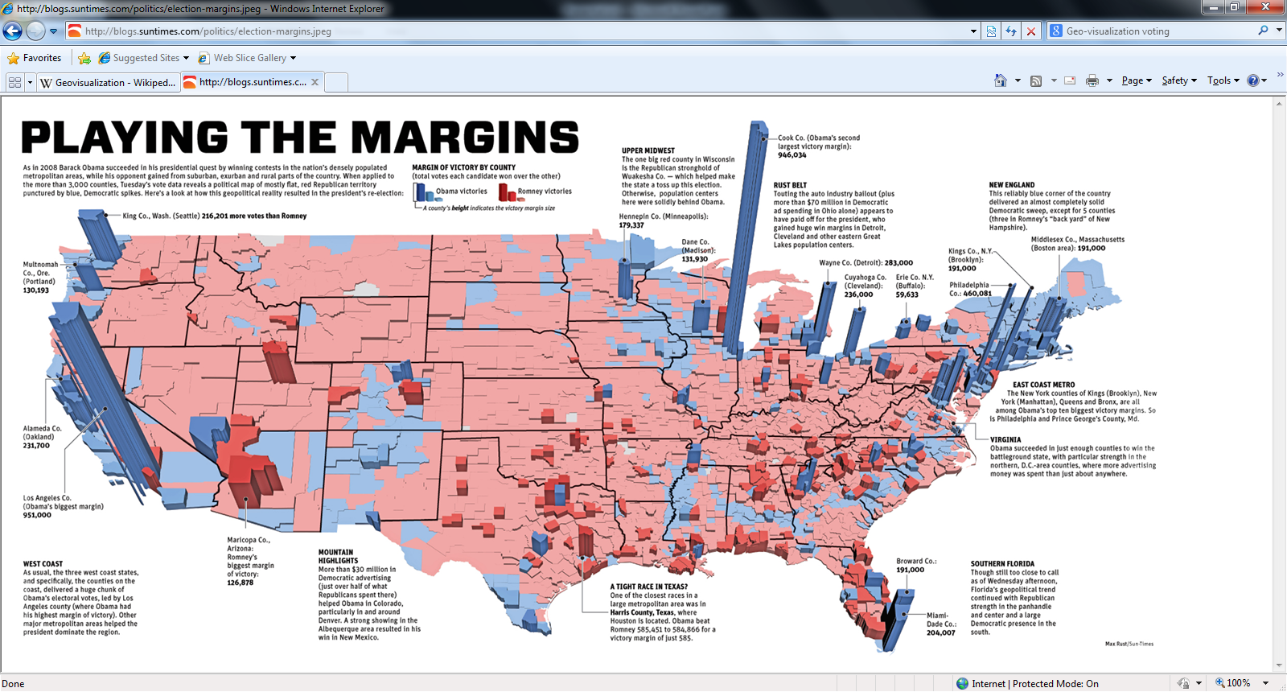
Voting
Notes:
In the recent US general election, it was very common amongst news channel to display voting data via Geo-visualization. This could be used to show the majorities parties had in the pervious general, highlighting what both parties were targeting the ‘Swing States’ where the majorities were very small.

Slide 4
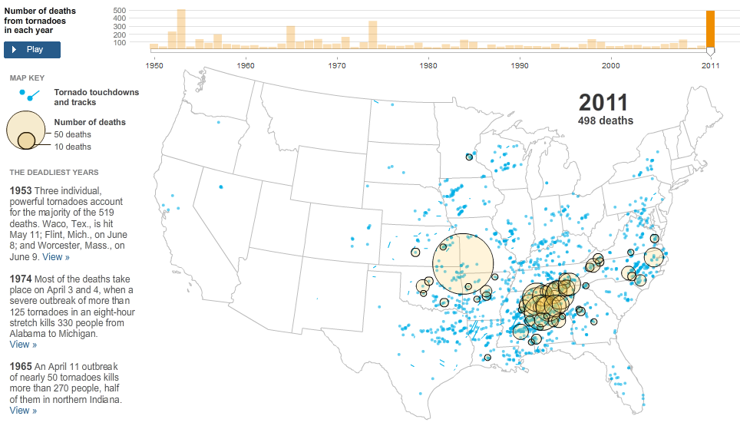
Natural disaster
Notes:
Mapping the effects of disasters is widely used. These can show what areas are most commonly hit and need to be prepared in the future. Also the scale of a disaster can be shown.

Slide 5
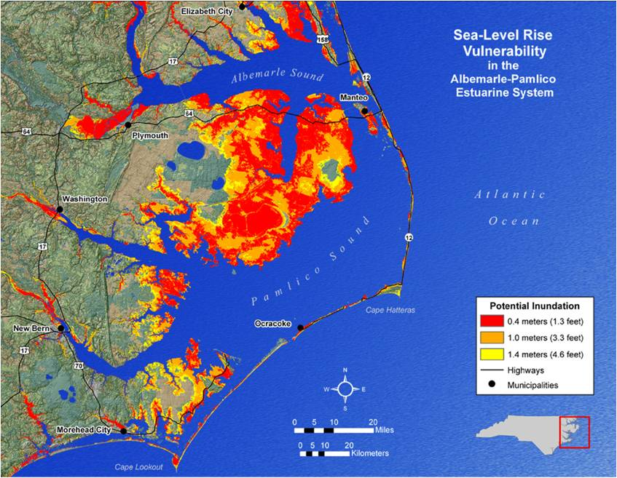
Environment
Notes:
Geo-visualisation can be used to show the effects on the environment different factors can have from carbon dioxide emission to a raise in sea level.

Slide 6
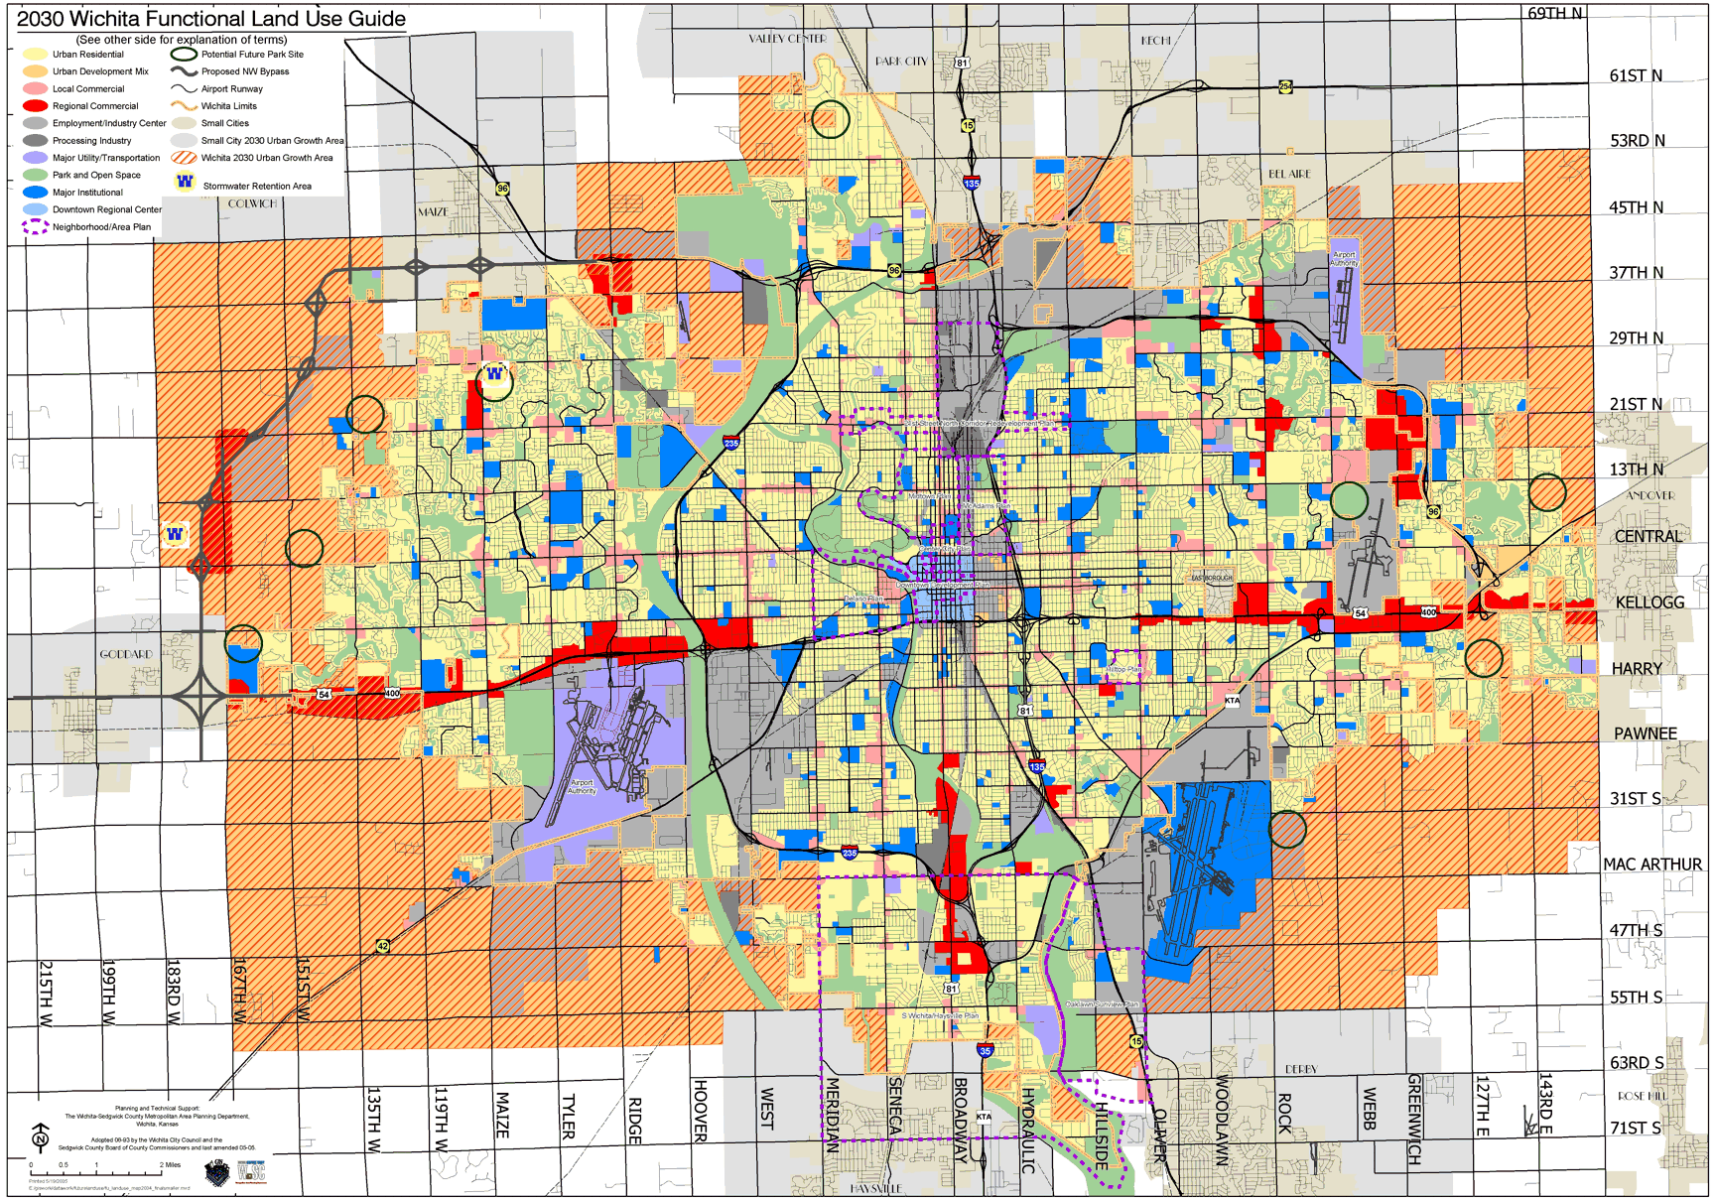
Urban Planning
Notes:
The future planning of areas.

Slide 7
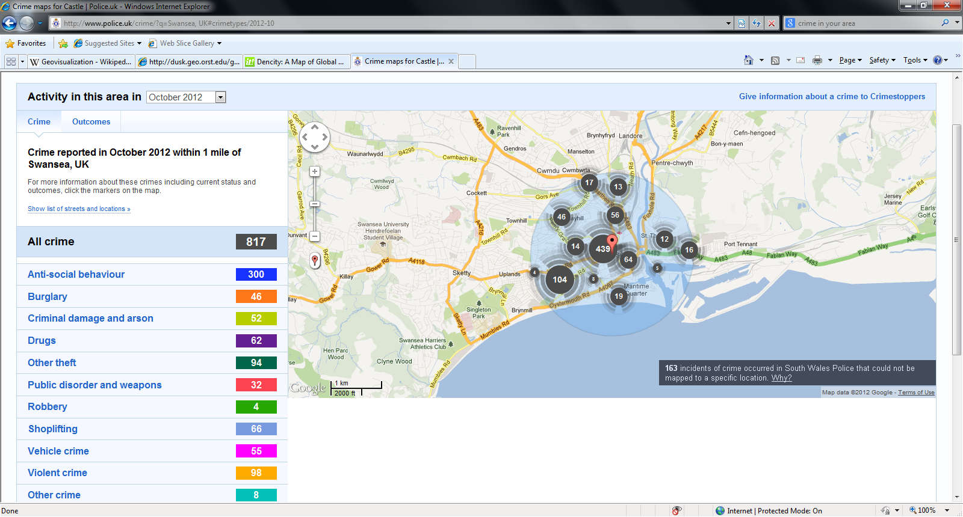
Crime
Notes:
The UK police have recently brought in Geo-visualization to show crime levels throughout the UK.

Slide 8
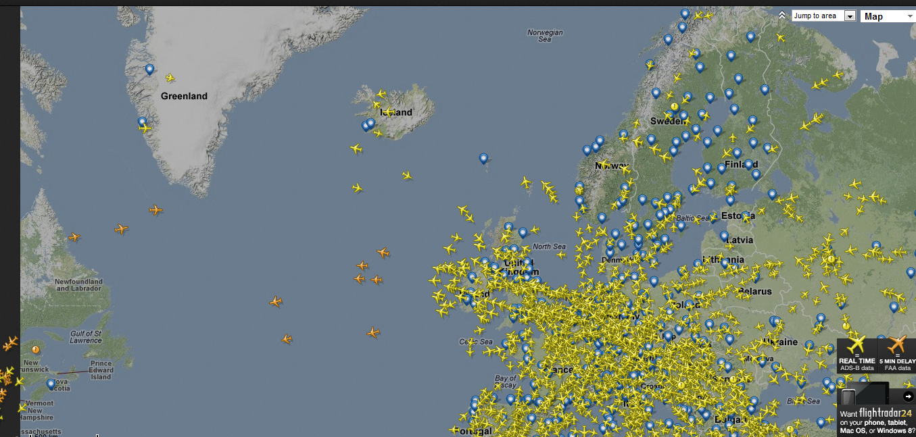
Flight Tracker
Notes:
Aviation is a massive business, so mapping for flights and routes is key to business planning. Geo-visualization allows visual demonstration of this.

Slide 9
GIS Mapping in the
Health Service

Slide 10
GIS Mapping can include
• Transport links
• Locality map with Mosaic groupings
• Resident population by Mosaic public sector group
• ‘Vignette’ style locality profile
• Key to electoral wards
• Population and distribution (various breakdowns)
• Projected population
• Ethnicity
• Fertility
• Teenage conception
• Life expectancy
• Indices of Multiple Deprivation (IMD)
• Unemployment/benefits/income
• Causes of death
• Admissions for assaults/mental and behavioural disorders
• Crime
• Housing tenure/overcrowding
• Distribution by number of bedrooms
• Adult obesity
• Binge drinking
• Smoking prevalence
• Fruit and vegetable consumption

Slide 11
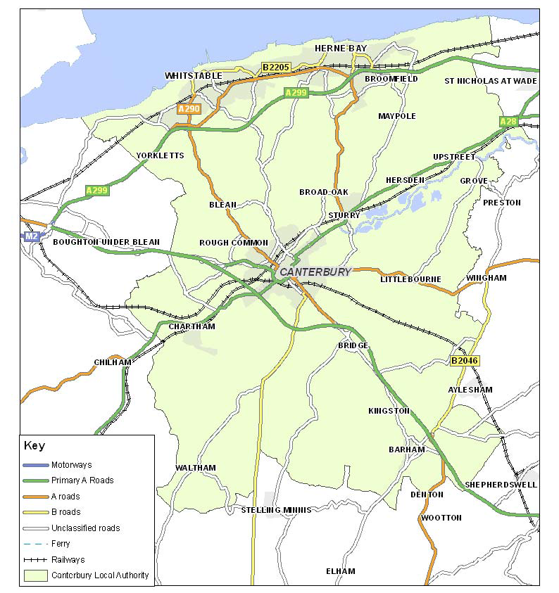
A huge area explored by the NHS is
Transport Links

Slide 12
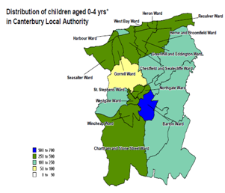
Thematic maps
Notes:
A Thematic Map of Children 0-4 in Canterbury.

Slide 13
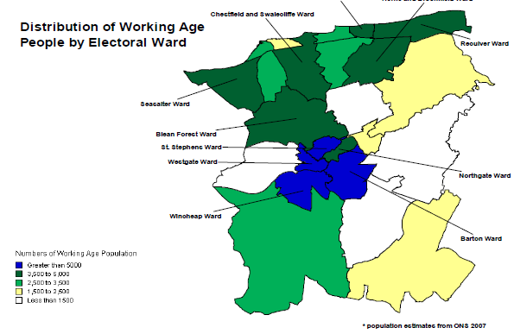
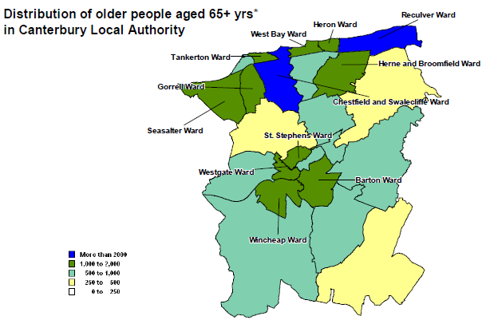
Population, both working and retirement age

Slide 14
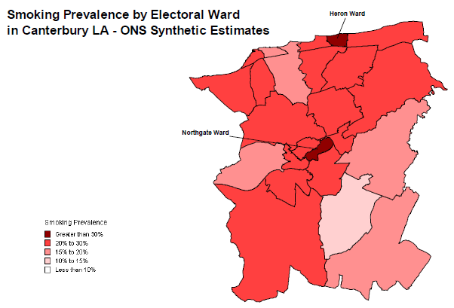
Smoking prevalence

Slide 15
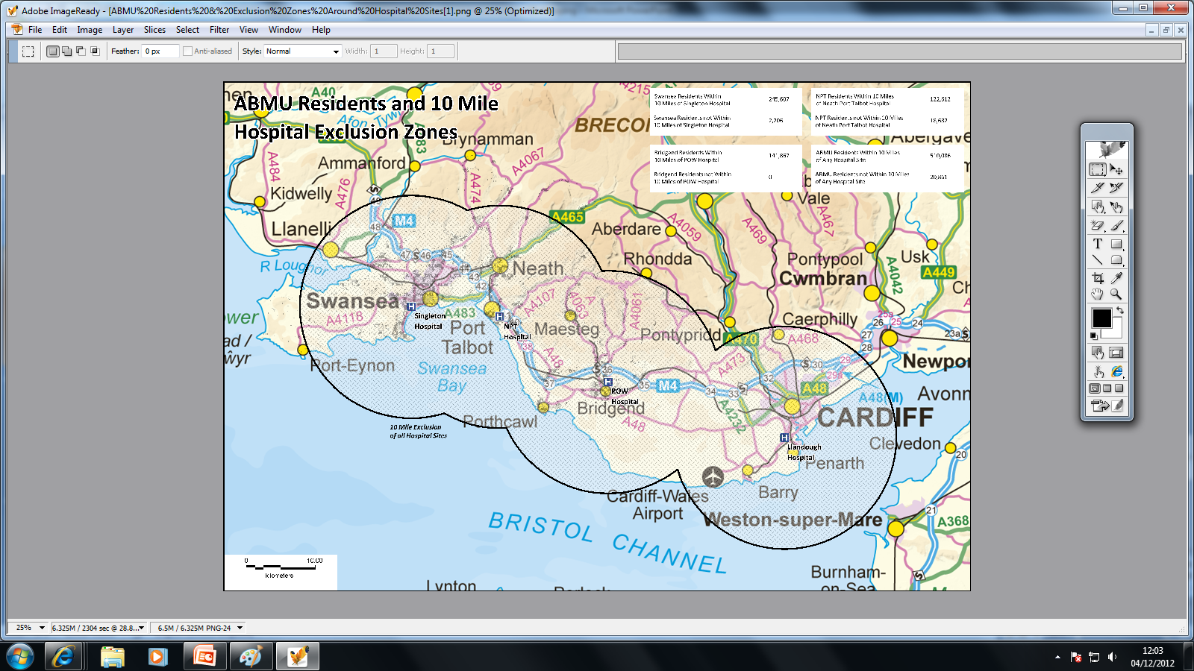
Local Health Board Maps

Slide 16
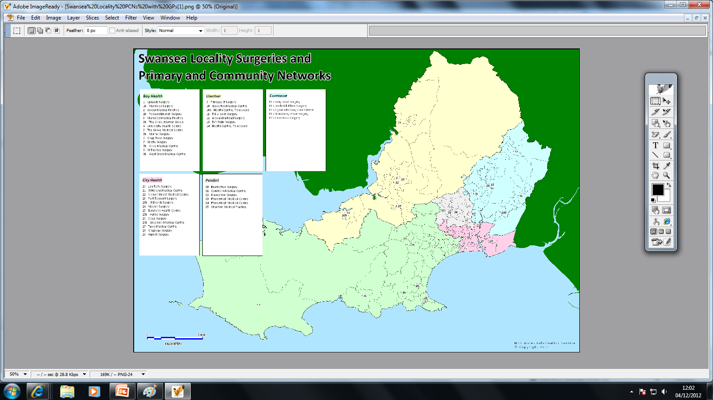
Swansea Local Surgeries

Slide 17
Links
http://www.e-canterbury.co.uk/ecanterbury/assets/Overview_and_Socio-demographics_Canterbury%5B1%5D.pdf
http://www.wales.nhs.uk/sites3/page.cfm?orgid=480&pid=6063.

Slide 18
Socio –Demographic
2001 Census
Dan Craven, Ekta Shah

Slide 19
Socials Factors
These factors were included to produce, reports, maps and graphs.
The following was collected in Swansea,
Population, age structure and marital status
Welsh language skills
Country of birth
Ethnic group and religion
Health and unpaid care
Qualifications
Economic status and employment by industry/occupation
Means of travel to work and hours worked
Household composition, tenure and amenities [1].
Religion (first included in 2001 [2])
Ref [1] http://www.swansea.gov.uk/2001census
Ref [2]http://www.hounslow.gov.uk/index/council_and_democracy/statistics/2001_census_information.htm

Slide 20
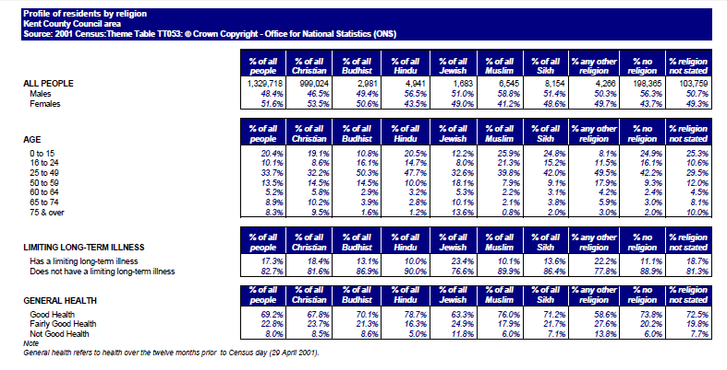
Examples of Data Collected
Religious Group, Kent 2001
[3]
Ref [3] http://www.kent.gov.uk/your_council/kent_facts_and_figures/equalities_and_diversity/religion_profile/2001_religion_profile.aspx

Slide 21
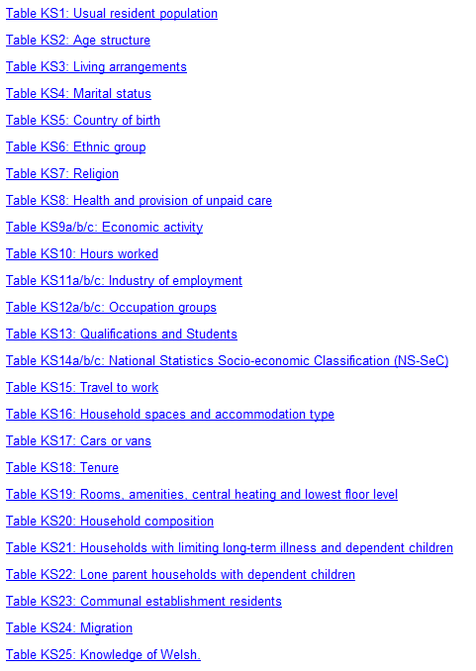
Available Data in Swansea
[4]

Slide 22
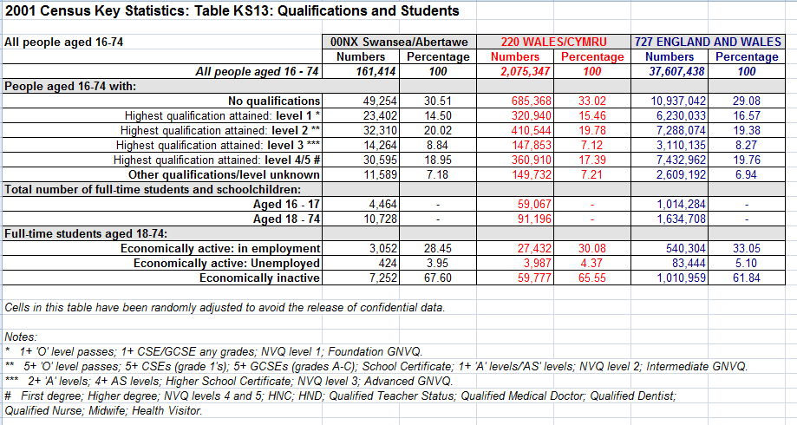
Qualifications and Students, Swansea 2001
Example of Swansea Data
[4]
Ref [4] http://www.swansea.gov.uk/index.cfm?articleid=15008

