Slide 1

আ
Structured Agentic-Style vs Direct LLM
Multilingual Travel Planning
গ
ই
চ
An English-Bengali TravelPlanner study with an exploratory multi-agent extension
Presenter: Rabeya Begum
ক
MSc Data and Artificial Intelligence
ত
40 matched cases
OUT
80 outputs
DATA
20 English + 20 Bengali
Baseline + structured pipeline
খ
Multi-agent
Results
ন
FLOW
CHECK
Exploratory extension
Rubric + validation
প
ম
1/12
Notes:
Hello everyone. My project is titled Structured Agentic-Style versus Direct LLM Generation for Multilingual Travel Planning: A Comparative Study with an Exploratory Multi-Agent Extension. In this presentation, I will explain what my results actually found. I compared a direct baseline with a structured agentic-style pipeline using English and Bengali TravelPlanner scenarios. I also included a small exploratory multi-agent extension. The main message is balanced: structure helped with grounding, but it did not simply beat the baseline across everything.

Slide 2



ই
Why this project matters
চ
Travel plans need to be correct, not just fluent.
ক
ত
01
The problem
A travel plan can sound fluent while still breaking constraints such as budget, dates, transport or accommodation.
Research questions
1
Does the structured pipeline reduce groundedness errors?
খ
02
The gap
There is limited evidence on how structured AI generation performs for multilingual travel planning, especially across English and Bengali.
Does it improve constraint adherence and feasibility?
ন
2
03
The aim
3
Do patterns differ across English and Bengali?
Compare a baseline one-shot system with a structured pipeline on matched bilingual TravelPlanner scenarios.
4
Which error patterns appear in manual and rule checks?
04
The extension
গ
Explore whether a small multi-agent setup shows descriptive promise on a supplementary sample.
5
What does the exploratory multi-agent extension add?
প
ম
Core focus: grounded, constraint-aware, bilingual AI travel planning.
র
MSc Data and Artificial Intelligence
2/12
Notes:
This study starts from a simple problem. Travel plans can look convincing, but they do not always respect real constraints. A plan might sound fluent but still miss the required dates, exceed a budget, or invent accommodation details. My research questions looked at grounding, constraint adherence, language differences, common error patterns, and whether a small multi-agent extension added anything useful. The aim was not to hype agentic AI, but to test it carefully against matched English and Bengali TravelPlanner cases.

Slide 3


ক
Dataset and experiment design
ত
TravelPlanner subset and matched outputs
খ
ন
40
20
FLOW
OUT
40
20 + 20
2
80
গ
matched scenario-language cases
English and Bengali
systems per case
generated outputs
প
DATA
TravelPlanner subset
→
TEXT
English / Bengali prompts
→
AI
Baseline + structured pipeline
→
CHECK
Manual rubric + rule validation
Example structure of the evaluated cases
Matched design improves fairness because both systems are evaluated on the same scenario structure.
চ
ID
MATCH
Scenario (EN)
Scenario (BN)
Key constraints
S01
ম
Travel request
Bengali query
dates, people, budget
S02
Travel request
Bengali query
origin, destination, duration
র
স
MSc Data and Artificial Intelligence
3/12
Notes:
For the main experiment, I used a matched subset of TravelPlanner. That gave me forty scenario-language cases in total, with twenty English and twenty Bengali cases. Because each case produced a baseline output and a structured-pipeline output, the main experiment contained eighty generated itineraries for scoring and validation. The matched design matters because it keeps the comparison fair: both systems are evaluated on the same underlying travel requirements.

Slide 4
Systems and evaluation framework
খ
ন
What was compared and how quality was scored
গ
প
AI
Baseline
STEP
Structured pipeline
FLOW
Multi-agent
Direct single-pass itinerary generation from the model.
One API call; ordered
checks inside prompt.
Planner → Checker →
Revision → Final
Validator (n = 6).
চ
ম
Evaluation
Manual rubric: 8 technical criteria
Rule-based validation
1. Hallucination control
2. Constraint satisfaction
✓ Requested dates covered
✓ Required days covered
3. Budget adherence
4. Date consistency
✓ Accommodation support
✓ Origin and destination
ত
5. Transport feasibility
6. Accommodation support
✓ Budget acknowledged
✓ Total within budget
7. Itinerary completeness
8. Language consistency
✓ Transport detected
✓ Output available
র
Independent second-rater: 24 blinded outputs scored with the same 0-2 rubric.
হ
স
MSc Data and Artificial Intelligence
4/12
Notes:
The main comparison in my study is between a direct grounded baseline and a structured agentic-style prompt. Both conditions used the same Gemini 2.5 Flash model and the same reference information. The structured condition was executed in one Gemini API call. Within that prompt, the model was instructed to identify constraints, inspect the supplied reference information, construct the itinerary and then re-check dates, budget and other requirements before answering. It did not use live tools, retrieval, persistent memory or autonomous action. Separately, I tested an exploratory multi-agent workflow consisting of a Planner, Checker, Revision stage and Final Validator on six scenario-language cases. A targeted repair exercise was also applied separately to two validation failures. Quality in the primary experiment was assessed using eight technical criteria and a separate holistic overall-validity judgement. I also completed a blinded independent second-rater validation on 24 outputs using the same rubric, alongside complementary deterministic rule checks.

Slide 5

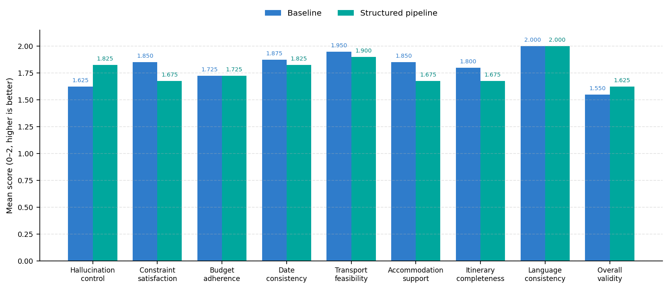
গ
Primary results
প
Mean scores show a grounding-completeness trade-off
চ
ম
AI
Structured pipeline higher on
hallucination control
ত
RESULT
Structured pipeline slightly higher on
র
overall validity
BASE
Baseline higher on
most completeness and feasibility criteria
ন
TIE
Tied on
budget adherence and language consistency
স
হ
Key message: structure improved grounding descriptively, but baseline kept more completeness.
য
MSc Data and Artificial Intelligence
5/12
Notes:
This figure shows the core result pattern. The structured pipeline performed better on hallucination control and was also slightly higher on holistic overall validity. However, the baseline remained stronger on several practical criteria, especially constraint satisfaction, date consistency, accommodation support, and itinerary completeness. Budget adherence and language consistency were effectively tied. This means the results are mixed rather than uniformly positive for the structured pipeline.

Slide 6
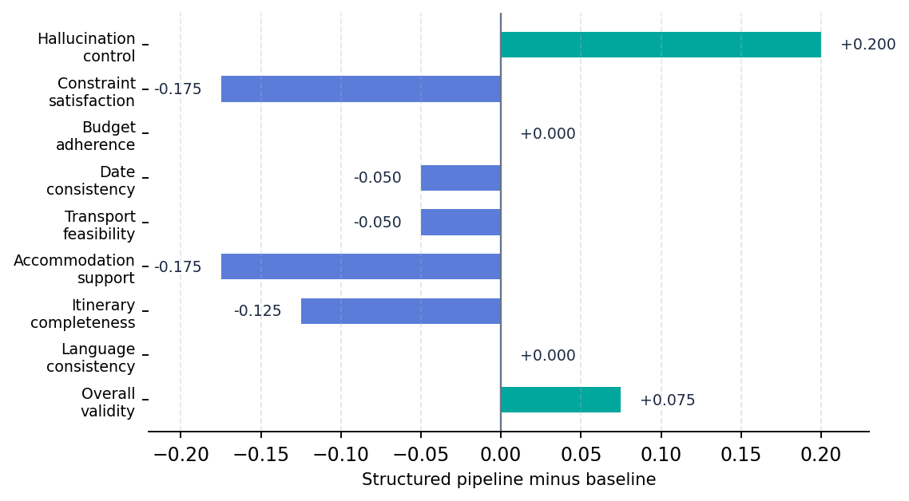

চ
What the results actually mean
ম
The structured pipeline changed the error profile.
ত
র
CHECK
Where the structured pipeline helped
• Better hallucination control
• Slightly higher holistic overall validity
ন
স
TRADE
Where it lost detail
• Lower accommodation support
• Lower itinerary completeness
• Some constraint satisfaction trade-offs
প
হ
য
Main interpretation: greater grounding, but some loss of completeness.
ব
MSc Data and Artificial Intelligence
6/12
Notes:
This slide explains the result rather than only showing the numbers. The structured pipeline seems to make the model more cautious and more grounded. That is why hallucination control improves. However, that caution also appears to reduce completeness in some practical areas. For example, accommodation support and itinerary completeness were lower for the structured pipeline. So the structured approach helped with some risks, but it also introduced omissions.

Slide 7
ত
Statistics and validation
র
Primary inferential outcomes and deterministic checks
ন
স
Inferential results
Rule-based validation
Hallucination control
Baseline mean validation score
Structured pipeline mean validation score
প
Δ = +0.200; Holm p = .5155; not statistically significant.
94.11%
93.68%
Pass rate 100.0%
Pass rate 97.5%
হ
Overall validity
Δ = +0.075; Holm p = 1.000; not statistically significant.
• Date failures: 40.0% structured vs 37.5% baseline
• Required-day failures: 27.5% vs 17.5%
• Accommodation omissions: 22.5% vs 15.0%
No corrected primary result reached statistical significance.
ম
য
Second-rater validation: 24 outputs; 80.6% exact agreement; 19.4% one-point differences; 0 major disagreements.
ব
ল
MSc Data and Artificial Intelligence
7/12
Notes:
When I tested the two primary outcomes statistically, neither remained significant after correction. Hallucination control improved descriptively, but the adjusted p-value was not significant. Overall validity also improved slightly, but again not significantly. The rule-based checks supported the same overall story: the structured pipeline improved some qualities but missed practical details more often in areas such as dates, required days and accommodation support. I also carried out an independent blinded second-rater validation on 24 outputs, balanced across both systems and both languages. Across 216 rubric judgements, 174 matched the original scores exactly, giving 80.6 per cent exact agreement. The remaining 19.4 per cent were one-point differences and there were no major two-point disagreements. Overall-validity agreement was 19 out of 24, or 79.2 per cent. This gives an additional human reliability check alongside the deterministic validation.

Slide 8
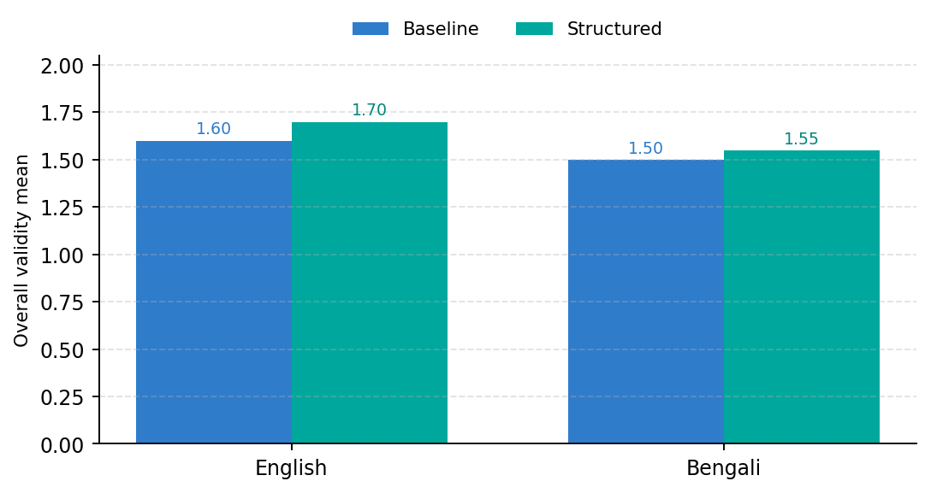

ন
English and Bengali findings
স
Both languages showed the same direction, but the gap was smaller in Bengali.
প
Overall validity score (0–2)
হ
English
Baseline = 1.60
Structured = 1.70
Difference = +0.10
ম
Bengali
য
Baseline = 1.50
Structured = 1.55
Difference = +0.05
Interpretation
The directional pattern was similar, but Bengali did not show as large an improvement. This suggests the multilingual part of the task remains important.
র
ব
ল
শ
MSc Data and Artificial Intelligence
8/12
Notes:
The language results are also important. In both English and Bengali, the structured pipeline had a slightly higher overall-validity mean than the baseline. The improvement was larger in English, at plus zero point one zero, and smaller in Bengali, at plus zero point zero five. I would not overclaim this because the sample is limited, but it does suggest that multilingual evaluation matters. A system that looks better in English may not improve by the same amount in Bengali.

Slide 9
প
Supplementary three-system evaluation
হ
Exploratory deterministic validation
ম
য
• Baseline: mean 93.64%, median 90.91%
• Structured pipeline: mean 93.64%, median 90.91%
• Multi-agent: mean 93.64%, median 95.45%
• No supplementary inferential test reported
র
ব
স
ল
No clear deterministic advantage; exploratory only.
অ
শ
9/12
Notes:
In the supplementary part of the project, I tested a Planner, Checker, Revision and Final Validator workflow on three underlying scenarios represented in both English and Bengali, giving six scenario-language cases. Because the archived project does not contain a persisted final nine-criterion scoring table, I do not report the earlier drafted Friedman or pairwise Wilcoxon analysis. Instead, the final dissertation uses the reproducible deterministic validation retained in the project archive. The mean validation score was 93.64 per cent for all three systems. The multi-agent workflow had a slightly higher median of 95.45 per cent compared with 90.91 per cent for the baseline and structured conditions, but its strict pass rate was lower. Therefore, this supplementary analysis remains exploratory and does not establish superiority for the more complex workflow.

Slide 10

ম
Key findings, contribution, and limitations
য
What the project adds
র
ব
02
Key findings
01
Contribution
TRADE
Limitations
স
• Structured pipeline improved hallucination control descriptively.
• Holistic overall validity was slightly higher, but not statistically significant.
• Baseline remained stronger on several completeness and feasibility criteria.
• Multi-agent workflow showed no clear deterministic advantage.
• Bilingual English-Bengali TravelPlanner evaluation
• Matched 40-case and 80-output design
• Manual rubric + rule validation + blinded second-rater check
• Repair stage suggests a useful future direction
• Independent second-rater check completed on 24 outputs
• Full-dataset multi-rater reliability not tested
• One model and one benchmark family
• Prompt-only design: no live tools, retrieval or memory
• Supplementary multi-agent sample was very small
ল
হ
শ
Overall conclusion: structure improved grounding, but it was not a universal improvement in planning quality.
অ
আ
MSc Data and Artificial Intelligence
10/12
Notes:
This slide pulls the project together. The structured pipeline improved hallucination control descriptively and had slightly higher holistic validity, but these improvements were not statistically significant after correction. The baseline remained stronger on several practical completeness and feasibility criteria. The multi-agent workflow was completed, but the exploratory comparison did not show a statistically supported advantage. My contribution is the bilingual matched design, the manual and rule-based evaluation framework, the independent blinded second-rater validation, and the careful evidence-based interpretation. The second-rater exercise covered 24 outputs and produced 80.6 per cent exact agreement with no major disagreements. The remaining limitations are that this reliability check covered a subset rather than the full dataset, only one model and benchmark family were tested, the primary design was prompt-only without live tools or retrieval, and the supplementary multi-agent sample was very small.

Slide 11

র
Final conclusion
ব
A balanced, evidence-based story
স
ল
CHECK
1. Structured helps grounding
The structured pipeline improved hallucination control descriptively and slightly improved holistic validity, but not significantly after correction.
হ
TRADE
2. It does not solve everything
শ
The baseline remained stronger on several practical completeness and feasibility criteria.
OUT
3. Evaluation must be multidimensional
AI travel planners should be judged on grounding, completeness, constraints and multilingual robustness.
য
অ
More structure changed the error profile, but better planning depends on measuring the full picture.
আ
ই
MSc Data and Artificial Intelligence
11/12
Notes:
My overall conclusion is that structured agentic-style generation can improve grounding, especially hallucination control, but it is not a guaranteed upgrade over a strong baseline. The results show a trade-off between caution and completeness. For multilingual AI travel planning, evaluation therefore needs to measure several dimensions at once rather than relying on fluency or a single overall score. The independent second-rater check also strengthens confidence that the rubric was applied consistently. More structure changed the error profile, but better AI planning depends on measuring the full picture.

Slide 12


স
Selected dissertation references
ল
Key sources used in the final report
হ
শ
[8] Xie, J. et al., “TravelPlanner: A Benchmark for Real-World Planning with Language Agents,” ICML 2024.
[24] Park, J. S. et al., “Generative Agents: Interactive Simulacra of Human Behavior,” UIST 2023.
য
[13] Yao, S. et al., “ReAct: Synergizing Reasoning and Acting in Language Models,” ICLR 2023.
[25] Mialon, G. et al., “Augmented Language Models: A Survey,” 2023.
অ
[17] Google, “Gemini API Documentation,” Google AI for Developers, accessed 2026.
[26] LangChain, “Agents,” LangChain Documentation, accessed 2026.
[22] Wei, J. et al., “Chain-of-Thought Prompting Elicits Reasoning in Large Language Models,” NeurIPS 2022.
ব
[29] Oh, J., Kim, E., and Oh, A., “Flex-TravelPlanner,” 2025.
[23] Schick, T. et al., “Toolformer: Language Models Can Teach Themselves to Use Tools,” 2023.
আ
ই
ক
Full IEEE reference list is available in the dissertation.
MSc Data and Artificial Intelligence
12/12
Notes:
These are selected dissertation references from the final report. They include the TravelPlanner benchmark, ReAct, Gemini API documentation, chain-of-thought prompting, Toolformer, generative agents, augmented language model surveys, LangChain, and Flex-TravelPlanner. I have kept the numbering aligned with the dissertation so that the slide references match the full IEEE reference list.

