Slide 1
Student Name: Colwin Kelly
Student ID: 2027494
Module code: BMSW4002 - Effective Team Working and Communication
Assignment title: Presentation – Strategies for Effective Communication in a Business Setting.
Lecturer’s name: Sujeewa Herath

Slide 2
Introduction
Tesco
  Retail Industry
  Customer type – B2C (business to consumer)
  Organisation / Company type: MNE (multinational Enterprise)/ Large organisation
  What are the channels of communication used by the organization and channels that can be used to improve communication?
Effective communication plays a major role in the development of a
organisation. Organisations such as Tesco use various channels of
communication to ensure the business runs efficiently.
These channels of communication are

Slide 3

Channels of communication used by Tesco
Tescos uses various communication methods to keep in contact with their Customers, Stakeholders, Suppliers etc.
Official Website
Press releases
Advertising campaign
Email
Telephone
Online conversation through social media
Face to face

Slide 4
Website
  Official website contains information about the company such as products, services, careers and opportunities.
Press Releases
  Providing stake holders with new updates and business developments
Advertising campaign
  Regularly carries out advertising campaigns for potential new customers and existing ones

Slide 5
Communication Process in Tescos
Communication can take place Internally and Externally
Internally
Managers
Employers
Subordinates
colleagues
Externally
Shareholders
Customers
Suppliers
Media
(Ukessays, 2018)

Slide 6
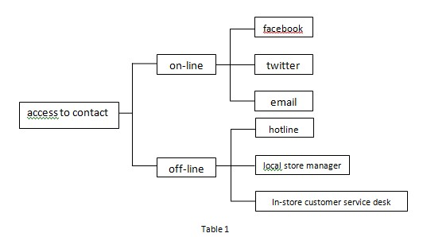
Channels to answer customer concerns

Slide 7
Networking is becoming more important as social media grows, business are
Finding it more difficult to deal with crisis online. This is how Tesco uses social
Media as an effective communication tool and improving how they get messages
across to targeted stakeholders
statements
Email
To cusomers
Video Interviews
Tesco website
Twitter
To media
Blogs
Facebook
Customers &
media

Slide 8
Channels that can be used to improve communication
Social Media
Start networking creating Partnerships with established social media influencers, they could help generate and bring more attention to the
Having more hands on approach with its own social media by keeping them updated, deal with customer queries professionally and quickly
Face to face
Promoting diversity and inclusion by doing Campaigns
Holding meetings with communities
Webinar
https://www.shrm.org/resourcesandtools/tools-and-samples/toolkits/pages/managingsocialmedia.aspx

Slide 9
References
shrm. (2016). Managing and Leveraging Workplace Use of Social Media. Available: https://www.shrm.org/resourcesandtools/tools-and-samples/toolkits/pages/managingsocialmedia.aspx. Last accessed 25 nov 2021.
tescos. (2021). Stakeholder engagement. Available: https://www.tescoplc.com/sustainability/our-ambitions-and-approach/little-helps-plan/stakeholder-engagement/. Last accessed 25 nov 2021.
UKEssays. November 2018. Channels of communication in Multi national organisations. [online]. Available from: https://www.ukessays.com/essays/management/channels-of-communication-in-multi-national-organisations-management-essay.php?vref=1 [Accessed 25 November 2021].

Slide 10
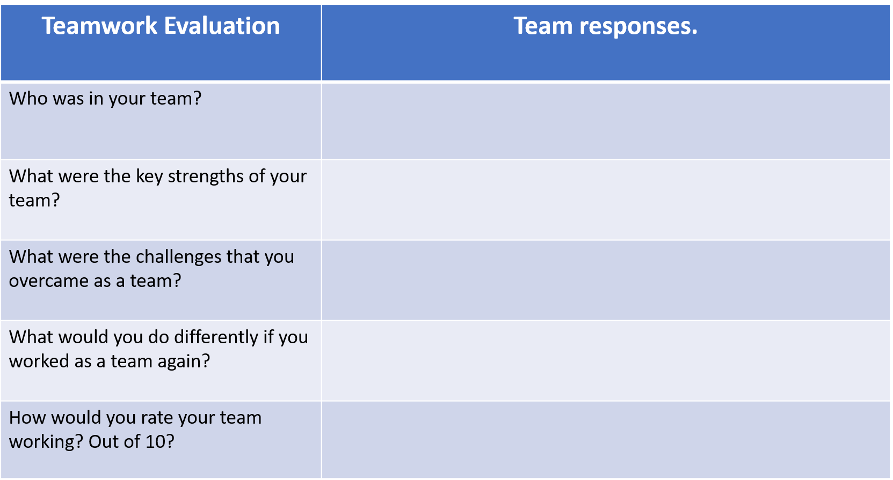
Colwin Shevorne and Joshua
I was working on my own
Lack of communication from team members
Call each member of the group
I was by myself so its hard to give a rating

