Slide 1
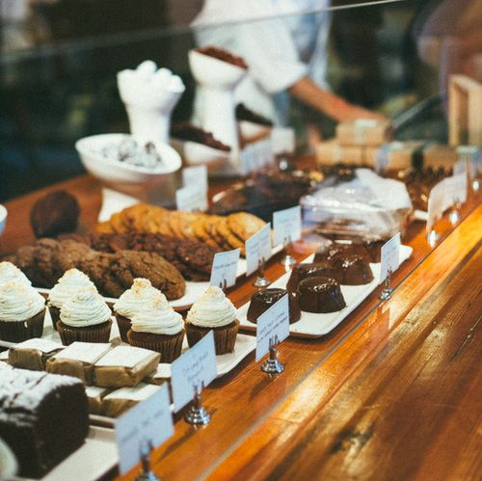
Managing Enterprise in the 21st century-BMSV4006
Business Plan
Ana-Maria Costache
Corina Cazacu
Rares Scobeniuc
Stefania Claudia Bulete
Lecturer: Light Zaglago
University of Wales Trinity Saint David

Slide 2




Table of Contents
Company overview
Product and services
Market Audit
Competitors
SWOT Analysis
PESTLE Analysis
Target Market
Marketing Plan
Management Team
Financial Plan
Cashflow Forecast
Profit & Loss
References

Slide 3
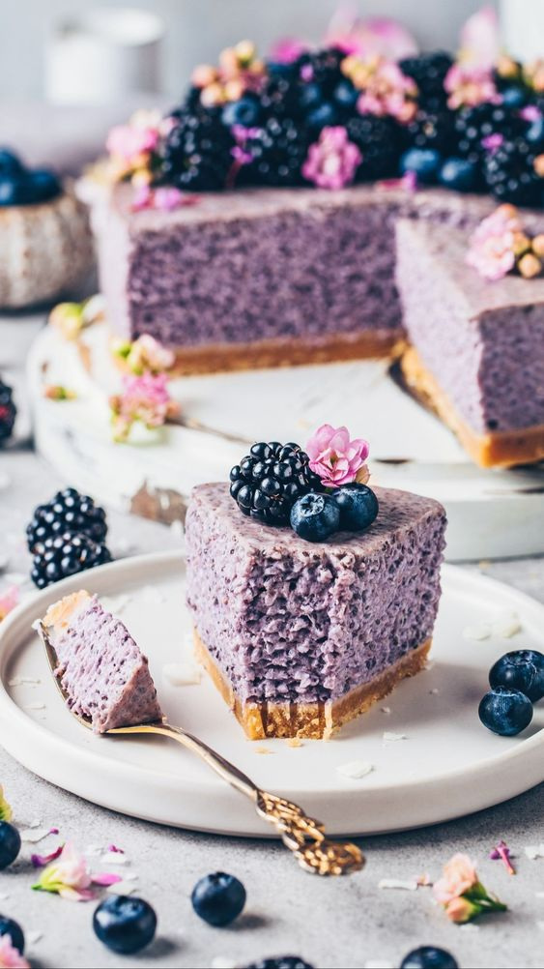
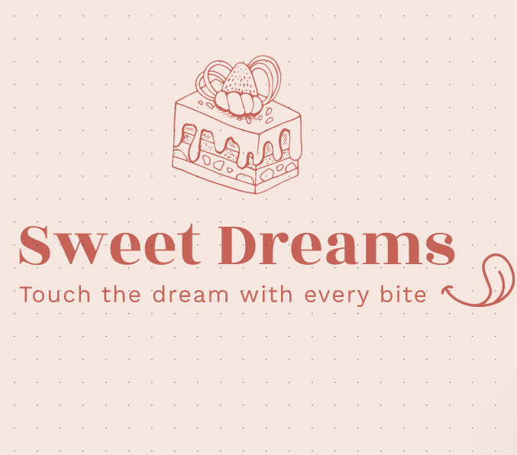
Company’s Logo & Motto
https://www.wix.com

Slide 4
Executive Summary
The Business plan of Sweet Dreams Partnership will picture all the important areas that an investor can look for. It will contain the operating way of the business, including the risks, challenges, financial forecasts, products, services and marketing plan.

Slide 5

Company Overview
Who we are
Sweet Dreams is a start-up positioned in Birmingham Central. We bring into your life handmade cakes and cookies, served with fresh juices, tea, coffee and love. Our Sweet Dream’s door is opened for you, your family and friends, for experiencing baking and decorating your favourite sweets.
Sweet Dreams Offers a wide range of cakes, available for local delivery and next day regional delivery.
The company seeks to expand in 5 years by opening 3 more restaurants in London, Manchester and Liverpool.
Mission and Vision
Our mission starts with the best friends and plans to continue in a lovely friendly environment, “happy colleagues, happy customers” we would like to make happy as many people as possible by offering our cookies and also experience of making them with the family and friends. Your happiness is our responsibility.

Slide 6

Company’s Legal Structure
PARTNERSHIP
It is a formal arrangement by two or more parties to manage and operate a business and share its profits. In particular, in partnership business, all partners share liabilities and profits equally, while in others, partners may have limited liability.
Our team chose the partnership as the legal structure, as it allow us to have equal right in the running of the business, equal rewards in terms of money and equal liabilities, so we all have the “skin in the game”.

Slide 7
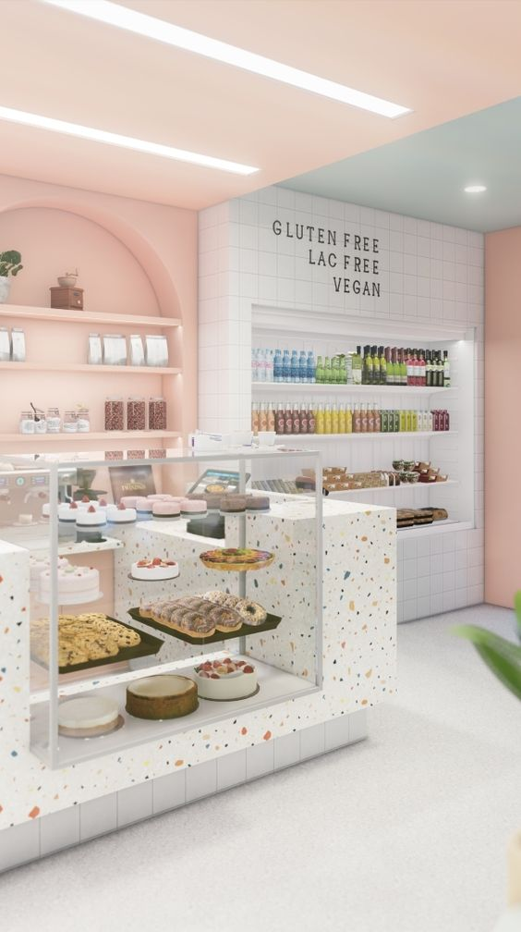
Products and Services
From chocolate to icecream deserts, birthday cakes to different occasions cookies and cakes, bringing for you only quality and fresh products, including seasonal fruits.
You will enjoy the deserts you dreamt of, including the vegan menu, lactose, sugar and gluten free.
Join us in our sweet family as part of the Sweet Dream’s Family.
The services includes: Plan for 1 ore more people and the discounts are available for each member you bring to enjoy with you and a plan for ordering at home every time you want, fresh products.
You have the opportunity of creating your own cakes or cookies by selecting the ingredients you wish.
The baking area is opened for you and your family and it is included in the Plan.

Slide 8
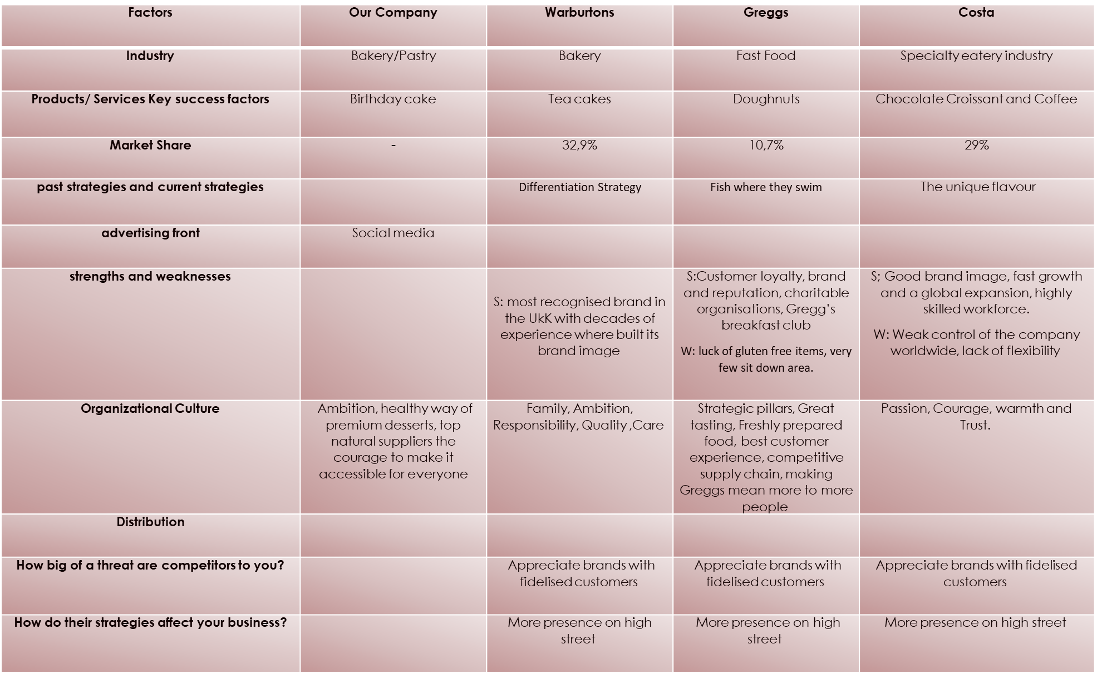
Market Audit-Competitors

Slide 9
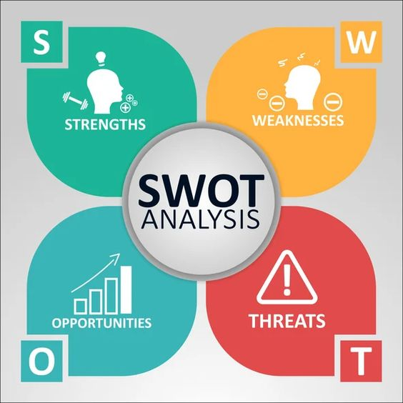
SWOT Analysis
Strengths
Friendly and opened environment
Customised products.
Our Location
Home Delivery
Weaknesses
New company
Low budget for marketing
Strong competition

Slide 10

Opportunities
The opportunity of opening a pastry came up when we could not find a wide range of healthy and ethical desserts.
Threats
The big competitors
The competitors don’t have as many products and services as we have, but their loyal customers will probably not try something different as they are used o their products and services, also, their brand make the difference.

Slide 11

PESTLE Analysis
Economic
Since our product is quite specialised, the prices are quite high. in the event of extreme inflation or a recession, foods like cupcakes and decadent desserts become a luxury to a lot of people and become something that can be avoided. In this case, in order to keep the revenue up and have customers buy our products, we may have to decrease the price of our products and since it is a luxury product, it is quite an elastic product since it is not a staple for the home. However, My Cupcake Fantasy may suffer some losses since we do pay a high price for our supplies.

Slide 12

Social
People are becoming more health conscious lately so foods like cupcakes that are high in sugar can become less popular, especially with parents buying it for their children. Furthermore, trends are constantly changing and with desserts and pastries, the trends can change as well. This is why our products are a perfect fit for this market.

Slide 13

Technological
We operate in a country where the technology is well-developed and that is making our online work much easier as a part of our business is online.
The orders are made online, payments, salaries, suppliers, reviews, market research.
Technology helps increase the efficiency of systems, products and services.
It helps truck and streamline processes, maintain data flow and manage contacts and employee record.

Slide 14

Target Market
Segmentation
Sweet dreams sells to corporation employees around the area of operating, youngers, parents and grandparents. The parents of little kids choose us for sweets as they are happy to offer to their kids healthy products.
Targeting
The target market is focused on families and kids. Families can make educated choice about our products as our brand have grown around the idea that the cakes are made with fresh ingredients and healthy recipes. They can buy the products and give it to their kids free of worries.
Positioning
Even if the business it is a start up, we are well positioned and known as one of the best in taste and healthy in the same time choice in the are. Amongst our customers we do receive very positive feedback when comes to taste and healthy ingredients.

Slide 15
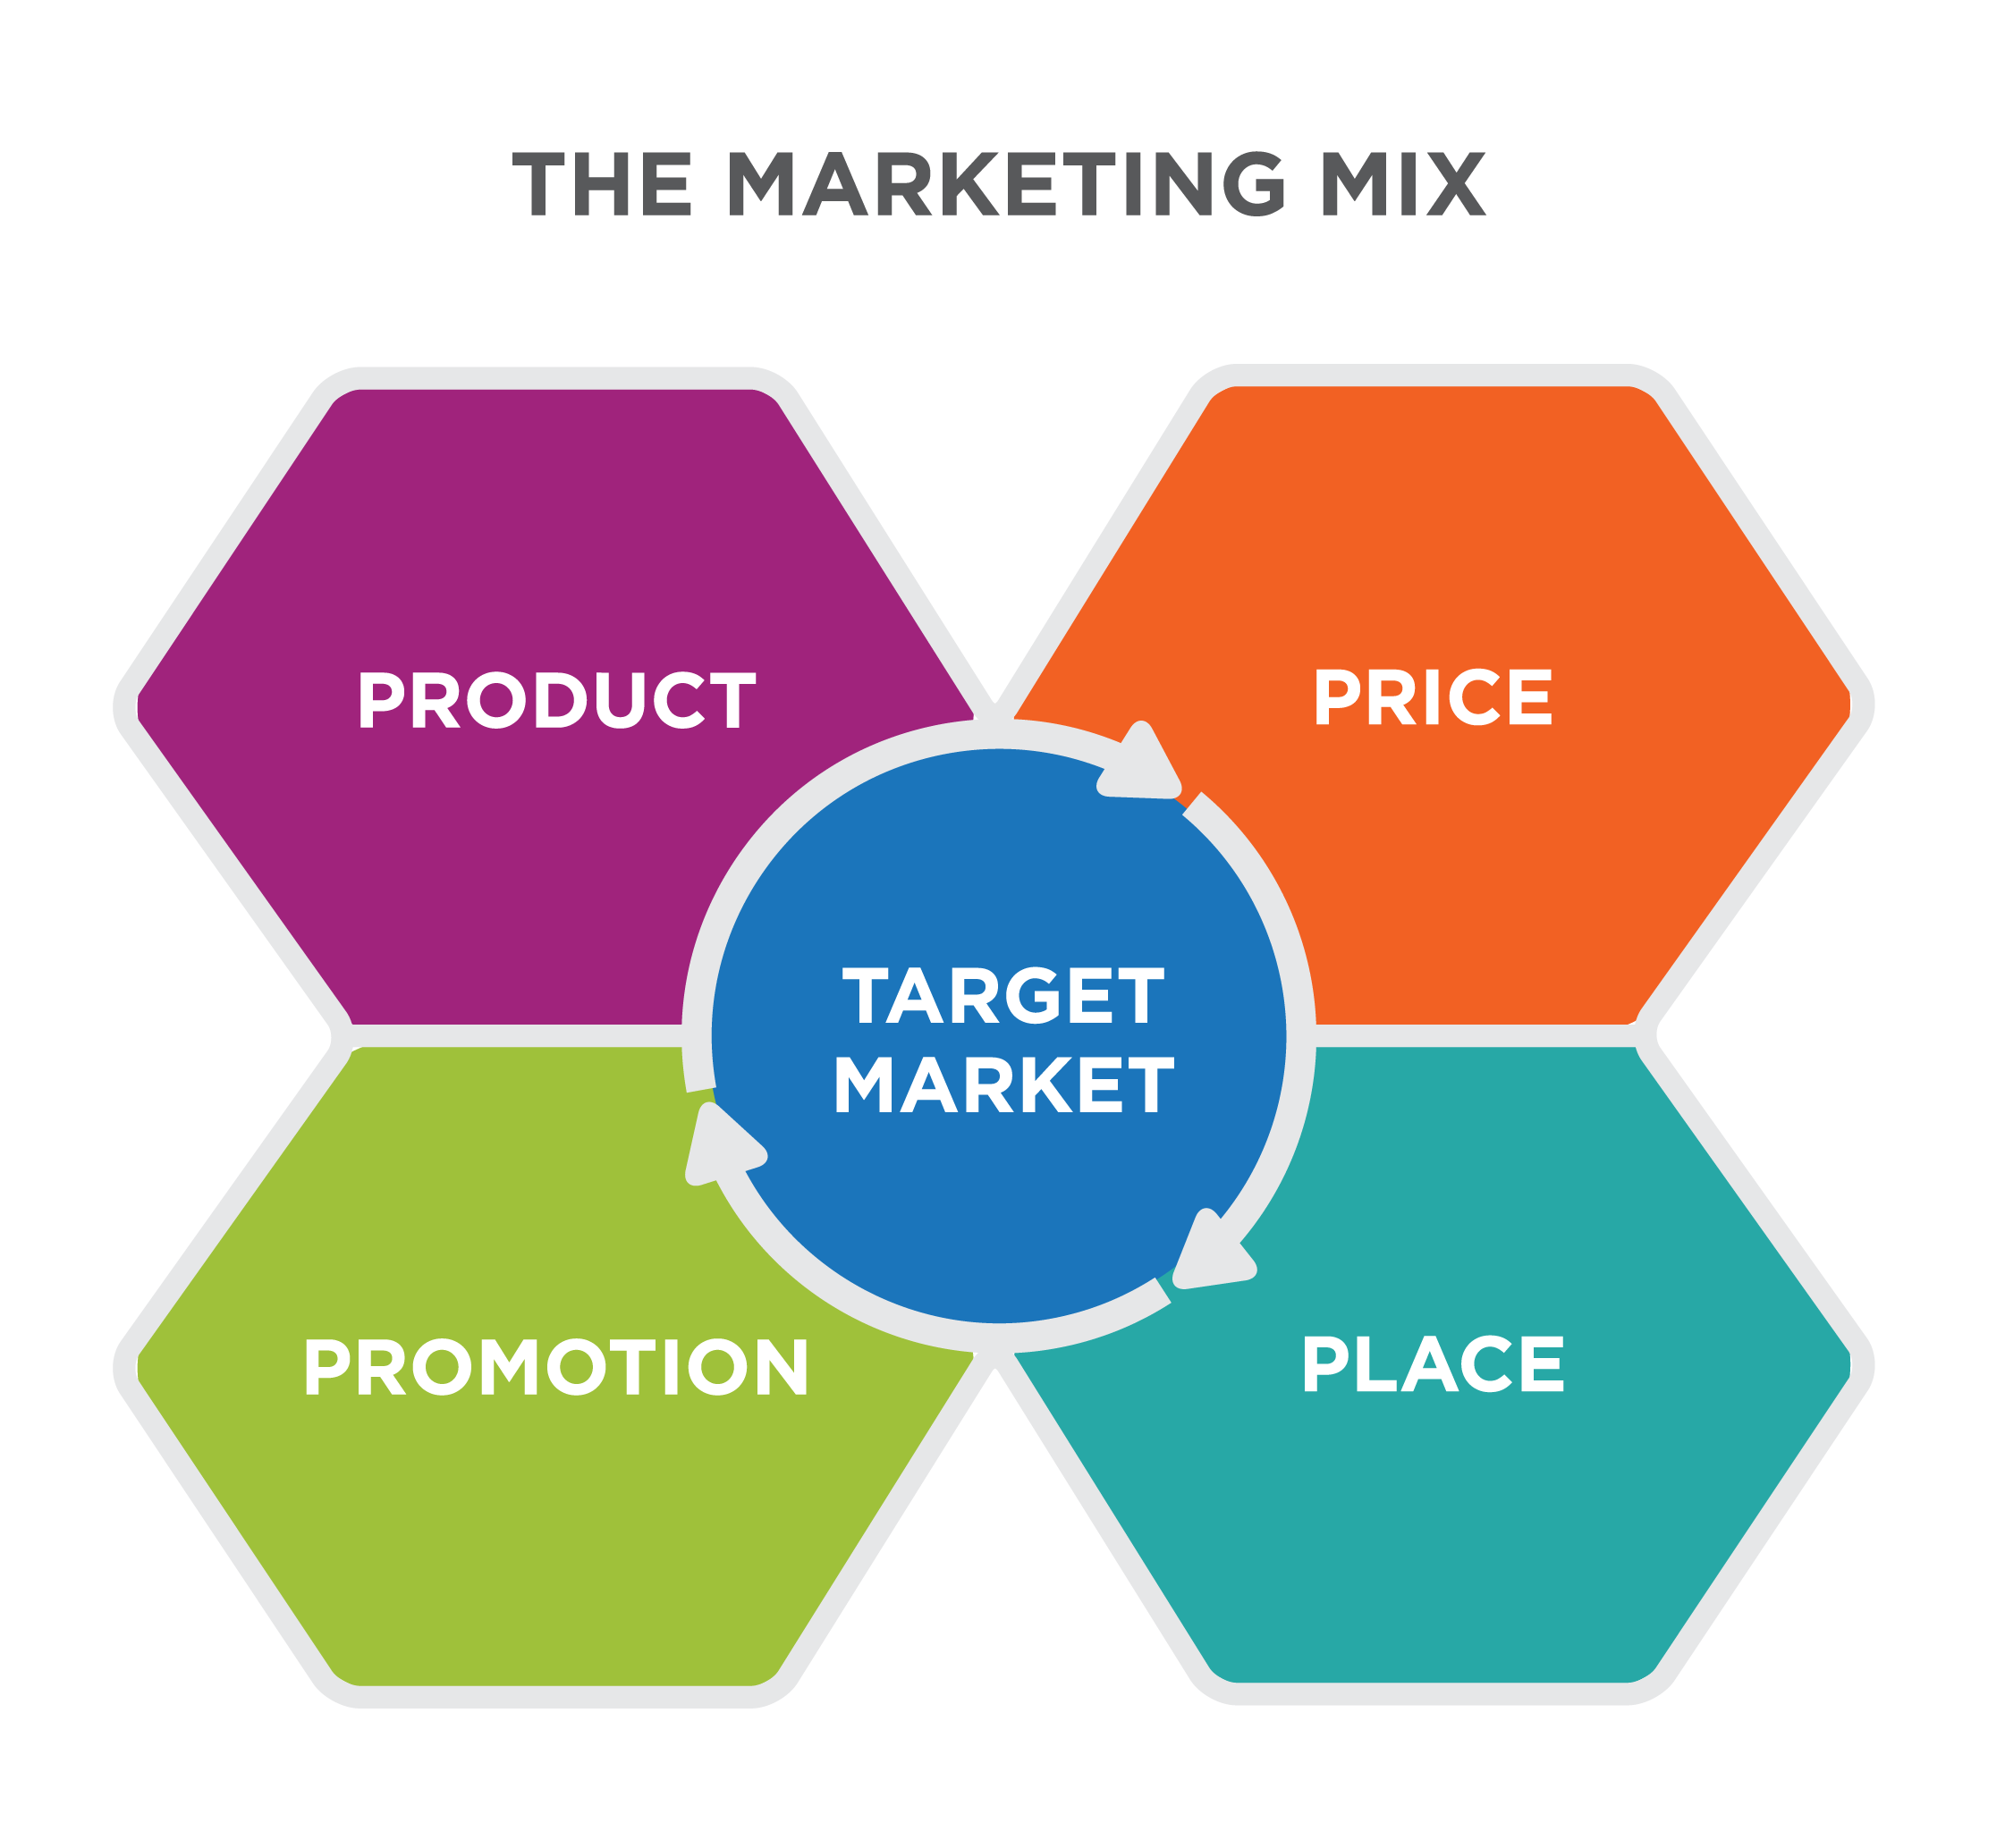
Marketing Plan
Products
In order to achieve the maximum potential in nowadays market, the sold product place a massive role. This is what we are doing at Sweet Dreams. Deliver a high quality product and services for our customers. Is already known that we are chose for freshness and healthiness, together with our fun and active packages where clients cook their own sweet with the professional chef.
Price
The clients, which are manly made from corporate families with a medium/high salary, tells about our business. The prices at Sweet Dreams are a bit spicy but still accessible for everyone. It does reflect the high quality suppliers we use, prime location, and a well trained team of chefs. Our suppliers are local, so we support local farming, and only use natural way of growing wheat.
Promotion
When it comes to promotions, we do have some ways of keeping the clients happy with a bit of a discount or other ways. Apart from free samples that you cand try every day, we do offer a free trial for our “Cook your own”, if you are a first time customer or 2 trial if you are a family with kids. As every prima brand Sweet Dreams have the option for a club card where the customers get a £10 voucher every month, and many more to come.

Slide 16

Place
The location of Sweet Dreams is well positioned in the city centre amongst the big employers, next to hotels, and very close to a high end residential. Its strategy is to atract not only the employees and residents, but the tourists visiting the big city, wishing a good Instagram photo for their post/story.
Packaging
Plays a vital role in our business as it creates an idea about our brand. Not only that it is made from 100% recyclable material, and looks premium, it has a smart and fun way of being opened, in order to stimulate the brain.
Marketing Channels
We do understand that promoting our products and services is o important for the wellbeing of the business, this are few of the channels we use: TikTok posts on Sweet Dreams page where customers get educated about the ingredients, the way we cook and fun giveaways together with all social media platforms.
We invested in YouTube ads where a short video tells you about our culture and where you can find us, or how you can order online.
In the same time we went for old school ways, and advertising on a big screen can bee seen in the city as well as a short announcement on a radio and even short articles in the papernews.

Slide 17

Management Team
Sweet Dreams has big plans for the future, but now its team is at a start up level.
The team is composed from Stefania, which deals with all the online administration and being the first point of contact with customers staying over thee counter.
A valuable team member is our colleague Rares, with his driving licence place a big role in the business as he is delivering the tasty products to our loved customers.
Corina and Ana are our much appreciated chefs which Sweet Dreams would not exist without them. They put their magic in our products day by day, to satisfy the clients taste in values.
Apart of the daily duties, the team is managing the whole business in the free time, including the decision making.

Slide 18
Financial Plan
Cashflow Forecast

Slide 19
Profit&Loss
Forecast
Business: Sweet Dreams
Period: Year to 31 December, 2023 Sales: |  |  | £ 101,240 | (A)
Less direct (variable) costs:
materials | £ | 10,580
direct wages | £ | 2,500
other | £ | -
Total direct costs |  |  | £ 13,080–
Gross profit/contribution: |  |  | £ 91,160 | (B)
Fixed costs (overheads):
wages/salaries (incl. taxes) | £ | 62,400
rent | £ | -
heat/light/power | £ | 2,400
advertising | £ | 5,500
insurance | £ | 1,200
transport/travel | £ | 1,800
telephone | £ | 360
stationery/postage | £ | -
repairs/renewals | £ | 450
depreciation | £ | 550
local taxes | £ | 950
other Prof. fees | £ | 0
other Sundry | £ | 0
Total fixed costs |  |  | £ 75,610 | (C)
Net profit |  |  | £ 15,550
Less drawings or dividends |  |  | £ -
Profit retained in the business |  |  | £ 15,550
Break-even point = A x C / B
83,970

Slide 20
References
Benun, I. and Top, P. (2008) The designer’s guide to marketing and pricing how to win clients and what to charge them. 1st ed. Cincinnati, Ohio: How Books.
Costa Limited: Foodservice - Company Profile & SWOT Analysis (2015) Canadean Company Reports. Basingstoke: GlobalData.
Greggs Plc : Retailing - Company Profile, SWOT & Financial Analysis (2016) Canadean Company Reports. Basingstoke: GlobalData
https://www.wix.com
Journal of small business management. (no date). Morgantown, W. Va: International Council for Small Business.
McDonald, M. (2007) Marketing plans how to prepare them, how to use them. 6th ed. Amsterdam ;: Elsevier Butterworth-Heinemann.
McDonald, M. and Dunbar, I. (2010) Market segmentation how to do it, how to profit from it. 4th ed. Oxford: Goodfellow Publishers
McMurtry, J. M. (2003) Big business marketing for small business budgets. 1st ed. New York: McGraw Hill.
PESTLE analysis’ (2016) A Dictionary of Business and Management. 6th edn. Oxford University Press.
Thiel, P., Masters, B. and Masters, B. (Blake G. . (2014) Zero to one : notes on start ups, or how to build the future. London: Virgin Digital

