Slide 1
Communication and counselling Skills
Sharon Langford

Slide 2

Reflecting
Mirror back
Thoughts
Feelings
Beliefs
Values
Ideas of self concept

Slide 3
Paraphrasing:
Is a counselling skill used as an empathic response
Repeat back your understanding of the material stated by the client/patient but in your own words.
A paraphrase reflects the essence of what has been said, choosing details such as thoughts, feelings and content.
Good paraphrasing indicates attentive listening
Helps build the client/patient rapport and builds empathy
It shows the client/patient that they have been heard
Enables the counsellor/nurse/helper to check out the client/patient understanding by clarifying the client’s meaning.

Slide 4
Example of Paraphrasing
Client:- “I’m having a hard time communicating with Bill and I don’t know what’s going on?”
Counsellor :- “It sounds like you’re frustrated that you and Bill aren’t getting along and are feeling confused to what is happing in your relationship”.
Client:- “ Yes….. and I think he’s avoiding me on purpose”.

Slide 5
Managing resistance in paraphrasing linking open ended questions
Client: - I think coming here is a waste of time. My parents keep picking on me and they are the ones who need help.
Counsellor: - You feel angry about coming here because you feel you parents are the people with the problems.
Client:- Yeah
Counsellor :- I sense that you are uncomfortable about being here, would you care to tell me how you view the situation as I would really like to understand your view point.

Slide 6

Example of paraphrasing in context

Slide 7
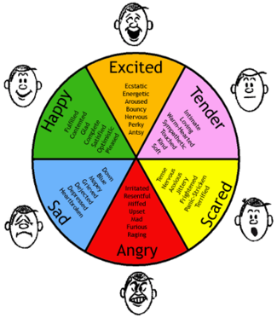

Slide 8
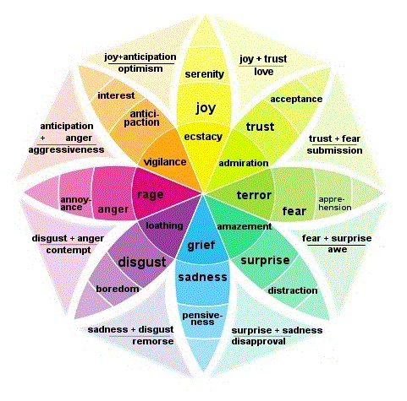

Slide 9
List a variety of words to describe an emotion
Anger
Sadness
Happy
Fear

Slide 10

Summarising
Longer paraphrasing
Sums up the main themes that are emerging
Purpose is to clarify emotions
Review the work
Move the counselling forward
Ties all the work together

