Slide 1
Module Title- Psychology in Health and Social Care
Module code-LCHS4010
Lecturer Name –Helen Parsons
Student: Mariam Gulzar (2521109)
Assignment Title – Understanding Shonas development through attachment theory (Individual presentation)
Date- October 2026

Slide 2

Case Study
Shona aged 3 recently joined nursery
Very anxious when carers leave
Verbal communication limited
Has difficulty to take part in group play
Needs support with emotional and social development
https://media.istockphoto.com/id/1226218425/vector/kindergarten-kids.jpg?s=1024x1024&w=is&k=20&c=3bq0WXDG2wCVNSsZmG73_eVe6pZuOZn74u4zGb48fM4=

Slide 3
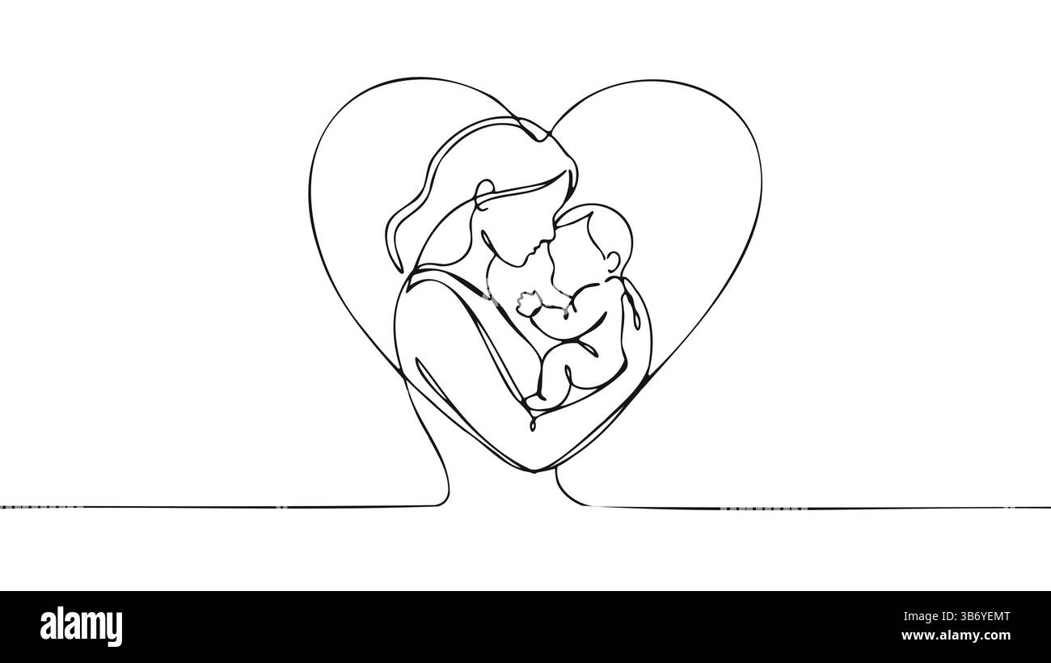
Bowlby’s Attachment Theory
Emotional bond between child and caregiver
Protection and emotional security
Reassurance when unsettled
Early relationships influence expectations a child has from caregivers
The caregiver as a secure base
(Bowlby,1988; Ainsworth et al,1978)
https://c7.alamy.com/comp/3B6YEMT/mother-holds-baby-inside-heart-simple-lines-create-woman-and-child-illustration-motherhood-designs-parenting-blogs-family-posters-minimalist-line-3B6YEMT.jpg

Slide 4

Key concepts
Attachment bond:
Emotional connection
Proximity seeking:
Seeking caregiver when distressed for reassurance
Secure base:
Confidence to explore
Internal working model:
Expectations from relationships
(Bowlby,1982; Bretherton, Munholland,2008)
https://www.dreamstime.com/illustration/sincere-love-parent-child.html

Slide 5
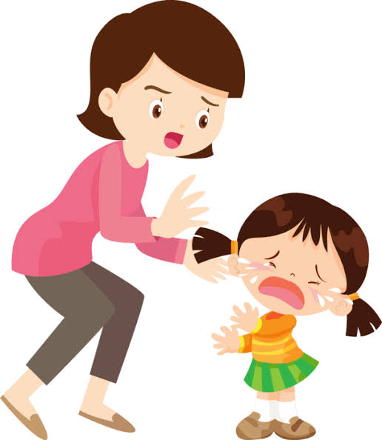
Bowlby Theory Shona
Separation:
Shona becomes anxious
Emotional security: reassurance from familiar faces
Secure base:
Practitioner support could encourage exploration
Exploration:
Better confidence can make positive impact on play and interaction
(Bowlby,1982; Zeanah et al.,2011)
Upset child being comforted by a parent 55544729 PNG

Slide 6

Language Development
Interactionist perspective
individual development + social interaction/environment = language progress
(combines nature and nurture)
- Responsive adult communication
- Turn taking
-Language modelling
- Play based interaction
- Time to respond
https://i.etsystatic.com/39753055/r/il/09b5aa/7499073025/il_1588xN.7499073025_3g81.jpg
(Bruner,1983)

Slide 7
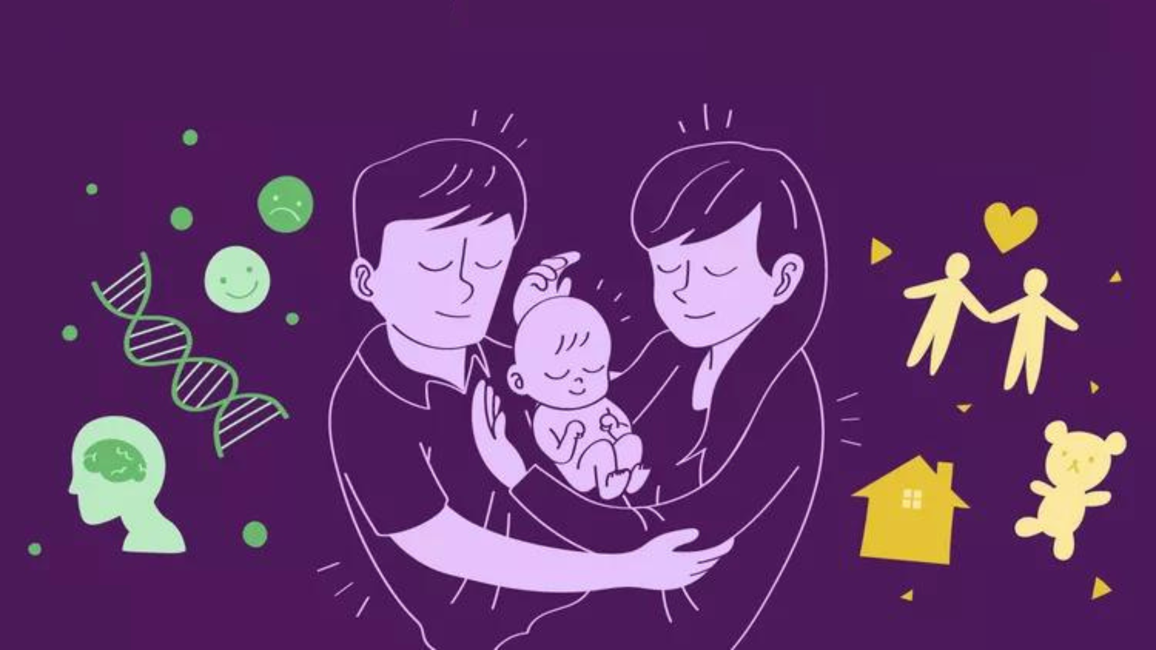
Nature and Nurture
Nurture
Caregiver relationships
Communication opportunities
Experiences/interactions
Nursery environment
Nature
Biological development
Individual differences
Possible developmental factors
Temperament
https://kamakhyaa.com/cdn/shop/articles/KFTS_Blog_Background_image_7.png?v=1771590308&width=1920
(Groh et al.,2017;Shah et al.,2022)

Slide 8
Supporting Shona in Nursery
Communication:
Responsive conversation and modelling
Consistency:
Key person and predictable routines
Partnership:
Working as a team alongside Shonas carers
Emotional support:
Comfort and reassurance
Play:
Small groups, activities led by children
Sensitive transitions:
Calm, consistent goodbye routines
NHS,2026;Donnelly et al.,2021)

Slide 9
Critical Evaluation of theory
Strengths:
Helps understand distress caused by separation
Highlights importance of relationships
Relevant to the well being of young children
Supports emotionally responsive practice.
Limitations:
Doesn’t cover all aspects of developmental behaviour and attachment research has developed considerably
Individuals' development can differ to other due to personal circumstances and experiences
Attachment classifications should be interpreted instead of being applied universally to all.
(Zeanah et al.,2011)

Slide 10

Conclusion
Consistent + responsive = individualised support
Bowlby's theory helps us understand:
Emotional security
Importance of relationships
Secure base behaviour
Separation
Cannot fully explain Shonas limited verbal communication of difficulty with group play
(Bowlby,1969, Zeanah et al.,2011)
https://www.shutterstock.com/image-vector/cartoon-portrait-young-mother-holding-260nw-2722676217.jpg
Understand the behaviour before responding to it

Slide 11
References
- Ainsworth, M.D.S., Blehar, M.C., Waters, E. and Wall, S. (1978) Patterns of attachment: A psychological study of the strange situation. Hillsdale, NJ: Lawrence Erlbaum Associates.
- Bowlby, J. (1969) Attachment and loss: Vol. 1. Attachment. London: Hogarth Press.
- Bowlby, J. (1982) ‘Attachment and loss: Retrospect and prospect’, American Journal of Orthopsychiatry, 52(4), pp. 664–678. doi:10.1111/j.1939-0025.1982.tb01456.x.
- Bowlby, J. (1988) A secure base: Parent-child attachment and healthy human development. London: Routledge.
Bretherton, I. and Munholland, K.A. (2008) ‘Internal working models in attachment relationships: Elaborating a central construct in attachment theory’, in Cassidy, J. and Shaver, P.R. (eds.) Handbook of attachment: Theory, research, and clinical applications. 2nd edn. New York: Guilford Press, pp. 102–127.
Bruner, J.S. and Watson, R. (1983) Child’s talk: Learning to use language. New York: W.W. Norton.

Slide 12
- Donnelly, S. and Kidd, E. (2021) ‘The longitudinal relationship between conversational turn-taking and vocabulary growth in early language development’, Child Development, 92(2), pp. 609–625. doi:10.1111/cdev.13511.
- Groh, A.M., Narayan, A.J., Bakermans-Kranenburg, M.J., Roisman, G.I., Vaughn, B.E., Fearon, R.M.P. and van IJzendoorn, M.H. (2017) ‘Attachment and temperament in the early life course: A meta-analytic review’, Child Development, 88(3), pp. 770–795. doi:10.1111/cdev.12677.
- National Health Service (2026) Separation anxiety. Available at: https://www.nhs.uk/baby/babys-development/behaviour/separation-anxiety/ (Accessed: 8 October 2026).
- Shah, S., Laplante, D., Atkinson, L. and Wazana, A. (2022) ‘From temperament and parenting to attachment: A review of the interplay of gene and environment factors in the developmental pathway to attachment’, Current Opinion in Psychiatry, 35(6), pp. 401–408. doi:10.1097/YCO.0000000000000817.
- Zeanah, C.H., Berlin, L.J. and Boris, N.W. (2011) ‘Practitioner review: Clinical applications of attachment theory and research for infants and young children’, Journal of Child Psychology and Psychiatry, 52(8), pp. 819–833. doi:10.1111/j.1469-7610.2011.02399.x.

