Slide 1

Independent Project
Conclusion Chapter

Slide 2
What is a conclusion?
A conclusion is the final chapter of your dissertation which draws together all of the work you have done and summarises key findings and recommendations.
This is the last thing someone will read of your work, so you want to include everything you want them to take away from your research.

Slide 3

What to include in a conclusion?
Answer your research question
  Make sure you identify the research aims and objectives from the introduction of your work and say exactly how your research has answered them. State your research aims and objectives clearly, and then go through one by one and explain how you have researched them and what you have found.
  Make sure you remember to include references here to the literature that you have discussed in your literature review chapter; linking back between your findings and the existing literature helps to show if you are confirming what has been found before, or challenging it with new information specific to your research context.

Slide 4
What to include in a conclusion?
Summarise and Reflect on your research
  Remind the reader of the key methodological decisions you have made and why they were relevant to the questions you were answering.
  Explore what challenges were faced in the research (limitations) and discuss how future research may improve or expand on your methods and scope.

Slide 5
What to include in a conclusion?
Make Recommendations
  Your research should have clear implications on how the problem you have discussed can be dealt with in the future. Your recommendations could be based on public policy, policing or additional research which could expand on what you have found.
  If you are making recommendations on further research, make these recommendations positive and constructive, rather than focusing on the shortcomings of your own. E.g. future research could expand to evaluate the same topic in another area, or with another sample, to see if your research findings can be replicated in another context.

Slide 6
What to include in a conclusion?
Explain your contribution to the field you are researching.
  Link back to your overall research objective – How has your research solved the problem you were interested in the first place?
  Restate the gaps in the literature you identified in your literature review chapter – What did your lit review tell you that people don’t know about your area, and has your work contributed to addressing that?
  Explain how your work has addressed a key theory behind your work – Has your research confirmed a previous theory, or have you found a new perspective on your problem area/topic?

Slide 7
What to include in a conclusion?
Finishing statement:
Report your key findings in context and summarise what you think is important about your research.

Slide 8
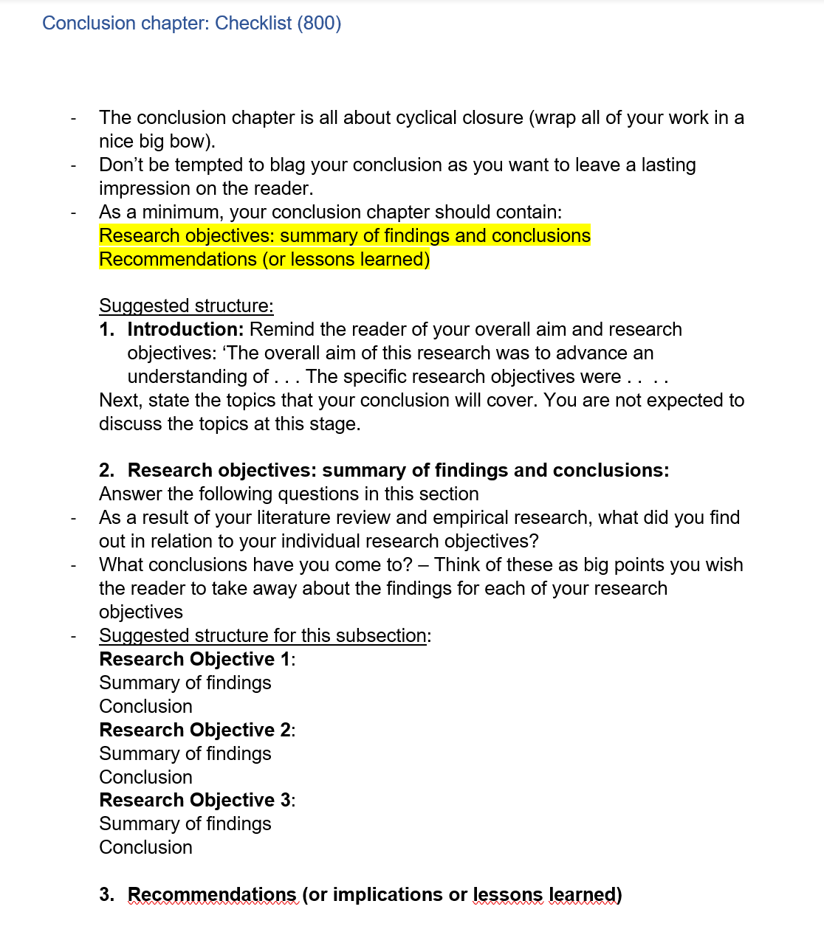

Checklist

Slide 9
Things to remember
This is a conclusion, the end of your work. You should not be introducing new ideas, theories or perspectives at this point, only summing up and explaining what you have found.
01
You absolutely can and should link back to references from previous chapters, but there should be no new references here.
If there have been challenges in your research, address them here in detail.
02
Being clear about the limitations and challenges you have faced show that you are aware and critical of your work. This is the time to evaluate what you have done and show that you know where things could be improved
When making your recommendations, make sure they are linked to what has come before
03
Your recommendations should be informed by your research findings. If you cannot point to something you have found in your research to justify what thing you are recommending, you shouldn’t be using it.

Slide 10
What to do next?
Go back to your introduction and re-read and edit.
Write your abstract.
Add cover page, contents page, declaration and acknowledgements
Proof read your assignment
Check your referencing and bibliography
Notes:
Go back to your introduction and re-read and edit.
Your introduction should introduce and summarise each of your chapters, and should reflect your conclusion in the key points it sets up.
Write your abstract.
Your abstract should be a short (150-200 word) paragraph summarising your whole dissertation. It should briefly cover your research aim, main methodology and key findings.
3. . Add declaration and acknowledgements
Proof read your assignment
Read it over and over, aloud if possible. This will help you spot issues you have had and structural or grammar problems that have slipped through as you are writing. There will always be some with a piece of work this big, so do your best to spot them early
Check your referencing and bibliography
Every reference throughout your work should have a name and date and should be full and included in the bibliography. Check it is all in line with Harvard Referencing formatting.

Slide 11
Remaining sessions
WEEK COMMENCING | Content
11-Mar | Individual supervision
18-Mar | EMPLOYABILITY WEEK
22-Mar | SUBMIT ANALYSIS
25-Mar | EASTER BREAK
15-Apr | Individual supervision
19-Apr | SUBMIT CONCLUSION
22-Apr | Individual supervision slots available
29-Apr | Individual supervision slots available
07-May | FINAL SUBMISSION

Slide 12

Any Questions?

