Slide 1
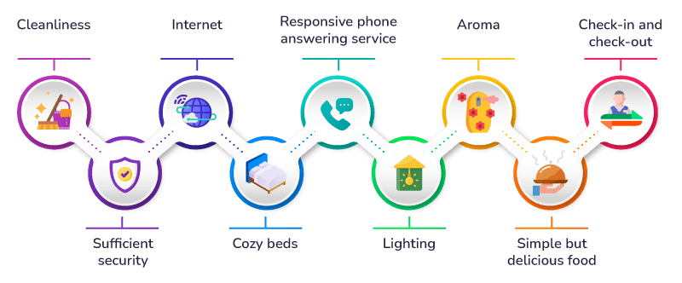
BMIH4006
Operating Hotel Facilities
AS3
Room Cleaning Checklist Training

Slide 2
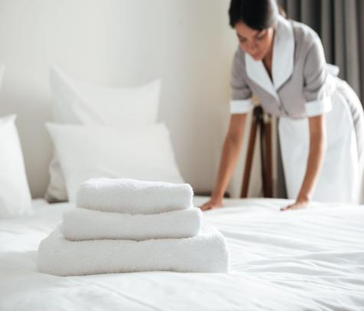
Introduction
This presentation focuses on developing a training module for the team members while linking an employee engagement model. Combining procedural compliance with an employee engagement strategy improves team performance, brand standards, and health and safety. The goal is to instil a culture of excellence in the team that goes beyond everyday chores (Zhang et al., 2021).
Notes:
Introduction
This presentation focuses on developing a training module for the team members while linking an employee engagement model. Combining procedural compliance with an employee engagement strategy improves team performance, brand standards, and health and safety. The goal is to instil a culture of excellence in the team that goes beyond everyday chores (Zhang et al., 2021). The presentation will focus on using pitching skills with the chosen employee engagement approach to improve standards and offer excellent visitor experiences. This initial presentation emphasises health and safety in the room cleaning in line with the designated hotel. During the next ten minutes, the audience will discover how these aspects work together to create a harmonious balance of efficiency, brand integrity, and staff pleasure (Wang et al., 2019).

Slide 3
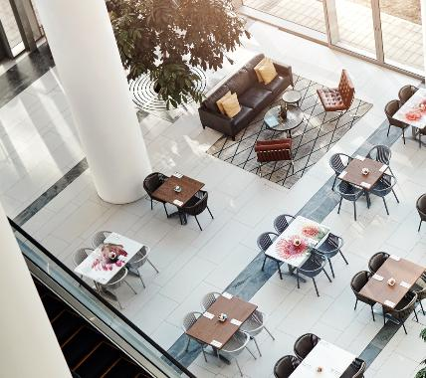
Agenda: Overview and Objectives
Objectives
The primary goal of this training session is to provide comprehensive instruction on room cleaning practices.
The Agenda
Dust and the Finishing Touches (Wang et al., 2019)
Enlightening and Revitalising
The Management and Organisation of Cobwebs (Ihsan & Alshaibani, 2018)
Outstanding Performance in Floor Care
Notes:
Agenda: Overview and Objectives
Objectives
The primary goal of this training session is to provide comprehensive instruction on room cleaning practices.
The Agenda
Dust and the Finishing Touches: Everything, from the bookcases to the furniture, should be dusted. As part of a full dusting strategy, pay attention to the window ledges, blinds, and baseboards (Wang et al., 2019).
Enlightening and Revitalising: The atmosphere of the space can be improved by dusting the lamps, light fixtures, and ceiling fans. A welcome and well-polished appearance can be achieved by wiping down doors and doorframes.
The Management and Organisation of Cobwebs: Ensure that every nook and cranny, including the ones that are hard to reach, has been thoroughly cleaned of cobwebs. Cleaning out the shoe closet will encourage organisation and add to the aesthetic attractiveness of the space (Ihsan & Alshaibani, 2018).
Outstanding Performance in Floor Care: Utilising efficient methods, hoover all of the floors, carpets and rugs, as well as the stairs. To attain results that are immaculate and free of allergens, rigorous floor maintenance must be implemented.

Slide 4
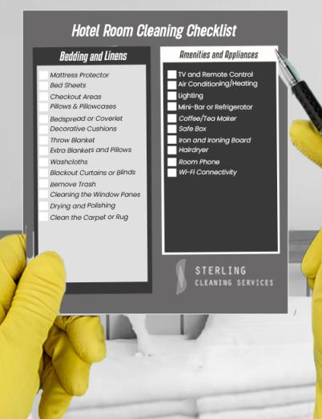
A Breakdown of the Key Cleaning Areas
Employee Engagement Impact
Disengaged employees are less likely to meet expectations, while engaged workers are more likely to do so (Zhang et al., 2021).
Greater Applicability
The Harvard Business Review found that organisations with stronger staff involvement have 48% fewer safety mishaps and 41% fewer patient safety events (Nikolskaya et al., 2019).
Surfaces: Wipe and Sanitize (Sun & Bunchapattanasakda, 2019).
Floor Cleaning
Clean and Restock Amenities (Mohsin et al., 2023)
High-Priority Zones
Notes:
A Breakdown of the Key Cleaning Areas
Employee Engagement Impact
Disengaged employees are less likely to meet expectations, while engaged workers are more likely to do so. They improve job performance and boost careers with their proactive attitude (Zhang et al., 2021).
Greater Applicability
This knowledge benefits healthcare and industrial companies as well as ours. The Harvard Business Review found that organisations with stronger staff involvement have 48% fewer safety mishaps and 41% fewer patient safety events (Nikolskaya et al., 2019).
Surfaces: Wipe and Sanitize: - Thoroughly wipe and sanitise surfaces for a hygienic workplace (Sun & Bunchapattanasakda, 2019).
Floor Cleaning: - To maintain a clean and safe environment, it is important to perform thorough floor cleaning, such as sweeping, mopping, and vacuuming.
Clean and Restock Amenities: - Enhance guest experience by ensuring clean and well-stocked amenities (Mohsin et al., 2023).
High-Priority Zones: - Prioritise vital areas for precise attention, maximising impact.

Slide 5
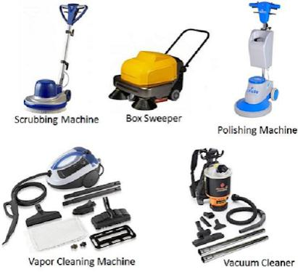
Essential Tools and Materials
It is vital to equip the workers with the appropriate tools and materials to empower the team and align the people and their activities with the ideas underlying employee engagement (Were & Maranga, 2022).
Cleaning Supplies
Microfiber Sponges and Cloths (Motyka, 2018)
A Hoover and Mop
Restocking Supplies (Mohsin et al., 2023)
Personal Protection Equipment
Notes:
Essential Tools and Materials
It is vital to equip the workers with the appropriate tools and materials to empower the team and align the people and their activities with the ideas underlying employee engagement (Were & Maranga, 2022). The following is a rundown of the requirements:
Cleaning Supplies: Using proper cleaning agents for sanitation and hygiene.
Microfiber Sponges and Cloths: For effective surface cleaning, provide the crew with high-quality microfiber towels and sponges (Motyka, 2018).
A Hoover and Mop: Providing reliable vacuums and mops for thorough floor care.
Restocking Supplies: Emphasising hygiene and client happiness by providing regular amenities (Mohsin et al., 2023).
Personal Protection Equipment: Providing gloves and masks to ensure safety.

Slide 6
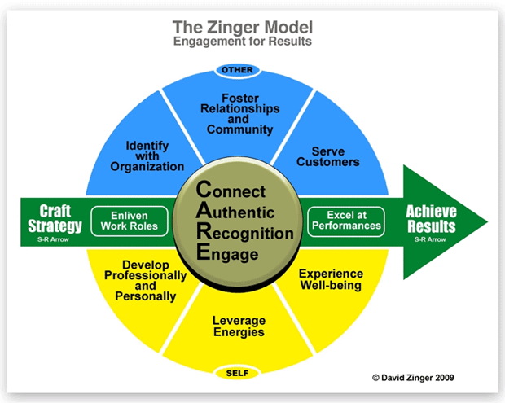
Employee Engagement Model
The Zinger Model
The Zinger Model explains the main characteristics that lead to engaged people and a high-performing organisation (Zhang et al., 2021).
Linking the Zinger Model with Facilities Management
Hotel facilities management teams can improve employee engagement and achieve organisational success by clearly communicating goals and objectives, involving team members in decision-making, cultivating a positive work environment, providing regular feedback and recognition, and empowering employees to take ownership of their work (Amos et al., 2019).
Notes:
Employee Engagement Model
The Zinger Model
The Zinger Model explains the main characteristics that lead to engaged people and a high-performing organisation. Five fundamental elements—Achieve Results, Craft Strategy, Connect, Authentic, and Recognition—form the paradigm. Companies may boost employee engagement and productivity by concentrating on these factors (Zhang et al., 2021).
Linking the Zinger Model with Hotel Facilities Management
Hotel facilities management teams can improve employee engagement and achieve organisational success by clearly communicating goals and objectives, involving team members in decision-making, cultivating a positive work environment, providing regular feedback and recognition, and empowering employees to take ownership of their work. This, in turn, results in greater experiences for hotel guests, increased levels of customer satisfaction, and eventually, improved financial performance for the hotel (Amos et al., 2019).

Slide 7
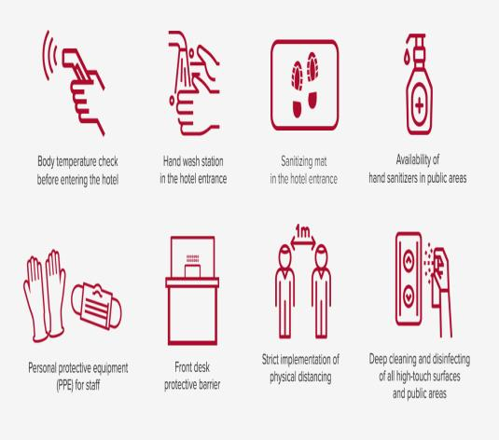
Safety Measures Emphasized
Prioritizing Employee Safety
Hotel facilities management must implement and enforce safety measures to protect guests and staff (Wang et al., 2019).
Essential Safety Measures
PPE (Hayes et al., 2017)
Social Distancing
Improved Ventilation (Oliveira et al., 2020)
Thorough Cleaning & Disinfection
Comprehensive Training (Ihsan & Alshaibani, 2018)
Notes:
Safety Measures Emphasized
Prioritizing Employee Safety
In any company, employee safety is vital. Keeping workers safe and healthy boosts productivity and corporate success. Hotel facilities management must implement and enforce safety measures to protect guests and staff (Wang et al., 2019).
Essential Safety Measures
These steps should be taken by hotel facilities management to ensure staff safety:
PPE: Provide and demand masks, gloves, and sanitizers to reduce exposure to dangerous materials and infectious diseases (Hayes et al., 2017).
Social distancing: In common areas and team interactions, follow social distancing principles to limit airborne infections and maintain a safe distance.
Improved Ventilation: Ventilate guest rooms, staff areas, and public spaces to increase air circulation and reduce airborne contaminants (Oliveira et al., 2020).
Thorough Cleaning & Disinfection: Clean and disinfect all work areas, guest rooms, and communal spaces to eliminate dangers and prevent pathogens.
Comprehensive Training: Train all staff in hazard identification, risk assessment, hazardous material handling, emergency procedures, and PPE use (Ihsan & Alshaibani, 2018).

Slide 8

The Common Challenges and the Preferred Solutions
Hotel Facilities Management Challenges
Hotel facilities management must balance employee morale, productivity, facility management, and guest satisfaction (Nikolskaya et al., 2019).
Solutions to Hotel Facilities Management Issues
Comprehensive preventative maintenance and regular inspections reduce facility issues. Personalised experiences, excellent customer service, and feedback mechanisms boost guest happiness (Sun & Bunchapattanasakda, 2019).
Notes:
The Common Challenges and the Preferred Solutions
Hotel Facilities Management Challenges
Hotel facilities management must balance employee morale, productivity, facility management, and guest satisfaction. As hotels optimise resource allocation and cut costs, cost management is another difficulty (Nikolskaya et al., 2019).
Solutions to Hotel Facilities Management Issues
Hotel facilities management might use several methods to address these issues. Employee recognition and rewards boost morale, while clear performance objectives and regular feedback boost productivity. Comprehensive preventative maintenance and regular inspections reduce facility issues. Personalised experiences, excellent customer service, and feedback mechanisms boost guest happiness. Costs are managed by budgeting, vendor negotiation, energy efficiency, and staffing optimisation (Sun & Bunchapattanasakda, 2019).

Slide 9

Conclusion
The efficient running, guest pleasure, and prosperity of a hotel depend on effective facilities management. Hotels may improve employee morale, facility management, and guest satisfaction by addressing common issues and adopting solutions.
Hotel facilities management should prioritise employee engagement and motivation, streamline work processes, execute preventive maintenance programmes, acquire and act on guest feedback, and manage costs to achieve these aims (Were & Maranga, 2022).
Notes:
Conclusion
The efficient running, guest pleasure, and prosperity of a hotel depend on effective facilities management. Hotels may improve employee morale, facility management, and guest satisfaction by addressing common issues and adopting solutions. Hotel facilities management should prioritise employee engagement and motivation, streamline work processes, execute preventive maintenance programmes, acquire and act on guest feedback, and manage costs to achieve these aims (Were & Maranga, 2022). These ideas can help hotels improve their facilities management, boosting their success and competitiveness. As technology, industry trends, and guest tastes change, hotel facilities management must adapt and be proactive. Hotels can maintain their facilities, surpass visitor expectations, and keep their personnel engaged, productive, and proud by regularly analysing and refining their methods (Motyka, 2018).

Slide 10
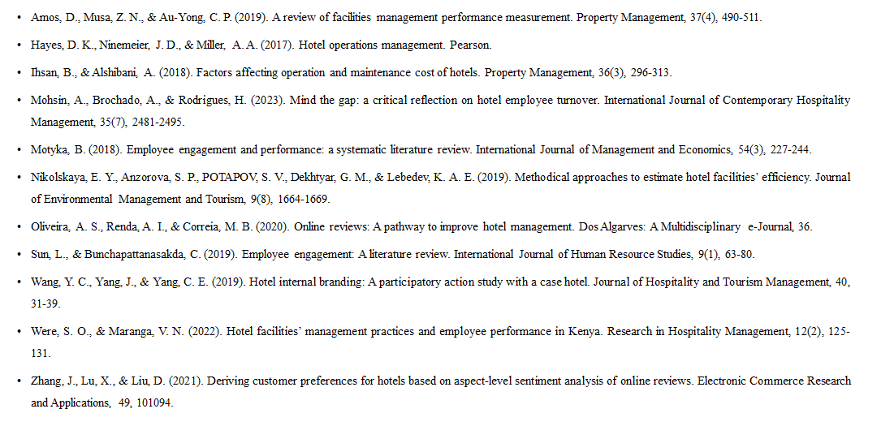
References
Notes:
References
Amos, D., Musa, Z. N., & Au-Yong, C. P. (2019). A review of facilities management performance measurement. Property Management, 37(4), 490-511.
Hayes, D. K., Ninemeier, J. D., & Miller, A. A. (2017). Hotel operations management. Pearson.
Ihsan, B., & Alshibani, A. (2018). Factors affecting operation and maintenance cost of hotels. Property Management, 36(3), 296-313.
Mohsin, A., Brochado, A., & Rodrigues, H. (2023). Mind the gap: a critical reflection on hotel employee turnover. International Journal of Contemporary Hospitality Management, 35(7), 2481-2495.
Motyka, B. (2018). Employee engagement and performance: a systematic literature review. International Journal of Management and Economics, 54(3), 227-244.
Nikolskaya, E. Y., Anzorova, S. P., POTAPOV, S. V., Dekhtyar, G. M., & Lebedev, K. A. E. (2019). Methodical approaches to estimate hotel facilities’ efficiency. Journal of Environmental Management and Tourism, 9(8), 1664-1669.
Oliveira, A. S., Renda, A. I., & Correia, M. B. (2020). Online reviews: A pathway to improve hotel management. Dos Algarves: A Multidisciplinary e-Journal, 36.
Sun, L., & Bunchapattanasakda, C. (2019). Employee engagement: A literature review. International Journal of Human Resource Studies, 9(1), 63-80.
Wang, Y. C., Yang, J., & Yang, C. E. (2019). Hotel internal branding: A participatory action study with a case hotel. Journal of Hospitality and Tourism Management, 40, 31-39.
Were, S. O., & Maranga, V. N. (2022). Hotel facilities’ management practices and employee performance in Kenya. Research in Hospitality Management, 12(2), 125-131.
Zhang, J., Lu, X., & Liu, D. (2021). Deriving customer preferences for hotels based on aspect-level sentiment analysis of online reviews. Electronic Commerce Research and Applications, 49, 101094.

