Slide 1
Bulimia nervosa
Component one. Poster
Student name: Alexandra Corfa
Student number: 2321699
Module code: BMHP6029
Module name: Psychopathological Classifications and Provisions
Lecture name: Kennedy Obohwemu

Slide 2
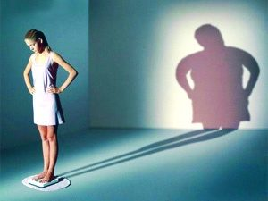

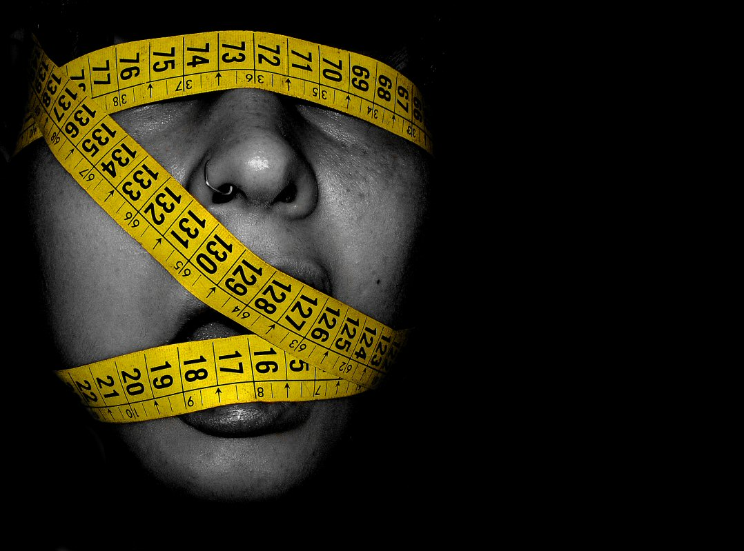

Bulimia Nervosa :
Historical evolution, contemporary treatment and social context
Introduction
Bulimia nervosa is a serious eating disorder characterised by cycles of binge eating follow by behaviours such as self-induce vomiting or excessive exercise to prevent weight gain. The condition affects both physical and mental health and is influences by psychological, biological, and social factors. Understanding its historical development, modern treatment approaches, and social context is essential for improving awareness and supporting effective care.(Russell, 1997).
2. Historical context
Early description
19t century medical texts linked disordered eating to hysteria
1979-Gerald Russell formally described Bulimia Nervosa (Russell, 1997).
Treatment approaches(past)
institutionalisation
Moral framing and behaviour control
Limited psychological formulation
Critical analysis
Gender bias influenced diagnosis
Western thin ideal shaped clinical interpretation
Focus on induvial pathology ignored social context (NICE,2017)
Eating disorders are influenced by genetic, psychological and environmental factors (Bulik, 2020)
4.Contemporary understanding
Biopsychosocial model
Genetic predisposition
Trauma and adverse experiences
Emotional regulation difficulties. (Maine et. Al. 2015)
Evidence based treatment
CBT-ED first-line treatment(NICE)
Antidepressants in some cases
Multidisciplinary approach (Hay, 1996)
Shift from past
Move from institutional control to collaborative , recovery-oriented care (Mott, 2019)
3.Social, Cultural and Political Influences
Sociocultural Factors
Media promotion of thin ideal ( Bordo, 1993)
Diet cultural and weight stigma
Social media comparison
Gendered body expectations
Inequality and access
Underdiagnosed in males
Under-recognised in ethic minorities
Barriers to specialist services
Long waiting times for specialist eating disorder services.(WHO, 2022)
8.Concusion
Bulimia nervosa reflects the interaction between individual vulnerability and socio-cultural pressure. Although treatment has evolved significantly , stigma inequality and systemic barriers remain. Future policy must prioritise prevention, early intervention and equitable access.
5. Stigma and discrimination
Misconception that eating disorders reflet vanity or lack of self-control.
Shame delaying help-seeking
Funding disparities compared to other mental disorder
6.Policy and classification
ICD-11 classification
NICE eating disorder guidelines
Mental health Act use in severe cases
UK shift to community care model (NICE, 2017)
7. Recommendation
Early screening in school
Increased NHS funding foe eating disorder services
Public heath campaigns addressing weight stigma
Training for GPs in early detection

Slide 3
Reference list
Bordo, S. (1993) Unbearable Weight: Feminism, Western Culture and the Body. Berkeley: University of California Press.
Bulik, C. (2020) Eating disorders. Oxford: Oxford University Press
Fairburn, C. (2008) Cognitive Behaviour Therapy and Eating Disorders. New York: Guilford Press
Gradl-Dietsch, G., Föcker, M. and Hebebrand, J., 2024. Eating Disorders in the ICD-11 and DSM-5. In Handbook of Eating Disorders and Obesity (pp. 15-25). Berlin, Heidelberg: Springer Berlin Heidelberg.
Hay, P.J. and Claudino, A.M., 2010. Bulimia nervosa. BMJ clinical evidence, 2010, p.1009.
Hay, P.P., Bacaltchuk, J., Stefano, S., Kashyap, P. and Cochrane Common Mental Disorders Group, 1996. Psychological treatments for bulimia nervosa and binging. Cochrane database of systematic reviews, 2009(4).
Maine, M. D., Samuels, K. L. and Tantillo, M. (2015) ‘Eating disorders in adult women: biopsychosocial, developmental, and clinical considerations’, Advances in Eating Disorders, 3(2), pp. 133–143. doi: 10.1080/21662630.2014.999103.
Mott, L.A. and Lumsden, B.D., 2019. Understanding eating disorders: Anorexia nervosa, bulimia nervosa and obesity. Taylor & Francis.
National Institute for Health and Care Excellence (2017) Eating disorders: recognition and treatment (NG69). London: NICE
Russell, G.F., 1997. The history of bulimia nervosa. Handbook of treatment for eating disorders, 2, pp.11-24.
Slade, E., Keeney, E., Mavranezouli, I., Dias, S., Fou, L., Stockton, S., Saxon, L., Waller, G., Turner, H., Serpell, L. and Fairburn, C.G., 2018. Treatments for bulimia nervosa: a network meta-analysis. Psychological medicine, 48(16), pp.2629-2636.
Walsh, B.T., Fairburn, C.G., Mickley, D., Sysko, R. and Parides, M.K., 2004. Treatment of bulimia nervosa in a primary care setting. American Journal of Psychiatry, 161(3), pp.556-561.
World Health Organization (2022) Mental health and eating disorders. Geneva: WHO.

