Slide 1
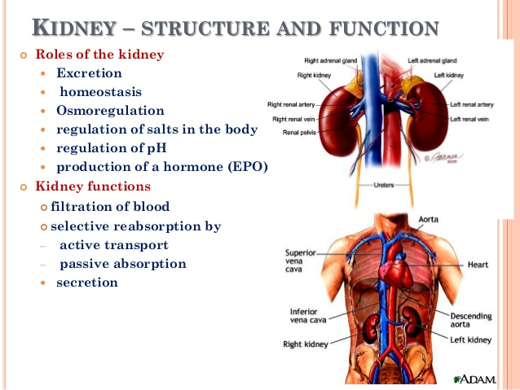

Slide 2
RENAL SYSTEM
EXCRETION
~ removal of toxic waste productions of metabolism from the body
WASTE
~ nitrogenous waste (urea & ammonia), CO₂, bile pigment

Slide 3
RENAL SYSTEM
OSMOREGULATION
~ the process maintaining constant osmotic equilibrium between the internal & external environment of an organism

Slide 4
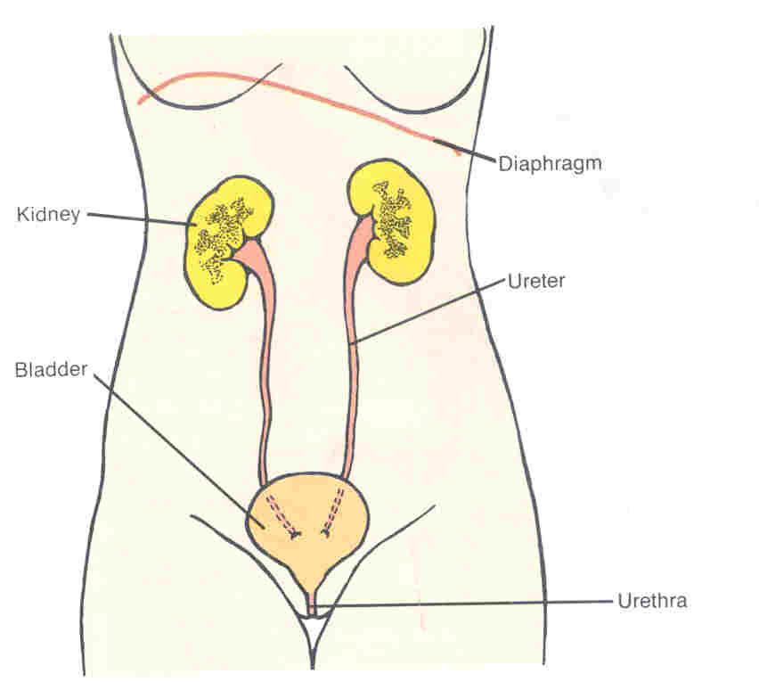
Diaphragm
Kidney
Ureter
Bladder
Urethra

Slide 5
Bladder
 muscular bag
 stores urine temporarily
 300 cm³ of urine  sensation of urination
 contraction of bladder + relaxation of sphincter muscle ⇨forces urine out

Slide 6
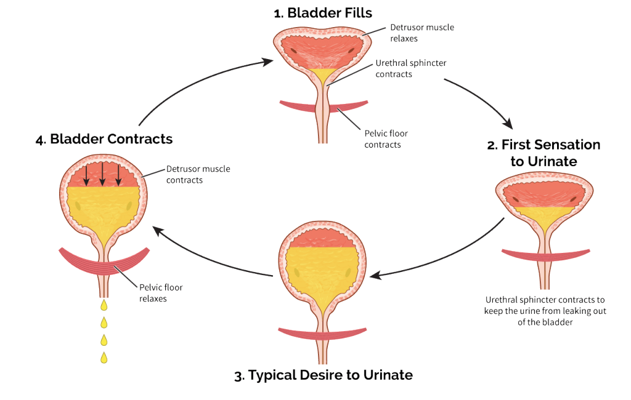

Slide 7
URETHRA
URETHRA
 muscular tube
 carries ONLY URINE in female
 carries URINE & SEMEN in male

Slide 8
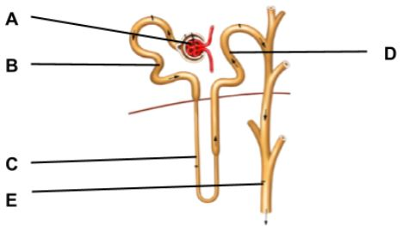

Slide 9
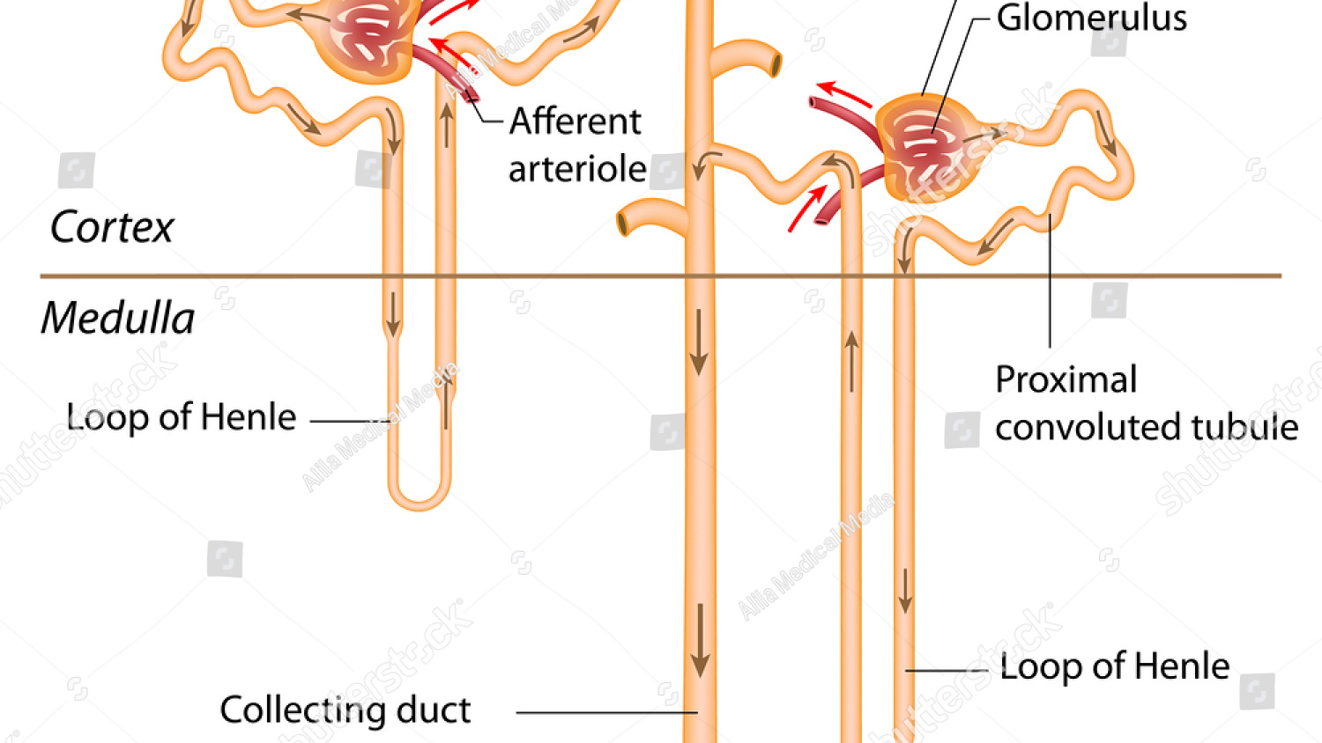

Slide 10
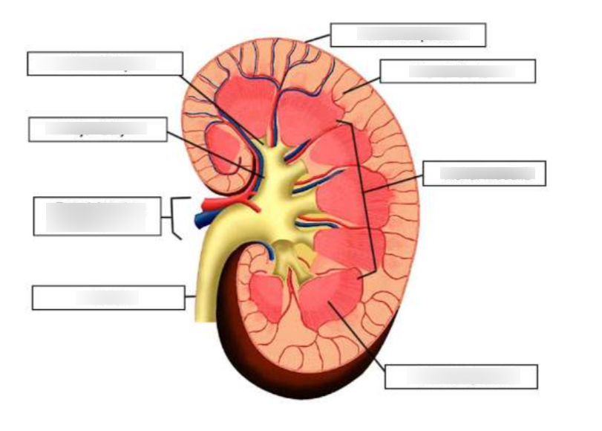

Slide 11
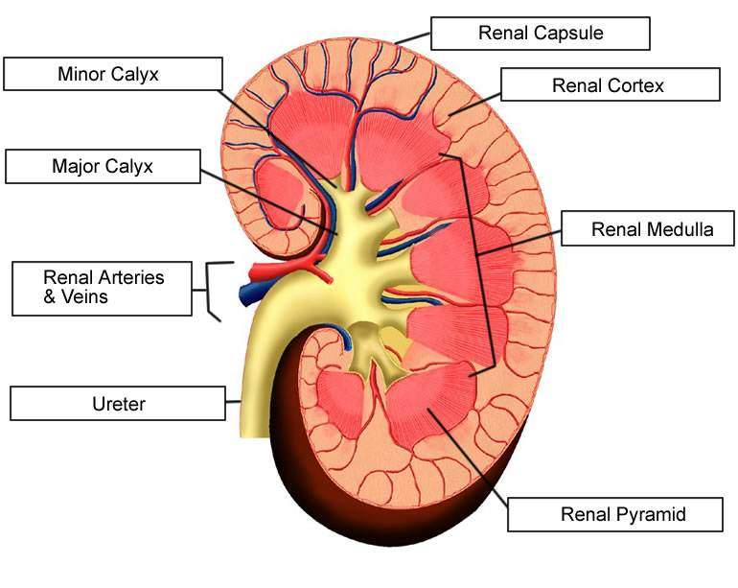

Slide 12
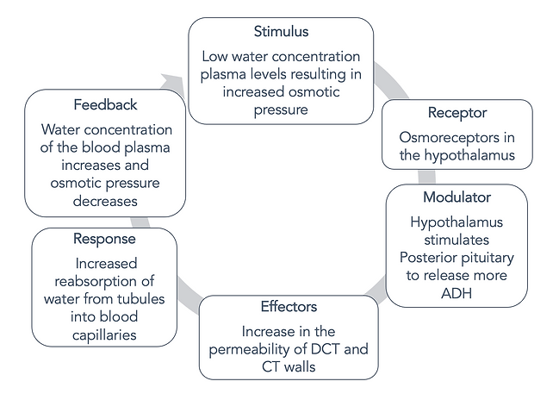

Slide 13
NEPHRON
☺ 1,000,000 nephrons / kidney
➢ structural & functional units
➢Cortical nephron
~ in cortex, short Loop of Henle, osmoregulation under NORMAL condition
➢ Juxtamedullary nephron
~ at junction of cortex & medulla, long Loop of Henle, osmoregulation when SHORT OF WATER

Slide 14
Nephron
➲ Glomerulus: knot of blood capillaries
➲ Bowman’s capsule
Proximal convoluted tubule
Descending limb of loop of Henle
Ascending limb of loop of Henle
Distal convoluted tubule
Collecting duct

Slide 15
Ultrafiltration
Glomerular filtrate: all substances in blood except RBCs & plasma protein
 Blood pressure:
Diameter of afferent arteriole > Diameter of efferent arteriole
 Glomerular filtrate rate
180l/ day
 Adaptation
large area, great pressure, thin ,membrane

Slide 16
Reabsorption
99% of the glomerular filtrate are reabsorbed
matter reabsorbed:
 all glucose, amino acid
 mineral salts
 other useful substances
➲ SELECTIVE REABSORPTION
Method of reabsorption
➢diffusion ➢ active transport

Slide 17
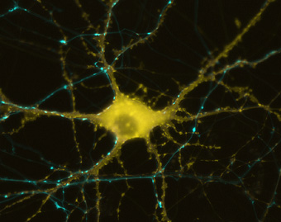
The Nervous System
Electrical
Communication

Slide 18
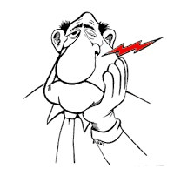
The Nervous System
Main Function:
This communication system controls and coordinates functions throughout the body and responds to internal and external stimuli.
Our nervous system allows us to feel pain.

Slide 19
The nervous system
The nervous system has two main parts: The central nervous system is made up of the brain and spinal cord. The peripheral nervous system is made up of nerves that branch off from the spinal cord and extend to all parts of the body. The nervous system transmits signals between the brain and the rest of the body, including internal organs.

Slide 20
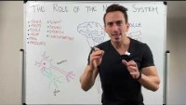
The Nervous System

Slide 21
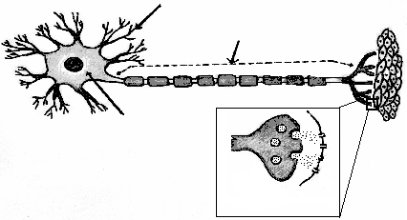
Impulse in a Neuron
dendrite
muscle tissue
Axon
cell body
cell
body
TYPICAL MOTOR NEURON
synapse

Slide 22
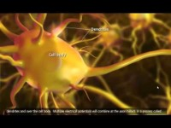
Impulse in a neuron

Slide 23
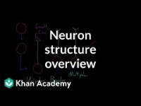
Please watch this video and draw a neuron along with the video

Slide 24
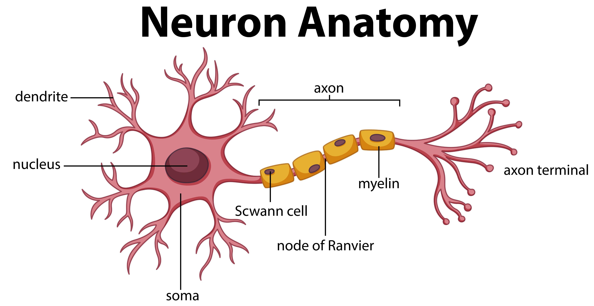

Slide 25
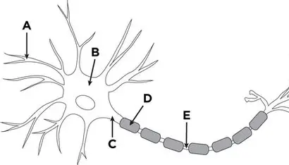

Slide 26
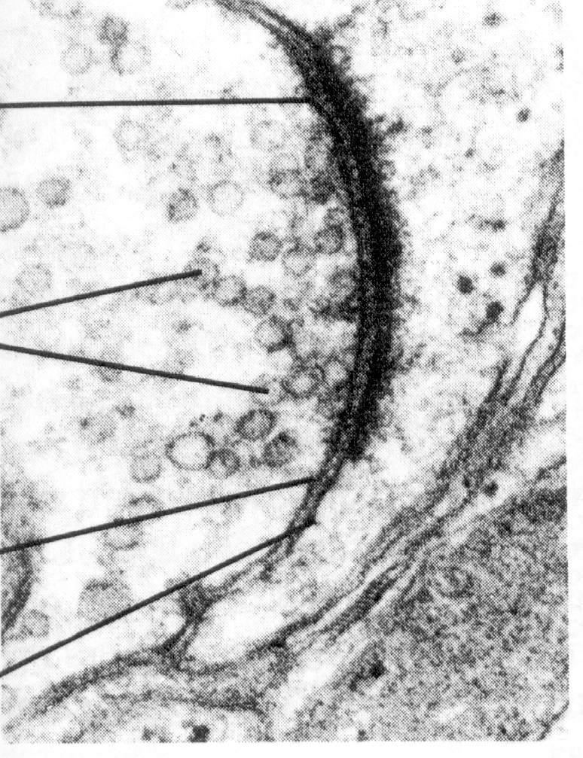
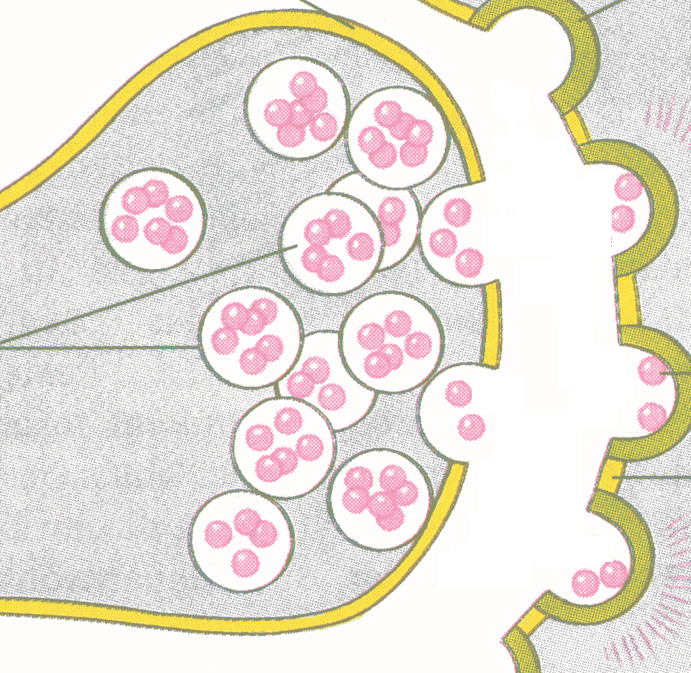

Because neurons never touch, chemical signalers called neurotransmitters must travel through the space called synapse between two neurons.
Neurotransmitters
(pink
spheres)
The message is transferred when RECEPTORS receive neurotrans-mitters.
Synapse (gap)

Slide 27
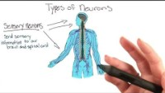
Types of neurons

Slide 28
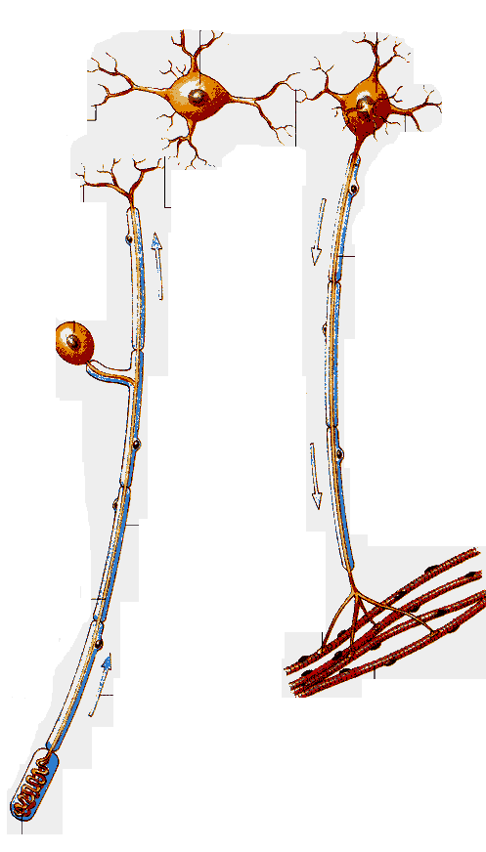
Types of Neurons
Sensory Neuron
Interneuron
Synapse
Synapse
Motor Neuron
Interneuron
Synapse
Motor Neuron
Muscle Contracts
Sensory Neuron

Slide 29
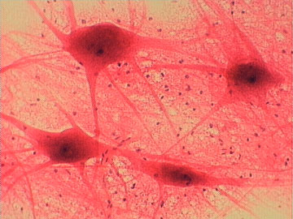
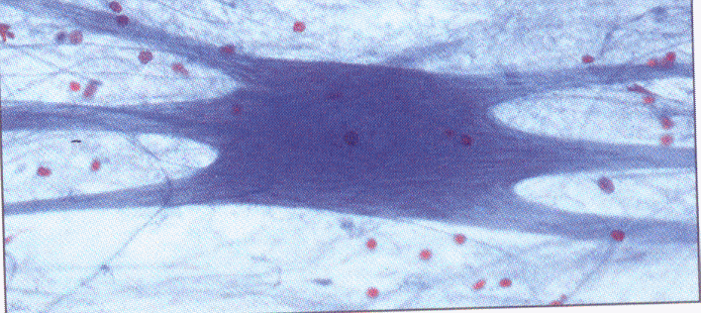
Interneuron
processes impulses in brain and spinal cord
- connect sensory and motor neurons

Slide 30
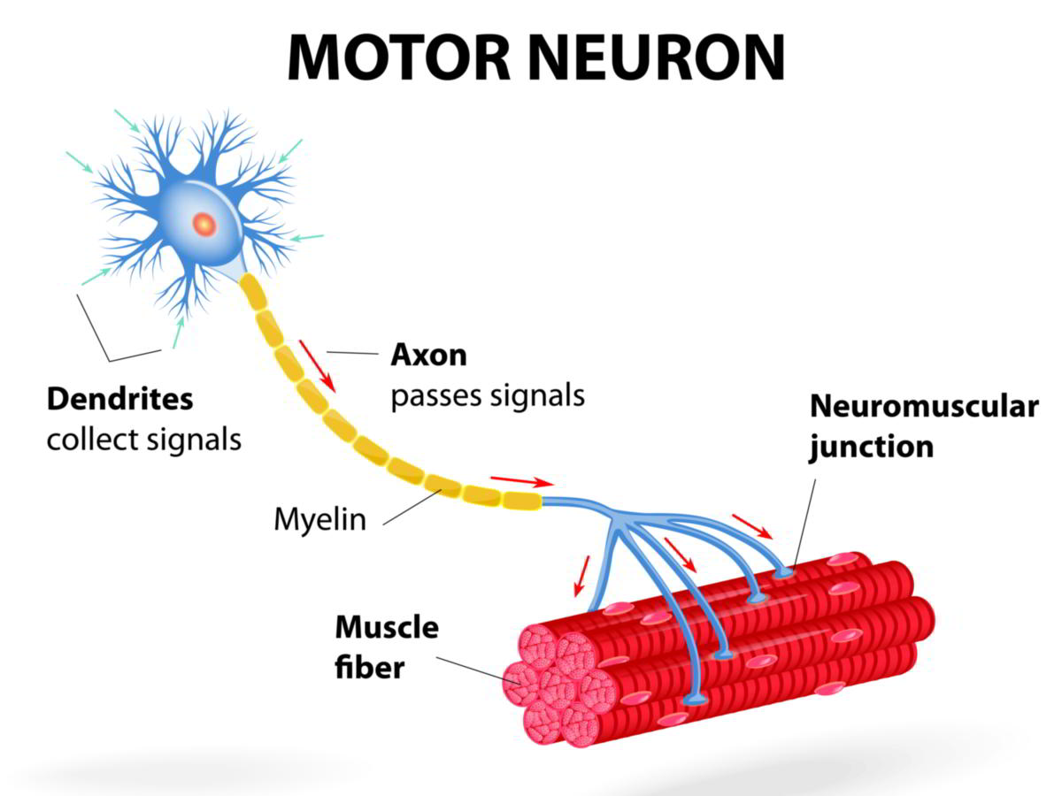
Motor neurons
A motor neuron is basically a nerve cell whose function is to respond to sensory stimulation by producing the required muscular movement. Motor neurons are located in the spinal cord, and their axon protrudes outside to the muscle fibers.

Slide 31
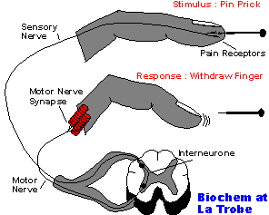
A reflex is an involuntary response that is processed in the spinal cord not the brain.
Reflexes protect the body before the brain knows what is going on.
Reflex Arc

Slide 32
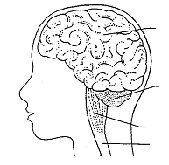
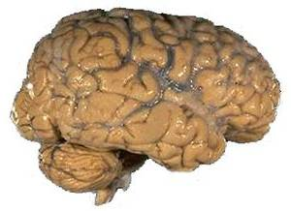
Cerebrum
brain
Cerebellum
Medulla Oblongata
Spinal Cord
Central Nervous System

Slide 33
Central Nervous System
Cerebrum | Voluntary or conscious activities of the body-learning, judgment
Cerebellum | Coordinates and balances the actions of the muscles
Medulla Oblongata (Brain Stem) | Controls involuntary actions like blood pressure, heart rate, breathing, and swallowing
Spinal Cord | The main communications link between the brain and the rest of the body

Slide 34
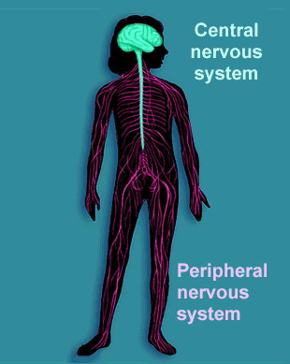
Peripheral Nervous System
Consists of: Sensory division and Motor division
-includes all sensory neurons, motor neurons, and sense organs

Slide 35
The layers
The epidermis is the outer layer.
2. The dermis is the middle layer.
3. The third layer is subcutaneous
fat.

Slide 36
Epidermis
The epidermis layer is the one that we can see and its always hard at work.
At the bottom of the epidermis new cells are forming. When the cells are ready they start moving to the top of your epidermis. As newer cells continue to move up, older cells die and rise to the surface of this organ.

Slide 37
Dermis
The next layer down is the dermis. This contains blood vessels, sweat glands, oil glands and nerve endings. It also contains collagen elastin, which are tough and stretchy.
These nerve endings tell how you things feel when you touch them, whether its the boiling oven, or the freezing fridge.

Slide 38
Last but not least its the layer of subcutaneous fat. This layer is essential to the body, without it we would be freezing cold and have no insulation. As well as keeping us warm it absorbs shocks, like if you bang into something or fall down.
Subcutaneous Fat

Slide 39
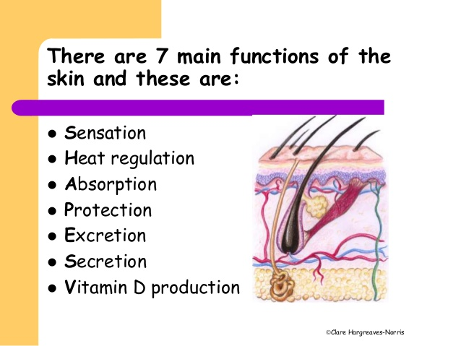

Slide 40
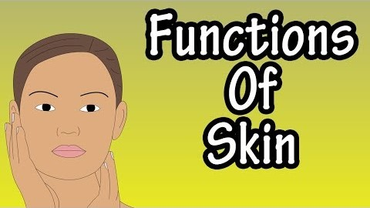
Functions of the skin

Slide 41
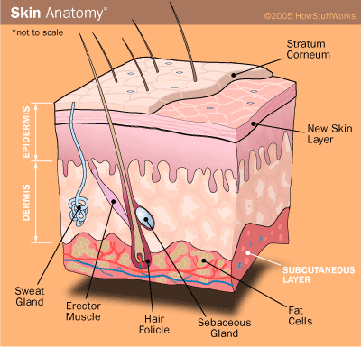

Slide 42
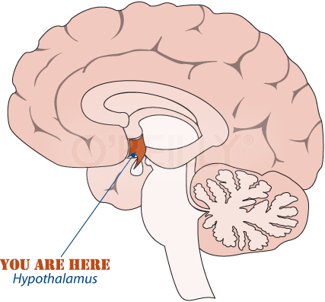
The hypothalamus is an important regulatory centre in the brain
The hypothalamus links the nervous system to the endocrine system
The hypothalamus controls hunger, important aspects of parenting and attachment behaviours, thirst, fatigue, sleep, circadian rhythms, and...
Hypothalamus
... body temperature

Slide 43
The thermoregulatory centre in the hypothalamus senses the temperature of the blood flowing through the hypothalamus
The hypothalamus also receives information via sensory neurones from heat receptors in the skin
If the core body temperature starts to rise the hypothalamus triggers responses which increase heat losses
Hypothalamus
If the core body temperature starts to fall the hypothalamus triggers responses which either reduce heat losses OR generate more heat

Slide 44
Vasoconstriction and Vasodilation
Heat is lost through the skin to the surrounding air
Smooth muscle in wall of arteriole contracts to control amount of blood flowing to capillaries
Capillaries close to surface of skin
Arteriole supplies blood to capillaries in skin
Shunt vessel

Slide 45
If body temperature rises this triggers...
VASODILATION
Rate of heat loss from body increases
Smooth muscle in wall of arteriole relaxes and arteriole dilates
More blood flows through capillaries close to surface of the skin
Less blood flows through the shunt vessel

Slide 46
If body temperature falls this triggers...
VASOCONSTRICTION
Rate of heat loss from body DECREASES
Smooth muscle in wall of arteriole contracts which constricts the lumen
Less blood flows close to surface of skin
More blood is shunted away from surface of skin

Slide 47
Pili Erection
(goosebumps)
Still layer of insulating air is trapped by hairs
As external temperature drops...
Hair
Follicle
Pili erector muscle
Pili erector muscles contract
Hairs stand upright
This reduces the rate of heat loss from the body

Slide 48
Sweating
This increases the rate of heat loss from the body
If core body temperature starts to rise...
Sweat gland
Water in sweat absorbs heat from body as it evaporates
Sweat is secreted onto surface of skin

Slide 49

Shivering
Muscles require energy to contract
This energy is supplied by respiration
During respiration some energy is always lost as heat energy
When we shiver, the muscles contract repeatedly...
... so the rate of respiration in the muscles increases, and...
... more heat is generated

Slide 50
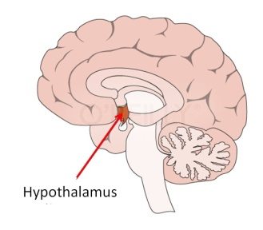
Change detected by hypothalamus
Vasodilation
Sweating
Triggers responses
Blood Temperature Rises
Temperature falls again
Normal Body Temperature 37˚C
Blood Temperature Falls
Temperature rises again
Triggers responses
Change detected by hypothalamus
Vasoconstriction
Goosebumps
Shivering

Slide 51
How to remember !
The Brain

Slide 52
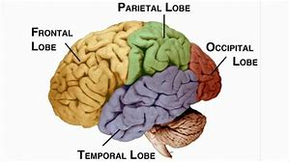
Lobes of the brain
Acronym to help remember the 4 lobes of the brain:
FTOP: Freud Tore his Pants Off

Slide 53
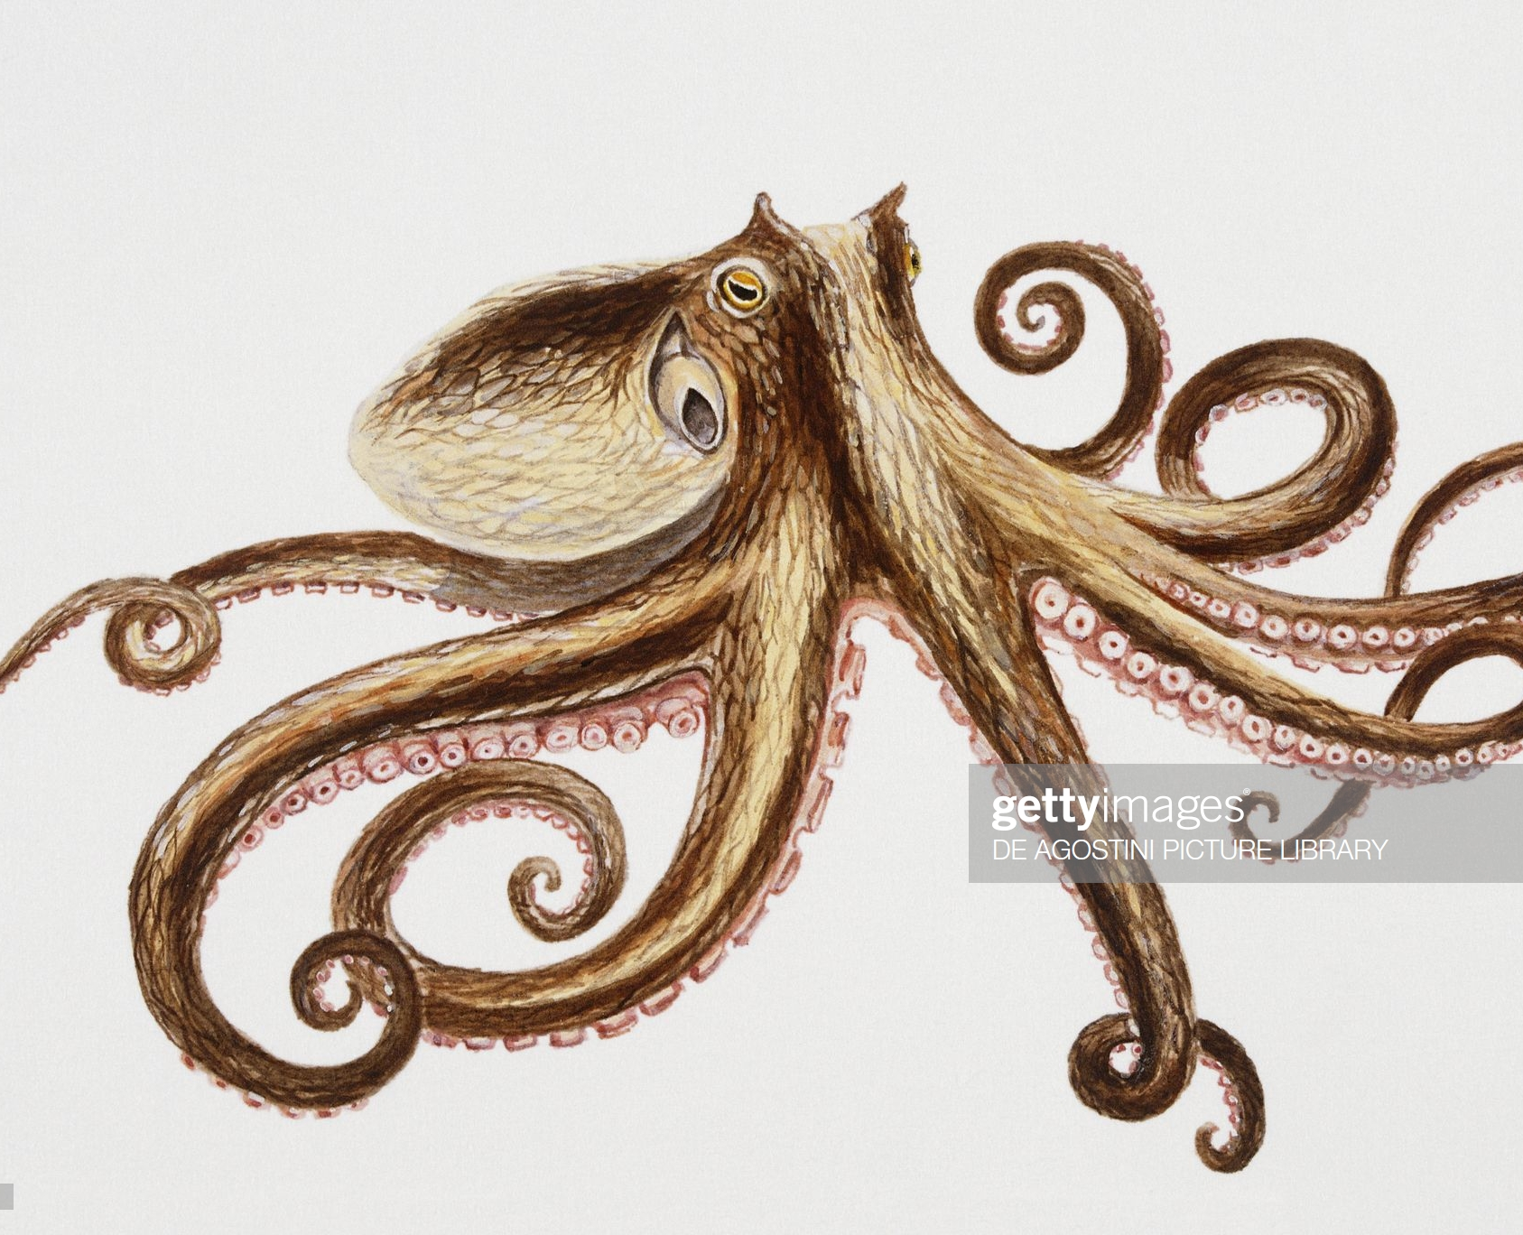
Occipital lobe
Occipital Lobe: Use the “Occ” part of the word Occipital and imagine an octopus. Since the occipital lobe processes visual information, picture eyeballs instead of suckers on the tentacles. Always good to make your image scary if you can.

Slide 54
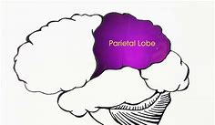
Parietal lobe
Parietal Lobe: processes sensory information. Use a “piranha” fish as your mnemonic. The piranha bites you on the top of the head (where the parietal lobe is located). That’s a sensation the parietal lobe would process.

Slide 55
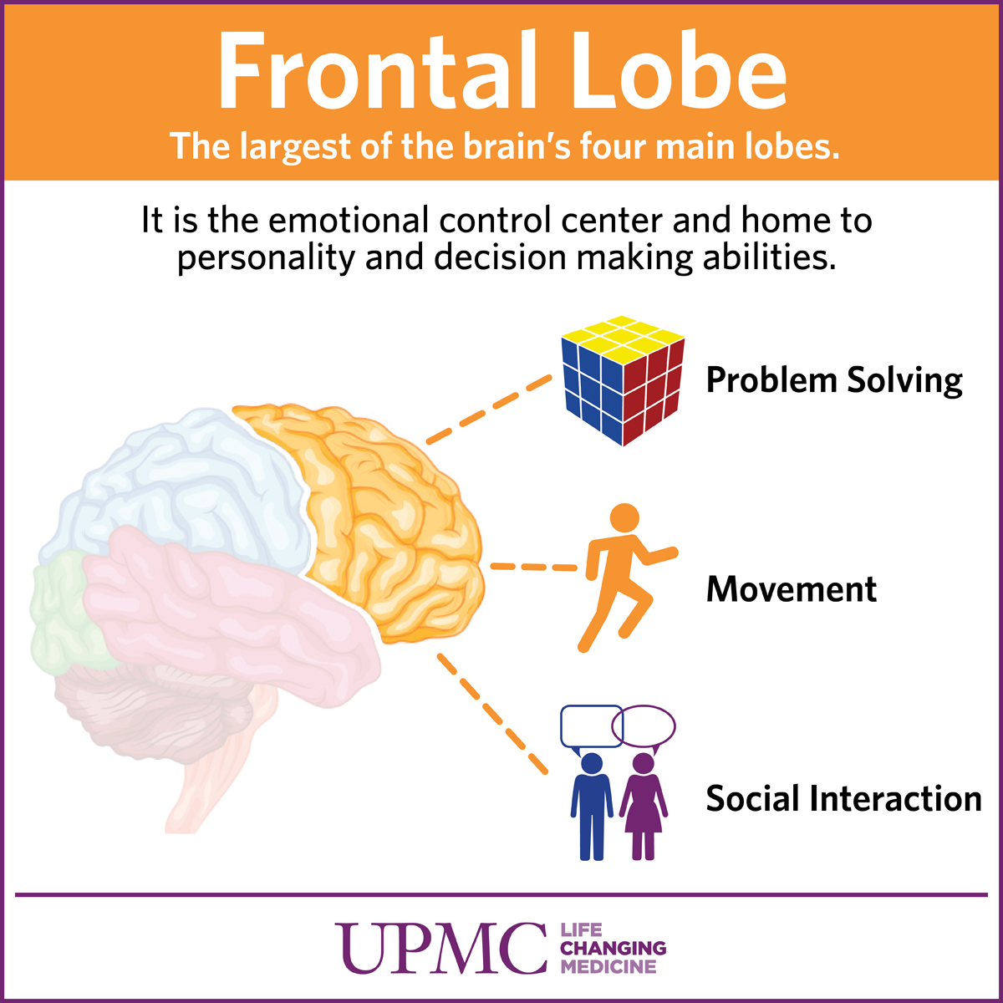
Frontal lobe
Frontal Lobe: the frontal lobe is where complex thinking occurs. Use “front door” as your mnemonic. Put the front door on your forehead and put Einstein (complex thinker) behind the door.

Slide 56
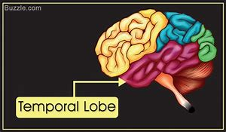
Temporal lobe
Temporal Lobe: the temporal lobe is where auditory processing occurs. Use “tempo” as your mnemonic and picture a metronome above your ear (where the temporal lobe is located).

Slide 57
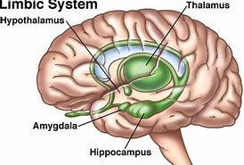
The Brain’s Limbic System
Acronym: “HATCH”
Hippocampus
Amygdala
Thalamus
Cerebellum
Hypothalamus

Slide 58

Hippocampus
Hippocampus: involved in memory. Use “hippo-compass”: picture a hippo who is lost and can’t remember how to get home, so he’s using a compass.

Slide 59
Amygdala
Amygdala: involved in your fear responses
Amygdala: if you’re familiar with attack planes, a “MIG” is a scary attack fighter jet.

Slide 60
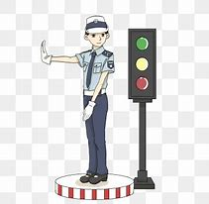

Thalamus
Thalamus: the thalamus relays information from the body to different areas of the brain for processing. Picture Hal and Amos as traffic cops.
Hal
Amos

Slide 61
Cerebellum
Cerebellum: involved in helping you maintain balance. Picture a tight walker using bells for balance. Or picture your favorite athlete trying to balance a bell on his/her head.

Slide 62
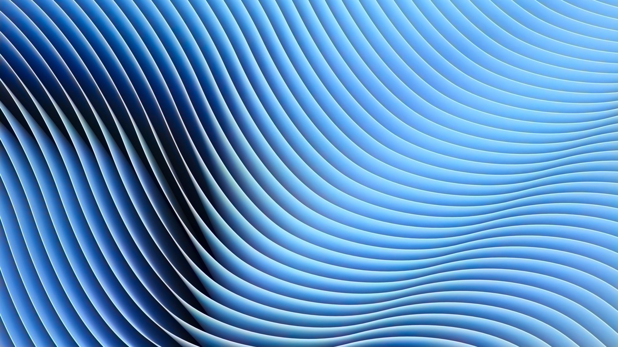
Hypothalamus
Hypothalamus: the hypothalamus regulates many of the body’s metabolic processes, thirst, hunger and body temperature. Use “hypothe-llamas" as your mnemonic. Picture a hypo spraying two thirsty llamas with water to quench their thirst and cool them down.

Slide 63
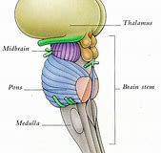
The Brain Stem
Acronym: Pavlov’s Really Frickin’ Mad!
Pons
Reticular
Formation
Medulla

Slide 64
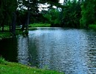
Pons
Pons: the pons is the part of the brain that regulates waking and relaxing. Put a “d” in pons and you have “ponds”. Ponds are relaxing to look. Your pons is activated when you look at a calm, relaxing pond

Slide 65
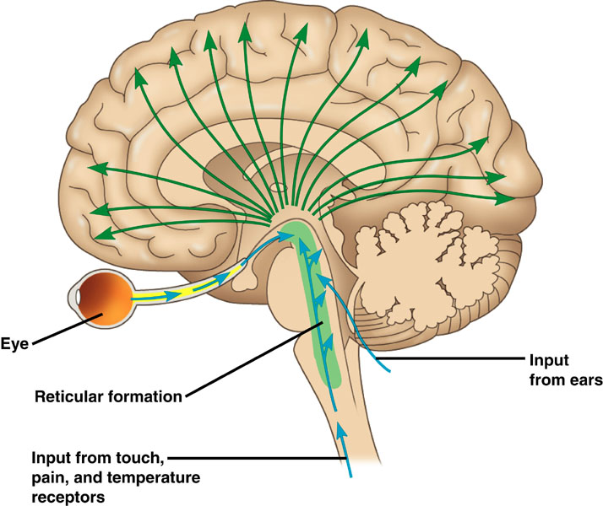
Reticular formation
Reticular Formation: the reticular formation is involved in motivation and alertness. Use “tickle” as your mnemonic. If you (or your roommate) were asleep and someone tickled you, your reticular formation would wake you up.

Slide 66
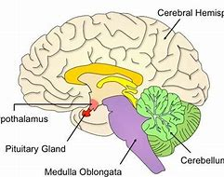
Medulla Oblongata
Medulla: the medulla regulates the autonomic activity of the heart and lungs.

Slide 67
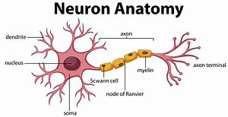
The Neuron
Acronym : Damn! Skinner Ate Mice?? Not Very Smart.
Dendrites
Soma
Axon
Myelin sheath
Nodes of Ranviers
Synaptic vesicles
Synapse

Slide 68
Dendrites
Dendrites: signals from muscles and other neurons enter the neuron through branches called dendrites. “Rites” rhymes with kites. Kites often fly into tree branches, and lightening can strike kites, so picture lightening striking kites which are attached to the branches of the soma.

Slide 69
Soma
Soma: The soma is the cell body of the neuron. Use “ma” or “someone’s ma” as your mnemonic. Picture your mother inside the cell body

Slide 70
Axon
Axon: the axon extends out from the soma. Use “ax” and picture an ax that has been stuck into “someone’s mam”.

Slide 71
Myelin Sheath
Myelin Sheath: the myelin sheath protects the axon and speed the signal down the axon. Picture sheep sitting on the axon, keeping it warm and also yelling at the signal to move it along the axon: “my yelling sheep”

Slide 72
Nodes of ranvier
Nodes of Ranvier: the Nodes of Ranvier are the spaces between the myelin sheath. As the signal travels down the axon it actually jumps from one node to another. Go with “noses” and picture noses between the “sheep” the signal jumps from one nostril to another.

Slide 73
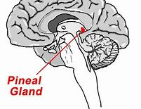
Pineal Gland
Pineal Gland: the pineal gland secretes melatonin. Use “pins and needles in a melon” as the mnemonic.

Slide 74
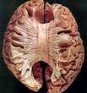
Corpus Callosum
Corpus Callosum: the corpus callosum connects the two hemispheres. Thus, the corPLUS CalloSUM.
Corpus Callosum: it is through the corpus callosum that the two hemispheres communicate. Thus, you could also picture “corpus CALL SOMEONE”.

Slide 75
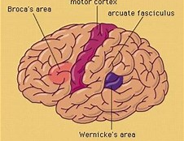
Broca area
Broca’s area: Broca’s area is the area of the brain responsible for producing speech. If it is damaged, you can understand what someone says, but your speech is disjointed. In other words, “Broca’s speech is broken” or “Broca’s banter is broken”.

Slide 76
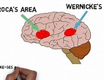
Wenicke’s
Wernicke’s area: Wernicke’s area is responsible for the comprehension of speech. If you have an aphasia in this area of the brain you are unable to understand and respond to what people are saying to you. In other words, “Wernicke’s comprehension is crappy”.

Slide 77
Now try the following
https://quizizz.com/admin/quiz/589cd327d82392cc0a832a3c/brain-lobes-functions

Slide 78
Objectives
Define
Define the terms endocrine gland, exocrine gland, hormone and target tissue
Explain
Explain the terms first messenger and second messenger
Describe
Describe the functions of the endocrine glands.

Slide 79
The Endocrine System
Main Function:
It releases hormones into the blood to signal other cells to behave in certain ways. It is a slow but widespread form of communication.
Chemical communication

Slide 80
Two types of glands
Endocrine gland
Contain cells that produce a hormone and release it straight into the blood
They are ductless
Exocrine glands
They produce a hormone which is not directly released into the blood
They have a duct which carries the secretion to another place

Slide 81
Two types of hormones
There are two types of hormones; the hormones regulate the physiology and behavior of the distant organs.
Protein and peptide hormones
Are not soluble in the membrane so DO NOT enter the cell. Peptide hormones mainly bind to the cell surface receptors.
Amino acids make up the peptide hormones

Slide 82
Targeting the signal
Each hormone is different from all the others
Some cells have complementary receptors on their plasma membrane (target tissues)
The hormone binds to the receptor and the cell then responds to the signal
This allows hormones to travel around the body without affecting other cells

Slide 83
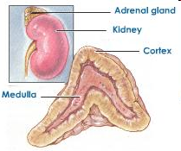
The structure of the adrenal gland
The centre of the gland is called the medulla (produces peptide hormones)
Surrounding the medulla is the cortex (produces steroid hormones)

Slide 84
Function of adrenal cortex
Uses cholesterol to produce certain steroid hormones;
  Mineralocorticoids (e.g. aldosterone) control the concentration of Na and K in the blood want to know more What Does Potassium Do for Your Body? A Detailed Review (healthline.com)
  Glucocorticoids (e.g. cortisol) help to control the metabolism of carbohydrates and proteins in the liver

Slide 85

Adrenaline
Hormone produce by the adrenal gland
Prepares the body for activity
Is an amino acid derivative
Cannot enter the target cell
Therefore it must cause an effect without entering the cell

Slide 86

Action of adrenaline (1)

Slide 87
Action of adrenaline (2)

Slide 88
Action of adrenaline (3)

Slide 89
First and second messengers
First messenger
  A hormone that transmits a signal around the body
Second messenger
  Is cAMP which transmits a signal inside the cell

Slide 90


Slide 91

The Endocrine System
Consists of:
Endocrine glands Release hormones into the bloodstream.
Hormones are chemicals released in one part of the body that travel through the bloodstream and affect the activities of cells in other parts of the body.

Slide 92


Slide 93
Steroid Hormones
Steroid hormones are secretions of ductless glands that consist of a characteristic steroid ring structure. Formed from cholesterol. Sex hormones produced in the sex organs (testosterone, oestrogen and progesterone), and hormones produced in the adrenal gland (aldosterone, cortisol, and androgens) are examples of steroid hormones..
  Can pass through the membrane and enter the cell
  Act upon the DNA in the nucleus

Slide 94


Pituitary Gland
Function: It secretes nine hormones that directly regulate many body functions and controls functions of other glands.
Disorders: To much growth hormones (GH) in early childhood can result in a condition called gigantism. To little GH can result in Pituitary Dwarfism.
Robert
Wadlow

Slide 95

Thyroid Gland
Function: plays a major role in regulation the body’s metabolism.
Disorders: If the Thyroid Gland produces to much Thyroxin, it can cause a condition known as Hyperthyroidism. If to little thyroxin produces it is called Hypothyroidism.

Slide 96
Pancreas
Function: The Insulin and Glycogen in the Pancreas help to keep the level of glucose in the blood stable.
Disorders: When the Pancreas fails to produce or properly use Insulin, it can cause a condition known as Diabetes Mellitus.

Slide 97

Adrenal Gland
Functions:
-The adrenal glands release Adrenaline in the body that helps prepare for and deal with stress.
-Also regulates kidney function.

Slide 98

Ovaries
Functions:
  Pair of reproductive organs found in women that produce eggs.
  Also secrete oestrogen and progesterone, which control ovulation and menstruation.

Slide 99

Testes
Functions:
  Pair of reproductive glands that produces sperm.
  Also secrete Testosterone to give the body its masculine characteristics.

Slide 100

Interaction of Glands
The hypothalamus is located in the brain and controls the release of hormones from the pituitary gland. It is an important link between the endocrine and nervous systems.
http://www.biocfarm.unibo.it/aunsnc/images/3D%20Objects/Hypothalamus.gif

