Slide 1
Using osteological and archaeological evidence, assess the validity of contemporary British sources that influence the modern stereotype of the Vikings?
Name: Matthew Cowley Student Number: 1700561 Module Code: HPHI6017

Slide 2
Stereotype
UNCIVILISED
PILLAGE
RAPE
SAVAGE
BIG
BEARDED
PAGAN
MURDER
RAIDER
LONGSHIP
BRUTISH
HORNED HELMETS

Slide 3
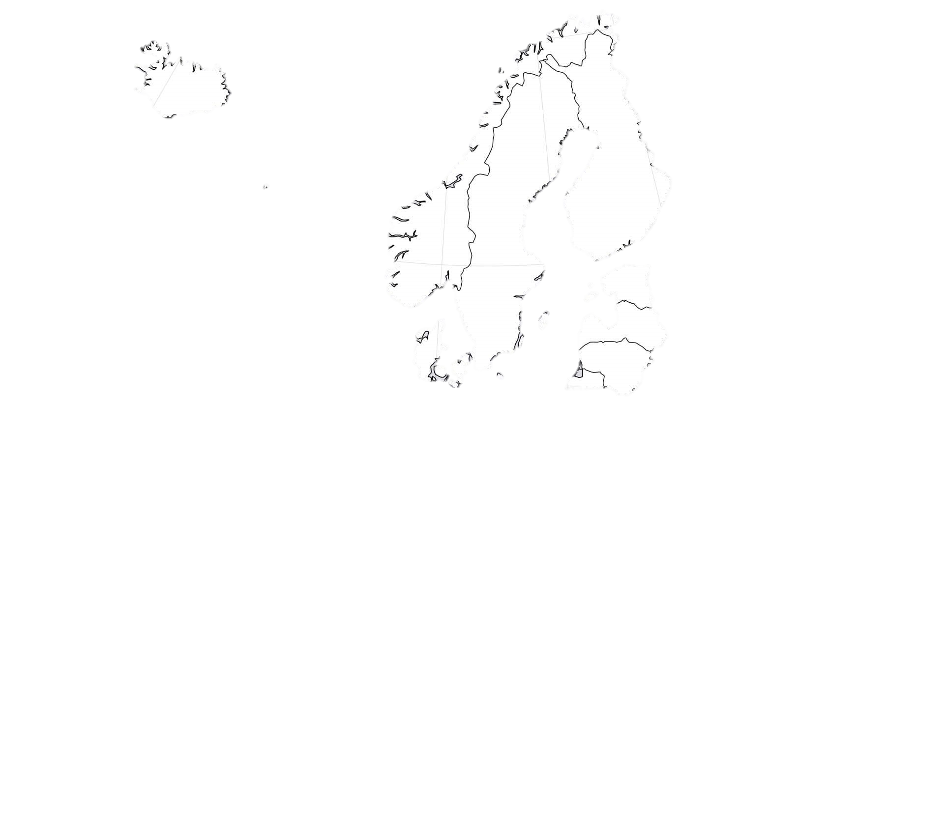
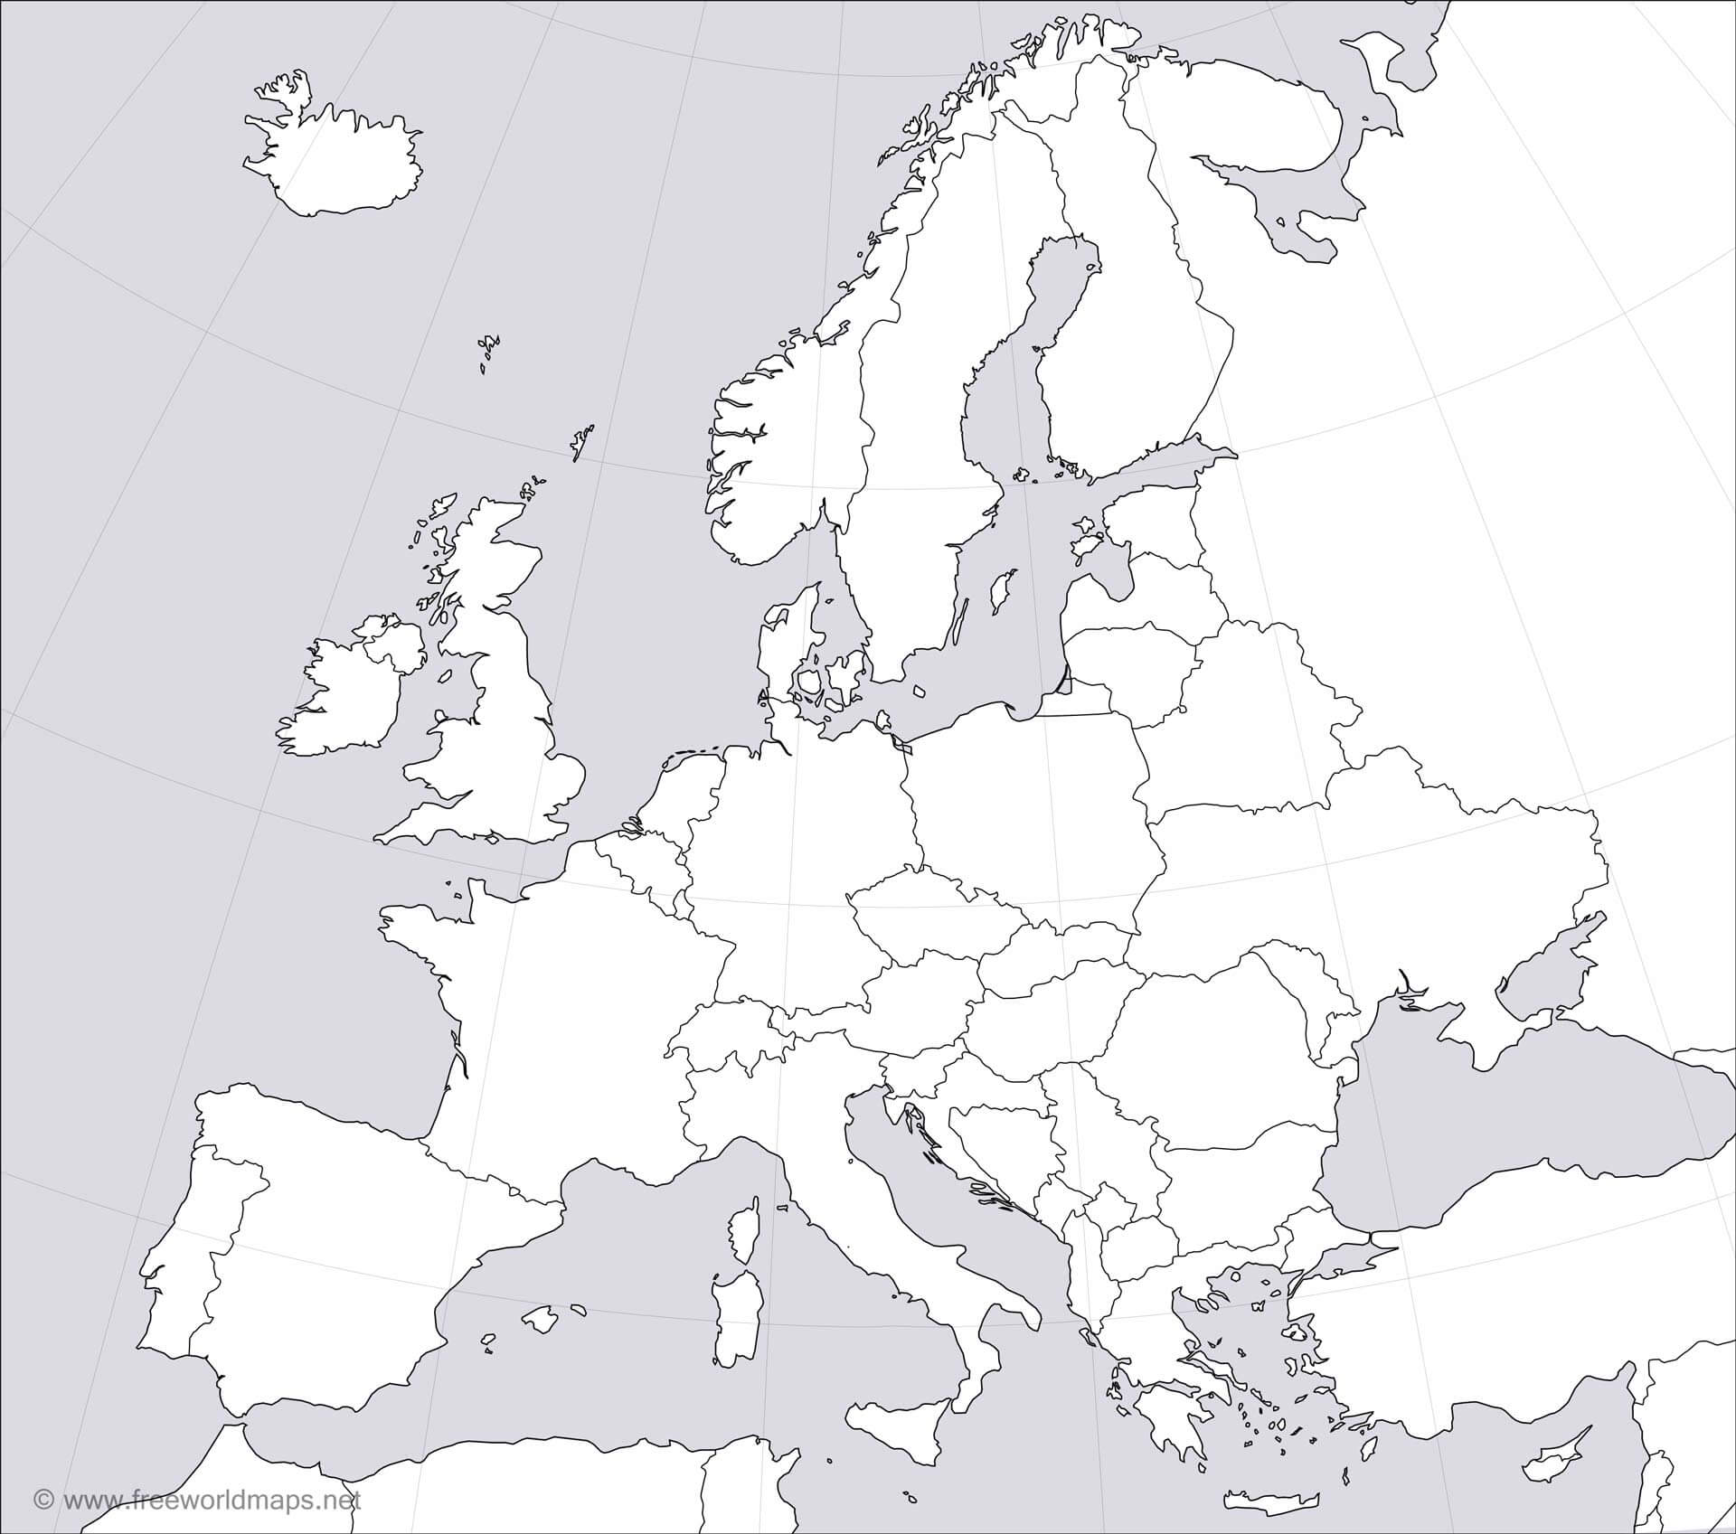
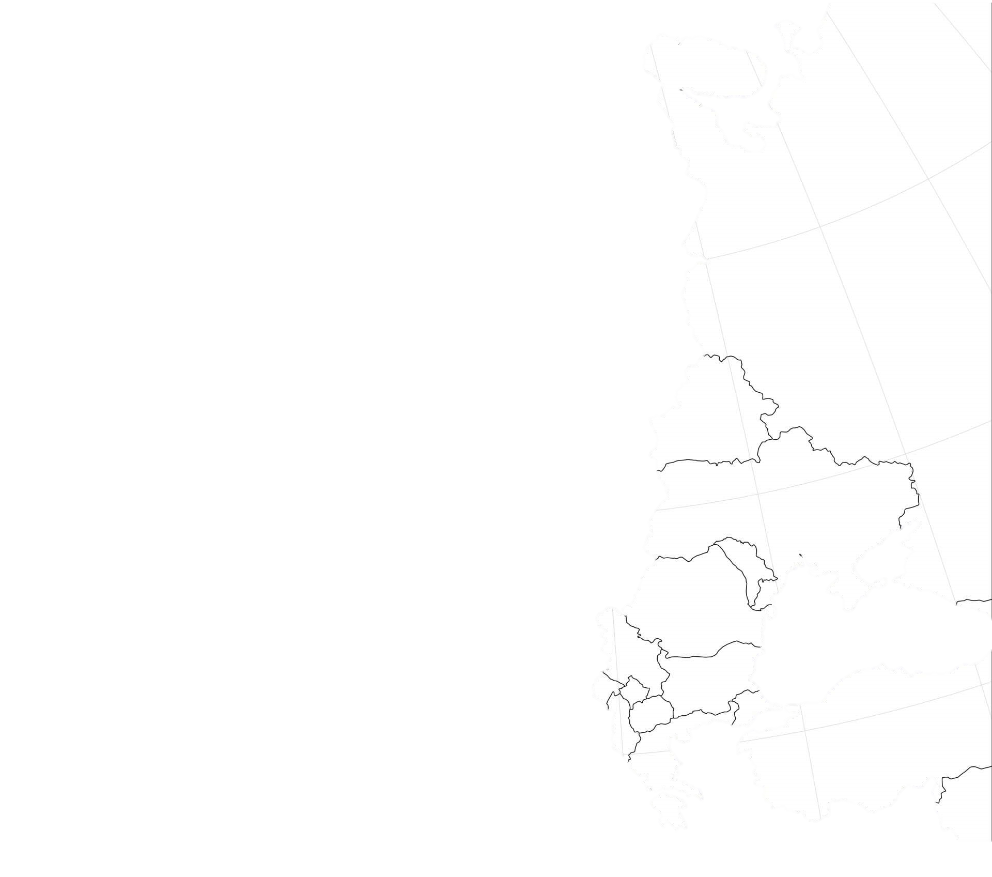


Initial Scope of Study
KEY
Scandinavia
Britain
Mainland Europe
Eastern Frontier
Map of Europe, Accessed from: https://www.freeworldmaps.net/europe/blank_map.html, on 04/02/2020.

Slide 4
Location of Important Archaeological Sites Used for this Study
Hringsdalur
Skálholt
Jarlshof
Gokstad
Skämsta
Kneep
Scar
Sigtuna
Oseberg
Birka
Salme
Kopparsvik
Slite Torg
Fröjel
Eyrephort
Balladoole
Trinitatis
Fjälkinge
Donnybrook
Llanbedrgoch
Coppergate
Vannhög
Culvet
Heath Wood
Repton
Oxford
Ridgeway Hill
Map of Europe, Accessed from: https://www.freeworldmaps.net/europe/blank_map.html, on 04/02/2020.

Slide 5
Objectives & Research Questions
Using osteological and archaeological evidence, assess the validity of contemporary British sources that influence the modern stereotype of the Vikings?
Objectives
To establish the legitimacy of contemporary accounts of Scandinavian activity using osteological and archaeological evidence.
To challenge modern stereotypes of the ‘Vikings’.
Research Questions
Do we know how violent the ‘Vikings’ were compared to their British contemporaries?
Do we know how civilised ‘Vikings’ society was compared to that of their British contemporaries?
Why?
20th Century historiography has corrupted thought regarding this period, leading the ‘Vikings’ becoming victims of stereotype.
If we are to teach the next generation, then we must make sure what they are taught is correct and based upon fact.

Slide 6
Methodology
(Re)Establish Stereotype
Find Contemporary Source
Analyse Scandinavian Osteology and Archaeology
Assess the Validity of Contemporary Source
Analyse Scandinavian Osteology and Archaeology in Britain
Analyse Osteology and Archaeology of British Natives
Using Arcini’s approach, based solely on Scandinavian sites, in a wider context.

Slide 7
Build – How tall were they compared to their British Contemporaries?
Contemporary Sources
Ibn Fadlān’s The Land of Darkness.
Henry of Huntingdon’s History of the English People.
Taller
Same Size/Shorter
Repton – Grave 511: 6ft
Scandinavian Sites
Salme 1 – Estonians (176cm &178cm)
Edix Hill (Saxon Burial)

Slide 8
Brutality – How violent were they compared to their British Contemporaries?
Contemporary Sources
Monastic Accounts, such as the work of John of Worchester, Alcuin, and the Anglo-Saxon Chronicle.
Battle of Maldon Poem
More Violent
Same/Less Violent
Raids
Great Heathen Army
St Brice’s Day Massacre
St John’s College
Ridgeway Hill
Henry of Huntingdon’s History of the English People.

Slide 9
Barbarism – How uncivilised were they compared to their British Contemporaries?
Contemporary Sources
Accounts of Missionaries, such as that of Ansgar, Willibrord, and Ebbo.
Classical Scholars.
More Barbaric
Less Barbaric
Non-Christian
Pagan Rituals (Human Sacrifice)
Repton – Respect for Dead
Gildas’ Saxon account
Health
Hygiene

Slide 10
Conclusion and Anticipated Results
My Research So Far:
Allowed me to challenge modern stereotypes.
Identify key characteristics surrounding ‘Viking’ identity.
Anticipated Results:
Build – YES, they were taller than their average contemporary.
Brutality – NO, they were not more violent. It was a violent time.
Barbarism – NO, they were not savages as they maintained health and hygiene.
Thank You For Listening. Are There Any Questions?

Slide 11
References
Slide 2: Stereotype
  Arcini, C.A,, The Viking Age: A Time of Many Faces. (Oxford: Oxbow Books, 2018), p. 1.
  Carroll, J., Harrison, S.H. and Williams, G., The Vikings in Britain and Ireland, (London: The British Museum Press, 2014), p. 6.
  Richards, J. D. ‘Pagans and Christians at the Frontier: Viking Burials in the Danelaw’, in Carver, M. (ed.) The Cross Goes North: Processes of Conversion in Norther Europe AD 300 – 1300. (Woodbridge: The Boydell Press, 2005), pp. 1 – 5.
Slide 3: Map of Europe with Initial Scope
  FreeWorldMaps.net, Europe Outline Maps (2019) <https://www.freeworldmaps.net/europe/blank_map.html> [accessed: 04/02/2020].
Slide 4: Map of Europe with Important Sites
  Allmäe, R. Maldre, L. and Tomek, T., ‘The Salme I Ship Burial: An Osteological View of a Unique Burial in Northern Europe’, Interdisciplinaria Archaeologica Natural Sciences in Archaeology, 2(2) (2011), pp. 109 – 124.
  Arcini, The Viking Age, p. 3.
  Biddle, M. and Kjølbye-Biddle, B. ‘Repton and the ‘Great Heathen Army’, in Graham-Campbell, J. et al. (ed.) Vikings and the Danelaw: Select Papers from the Proceedings of the Thirteenth Viking Congress. (Oxford: Oxbow Books, 2001), pp. 45 – 80.
  FreeWorldMaps.net, Europe Outline Maps (2019) <https://www.freeworldmaps.net/europe/blank_map.html> [accessed: 04/02/2020].
  Loe, L. et al. ‘Given to the Ground’: A Viking Age Mass Grave on Ridgeway Hill, Weymouth. (Dorset: Dorset Natural History and Archaeological Society, 2014), pp. 1 – 200.
  Richards, J. D. et al. ‘Excavations at the Viking Burrow Cemetery at Heath Wood, Ingleby, Derbyshire’, The Antiquities Journal, 84 (2004), pp. 23 – 116.
Slide 5: Objectives and Research Questions
  Richards, ‘Pagans and Christians at the Frontier: Viking Burials in the Danelaw’, pp. 1 – 5.

Slide 12
References
Slide 6: Methodology
  Arcini, The Viking Age, pp. 1 – 20.
Slide 7: Build
  Allmäe, Maldre, and Tomek, ‘The Salme I Ship Burial’, pp. 109 – 124.
  Ahmed Ibn Fadlān, Ibn Fadlān and the Land of Darkness: Arab Travellers in the Far North, ed. and trans. P. Lund, and C. Stone (London, 2012), pp. xiii – 58.
  Biddle, and Kjølbye-Biddle, ‘Repton and the ‘Great Heathen Army’, pp. 45 – 80.
  Henry of Huntingdon, The History of the English People 1000 – 1154, 2nd edition, ed. and trans. D. Greenway (Oxford, 2002), pp. 7 – 25.
  Loe, L. et al. ‘Given to the Ground’, pp. 1 – 200.
  Malim, T. and Hines, J, The Anglo-Saxon Cemetery at Edix Hill (Barrington A), Cambridgeshire: Excavations 1989–1991 and a summary catalogue of material from 19th century interventions. (York: Council for British Archaeology, 1998).
Slide 8: Brutality
  Anglo-Saxon Chronicle, 2nd edition, ed. and trans. G.N. Garmonsway (London, 1953 – 92).
  Chartrand, R. et al. The Vikings. (Oxford: Osprey Publishing, 2016), pp. 10 – 110.
  Henry of Huntingdon, The History of the English People, pp. 7 – 25
  Loe, L. et al. ‘Given to the Ground’, pp. 1 – 200.
  Williams, T, Viking Britain: A History. (London: William Collins, 2017), pp. 1 – 32.
Slide 9: Barbarism
  Arcini, The Viking Age, pp. 1 – 100.
  Biddle, and Kjølbye-Biddle, ‘Repton and the ‘Great Heathen Army’, pp. 45 – 80.
  Eaton, J, An Archaeological History of Britain: Continuity and Change from Prehistory to the Present. (Barnsley: Pen and Sword Archaeology, 2014), pp. 99 – 122.

Slide 13
Bibliography
Primary Sources
  Ahmed Ibn Fadlān, Ibn Fadlān and the Land of Darkness: Arab Travellers in the Far North, ed. and trans. P. Lund, and C. Stone (London, 2012).
  Anglo-Saxon Chronicle, 2nd edition, ed. and trans. G.N. Garmonsway (London, 1953 – 92).
  Henry of Huntingdon, The History of the English People 1000 – 1154, 2nd edition, ed. and trans. D. Greenway (Oxford, 2002).
Secondary Sources
  Allmäe, R. Maldre, L. and Tomek, T., ‘The Salme I Ship Burial: An Osteological View of a Unique Burial in Northern Europe’, Interdisciplinaria Archaeologica Natural Sciences in Archaeology, 2(2) (2011), pp. 109 – 124.
  Arcini, C.A, The Viking Age: A Time of Many Faces. (Oxford: Oxbow Books, 2018).
  Biddle, M. and Kjølbye-Biddle, B. ‘Repton and the ‘Great Heathen Army’, in Graham-Campbell, J. et al. (ed.) Vikings and the Danelaw: Select Papers from the Proceedings of the Thirteenth Viking Congress. (Oxford: Oxbow Books, 2001).
  Carroll, J., Harrison, S.H. and Williams, G., The Vikings in Britain and Ireland, (London: The British Museum Press, 2014).
  Chartrand, R. et al. The Vikings. (Oxford: Osprey Publishing, 2016).
  Eaton, J, An Archaeological History of Britain: Continuity and Change from Prehistory to the Present. (Barnsley: Pen and Sword Archaeology, 2014).
  Hubbard, B, Warriors of the Viking World: The Seafaring Raiders and Explorers who Terrorised Europe for Centuries. 2nd Ed. (London: Amber Books Ltd, 2018).
  Loe, L. et al. ‘Given to the Ground’: A Viking Age Mass Grave on Ridgeway Hill, Weymouth. (Dorset: Dorset Natural History and Archaeological Society, 2014).
  Malim, T. and Hines, J, The Anglo-Saxon Cemetery at Edix Hill (Barrington A), Cambridgeshire: Excavations 1989–1991 and a summary catalogue of material from 19th century interventions. (York: Council for British Archaeology, 1998).
  Richards, J. D. et al. ‘Excavations at the Viking Burrow Cemetery at Heath Wood, Ingleby, Derbyshire’, The Antiquities Journal, 84 (2004), pp. 23 – 116.
  Richards, J. D. ‘Pagans and Christians at the Frontier: Viking Burials in the Danelaw’, in Carver, M. (ed.) The Cross Goes North: Processes of Conversion in Norther Europe AD 300 – 1300. (Woodbridge: The Boydell Press, 2005).
  Welander, R.D.E., Batey, C.E. and Cowie, T.G, ‘A Viking Burial from Kneep, Uig, Isle of Lewis’, Proceedings of the Society of Antiquaries of Scotland, 117 (1987), pp. 149 – 174.
  Williams, T, Viking Britain: A History. (London: William Collins, 2017).
Electronic Sources
  Friðriksson, A., Gestsdóttir, H., Daxböck, A. and Gisladóttir, G.A. 'Hringsdalur í Arnarfirði', Archaeological Survey 2006: FS413-06441, Reykjavík: Archaeological Institute of Iceland (2010), <https://www.nabohome.org/cgi-bin/explore.pl?seq=99> [Accessed: 15th October 2019].
  FreeWorldMaps.net, Europe Outline Maps (2019) <https://www.freeworldmaps.net/europe/blank_map.html> [accessed: 04/02/2020].

