Slide 1

Digital skills and research methods bwsw4003 abdi rahman
Alexandra felicia Merauta 2121306
Cristian rotaru 2123735
Daniel oprea 2118369

Slide 2
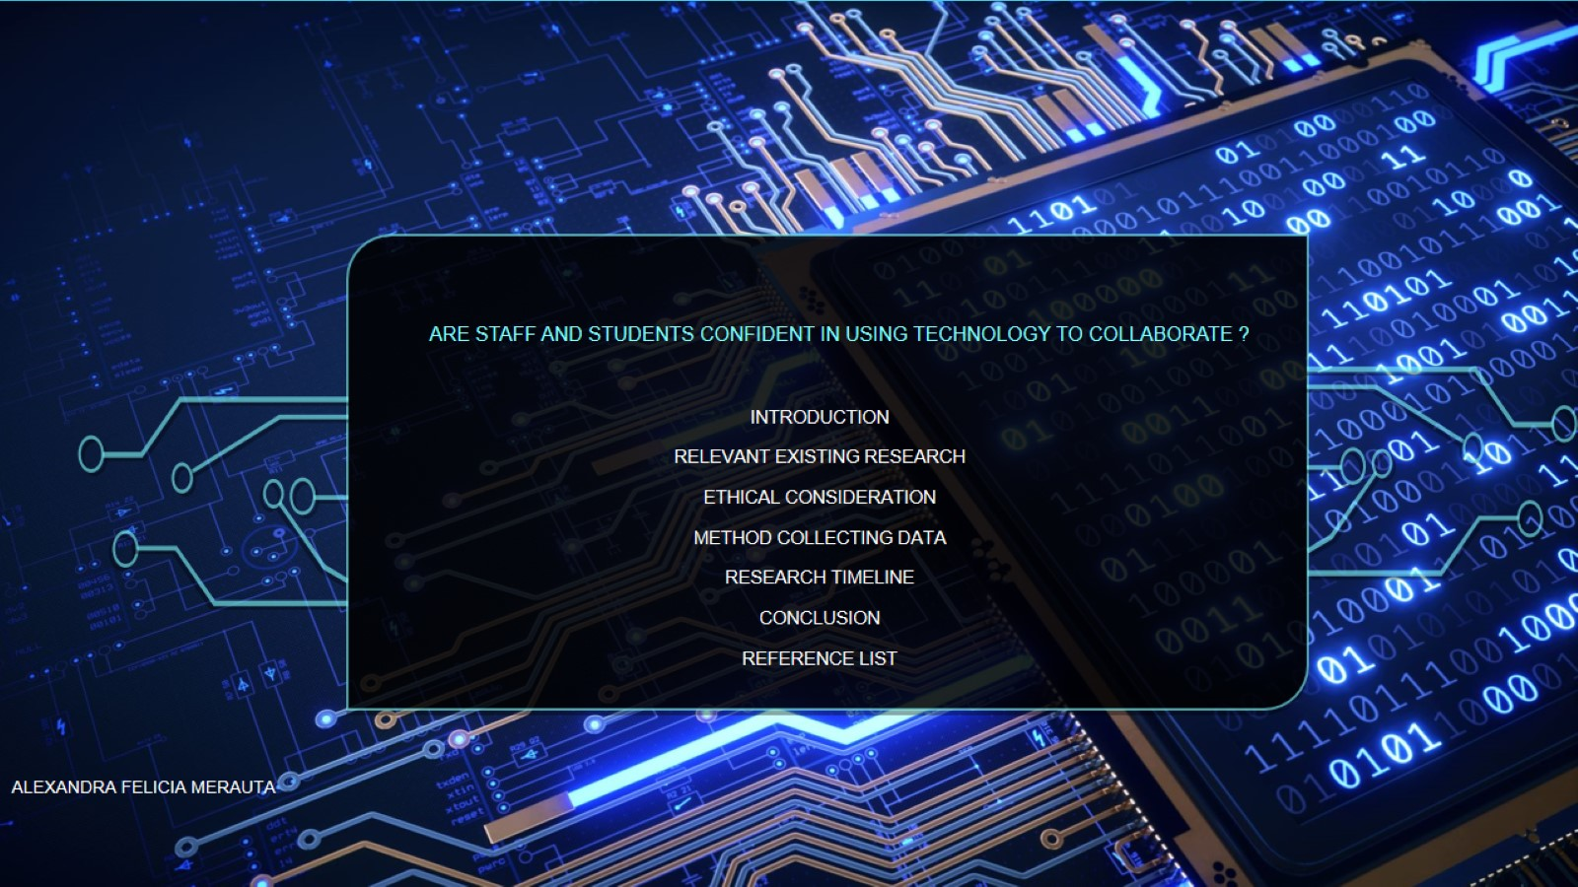
Are staff and students confident in using technology to collaborate ?

Slide 3
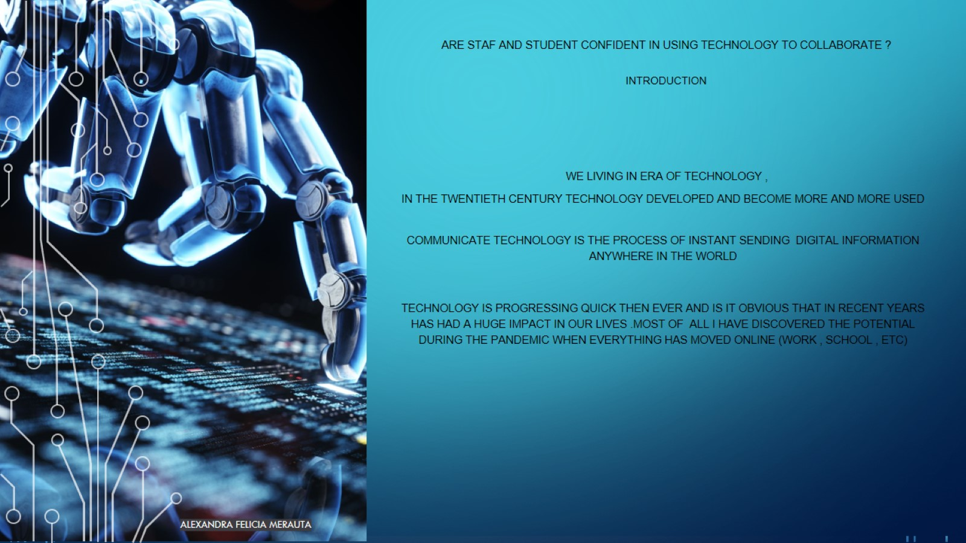
are staf and student confident in using technology to collaborate ?
Introduction

Slide 4
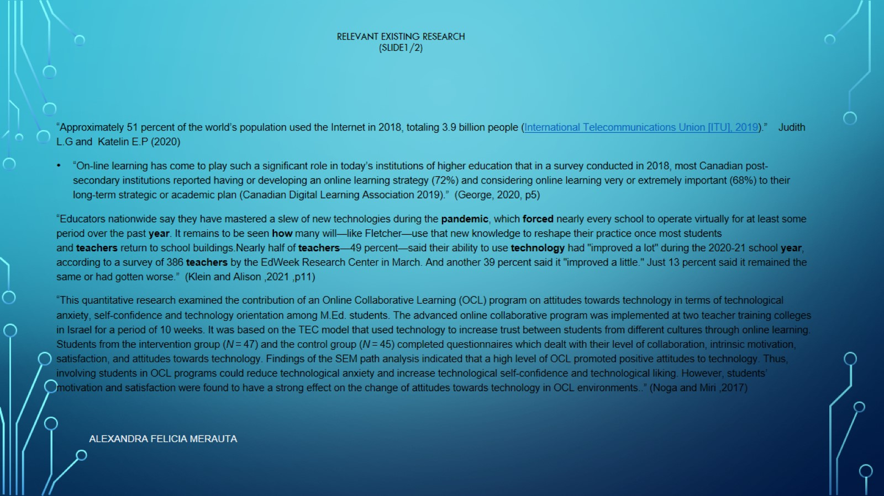
relevant existing research
(slide1/2)

Slide 5
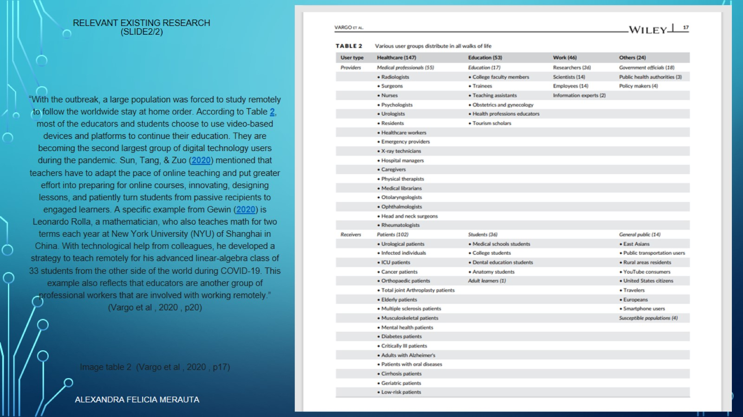
Relevant existing research
(slide2/2)

Slide 6
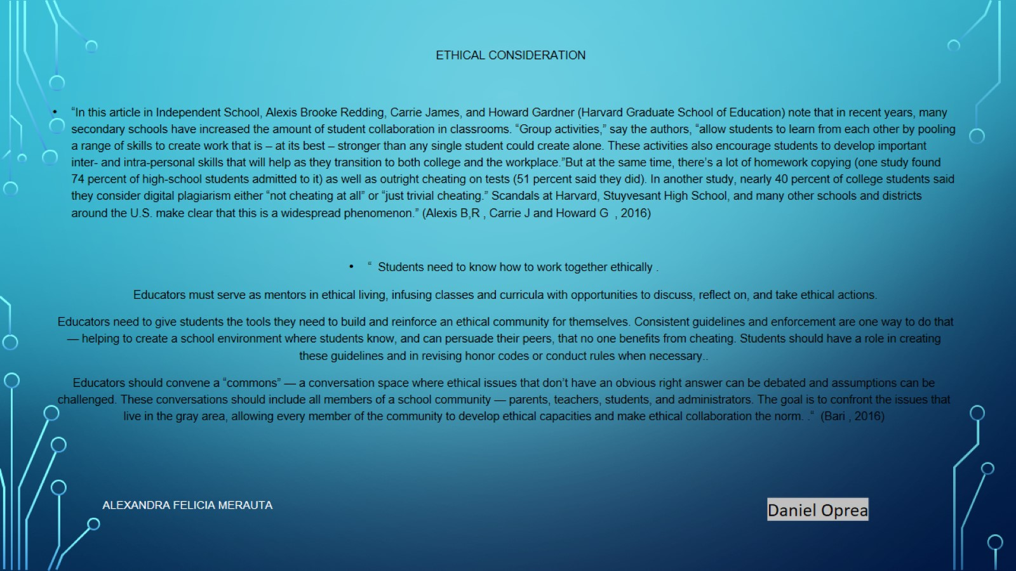
Ethical consideration

Slide 7
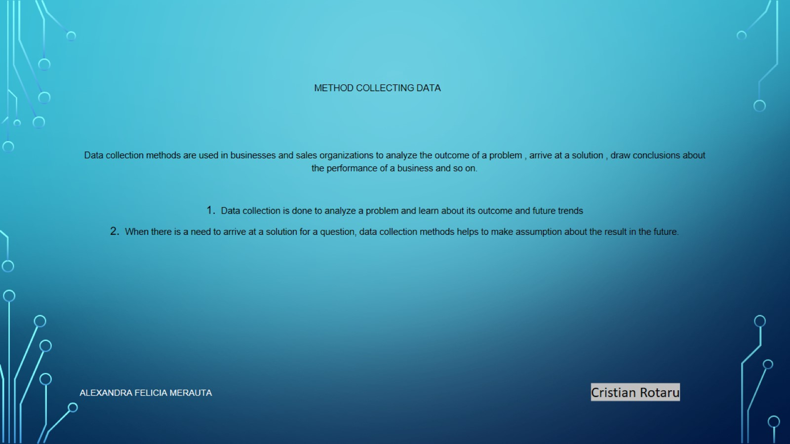
Method collecting data

Slide 8
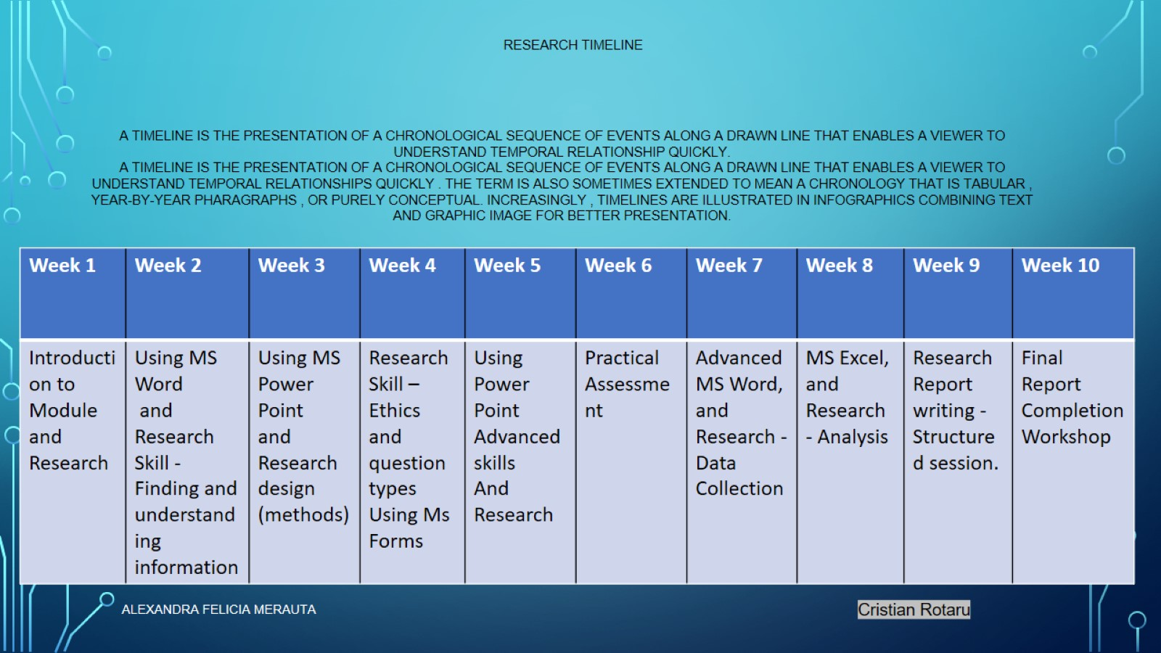
Research timeline

Slide 9
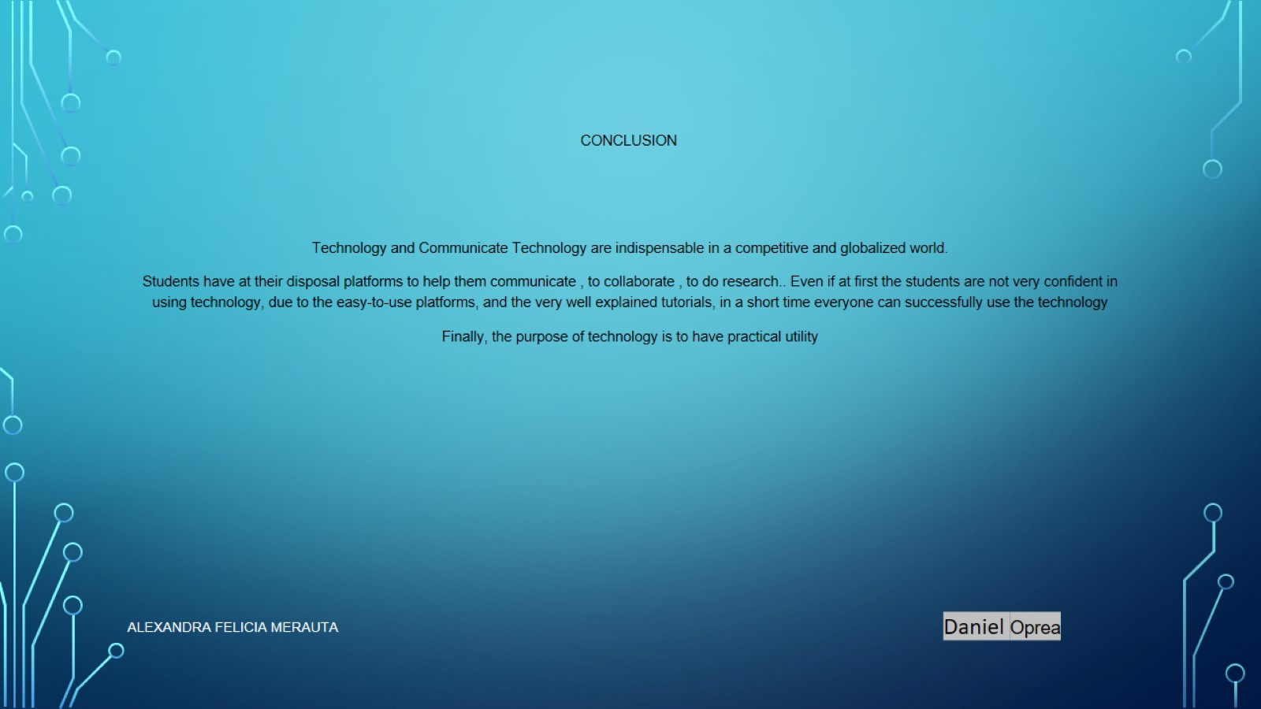
conclusion

Slide 10
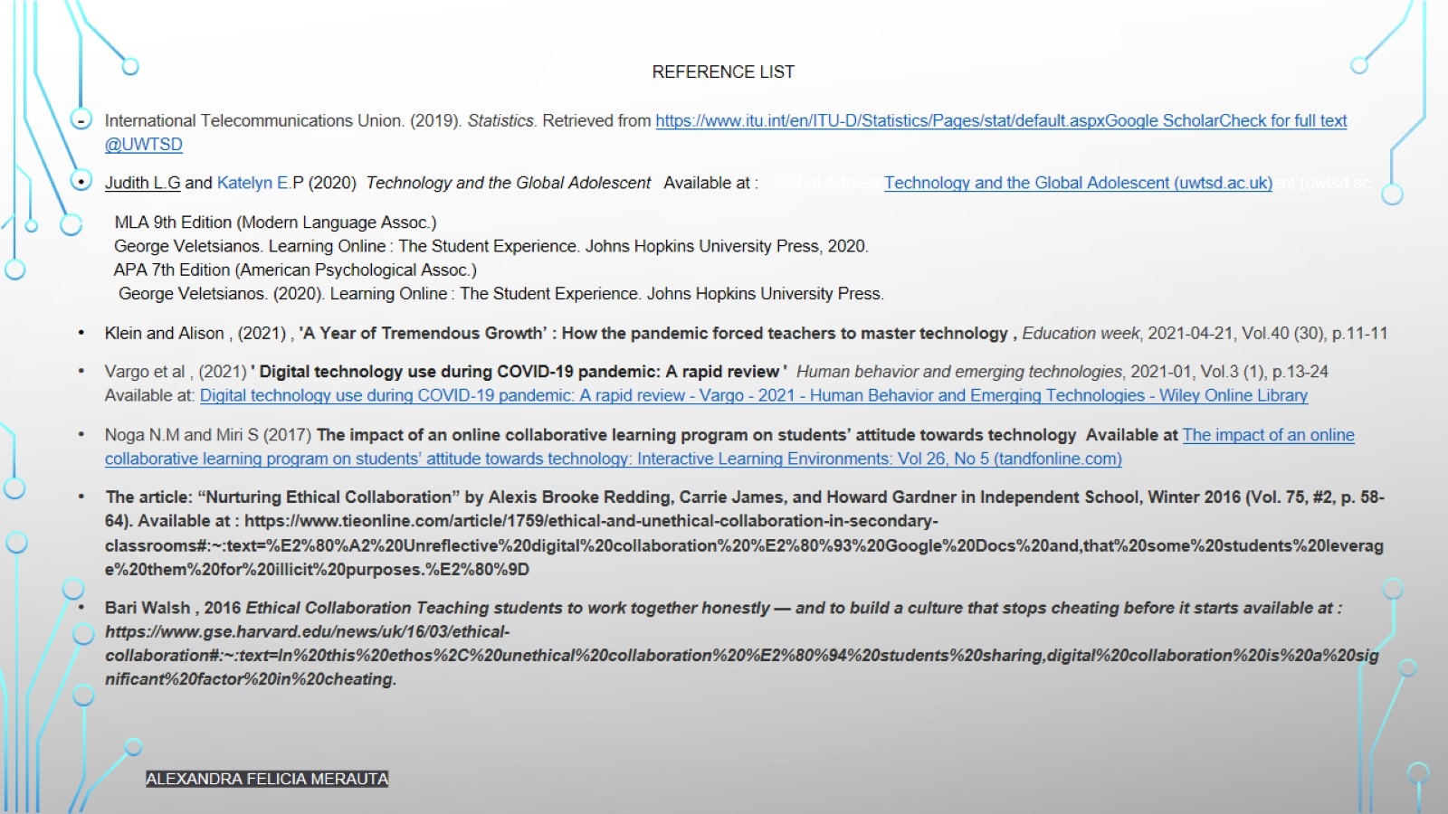
Reference list

