Slide 1

Performance Improvement of Wireless SOHO Network
University of Wales
Trinity Saint David
London
By student:
1917112
Mari I Uchkunova

Slide 2





AGENDA
Introduction
Aim and Objectives
Literature review
Methodology
Design overview
Demo
Gantt Chart
Conclusion
References
Q&A

Slide 3
Introduction
There have been several issues and problems with poor wireless networks due to which most of the SOHO’s face multiple issues and problems in day-to-day operations. To deal with that, this project will describe the advancement methodology and network optimization techniques that help to maximize the performance of wireless networks to bring more accuracy and fast information exchange medium to the organizations.

Slide 4


Aim Objectives
The aim or purpose of the project is to improve the overall efficiency and performance of a small office network/home office network by using modern network optimization techniques.
To decrease the traffic load on the SOHO network to get better efficiency in network performance.
To maximize the QoS (quality of service) of a small office network/home office network by using modern networking technology [1].
To get enhanced data communications lead to faster transfer of data within a SOHO and between other factors.

Slide 5
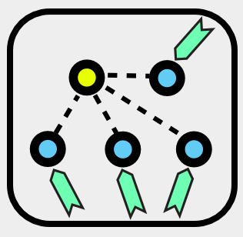
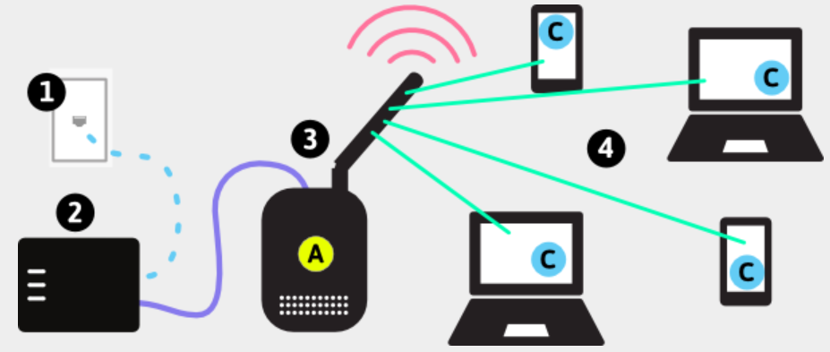
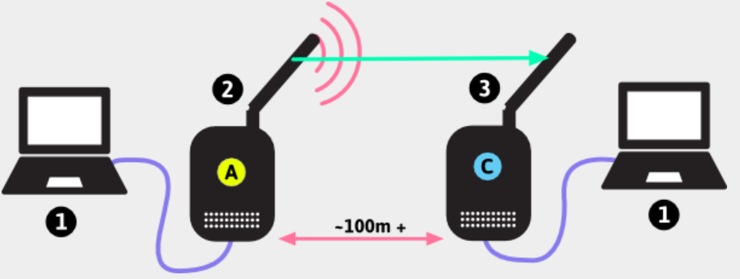
Literature review
Wireless Clients (Station)
Access Point - Home or Office network
The Client-Side Access Point with 360° Coverage
Wireless Connection Problems Fixing

Slide 6

Previous works

Slide 7

Metodology
Experiments served as the primary production process for the artifact. This style was chosen since understanding and writing about WLAN security can be quite theoretical. The project becomes lot more enjoyable, and the theory may be put into reality by interspersing something more useful.
There will be the collection of a secondary as well.

Slide 8
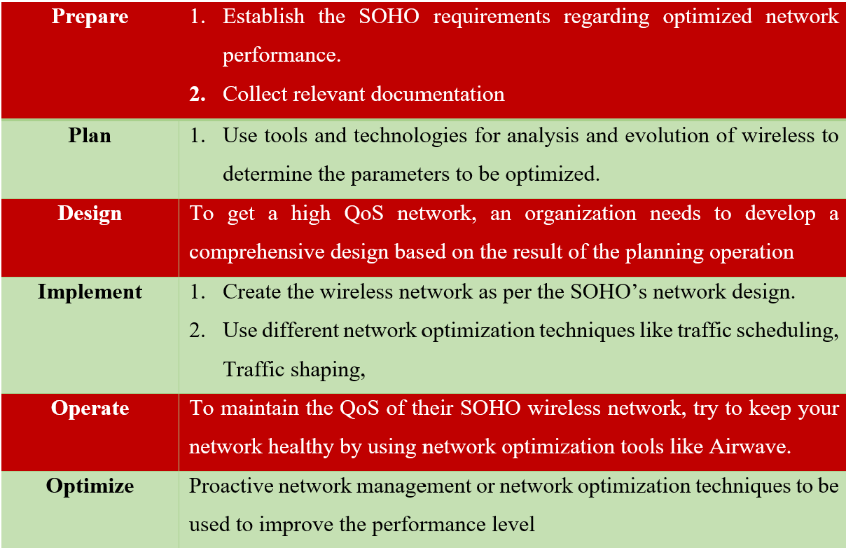
Design overview

Slide 9
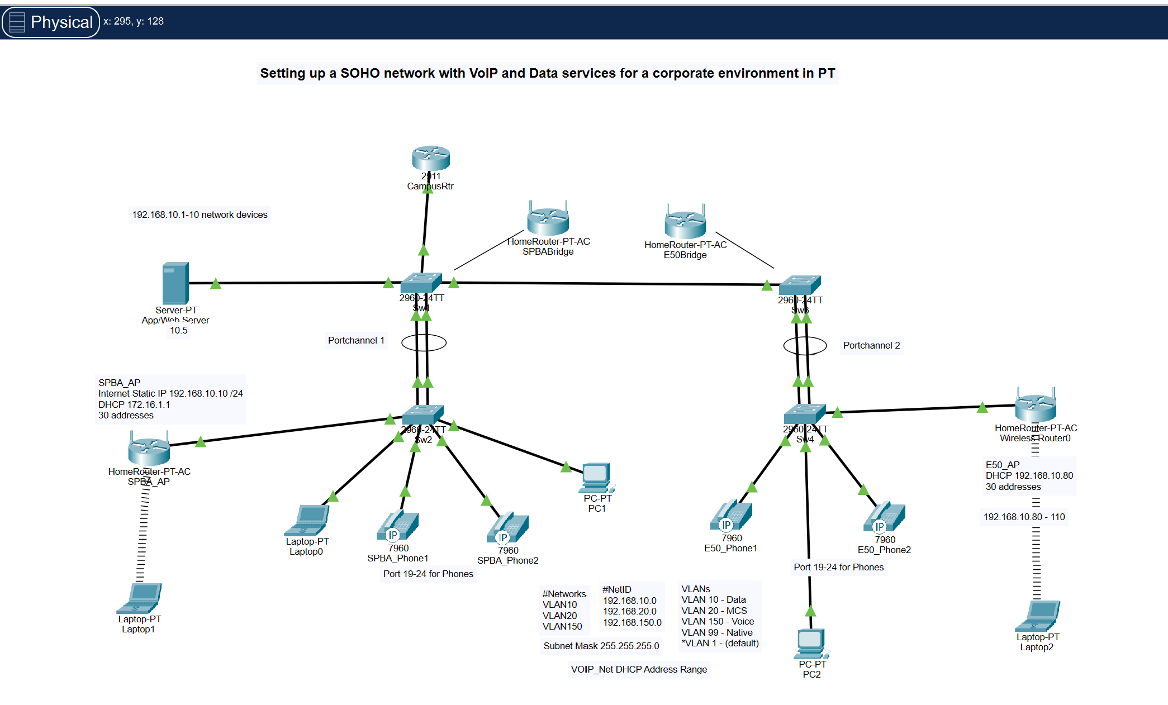
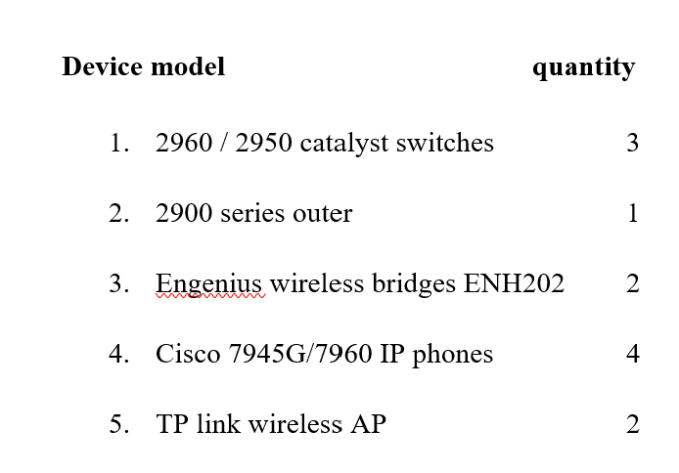
Snip 2. Device module
Snip 1. Setting up a SOHO network Voip and Data service for a corporate environment

Slide 10
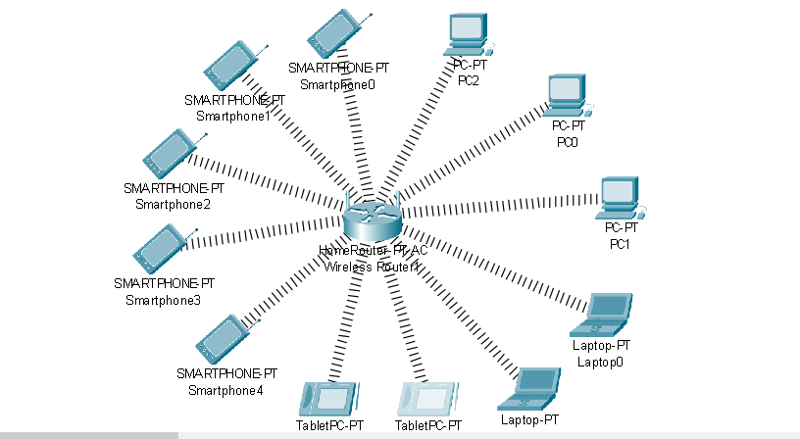
Snip 3. Wireless network which will be used for testing

Slide 11
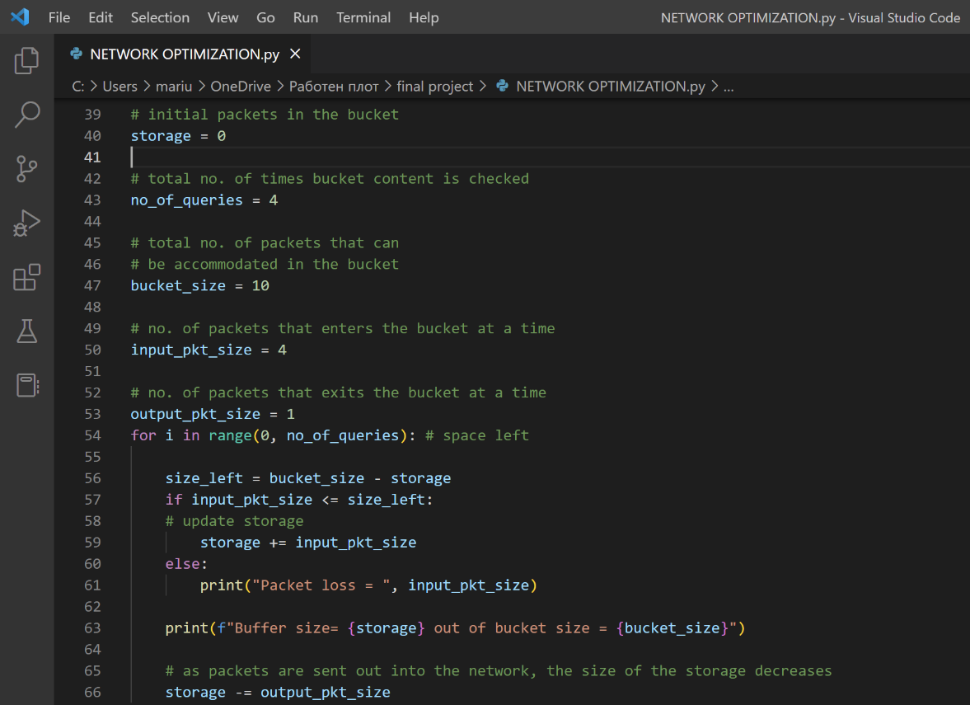
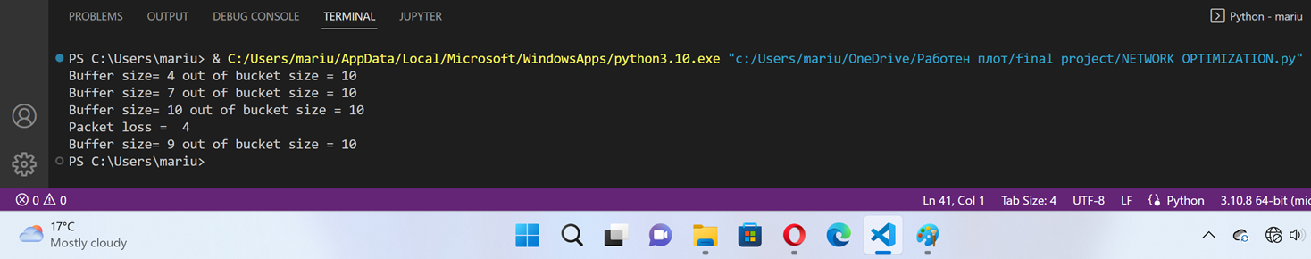
Demo
A simple leaky bucket algorithm in python:
Figure 3: Python Optimization Code line
Snip 4: Actual Buffer reduction

Slide 12
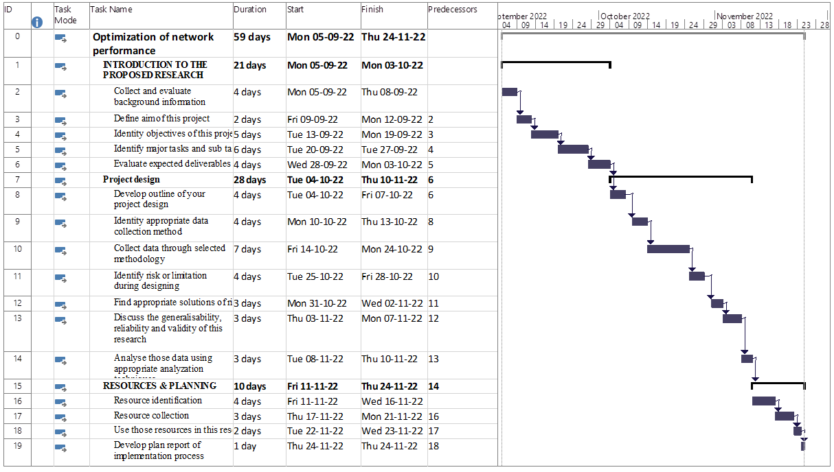
Gantt chart

Slide 13
Conclusion
Introduction
Aim and Objectives
Literature review
Methodology
Design overview
Demo
Gantt Chart
Conclusion
References
Q&A

Slide 14
References
[1] K. Jaiswal and V. Anand, “EOMR: An Energy-Efficient Optimal Multi-path Routing Protocol to Improve QoS in Wireless Sensor Network for IoT Applications,” Wireless Personal Communications, vol. 111, no. 4, pp. 2493–2515, Dec. 2019, doi: 10.1007/s11277-019-07000-x.
[2] Haijian Shi, “Best-first decision tree learning. Hamilton”, NZ. 2017.
[3] Jerome Friedman, Trevor Hastie, Robert Tibshirani (2020). Additive logistic regression : A statistical view of boosting. Annals of statistics. 28(2):337-407.

Slide 15
Q&A

