Slide 1
Basil's Bakery
Robina Kosir
ID:2519453
LCLM4004
Problem Solving and Decision Making

Slide 2
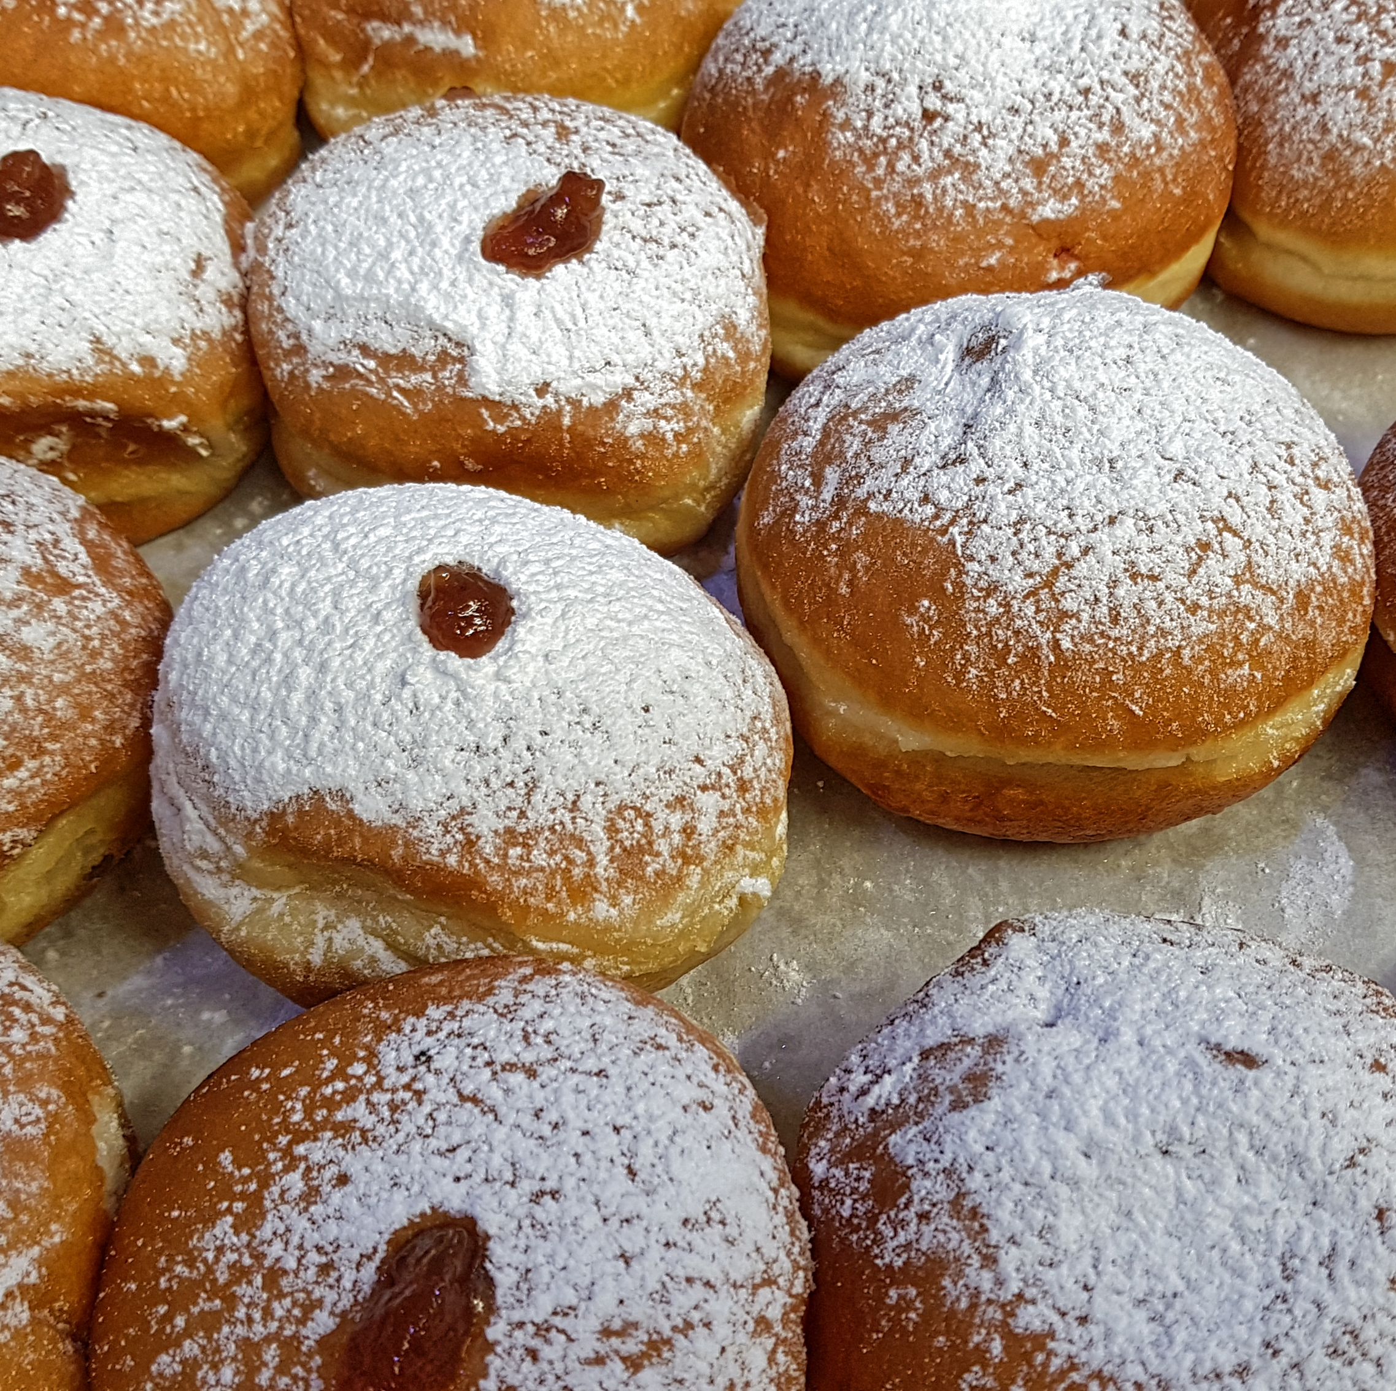
Introduction:
Small bakery located in a shopping retail park in Coventry .
Sales figures increased year on year
In 2020, the footfall and sales significantly decreased.
Restrictions imposed during lockdown.
Shopping center is much quieter now than in 2019
Delivery service not available
I will investigate the key factors contributing to this decline and identify the main issues affecting the bakery's future sustainability,

Slide 3
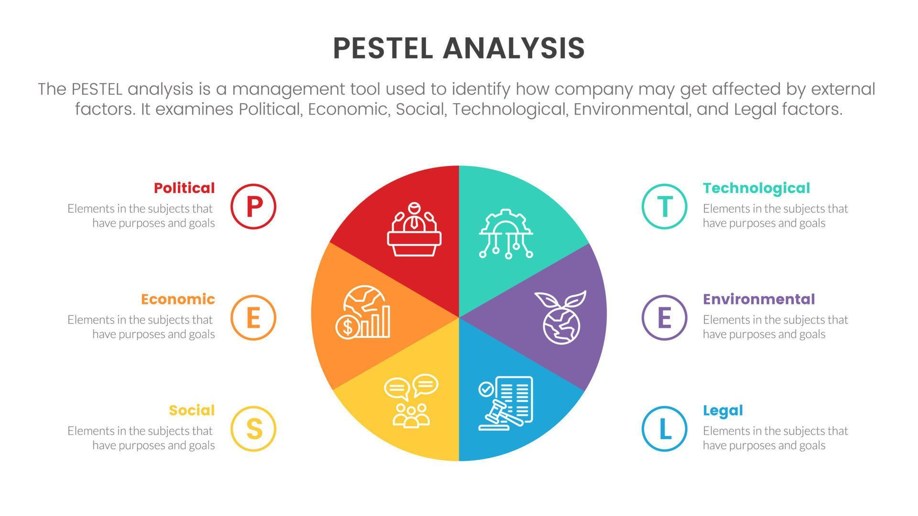

Slide 4
PESTEL Analysis to Basil's Bakery
Many factors involved
Government imposed restrictions during lockdown
Environment was not in favor of business.
Socially, people had limited their interactions with one another.
Technically they were unable to provide online services like delivery services and pre order systems.
Organic ingredients are vulnerable to weather conditions and crop failures, creating unpredictable supply costs.
Legally,
All business environment has been changed and in its present format is not viable to continue this business.

Slide 5
Main Problems
There is a stagnation in sales and Business growth.
Two types of problems:
1 -Internal problems
Limited marketing activities
Lack of product innovation to meet changing customer preferences
Lack of training
2-External problems.
Rising costs of ingredients, energy etc.
Changes in consumer spending attitudes.
Decreased customer demand

Slide 6
Critique of PESTEL Analysis
What is PESTEL?
WHY IS IT USED ?
Benefits of PESTEL
Limitations of PESTEL
In-text citation:
(Johnson et al, 2020)
(Gupta,2013)

Slide 7
Critique of Cause and Effect(fishbone)
What is cause-and-effect Analysis?
A problem- solving tool used to identify root causes of a problem.
Benefits identifies underlying causes
Easy to understand
Supports problem diagnosis
Limitations: does not prioritise causes
Depends on quality of information
Does not generate solutions
. Ishikawa(1985) Slack &Brandon-Jones(2022)

Slide 8
Fishbone diagram
Main problem-----------sales stagnation(25%below2019 level)
Customers—working from home, Redundances, Park visitors
Processes---no delivery service, no pre order capability, long waiting
Environment-retail park decline—shop closures
Finance—increased utilities—higher rent—rising insurance cost
Suppliers—crop failures—organic ingredient price volatility

Slide 9
Key findings
Sales remain 25% below pre-pandemic levels.
External environment changes are reducing customer demand
Rising operating costs less profits
Lack of delivery and digital ordering limits customer accessibility
Economic ,social and technological factors are the most significant influences (johnson,R,2020)

Slide 10


