Slide 1
Observation Techniques

Slide 2
Types of Observation
Participatory and
Non-participatory

Slide 3

Participatory
Observer engages with child during activity or daily routine.
May not always be recorded in written format.
Could be recorded as diary – feedback to parent.
Can be difficult to manage and record.
Can be planned or unplanned.
Keep a note pad handy for spontaneous activities or events!

Slide 4
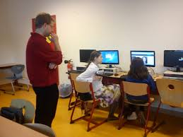
Non-Participatory
Observer stays outside activity.
Concentrates on child or aspect being watched.
Observer can watch child as an individual and in the context of an activity.
Observer needs to sit where they can see and hear without affecting child observed.
Children need to know which adults are available for help during observation.

Slide 5
Participatory & Non-Participatory
In general try to record the child’s behaviour without being involved because the observer could be influencing the child if they are involved in the activity.
It also becomes difficult to record information immediately if the observer is actively involved.

Slide 6
Structured and Naturalistic Observations
Might be set tasks which are organised in order to observe a particular behaviour with a child.
Naturalistic observations are based on events which happen spontaneously, for example a child offering to share their snack, or share a toy.

Slide 7
Observation Techniques

Slide 8
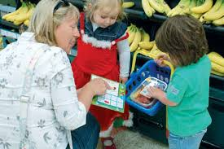
Observing Children
Please click on the image below to watch the video clip (approximately 5 minutes).

Slide 9
Remember Permissions
If using photographs, video or audio recordings of children you must have permission to do so before starting your observations.

Slide 10
Observation Techniques
Discussion
What do you think is meant by ‘technique’?
Can you name any that you may have
previously seen or used?

Slide 11
Methods
Written Record/Free description/Narrative
Checklist
Target observation/Time or Event Sample
Movement/tracking/spider’s web
Sociogram (or a graph of social links; it plots the structure of interpersonal relations in a group situation)

Slide 12
Select an Appropriate Technique
Understand the purpose of the technique.
Match the technique to the aim of the observation.
Different techniques gather specific data.
Using a range of techniques:
  Can enable holistic development to be observed.
  Can help the observer to accurately predict the child’s behaviour.

Slide 13
How do you choose the method?
Free description
To detail specific behaviour for a child’s
records, to plan for individuals, often over
short period of time (10 - 15 minutes).
Time sampling
For behaviour modification baseline data, for
child development research.

Slide 14
How do you choose the method?
Event Sampling
For behaviour modification, identifying a
trigger for an unwanted behaviour.
Checklist
To determine presence/absence of specified
behaviours, to plan for individuals, give an
overview of a child’s development/progress.

Slide 15
Written Records

Slide 16
Written Records
Free Description or Snapshot
Participatory or non-participatory
The observer records a free flowing description
everything seen within the time period of the
observation.
Record:
Everything child does and says.
Conceptual awareness – number, colour, shape.
Skill development.
How child approaches tasks and problem solves.
Persistence, motivation and attitudes in general.

Slide 17
Disadvantages
Can be difficult to record everything being observed.
Can also be very time consuming to write up everything that has been observed.
Needs to be written up immediately after observation completed to ensure accuracy.

Slide 18
Narrative free description observation account
Child playing with camera
The adult shows ‘child A’ the camera, he is looking at the camera and turns to look at the front of it. He places his hands on the camera and the adult supports the child to hold the camera in two hands. He tries to look through the camera and find the button; the adult places his finger on the button. The child looks through the camera and presses the button. The child gives the camera back to the adult and leaves the area.

Slide 19
Some useful descriptive vocabulary
Instead of says:
Whispers Stammers Mutters
Shouts Grumbles Argues
Declares Insists Announces
Instead of walks:
Marches Prances Strolls
Stomps Tiptoes Skips
Shuffles Toddles Strides

Slide 20
Tracking Diagrams

Slide 21
Tracking
Non-participatory
Floor map or plan of activities.
Tracks child’s movements between activities.
Observe:
  Concentration levels.
  Social interactions.
  Interest in activities/experiences.
  Behaviour.
  Also record other relevant information.

Slide 22
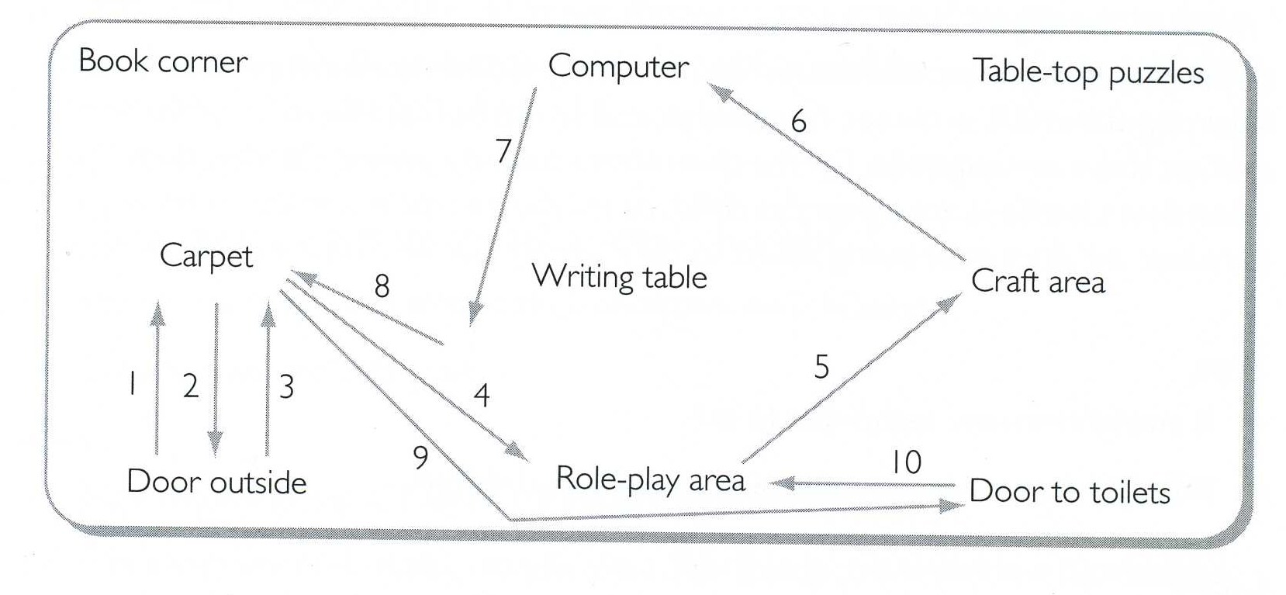
Tracking Diagram

Slide 23
Tracking Diagram
Diagram alone provide limited information.
Add additional notes (separate sheet):
  How long child stayed at activities.
  Who was present at each activity (adults/children).
  Brief notes on interaction, language and what child does at each activity.
These notes provide more information to enable more accurate interpretation later.

Slide 24
Checklists

Slide 25
Checklists
Can be used to record a single child’s progress
or to compare development between children.
Sometimes LEA’s/schools will have their own
development checklist.

Slide 26
Checklists or Tickcharts
Non-participatory
List of specific traits or behaviours whereby the observer indicates presence of absence of that trait/behaviour.
Often used in different settings to observe development and milestone achievement/ curriculum goals/attainment targets – these need to be researched in advance.
Can be used to record if a child can achieve a task, with or without assistance.
Used by a variety of health, care and education professionals.
Simple to use and can be a quick record to use to reflect on children’s development.
Need to be prepared in advance and need to be detailed enough to ensure conclusions can be made.

Slide 27
Checklists or Tickcharts
Additional comments may be added.
Further development activities can be planned following a tick list observation.
The same tasks can be carried out at a later date to compare and check the development and progress of the child.
Can be used with many children to give a broader picture of the age range.
Valuable tool for focussing attention when many different criteria need to be observed

Slide 28
Tick List
Child’s Name: D.O.B. Date: Observer:
Developmental Checklist
By 12 Months | Yes | No | Sometimes
Walk with some help?
Transfer objects from one hand to another
Respond verbally to someone talking to her
Clap hands
Stack two blocks
Hold beaker with two hands
Respond’s to own name being called

Slide 29
Advantages
Quick and relatively easy to use.
Can be repeated to check progress at a later date.
Useful in recording physical development.

Slide 30
Disadvantages
Only the skills assessed are recorded, they can be quite restrictive.
Relatively un-detailed and does not give a rounded picture of the child, only records how they completed the task on that particular day.
Often limited to one area of development
Must be prepared in advance
May not coincide with activity, therefore awareness of planning is required

Slide 31
Ways of recording observations
Field notes – Notebooks, logs
Diaries
Record sheets
Checklists/tally charts
Photographs, videos and audio recordings
Movement charts/Spider webs
Sociograms

Slide 32
Record of Observations
Whichever method you choose to use, all recordings must be made in the present tense!

Slide 33
References
Beaty, J. (2006) Observing Development of the
Young Child. Seventh Edition. Harlow: Pearson
Education Inc.

