Slide 1

NightShift Nail Lounge – A 24-Hour Safe Beauty Space for Women
2XXX
Module Name: Enterprise and Entrepreneurship
Module Code: LCLM4006
Assignment Title: Part 2 – Individual Presentation Pitch

Slide 2

Market Context and Identified Business Opportunity
The institutional changes in the UK labour trends have created quantifiable service-accessibility disparities in the beauty industry, especially to the female workers on shifts.
Approximately 28% of UK employees work evenings, nights, or rotating shifts, limiting access to standard daytime services (ONS, 2023).
One of the industries with large percentages of shift workers is healthcare, as well as retail, hospitality, and transport.
The majority of nail salons work 9:00am-7:00pm and cannot offer services after this time (Sharma, 2025).
Women to indicate increased fear of night-time urban areas and this affects mobility and consumption decisions (Johansson and Haandrikman, 2023).
Night-time economy continues to be an important economic factor (Meers, 2024), but there is disproportionate access to services.
NightShift Nail Lounge fills this structural gap.

Slide 3
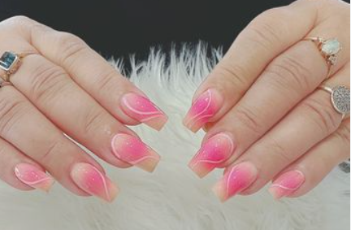
Business Overview – Core Service Offering
Service Model
NightShift Nail Lounge is a professional manicure and pedicure Salon that is available 24 hours in the area of the hospitals and transport centers to acquire intensive demand during shifts. The model will allow women who work night and evening shifts to access the service, as the service will be available according to the changes in labour patterns (ONS, 2023). Treatments involve the use of sterilised equipment and controlled procedures of chemical handling, which are in line with COSHH requirements (HSE, 2023).
Market Positioning
The enterprise does not compete in crowded markets during the daytime but takes a niche positioning. The business achieves differentiated value in the changing UK beauty industry by combining safety, professional standards and sustained accessibility (Sharma, 2025).

Slide 4
Unique Value Proposition and Competitive Differentiation
Strategic Element | Competitive Significance
“Safe Beauty After Hours” positioning | Differentiation through security-led value rather than price competition (Porter and Kramer, 1985)
CCTV, controlled entry, alarm systems | Reduces perceived vulnerability influencing female behaviour
Female-only late-night staffing | Enhances trust and psychological reassurance
Sterilised tools and regulated substances | Aligns with COSHH compliance standards (HSE, 2023)
24-hour availability | Captures unmet after-hours demand
The result of this integrated safety-quality model is the development of defensible competitive advantage in an underserved segment.

Slide 5
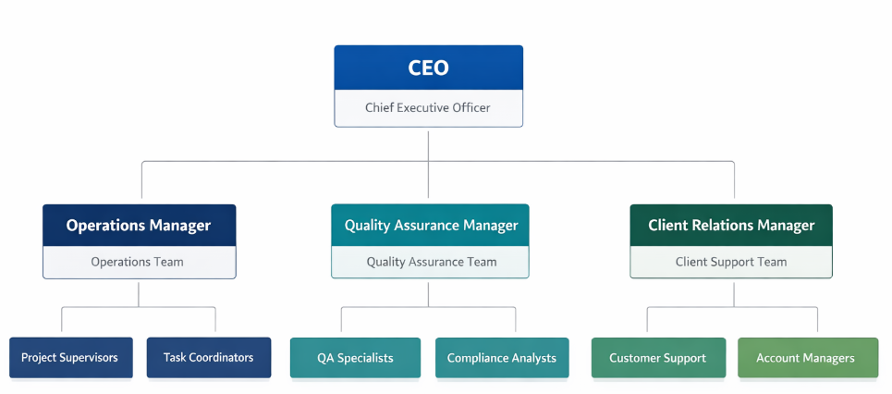
Organisational Structure and Legal Framework
Organisational Structure
The business incorporates a lean business design that is headed by the Founder and Managing Director who is in charge of financial management and strategic planning. The two registered nail technicians will switch on 24-hour shifts to maintain the continuity of services. A security and reception officer is available to ensure there is controlled entry in the late hours, to strengthen the position of safety. A part-time digital marketing coordinator is an individual who implements targeted campaigns and balances the promotional spending with the strategic goals (Chaffey and Smith, 2022).
Organisational Structure of NightShift Nail Lounge
Legal Framework
The company is registered as a Private Limited company (Ltd), which restricts the individual liability and enhances the credibility of investors, which contributes to the further expansion (Vernimmen et al., 2022).

Slide 6
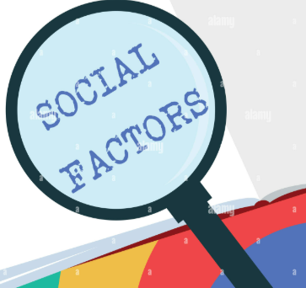
External Environment Analysis – Social Factors
The use of female labour is still increasing, changing the demand on the time and availability of consumption (Office for National Statistics, 2023).
Economic expansion of shift-based jobs in the healthcare and service changes the service demand patterns.
The literature on urban nightlife affirms that there is a constant gendered fear that affects women in their spatial behaviour (Garcia-Carpintero et al., 2022).
Females have a higher fear of crime than males (Johansson and Haandrikman, 2023).
Secure professional managed environment is becoming more and more important to consumers.
Such social changes create long-term demand of a safety-modeled integrated beauty model in line with the non-traditional working schedules.

Slide 7

External Environment Analysis – Economic Factors
Market Scale
The UK night-time economy is economically relevant, and it makes extended-hours commercially viable. The urban job concentration increases the sustainability of the services. The beauty and personal care industry is experiencing structural growth due to a change in lifestyle (Sharma, 2025).
Revenue Viability
Premium pricing is still an option where there is value differentiation in lieu of price competition (Porter and Kramer, 1985). Organized membership model strengthens predictable cash flow, stability in retention, which is a core concept of good financial planning (Vernimmen et al., 2022). The industry is thus under economic conditions that favour niche premium positioning.

Slide 8
External Environment Analysis – Legal and Regulatory Factors
The observation of COSHH guarantees the safe use of nail treatment chemicals (HSE, 2023).
The night work and Working Time rules are the regulations of employee protection in the working conditions based on shifts (ACAS, 2025).
Legitimacy of the workforce is guaranteed by compliance with National Minimum Wage.
Licensing of salon premises involving health and safety.
Membership and digital booking system data governance.
Structured regulatory compliance enhances legitimacy, reduces legal exposure, and supports sustainable operations.

Slide 9
Marketing Strategy I – Concentrated Targeting and Digital Engagement
Target Market Focus
Segment Dimension | Strategic Application
Demographic | Women aged 20–45
Geographic | Hospitals, universities, transport hubs
Psychographic | Safety-conscious, convenience-oriented professionals
Strategic Implementation
Instagram and Tik Tok campaigns are also digital, which increases the relevance of the message based on the shift-change (Chaffey and Smith, 2022). Promotions of institutional partnerships with NHS trusts and universities are more credible. Organic growth is stimulated by referral incentives.
Strategic Outcome
This targeted approach enhances the level of marketing and increases the local brand loyalty.

Slide 10


Marketing Strategy II – Premium Pricing and Membership Model
Pricing Strategy
Premium convenience-based pricing demonstrates a 24-hour availability and investment security. Differentiated NHS and student promotions would ensure penetration of the market without losing value (Kotler et al., 2021).
Membership Structure
Subscription of a month will offer priority booking and loyalty offers. Rewards on referrals would promote repetition.
Strategic Impact
The recurring revenue is made more stable with the help of this structured model, as well as customer lifetime value is enhanced and the dependence on one-time purchases is minimised, which reinforced financial sustainability (Vernimmen et al., 2022).

Slide 11
Funding Requirements and Financial Allocation
NightShift Nail Lounge requires £65,000 in start-up capital structured as follows:
Allocation Area | Amount (£)
Renovation & Fit-out | 20,000
Equipment | 10,000
Security Systems | 8,000
Inventory | 7,000
Legal & Licensing | 5,000
Marketing | 5,000
Working Capital | 10,000
The funding will consist of 20 percent of founder equity, 20 percent of a loan, and 20 percent of an angel investment, which will diversify the financial risk, reducing the strategic control.

Slide 12
References
ACAS. 2025. Night workers - Working time rules [Online]. Available: https://www.acas.org.uk/working-time-rules/night-workers [Accessed 17 March 2026].
Chaffey, D. & Smith, P. R. 2022. Digital marketing excellence: planning, optimizing and integrating online marketing, Routledge.
García-Carpintero, M. Á., de Diego-Cordero, R., Pavón-Benítez, L. & Tarriño-Concejero, L., 2022. ‘Fear of walking home alone’: Urban spaces of fear in youth nightlife. European Journal of Women's Studies, 29, 39-53.
HSE. 2023. Control of Substances Hazardous to Health (COSHH) [Online]. Available: https://www.hse.gov.uk/coshh/ [Accessed 17 March 2026].
Johansson, S. & Haandrikman, K., 2023. Gendered fear of crime in the urban context: A comparative multilevel study of women’s and men’s fear of crime. Journal of Urban Affairs, 45, 1238-1264.
Kotler, P., Armstrong, G. & Opresnik, M. O. 2021. Principles of marketing 18e global edition, Pearson Education Limited.
Meers, J., 2024. “Vertical drinking” in the night-time economy: alcohol licencing and proxies for “uncivilised” drinking bodies. Leisure Studies, 43, 722-738.
Office for National Statistics. 2023. Working patterns in the UK labour market: 2023 [Online]. Available: https://www.ons.gov.uk/releases/uklabourmarketaugust2023 [Accessed 17 March 2026].
Porter, M. E. & Kramer, M. R., 1985. Advantage. Creating and Sustaining Superior Performance, Simons, 56-68.
Sharma, M. N. 2025. A Study of Changing Scenario of Beauty and Personal Care Industry.
Vernimmen, P., Quiry, P. & Le Fur, Y. 2022. Corporate finance: theory and practice, John Wiley & Sons.

