Slide 1
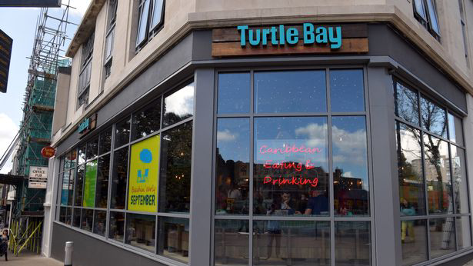
Turtle Bay
Presentation on Turtle Bay Swansea: analysis of food and service experience.

Slide 2

Turtle Bay: a Caribbean experience.
Provide unique Caribbean experience: rum-based cocktails, menu that combines Caribbean spices with fragrant marinates, hot sauces, fresh fruits, signature jerk chicken.
Restaurant chain founded 12 years ago by Ajith.

Slide 3
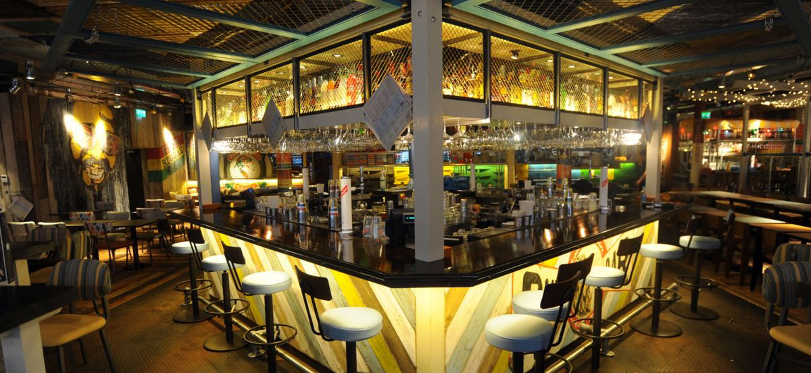
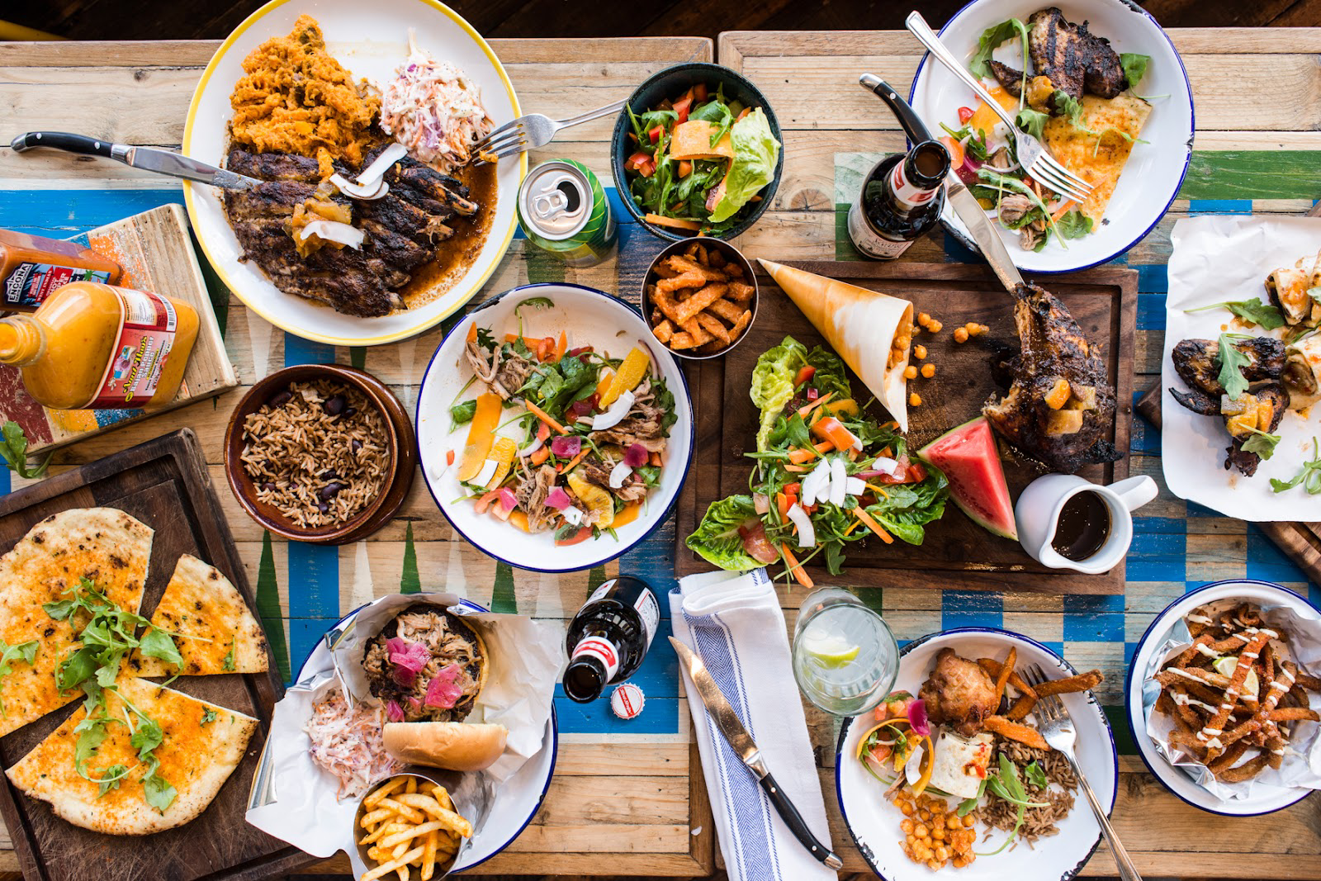
Marketing:
A centralised island bar.
Open view kitchen.
Warm atmosphere: “we’ve done our best to recreate the spirit, the smiles and the magic of the Caribbean”(..)
Reggae soundtrack.
Menu: many options including vegan/vegetarian.
Different offers: Breakfast/Brunch/ Bottomless Brunch.
Drinks: extended choice of cocktails and mocktails, spiced and flavoured, Red Stripe draft beer.
Price range: around £20/£30.
Advertising: Facebook, Instagram, TikTok, official website.

Slide 4
Customer value:
It offers unique experience: typical Caribbean music, eye for details, colours that reminds reggae style.
Turtle Bay Club: app that offers stamp, discounts, invitations to try new dishes, booking and ordering, give feedback, attend events.
Based on my experience: I had crispy chilli squid, coconut rice and peas, chicken Buddha, coconut espresso martini and banana toffee cheesecake. Overall experience: bad. Long waiting time, cold food, poor service. Good good quality.

Slide 5
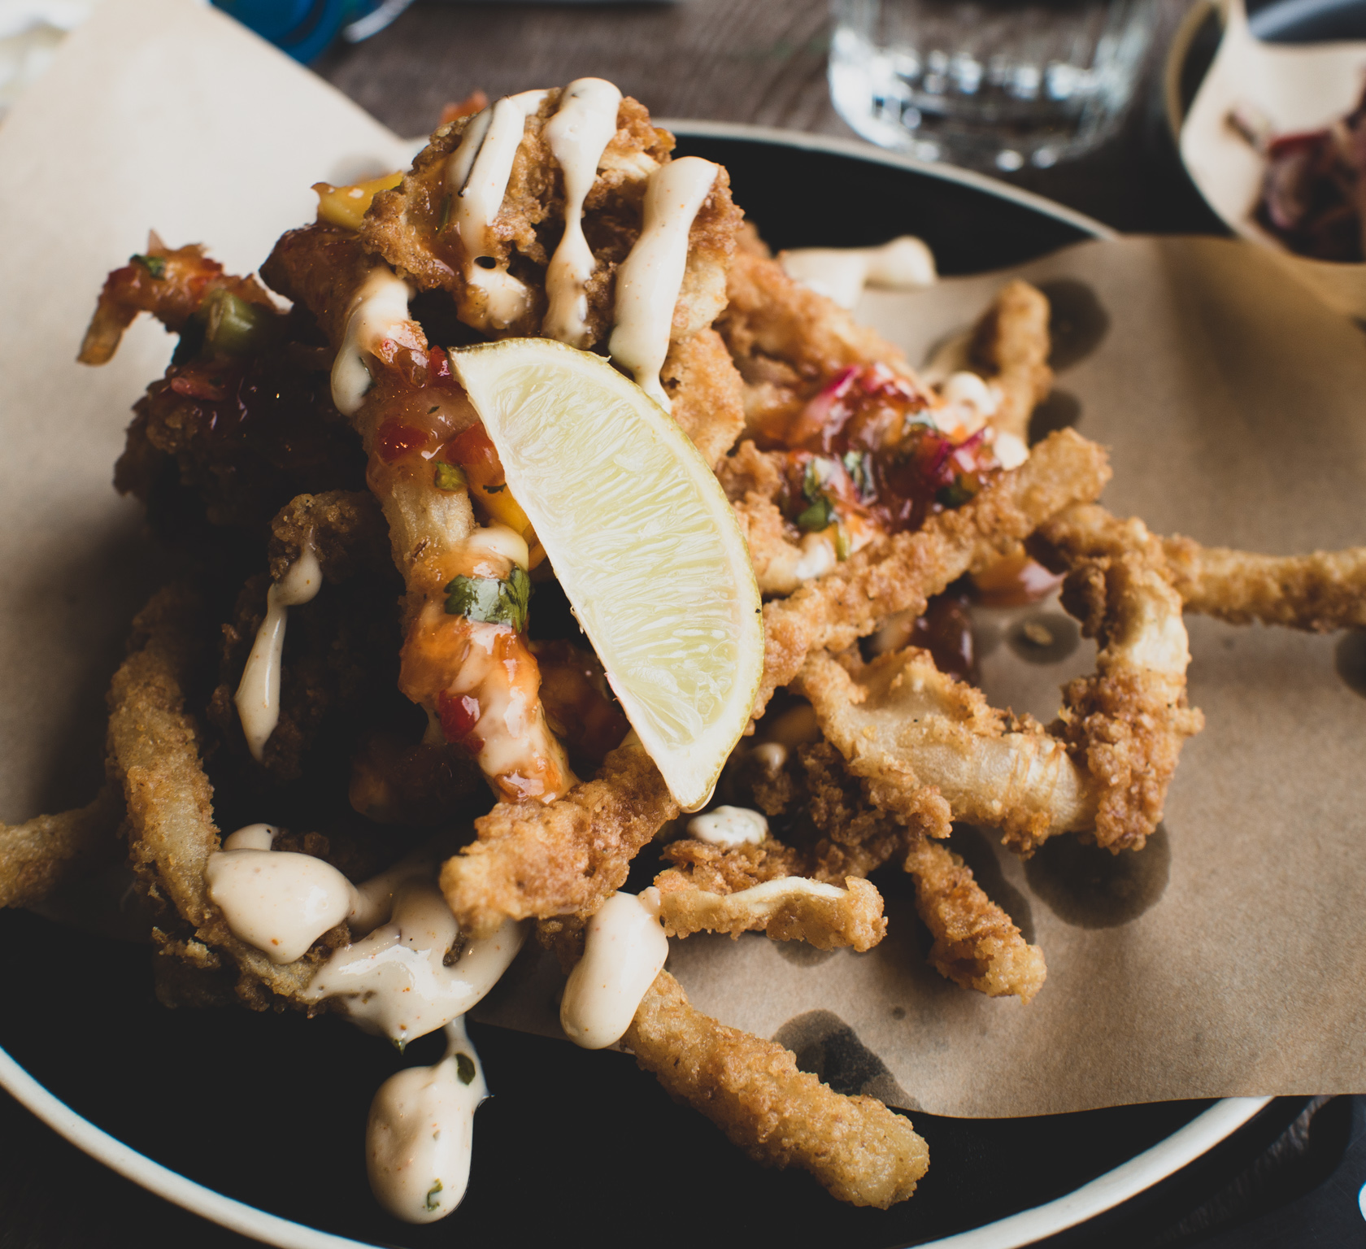
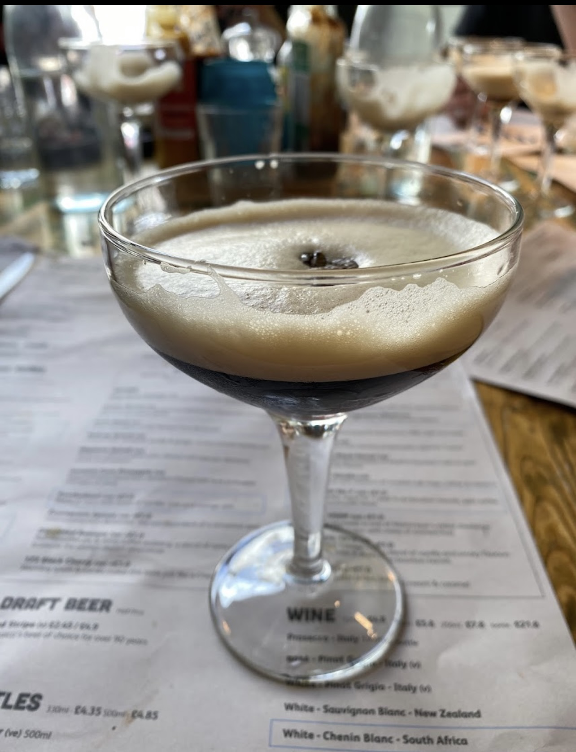
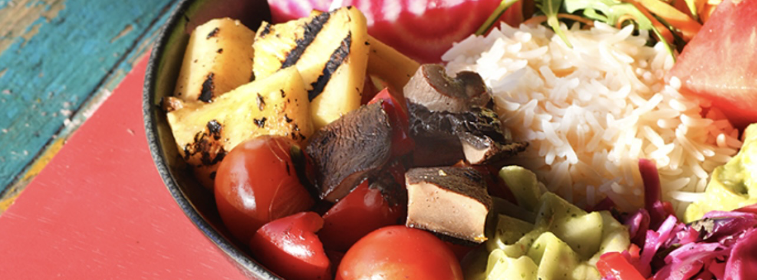
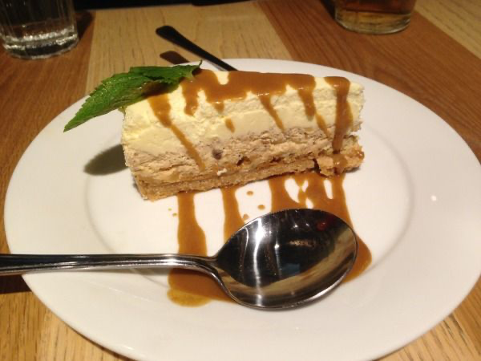
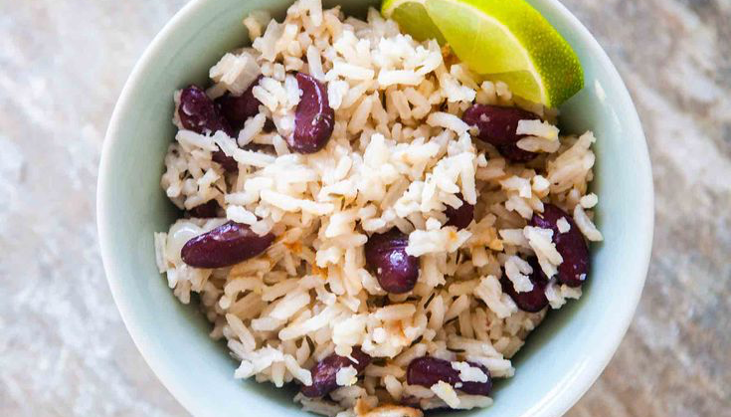

Slide 6

References:
Turtle Bay available at: https://turtlebay.co.uk/news/our-story. (accessed on 10/06/2022.)
Turtle Bay app available at: https://turtlebay.co.uk/app (accessed on 10/06/2022.)
Piper available at: piper.co.uk/about-us/ (accessed on 10/06/2022.)
Piper partnership with Turtle Bay available at: piper.co.uk/our-brands/ (accessed on 10/06/2022.)
Turtle Bay offers available at: turtlebay.co.uk/bottomless-brunch (accessed on 10/06/2022.)
Turtle Bay gift cards available at: turtlebay.co.uk/gift-cards (accessed on 10/06/2022.)
Turtle Bay vacancies available at: turtlebay.co.uk/careers/all-vacancies (accessed on 10/06/2022.)
Turtle Bay recipes available at: turtlebay.co.uk/news (accessed on 10/06/2022.)

