Slide 1
Models of Modern Policing
Evidence Based Preventative Policing (EBP)
Wynne Jones

Slide 2

Evidence Based Policing Objectives
Understand the Principles of Evidence Based Preventative Policing (EBP)
To gain an Understanding how EBP can improve ‘policing’ and ‘public safety’, and how it can serve to reduce crime, harm and disorder.
To evaluate the effectiveness of EBP in comparison with other models of policing.

Slide 3
EBP
One goal of modern policing structures is to ensure that strategic and tactical plans and actions are evidence based.
Research is the foundation of evidence based policing and projects and police operations are often evaluated by external agencies such as Universities.

Slide 4
What is evidence-based policing (EBP)?
Evidence-Based Policing (EBP) can be understood as a problem-solving cycle that involves police officers and staff using and creating the best available research evidence to inform or test policing policies, decisions and practices.

Slide 5
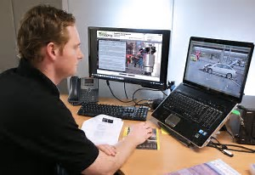
EBP - A Definition….
‘Informing policing priorities by weighing the harms of criminality together with data from beyond crime and disorder, in order to focus police resources in furtherance of both crime and harm reduction’.
(Ratcliffe 2015a:3)

Slide 6
Evidence Based Policing - What is it ?
“A philosophy or managerial style, where scientific evidence should be the central foundation for decision making in policing”. (Sherman 1998)

Slide 7
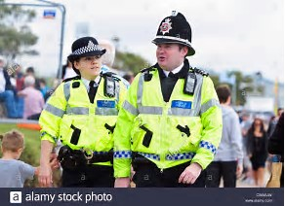
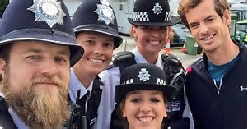
Functions of EBP
Research used to target places where police are needed most,
Evidence tested when deciding on policing ‘tactics’,
Recognition that policing is not just about crime fighting but also:

Slide 8

Functions of EBP
‘to improve the safety and well being of the people by promoting measures to prevent crime, harm and disorder’
(Independent Police Commission 2015:31)

Slide 9
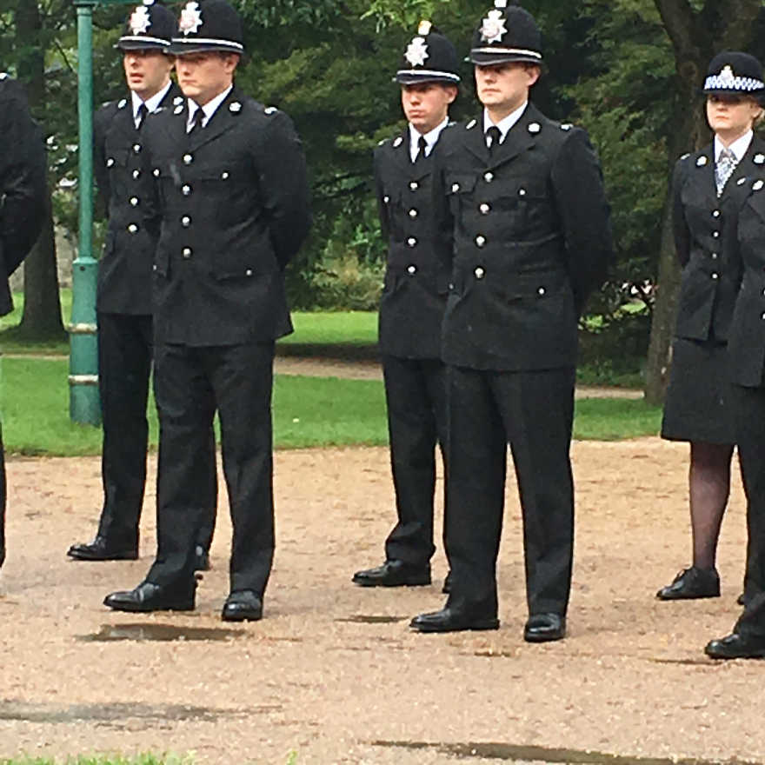
Stages of EBP:
Identify Problem
Define Problem
Understand Problem
Develop Ideas
Identify Opportunities
Plan
Implement
Evaluate

Slide 10

Collaborative Working:
Local Authorities
Emergency Services
Community
Local businesses

Slide 11
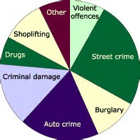
Identifying Sources of evidence to inform policing decisions:
Practice based expertise (experience)
Research (Qualitative and Quantitative)

Slide 12
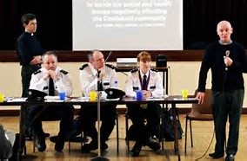
Sources of evidence to inform policing decisions:
Community
Colleagues
Surveys
Other forces
Other agencies
Universities (research)

Slide 13



Causes for Concern in Policing:
ASB
Vulnerable persons
Crime Rates
Fear of Crime

Slide 14
ADAPT….
Change things (or leave them the same) dependent on outcomes of actions taken.

Slide 15
The “triple-T” Strategy
Targeting, Testing, and Tracking.
Evidence-based Targeting requires systematic ranking and comparison of levels of harm associated with various places, times, people, and situations that policing can lawfully address.
Evidence-based Testing helps assure that police neither increase crime nor waste money.
Tracking whether police are doing what police leaders decide should be done may grow most rapidly in coming years by the use of GPS records of where police go and body-worn video records of what happens in encounters with citizens.

Slide 16
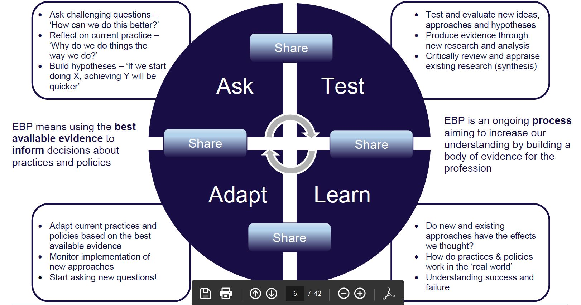
Introducing ATLAS….

Slide 17
ASK……
The start of the problem-solving cycle involves asking questions that will help to understand a particular problem or area of policing better and then using this understanding to develop a theory (or hypothesis) about the effect of doing things differently.

Slide 18
TEST…..
This stage helps you to understand whether your response will achieve the effect that you wanted e.g. reduce antisocial behaviour.
When testing a new response you need to be clear about what you did (how the response was implemented) and what change you are expecting and how this will be measured (the outcome).
In the example of antisocial behaviour you could measure the number of ASB incidents recorded or number of calls for service.

Slide 19

LEARN…..
Once you have introduced your intervention then you need to measure your outcomes.
The timing of your measurement will depend on how quickly you think your response will work and this will vary depending on the intervention.

Slide 20
ADAPT…..
Once you have measured your outcome you should adapt your response to reflect what you found.
If you find that your intervention isn’t having any effect then you should stop using the resources in this way and use the findings to adapt your understanding of the problem.
If you find that it is working then you might want to suggest trying it in areas which are experiencing similar problems.

Slide 21
SHARE….
At all points in the process you should share, for example, your questions, your plans, your findings, your lessons, your experiences of change – and your new questions!
By sharing your questions and findings you might identify others trying to tackle similar problems or you can stop somebody using their resources on something you have found doesn’t work.

Slide 22
ATLAS
ASK- QUESTIONS TO UNDERSTAND PROBLEM
TEST – WHAT YOU DID
LEARN – MEASURE YOUR OUTCOMES
ADAPT – STOP or EXPAND USE
SHARE – WITH OTHERS FACING SAME PROBLEM

Slide 23
What do we mean by ‘best available’ evidence?
Another part of using an evidence-based approach is to use the ‘best available’ evidence.
By ‘best available’ we mean evidence based on research which is carefully conducted and peer reviewed, relevant and appropriate to the question being asked, and transparent about how it has reached its conclusions, and about its limitations.

Slide 24
What do we mean by ‘best available’ evidence?
1. Were the aims and objectives clearly reported?
2. Was there an adequate description of the context in which the research was carried out (including a rationale for why the study was undertaken)?
3. Was there an adequate description of the sample used and the methods for how the sample was identified and recruited?
4. Was there an adequate description of the methods used to collect data?
5. Was there an adequate description of the methods used to analyse data?

Slide 25
Questions???

