Slide 1

DIGITIAL SKILLS & RESEARCH METHODS
Name: Clement Ununamon Ehiosun (1917207), Jacquelina Pedro (2224743), Natalia Domnita (2224748) & Salim Patwary (2228594)
Lecturer: Koshik Modak
Lecture Code: LCHS4002_LON

Slide 2
Table of contents
The use of contemporary technology in healthcare
The use of technology during the Covid-19 pandemic
The use of digital communication, collaboration & participation
The relevance of technical proficiency for data & information handling
The use of digital literacy for employee well-being & career development
Notes:
The relevance of technical proficiency for data & information handling

Slide 3

The use of contemporary technology in healthcare

Slide 4
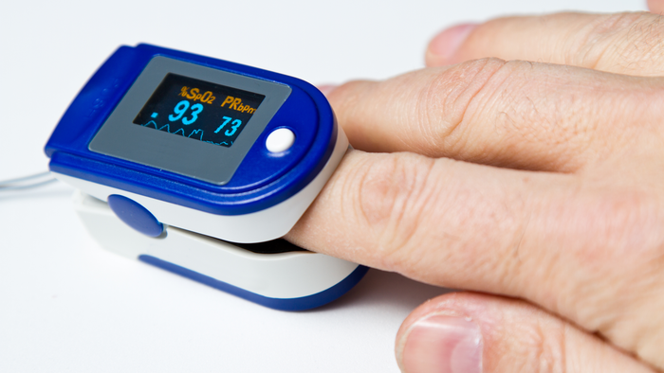
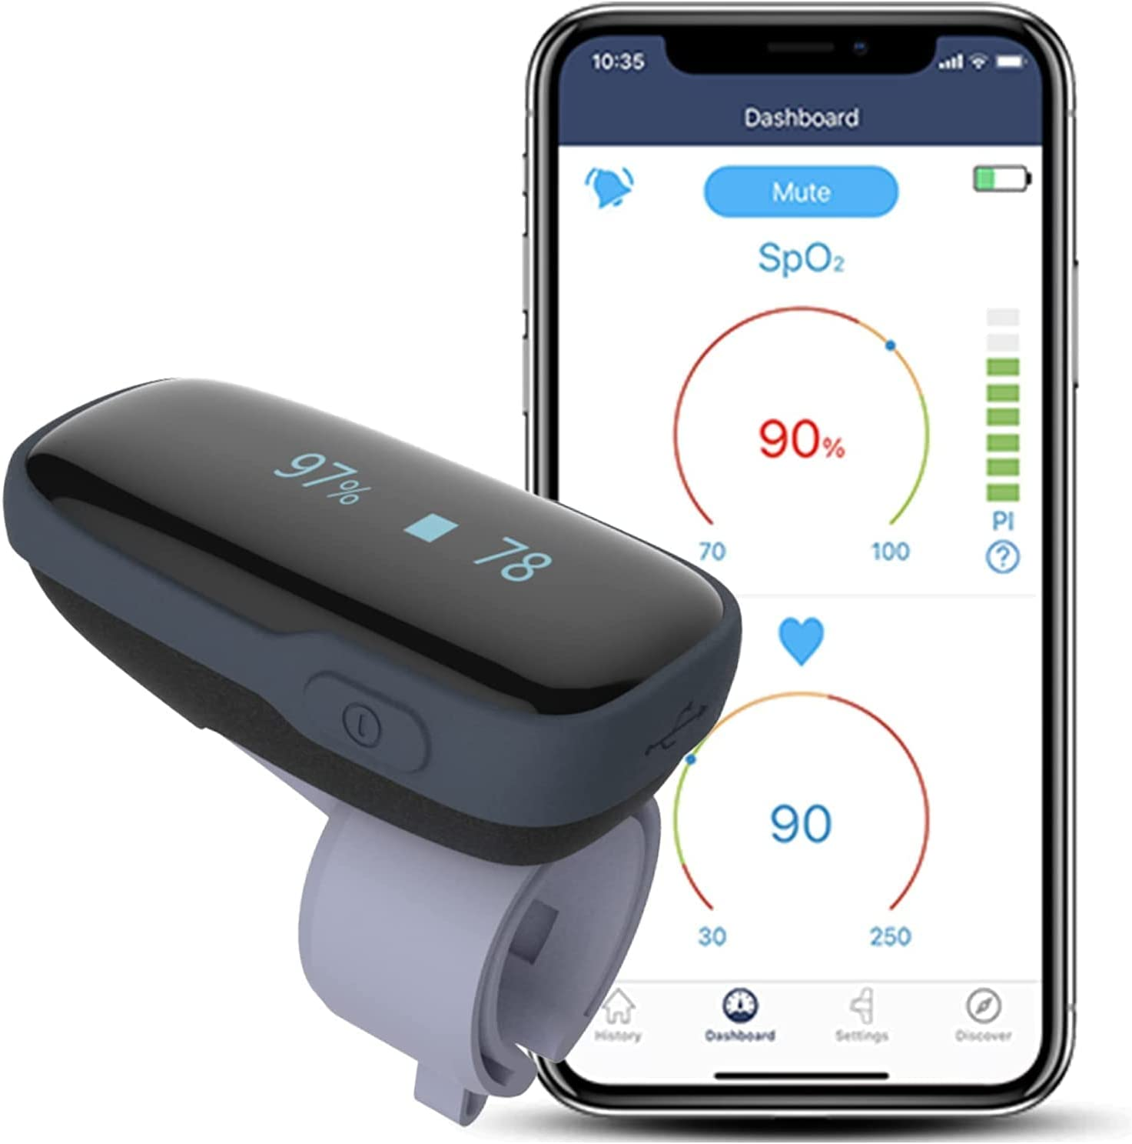
NEW TECHNOLOGY USED IN GATE LODGE RESIDENTIAL CARE HOME PURLEY.
Diagnostic: Pulse oximeter Bluetooth Oximeter
Heart Rate Monitor:
Helps to identify the heart movement or Rate (Clinic, 2023)
Blood Oxygen Monitor:
To measure the Oxygen levels in the blood
95% to 99% for healthy person range. Below 88% call 999 (Today, 2022).
Sleep Oxygen Monitor :
With finger monitor for overnight use
to measure heartrate
The device beeps to track data for Low SpO2 Level (Masimo,2023).
(Masimo, 2023)
(Masimo, 2023)

Slide 5

DESCRIPTION
The contemporary Technology are those new forms of
Information and transactions PROCESS
Including Medical Devices:
“IT Systems, MCM
Laboratory tests
Ultrasound, Scans, Electrocardiogram
Hoist” and many more …
Their benefits are to improve Patients Health
Safety and well-being, to Help professional for time management
And Data protection regulation (Techzone, 2023).
(Matters, 2023)

Slide 6
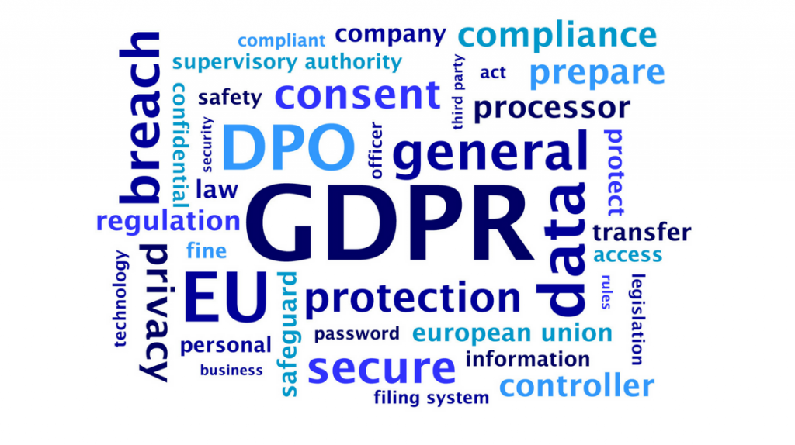
Administrative
GDPR compliant (General Data Protection Regulation)
How business process and handle data
the Laws that protect the personal information of individuals
Digital Care System:
“Use of information and communications technologies in medicine and health professions to menage illnesses and health risks and promoting wellness.”( smartphones, scanners…)
(Willcox, 2018)
(Wilcox,2018

Slide 7
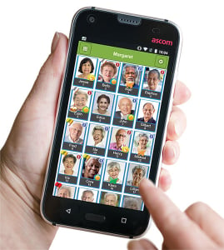
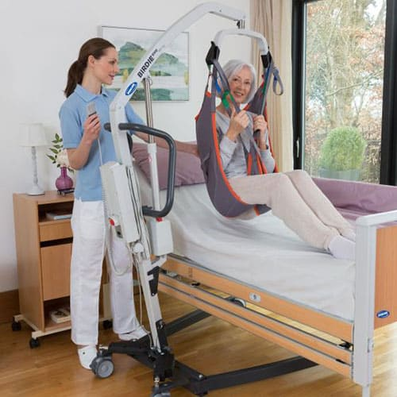
CARE SUPPORT : MCM AND HOIST
MCM HOIST
Mobile Care
Monitoring
Storing Patients Details.
Recording observations, activities, care, food and fluid
Documenting Medication, professional visit (Software,2023).
Equipment
to ensure safe handling of
patient
New technology
To improve Maximum comfort and security when lifting or transferring a patient (Hire,2023).
(Software, 2020)
(Hire, 2023)

Slide 8
The use of technology during the Covid-19 pandemic

Slide 9
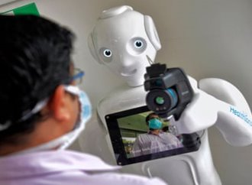
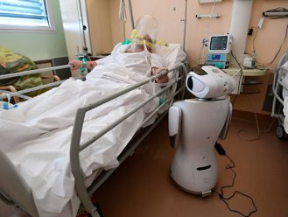
USE OF ROBOTS
A Robot called Mitra was developed in India.​
Facial and chest mounted tablet technology was developed for both patients and families ​
Take vital readings, treatments and consultations by Doctors for patients.​
(Sunder, 2020)
Source: (AFP,2020)
Source Photograph: Manjunath Kiran/AFP/Getty

Slide 10
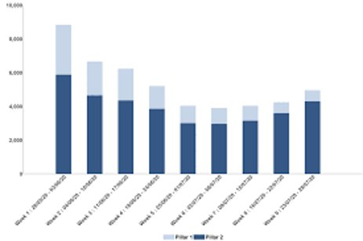

NHS TRACK & TRACE
Covid/Vaccine pass​
Covid Self testing- Rapid Antigen Test (RAT)​
Send and receive messages through smartphone, tablet or PC​
Help to quarantine infected person(s)​
(NHS,2020)
Source: (NHS,2020)

Slide 11
The use of digital communication, collaboration & participation

Slide 12
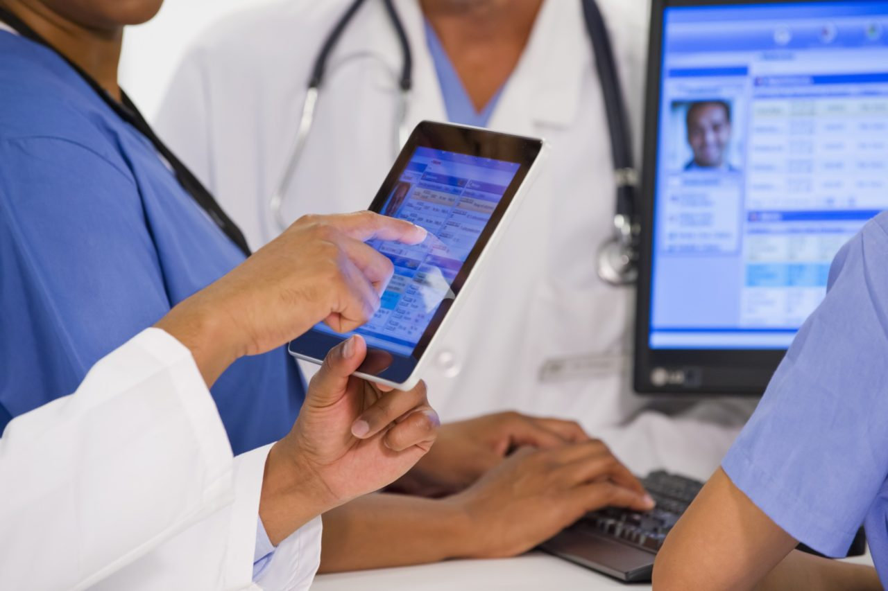
THE USE OF DIGITAL COMMUNICATIONS IN HEALTH
Figure 1: Example of digital communications in health
Overview of digital communications:
NHS have incorporated digital communications between clinicians and patients by effectively introducing NHS111
Research shows digital communications are effective in healthcare (e-mail services have improved outcomes
Barriers are shown in digital communication in healthcare. May exclude the disadvantaged groups (older and disabled people).
(Huxley, C.J. et al, 2015)
(Morr, 2020)

Slide 13
THE DIGITAL COLLABORATION IN HEALTH
Overview of digital collaboration:
Digital collaboration is a platform of learning and support for clinicians to deliver remote services to patients
Innovative Collaborative workshop: clinicians can discuss their experiences
However, IT systems are becoming difficult for hospitals to maintain (Gleiss & Lewandowski, 2021)
The Intel Unite Solution: “…collaboration platform that allows clinicians to easily, more securely and wirelessly share digital information…” (Intel.co.uk, 2023)
(NHS 75 England, no date)

Slide 14
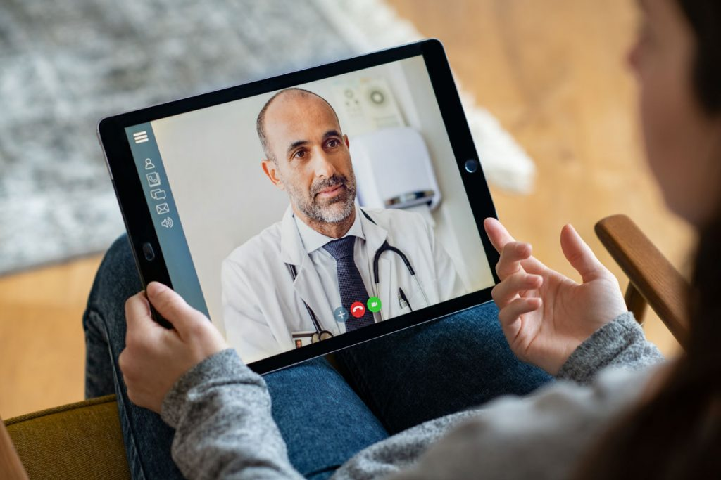
THE USE OF DIGITAL PARTICIPATION IN HEALTH
Overview of digital participation:
Digital participation “…refers to the active involvement…through the use of modern information and communication technology (ICT), such as the internet.” (Seifert & Rössel, 2019)
(digital.nhs.uk, no date)
Figure 3: Example of digital participation between clinician and patient
  (Infinite Connect, 2021)

Slide 15
THE USE OF DIGITAL PARTICIPATION IN HEALTH
The NHS long-term plan wants to reduce inequalities surrounding digital exclusion
Patients' characteristics under the Equality Act 2010 (age, disability and race) are more likely to experience digital exclusion (digital.nhs.uk, no date)
(digital.nhs.uk, no date)
The positive impact of increased digital inclusion:
The NHS Widening Digital Participation programme displayed advantages of digital inclusion.
The negative impact of increased digital exclusion:
(digital.nhs.uk, no date)
59%
Confidence grew when using online health information
52%
Felt less lonely/isolated

Slide 16
Digital communications, collaborations & participation in healthcare offer many benefits to local teams. Clinicians can effectively provide patient care remotely. Patients have access to digital health.
Consequently, as a sector, more support is required under all three areas of digital. Clinicians require support (IT maintenance) whilst patients need digital support to avoid the downsides of the internet.
Notes:
As a sector, we understand how digital communications, collaborations and participation can benefit clinicians and patients. However, we need to examine further support for digital health to protect both clinicians and patients.

Slide 17
The relevance of technical proficiency for data and information handling

Slide 18
THE RELEVANCE OF DATA HANDLING
Data can be a number, symbol, codes, graphs, word, etc. Handling data information is utilized to make forecasts, presentations and to store information. Collecting data requests technical skills as data analysis, programming languages, common operating systems and technical writing.

Slide 19



TECHNICAL PROFICENCY
Definition: Technical skills and knowledge required in professional job role. Ability to apply technical skills in data analysis, web development, graphic design, writing, etc.

Slide 20



TECHNICAL PROFICIENCY FOR DATA INFORMATION HANDLING
Using complex tools both software and hardware
Using number-based methodologies to create forecasts
Recording and analysing data with precision

Slide 21
The importance of technical proficiency in health and social care
- develop web pages to promote services
-write reports
-plan forecasts
-organize shifts
-manage finances

Slide 22
The use of digital literacy for employee well-being & career development

Slide 23

Digital literacy
The ability to navigate in internet using skills as writing, reading, listening, etc.

Slide 24
THE USE OF DIGITAL LITERACY
Digital literacy is used for employees' professional career and their well being by :
- the ability to use software
-collaboration
-the ability to find information
-the ability to manifest creativity
-critical thinking

Slide 25
EMPLOYEES PROFESSIONAL SKILLS & WELL BEING
Teamwork Mental well being
Emotional intelligence Emotional health
Organization Financial
Problem-solving Cultural
Empathy Environmental

Slide 26
THE USE OF DIGITAL LITERACY FOR EMPLOYEES WELL BEING & THEIR PROFESIONAL CAREER IN SOCIAL CARE
A social care worker must be updated with digital evolution in order to achieve results at work. A healthy employee offers to the company higher results and efficiency. In social care department an employee must be skilled to be able to use

Slide 27
REFERENCES
Clinic, C., 2023. Home page. [Online]
Available at: https://my.clevelandclinic.org/health/diagnostics/23429-heart-rate-monitor
[Accessed 13 April 2023].
Crouch,H 2020 https://www.digitalhealth.netnhs-trust. Assesed 5 may, 2020​
Davis,N 2020 https://www.theguardian.com/society/2020/jul/05/gp-appointments-phone-video-coronavirus-lockdown-nhs
digital.nhs.uk (no date) Why digital inclusion matters to health and social care, digital.nhs.uk. NHS 75 digital . Available at: https://digital.nhs.uk/about-nhs-digital/corporate-information-and-documents/digital-inclusion/digital-inclusion-in-health-and-social-care (Accessed: April 7, 2023).
Gleiss, A. and Lewandowski, S. (2021) “Removing barriers for digital health through organizing ambidexterity in Hospitals,” Journal of Public Health, 30(1), pp. 21–35. Available at: https://doi.org/10.1007/s10389-021-01532-y.
Hire, M., 2023. Home page. [Online]
Available at: https://mobilityhire.com/hire/care-product/patient-hoist-150kg-compact
[Accessed 13 April 2023].
Hustchings,R 2020 :The impact of Covid-19 on the use of digital technology in the NHS, Nuffiedtrust.org.uk​
Huxley, C.J. et al. (2015) “Digital communication between clinician and patient and the impact on marginalised groups: A realist review in general practice,” British Journal of General Practice, 65(641). Available at: https://doi.org/10.3399/bjgp15x687853.
Intel.co.uk. (2023) Collaboration helps connect healthcare professionals in a crisis, How a Modern Collaboration Solution Can Help Connect Healthcare Professionals During a Healthcare Crisis (or Any Time). Intel Unite Solution . Available at: https://www.intel.co.uk/content/www/uk/en/architecture-and-technology/unite/modern-collaboration-connects-healthcare-professionals-case-study.html (Accessed: April 7, 2023).
Masters, S 2022 www.ukri.org​
Matters, C. M., 2023. Person Centred Software Ltd. [Online]
Available at: https://www.caremanagementmatters.co.uk/listing/person-centred-software/
[Accessed 13 April 2023]
Masimo, 2023. Home page. [Online]
Available at: https://www.masimo.co.uk/products/monitors/spot-check/mightysatrx/
Morr, M. (2020) Electronic Communication From Pulmonologist to PCP Beneficial in COPD Care. Pulmonology advisor. Available at: https://www.pulmonologyadvisor.com/home/meetings/ats-2020/electronic-communication-from-pulmonologist-to-pcp-beneficial-in-copd-care/ (Accessed: April 2023).
Moxon, D.D. (no date) Digital Participation, SALTO. Available at: https://participationpool.eu/resource-category/youth-participation/alternative-forms-of-participation/digital-participation/ (Accessed: April 8, 2023).
[Accessed 11 April 2023].
NHS 75 (no date) NHS England - Transformation Directorate. NHS 75 England. Available at: https://transform.england.nhs.uk/covid-19-response/technology-nhs/innovation-collaborative-for-digital-health/ (Accessed: April 7, 2023).
Seifert, A. and Rössel, J. (2019) “Digital Participation,” Encyclopedia of Gerontology and Population Aging, pp. 1–5. Available at: https://doi.org/10.1007/978-3-319-69892-2_1017-1.
Software, P. C., 2020. Home page. [Online]
Available at: https://personcentredsoftware.com/resources/mobile-care-monitoring-overview-video
[Accessed 13 2023 April].
Techzone, H., 2023. Home page. [Online]
Available at: https://www.healthtechzone.com/topics/healthcare/articles/2023/04/11/455538-digital-health-intersection-technology-healthcare.htm
[Accessed 13 April 2023].
Today, M. n., 2022. Home page. [Online]
Available at: https://www.medicalnewstoday.com/articles/321044
[Accessed 13 April 2023].
Whittington, https://www.whittington.nhs.uk
Willcox, D., 2018. Responce source. [Online]
Available at: https://www.responsesource.com/blog/gdpr-compliance-media-relations/
[Accessed 2023 April 2023].

