Slide 1
Organisational Leadership –
Assignment 1
Supporting Presentation
Rio Bonnici (2104333)

Slide 2
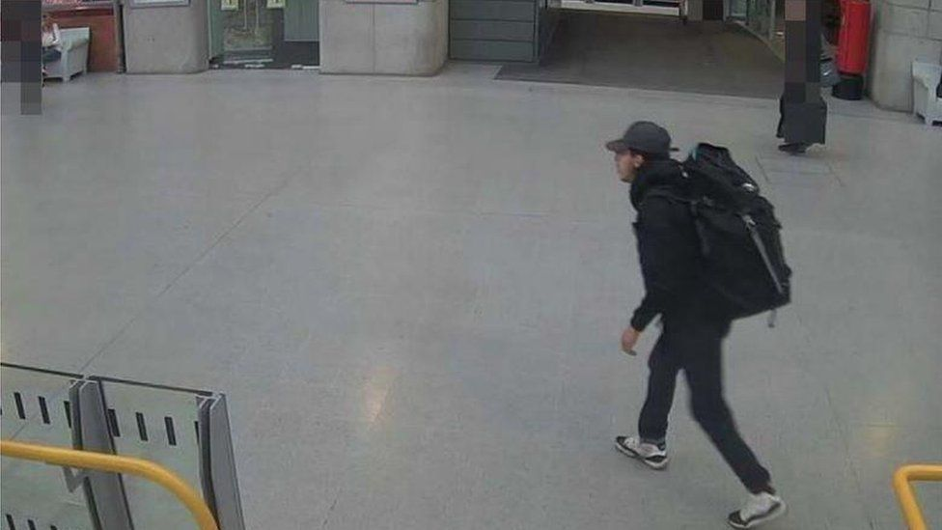
Background of the Incident
22nd May 2017
Salman Abedi:
Detonated a bomb as attendees were leaving the Ariana Grande concert.
The event caused widespread panic as people were fleeing the venue for their lives, this also shocked the world in many ways by displaying how the public services had failed to be as effective as they potentially could have been.
Although it was found that ‘even in the best prepared units, such an incident will pose significant challenges due to the unpredictable nature of these events with respect to timing and number of casualties’ (Farrelly; Craigie; Santos; Smith; Pollard; Jones, 2020).
Took the lives of 22 people as well as injuring over 800 people.
(BBC, 2020)

Slide 3
Democratic Style of Leadership
Theorised by Kurt Lewin in 1939
Leader values opinions and ideas given by others
Followers do not blindly take orders
A final decision is made after many aspects discussed within the team have been considered.
The team members will feel motivated by their leader if this leadership style is used because the leader will take consideration into the team’s ideas and points of discussion.
Most beneficial when working towards a goal over time where the team can progress and improve in order to achieve the common goal.

Slide 4
Autocratic Style of Leadership
Also theorised by Kurt Lewin in 1939
Strict style of leadership
Very opposite when compared to the democratic style of leadership
Leader gives out tasks and objectives and expects no questioning or discussion from the team. Team members are expected to follow orders from the leader.
Leader ultimately has the final decision no matter of any team members’ input. The leader maintains maximal control over the tasks.
This style of leadership is used mostly in dangerous situations because they do not have time to discuss and make a decision, the leader needs to think of an idea as soon as possible and the team is required to follow in order to ensure public safety.

Slide 5
Police and the Manchester Arena Attack
As previously mentioned, the authoritarian style of leadership is beneficial to use in immediate circumstances such as the Manchester arena bombing.
Time was of the essence that night, so the leaders had to act fast as well as the officers to ensure the safety of as many lives as possible.
The Chief constable from British Transport Police found that ‘there were mistakes and misjudgements, but there was also compassion and bravery. Police officers and staff who ran towards the attack without hesitation, as well as security staff and members of the public’ (D’Orsi, 2022).

Slide 6
If a similar event were to arise:
If an event such as the Manchester arena attack were to occur it is known that the circumstances are dire, and the public services are required immediately.
‘Police leadership style may be either autocratic or democratic; the autocratic style results in lower morale but also higher quality work. Autocratic leadership is best in crises’ (Henderson, 1982).
In most circumstances within the police force, a democratic style of leadership is most beneficial due to improvement and efficiency that the team will gain. Although in immediate circumstances, the opportunities that allow democratic leadership to take place are extremely difficult to maintain.
Therefore, the authoritarian style of leadership is necessary due to the decisions needing to be definitive and finalised at a faster rate.

Slide 7
References
BBC, 2020. Manchester Arena bomber Salman Abedi captured on CCTV seconds before blast. [Online] Available at: https://www.bbc.co.uk/news/uk-england-manchester-51633711. Accessed 8 March 2024].
Craigie, R. J. et al., 2018. Manchester Arena bombing: lessons learnt from a mass casualty incident. [Online] Available at: https://pubmed.ncbi.nlm.nih.gov/29626139/. [Accessed 2 March 2024].
D'Orsi, L., 2022. BTP's response to the Manchester Arena Inquiry report. [Online] Available at: https://www.btp.police.uk/news/btp/news/england/btps-response-to-the-manchester-arena-inquiry-report---volume-two/. [Accessed 3 March 2024].
Henderson, G., 1981. Police Leadership. [Online] Available at: https://www.ojp.gov/ncjrs/virtual-library/abstracts/police-leadership-police-human-relations-p-297-316-1981-george#:~:text=Police%20leadership%20style%20may%20be,toward%20commitment%20to%20their%20mission. [Accessed 5 March 2024].

