Slide 1
ECGE4005Q
Assessment 2
Magdalena Budylowska
2210507

Slide 2
How I Referenced my First Assessment
The main focus of my presentation is to show you how I referenced throughout my first assessment – ‘ The Challenges in Todays Rural Society’
I will present this by:-
Discuss what plagiarism and referencing is.
How to reference from a book, journal, website and image.
How to create final reference list.

Slide 3
Plagiarism & Referencing
Plagiarism:
  University of Oxford (2022) states that ‘Plagiarism is presenting someone else’s work or ideas as your own, with or without their consent, by incorporating it into your work without full acknowledgement. All published and unpublished material, whether in manuscript, printed or electronic form, is covered under this definition. Plagiarism may be intentional or reckless, or unintentional. Under the regulations for examinations, intentional or reckless plagiarism is a disciplinary offence’.
Referencing:
  According to Pears and Shields (2022, p. 1)‘ Referencing is the process of acknowledging other people’s work when you have used it as evidence in your assignments, presentations or research. It is vital that you distinguish their work from your own contribution, and you do this by referencing.’

Slide 4
Referencing a Book
To reference a book we need to know the:
Author
Year of publication
Title (in Italic)
Edition number
Place of publication
Publisher
Pears and Shields (2022, p. 43)
My example:
Rogers and Burdge (1972, p. 167) indicated that ‘The modern family spends little time together’
To demonstrate how to resume something from the same book we would:
They continued with ’… Farm families tend to spend more time together than do urban families.’
Reference List:
Rogers E.M. and Burdge R.J (1972, p.167) Social Change in Rural Societies. 2nd edn. New Jersey: Prentice- Hall, Inc.

Slide 5
Referencing a Research Journal Article
To reference a Research Journal Article, we need to know:
Author
Year of publication
Title of article
Title of journal
Issue information: volume and, where applicable, part number, month or seasons
Page reference or article number
Pears and Shields (2022, p. 53)
Example: Morgan (2021, p. 567) states that ‘…education is a process by which knowledge, skills…, cultural norms, values and beliefs are acquired.’
To resume: He continued to say that…’ It should be noted however that teaching is about transmitting knowledge and skills…’
Reference List:
Morgan W.J (2021) ‘Philosophy of Education: Challenges of Modernity’, Journal of Philosophy, 25(4), pp. 565-573. Available at: What is a Philosophy of Education? – Wales Institute of Social and Economic Research and Data (wiserd.ac.uk) (Accessed: 30 October 2022).

Slide 6
Referencing a Website
To reference website we need:
Author
Year that the site was published/last updated (in round brackets)
Title of web page (in Italics)
Available at: URL (Accessed: date)
Pears and Shields (2022, p. 116)
Example: Diesburg (2016) commented that…’ the biggest issue facing the agriculture industry today is not GMO labelling or animal rights and welfare, but a lack of education.’
To resume: Diesburg believes ‘…that agriculture should be an essential part of …education.’
Reference List:
Diesburg A. (2016) Odyssey. Available at: The Importance Of Agricultural Education (theodysseyonline.com) ( Accessed: 30.10.2022).

Slide 7
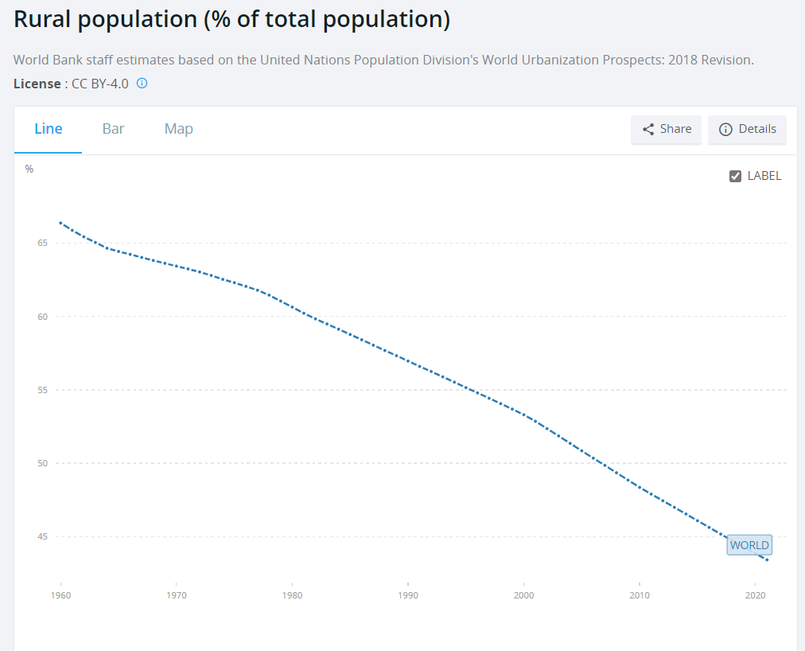
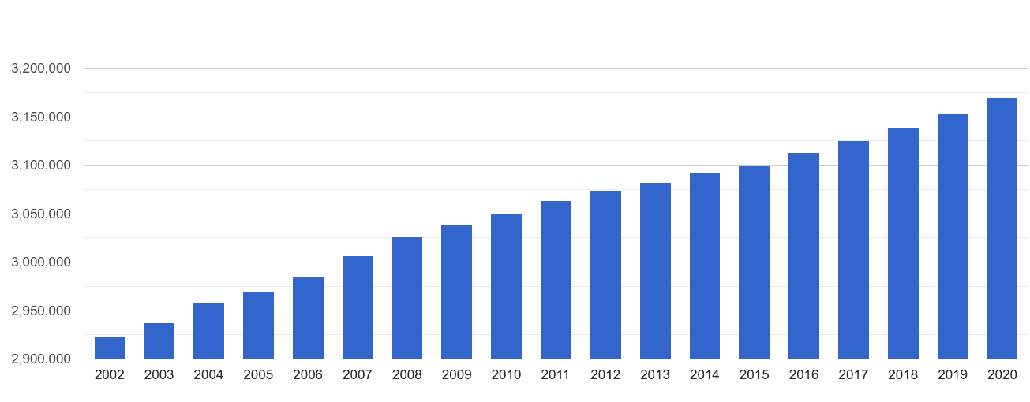
Referencing a Image from a Website
To reference an Image
Image number 1: Rural population (% of total population)
The World Bank Data (2018)
To resume:
Image number 2: Wales Population Statistics
Plumplot (2018)
Reference List:
The World Bank Data (2018) Rural population (% of total population) [online]. Available at: Population, male (% of total population) | Data (worldbank.org) (Accessed 30 October 2022).

Slide 8
Conclusion
This presentation shows that it is important to correctly reference information we use
This presentation impacts on everyone that is involved in publication e.g. those that use other peoples information, work and images and those that use it.
I am planning to use this information to help with correct referencing in my future assignments.

Slide 9
Reference List
Diesburg A. (2016) Odyssey. Available at: The Importance Of Agricultural Education (theodysseyonline.com) ( Accessed: 30.10.2022).
Morgan W.J (2021) ‘Philosophy of Education: Challenges of Modernity’, Journal of Philosophy, 25(4), pp. 565-573. Available at: What is a Philosophy of Education? – Wales Institute of Social and Economic Research and Data (wiserd.ac.uk) (Accessed: 30 October 2022) Pears, R. and Shields, G. (2022, pp.1, 43, 53, 116) Cite Them Right. 12th edn. London: Bloomsbury Publishing Inc.
Plumplot (2016) Wales Population Statistics [Online]. Available at: Wales population stats in maps and graphs. (plumplot.co.uk) (Accessed: 30 October 2022).
Rogers E.M. and Burdge R.J (1972, p.167) Social Change in Rural Societies. 2nd edn. New Jersey: Prentice-Hall, Inc.
The World Bank Data (2018) Rural population (% of total population) [Online]. Available at: Population, male (% of total population) | Data (worldbank.org) (Accessed 30 October 2022).
University of Oxford (2022) Plagiarism. Available at: Plagiarism | University of Oxford (Accessed: 30 October 2022).

