Slide 1
Digital Transformation in the Health and Care Professions (BMHP6026)
Component 2 Assessment
Student name: Patricia Amofa
Student ID: 2315962
Lecturer: Shepherd Ziko

Slide 2



What Are Electronic Health Records (EHRs)?
Digital versions of patients’ paper charts used to collect, store and manage patient’s information Contain medical history, diagnoses.
Medications, treatment plans, allergies, and test results
EHRs are accessible in real-time by authorized healthcare professionals
(NHS England, 2022)

Slide 3
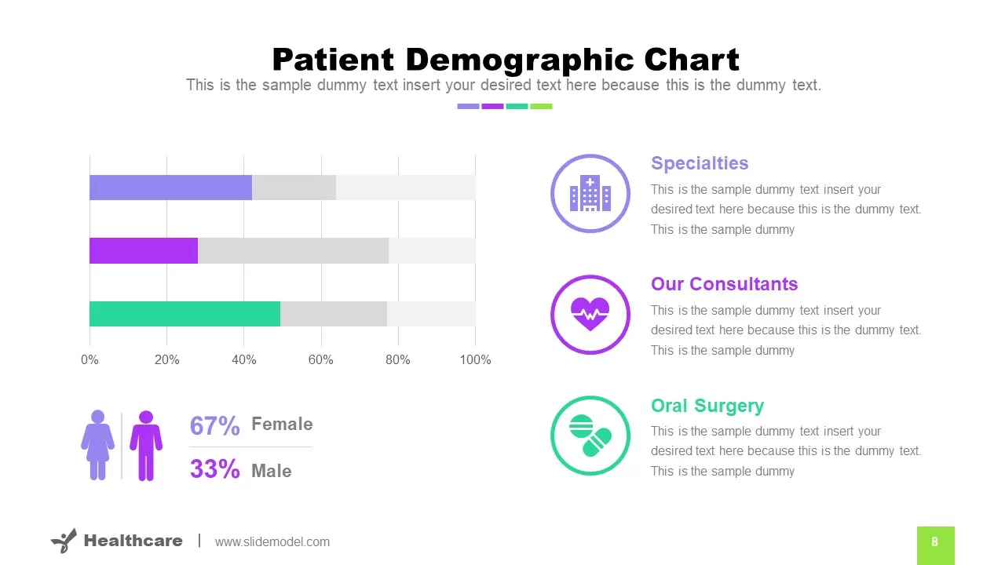
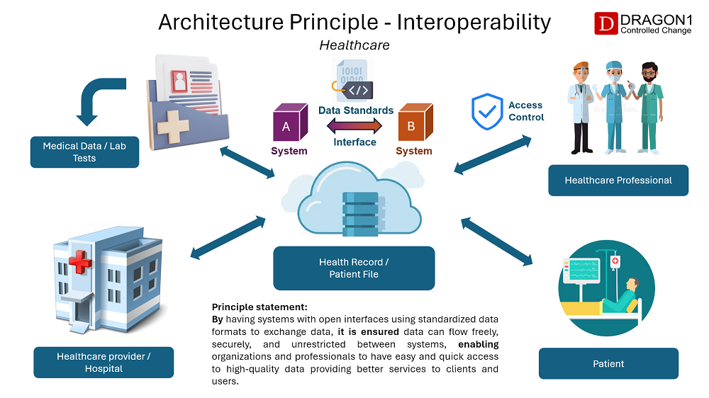

Key Features
Patient demographics and history
Electronic prescribing (e-prescribing)
Interoperability: ability to share data between different sectors
Appointment scheduling
Clinical decision support tools
(Alami et al., 2020)

Slide 4



Benefits of EHRs
Improved patient safety and care coordination
Reduced errors and duplication
Better communication among professionals
Supports research, clinical audits and service planning
(Greenhalgh et al., 2019)

Slide 5

EHRs in Practice
Used by hospitals, GP surgeries, and community health teams
Integration across health and social care
Examples: NHS Spine, EMIS, Cerner
(Reeves et al., 2020)

Slide 6



Challenges of EHR Implementation
High cost and staff training requirements
Data privacy and cybersecurity risks
Resistance to change from staff
Technical issues and interoperability
(National Audit Office, 2023)

Slide 7


Legal and Ethical Considerations
GDPR and data protection laws
Patient access, consent and confidentiality
Secure data storage and access control
(National Data Guardian, 2023)

Slide 8



The Future of EHRs
Integration with AI and predictive analytics
Remote monitoring and telehealth links
Greater patient access through apps
(Ghosh et al., 2022)

Slide 9

Summary
EHRs improve efficiency, safety, and quality of care
Require investment, training, and data security
Key to modern, connected healthcare

Slide 10
AI Acknowledgement
I confirm that I have not used any AI tools in the research and creation of this assignment. I confirm that I have not presented any AI generated materials as my own work. I confirm I have copies of my drafts, notes, and other resources I used, which I may be asked to provide in evidence

Slide 11
References
NHS England (2022) NHS Digital Transformation Strategy 2022–2027. London: NHS England.
Alami, H., Lehoux, P., Auclair, Y. & de Guise, M. (2020) ‘Digital transformation and health system performance: A scoping review’, BMC Health Services Research, 20(1), pp. 1–14.
Ghosh, S., Davies, J. & Wilson, R. (2022) ‘Clinician attitudes toward EHR usability and workload in UK hospitals’, Journal of Medical Informatics Research, 44(3), pp. 211–230
Greenhalgh, T., Wherton, J. & Shaw, S. (2019) ‘Infrastructure revisited: Technology, governance and the NHS digital ecosystem’, Social Science & Medicine, 239(5), pp. 1–10.
National Audit Office (2023) Cybersecurity in the NHS: Progress Report 2023. London: NAO.
National Data Guardian (2023) Data Security and Patient Trust Review. London: Department of Health and Social Care.
Reeves, S., Pelone, F. & Harrison, R. (2020) ‘Interprofessional collaboration and digital transformation in healthcare’, BMJ Quality & Safety, 29(3), pp. 1–10.

