Slide 1
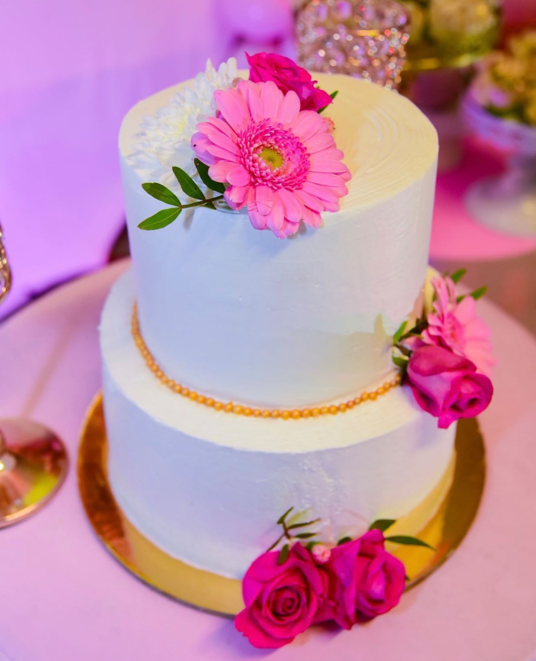
Enterprise and Entrepreneurship
🎂🧁☕
Jordana's Cake & Cia
Jordana's Cake & Cia

Slide 2
Business Plan
🎂🧁☕
Name: Jordana Nunes De Moura Oliveira
Student ID: 2510588
Module Code: LCLM4006
Module Title: Enterprise and Entrepreneurship
Lecturer: Mustakkima Afrin
Jordana's Cake & Cia

Slide 3
Table of Contents
🎂🧁☕
1. Introduction
2. Business Idea
3. Legal Structure
4. Organizational Chart
5. PESTEL
6. Marketing
7. Funding
8. Financial Forecast
9. Break-even
10. Conclusion
Jordana's Cake & Cia

Slide 4
Introduction
🎂🧁☕
My name is Jordana and I am from Brazil. I am studying Business because
I want to open my own Coffee Shop & Bakery.
The purpose of this presentation is to explain my business plan,
present my business idea, and outline my future.
goals for expanding Jordana’s Cake & Cia into a successful
coffee shop and bakery in Bromley, London.
Jordana's Cake & Cia

Slide 5
Business Idea
🎂🧁☕
Jordana’s Cake & Cia is a modern and welcoming café shop
that combines high-quality homemade cakes, specialty coffee, and a cozy atmosphere.
The idea is to create a place where customers can enjoy delicious desserts, relax, socialize, and celebrate special moments. Our mission is to offer a unique café experience by combining traditional cake recipes with creative flavors, excellent customer service, and a comfortable environment.
Jordana's Cake & Cia

Slide 6
Legal Structure
🎂🧁☕
Sole Trader
• Easy to set up
• Low cost
• Full control
• Suitable for my current business.
I would choose to run my Café shop as a sole trader because it is simple and easy to setup.
As the owner, I would have full control over all business decisions.
This business structure has fewer legal requirements and lower set up costs.
It is suitable for a small Café Shop because I can manage the business on my own.
Overall, being a sole trader allows me to start quickly while keeping the business simple
and flexible.
Jordana's Cake & Cia

Slide 7
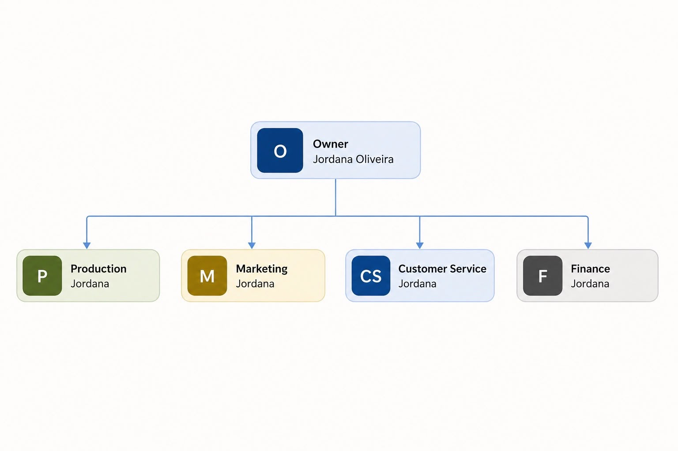
Organizational Chart
🎂🧁☕
Jordana's Cake & Cia

Slide 8
PESTEL Analysis
🎂🧁☕
Factor Impact
Political: UK food businesses must comply with Food Standards Agency regulations, food hygiene legislation,
and local council requirements. Business registration and food safety inspections will be essential before opening the café.
Economic: Inflation and increases in ingredient costs may affect profitability. However, consumers continue
to spend on premium food products and café experiences despite economic uncertainty.
Social: Growing demand for artisan bakeries, specialty coffee, customized celebration cakes, and independent
cafés supports the business concept. Consumers increasingly value local businesses and personalized service.
Jordana's Cake & Cia

Slide 9
Marketing Strategies
🎂🧁☕
Technological: Social media marketing, online ordering systems, contactless payments, and digital customer
reviews are essential tools for business growth. Instagram already plays an important role in promoting Jordana’s Cake & Cia.
Environmental: Customers increasingly prefer businesses using recyclable packaging, reducing food waste, and sourcing ingredients responsibly. Implementing sustainable practices will improve the company’s reputation.
Legal: The business must register with the local authority, comply with Food Hygiene Regulations, obtain public liability insurance, follow employment legislation when hiring staff, and comply with GDPR when handling customer data.
Jordana's Cake & Cia

Slide 10
Funding
🎂🧁☕
Startup Costs | £
Lease deposit and first rent | 4,000
Renovation and interior design | 5,500
Kitchen equipment | 4,000
Coffee machine and grinder | 2,000
Furniture and decor | 1,500
Initial stock and inventory | 1,000
Licenses and permits | 500
Branding and Launch marketing | 500
POS system and software | 500
Contingency fund | 500
Total Startup Cost | 20,000
Fixed Cost | Per Month £
Rent | 1,000
Salaries | 1,000
Utilities | 200
Insurance | 80
Internet and phone | 50
Accounting and software | 70
Cleaning and maintenance | 100
Marketing | 100
Total Fixed Costs | 2,600
Jordana's Cake & Cia

Slide 11
Costs
🎂🧁☕
Variable Costs | Jan | Feb | Mar | Apr | May | June
Ingredients and fillings | 500 | 550 | 610 | 700 | 850 | 940
Packing | 100 | 120 | 180 | 240 | 300 | 380
Delivery fees | 50 | 70 | 100 | 150 | 220 | 300
Card payment fees | 50 | 70 | 100 | 160 | 230 | 300
Seasonal stock | 100 | 130 | 200 | 280 | 350 | 420
Total Variable Costs | 800 | 940 | 1,190 | 1,530 | 1,950 | 2,340
Jordana's Cake & Cia

Slide 12
Financial Forecast
🎂🧁☕
 | Jan | Feb | Mar | Apr | May | June
Fixed Costs | 2,600 | 2,600 | 2,600 | 2,600 | 2,600 | 2,600
Variable Costs | 800 | 940 | 1,190 | 1,530 | 1,950 | 2,340
Total Cost | 3,400 | 3,540 | 3,790 | 4,130 | 4,550 | 4,940
Revenue | 2,500 | 3,125 | 3,906 | 4,883 | 6,104 | 7,630
Profit/Loss | -900 | -415 | 116 | 753 | 1,554 | 2,690
Jordana's Cake & Cia

Slide 13
Break-even
🎂🧁☕
Investment capital needed = £21,315
(‘£20,000+ £900 + £415,00 = 21,315)
Calculation
Startup Cost= £20,000
January Loss= £900
February Loss=£415
Jordana's Cake & Cia

Slide 14
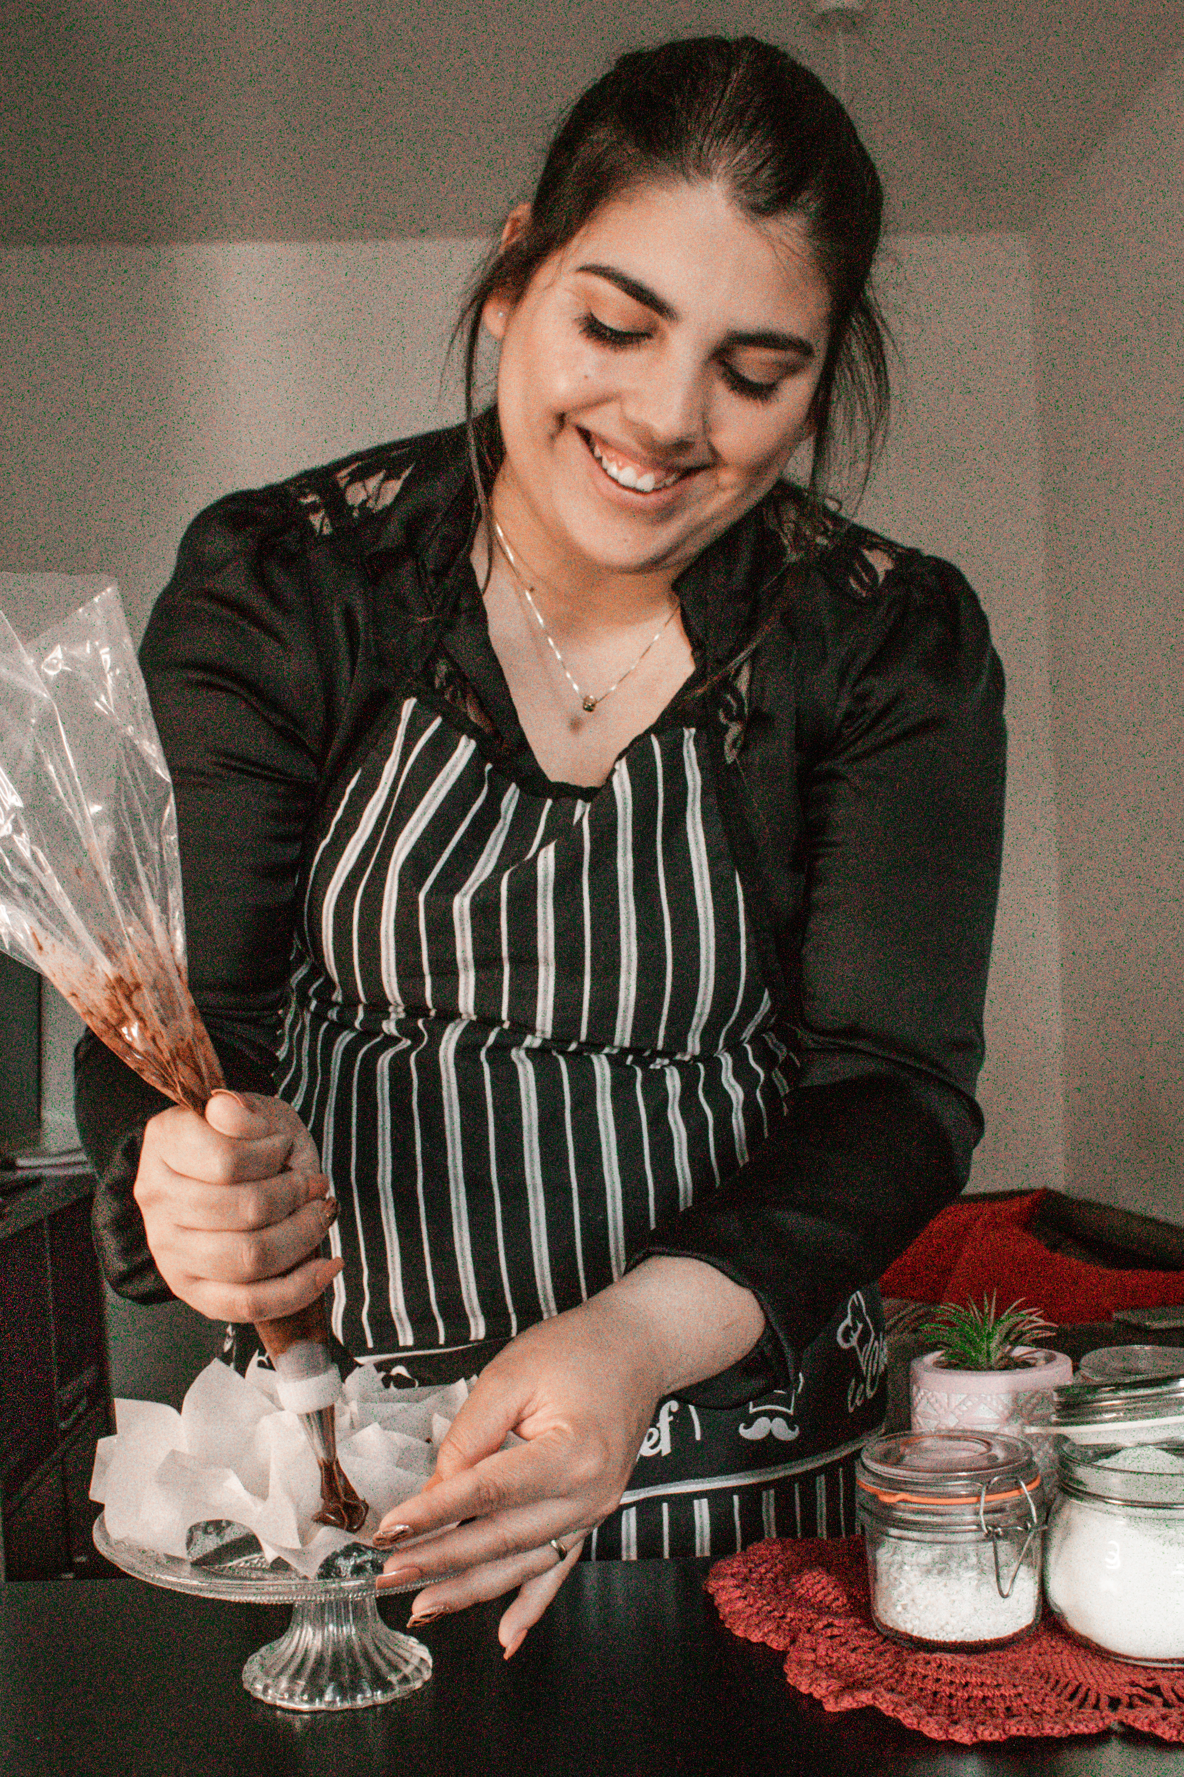
🎂🧁☕
THANK YOU
Jordana's Cake & Cia

