Slide 1
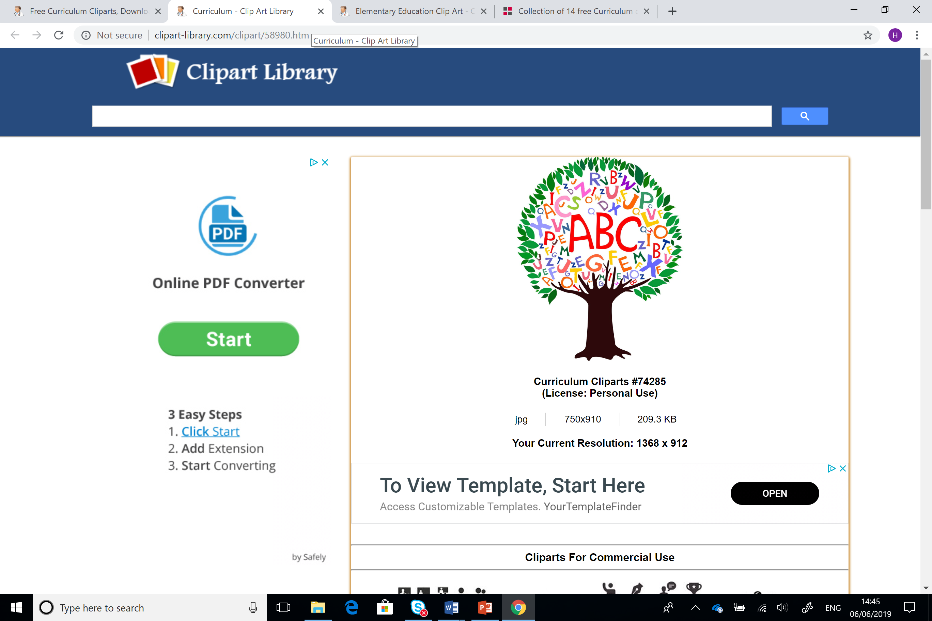
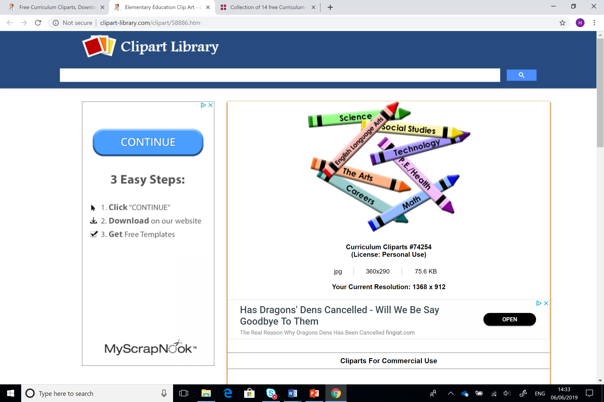
Astudiaethau Cwricwlwm ac Asesu
Curriculum and Assessment Studies
ECES6017/C
W2 SESIWN ANGHYDAMSEROL/ASYNCHRONOUS

Slide 2
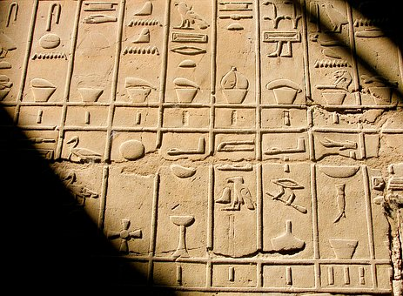




Beth yw ysgrifennu?
What is writing?

Slide 3
Pam bod ysgrifennu yn bwysig?
Why is writing important?
Ceir llai o waith da a rhagorol mewn ysgrifennu na darllen.
Mae’r bwlch rhwng perfformiad bechgyn a merched wedi cynyddu, a cheir y bwlch mwyaf ym maes ysgrifennu.
Mae sillafu, atalnodi a gramadeg anghywir yn difetha cynnwys yr hyn y mae llawer o ddysgwyr o bob gallu’n ei ysgrifennu.
Historically, pupils tend to do better in reading skills than writing skills.
There’s a ‘gender gap’ between boys’ and girls’ attainment in writing.
Schools have been criticised in the past for not paying enough attention to accuracy of spelling, punctuation and grammar.

Slide 4

Beth yw ysgrifennu da?
What does good writing look like?
Ystyriwch nodweddion ysgrifennu effeithiol.
Yna ymchwiliwch a chymharwch eich atebion.
Consider the characteristics of effective writing.
Then research and compare your answers

Slide 5
Mae ysgrifennwyr da yn…
ennyn diddordeb darllenwr/wyr
addasu eu hysgrifennu yn ôl y gynulleidfa a pwrpas y darn
defnyddio nodweddion gramadegol ac arddulliadol i sicrhau eglurder, y naws gywir ac i greu effeithiau penodol
defnyddio amrywiaeth o strwythurau brawddegau
trefnu eu hysgrifennu, cysylltu eu syniadau’n gydlynol a defnyddio paragraffau’n effeithiol
dewis a defnyddio geirfa briodol
defnyddio atalnodi i egluro ystyr
defnyddio amrywiaeth o strategaethau i’w galluogi i sillafu’n gywir
cyflwyno eu hysgrifennu’n briodol, naill ai â llaw neu drwy ddefnyddio technoleg gwybodaeth a chyfathrebu (TGCh).
(LlCC, 2010)
Good writers…
engage their reader(s)
adapt their writing to suit the audience and purpose of the piece
use grammatical and stylistic features to ensure clarity, achieve the right tone and create particular effects
use a range of sentence structures
organise their writing, linking ideas coherently and using paragraphs effectively
choose and use appropriate vocabulary
use punctuation to clarify meaning
use a range of strategies to enable them to spell correctly
present their writing appropriately, either by hand or by using information and communication technology (ICT).
(Welsh Assembly Government, 2010)

Slide 6

Ysgrifennu yn y FfLlRh
Writing in the LNF
Ysgrifennu er gwybodaeth:
Trefnu syniadau a gwybodaeth
Ysgrifennu’n gywir
  Writing for information:
  Organising ideas and information
  Writing accurately

Slide 7
Elfen: Trefnu syniadau a gwybodaeth
Element: Organising ideas and information
    AGWEDD- Ystyr, diben a chynulleidfa:
    cynllunio ac addasu arddull ysgrifennu ar gyfer y gynulleidfa a’r pwrpas
    gwella ysgrifennu trwy adolygu annibynnol ac ailddrafftio
    ysgrifennu yn llawn ar y testun
    gwella cyflwyniad yr ysgrifennu (wrth gynnwys y defnydd o TGCh)
    adlewyrchu, addasu ac ailddrafftio er mwyn gwella ysgrifennu.
ASPECT - Meaning, purposes and readers:
plan and adapt writing style to suit the audience and purpose
improve writing through independent review and redrafting
write to ensure full coverage of a topic
improve the presentation of the writing (by including the use of ICT)
reflect, edit and redraft to improve writing.

Slide 8

Elfen: Trefnu syniadau a gwybodaeth
Element: Organising ideas and information
AGWEDD – Strwythur a threfn:
defnyddio strwythur sy’n addas i bwrpas a ffocws y dasg.
dewis, dadansoddi a chyflwyno gwybodaeth yn briodol
sefydlu strwythyr i drefnu ysgrifennu.
ASPECT - Structure and organisation :
use a structure that is appropriate to the purpose and focus of the task
select, analyse and present information appropriately
establish a structure to organise writing.

Slide 9

Elfen: Ysgrifennu’n gywir
Element: Writing Accurately
AGWEDD - Iaith:
defnyddio iaith addas i ysgrifennu
defnyddio termau technegol addas a geirfa/iaith addas i’r cyd-destun pynciol penodol
ASPECT - Language:
use language appropriate to writing
use appropriate technical terms and vocabulary/language appropriate to the subject-specific context

Slide 10
Elfen: Ysgrifennu’n gywir
Element: Writing Accurately
AGWEDD - Gramadeg, atalnodi, sillafu, llawysgrifen:
gosodiadau penodol mewn perthynas â datblygiad pob agwedd yn ddibynnol ar y math o ysgrifennu a’r lefel oedran.
ASPECT - Grammar, punctuation, spelling, handwriting:
specific statements relating to the progression of each aspect depending on the type of writing and the age level

Slide 11

Sawl math o ysgrifennu sydd?
How many types of writing are there?
Ysgrifennwch restr o wahanol fathau o ysgrifennu.
Trefnwch eich rhestr – pa rhai sy’n ffuglen neu’n ffeithiol
Ar gyfer pob un, nodwch beth allai pwrpas yr ysgrifennu fod.
Make a list of the different types of writing we might see in a primary classroom.
Sort your list according to whether they are fiction or non-fiction.
For each item on your list, identify what the purpose of each type of writing might be.

Slide 12
Chwe Math o Ysgrifennu Ffeithiol
Six Non-Fiction Text Types
Mae Sue Palmer yn awgrymu bod yna 6 math o ysgrifennu ffeithiol.
Edrychwch ar eich rhestr. Rhowch nhw mewn i 6 categori.
Cymharwch eich rhestr chi i rhestr Sue Palmer.
adroddiad • cyfarwyddo • dwyn i gof • perswadio • esbonio • trafod.
Palmer suggest that there are only 6 types of non-fiction writing.
Look again at your list – can you categorise your non-fiction writing into 6 areas?
Compare your answers to the six text types.

Slide 13
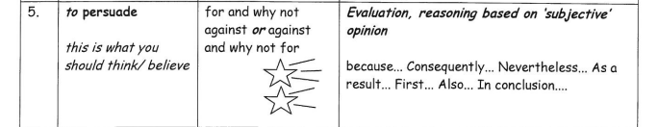
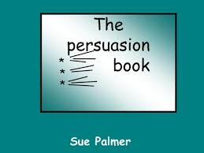
THE BIG BOOK!
Y LLYFR MAWR!

Slide 14
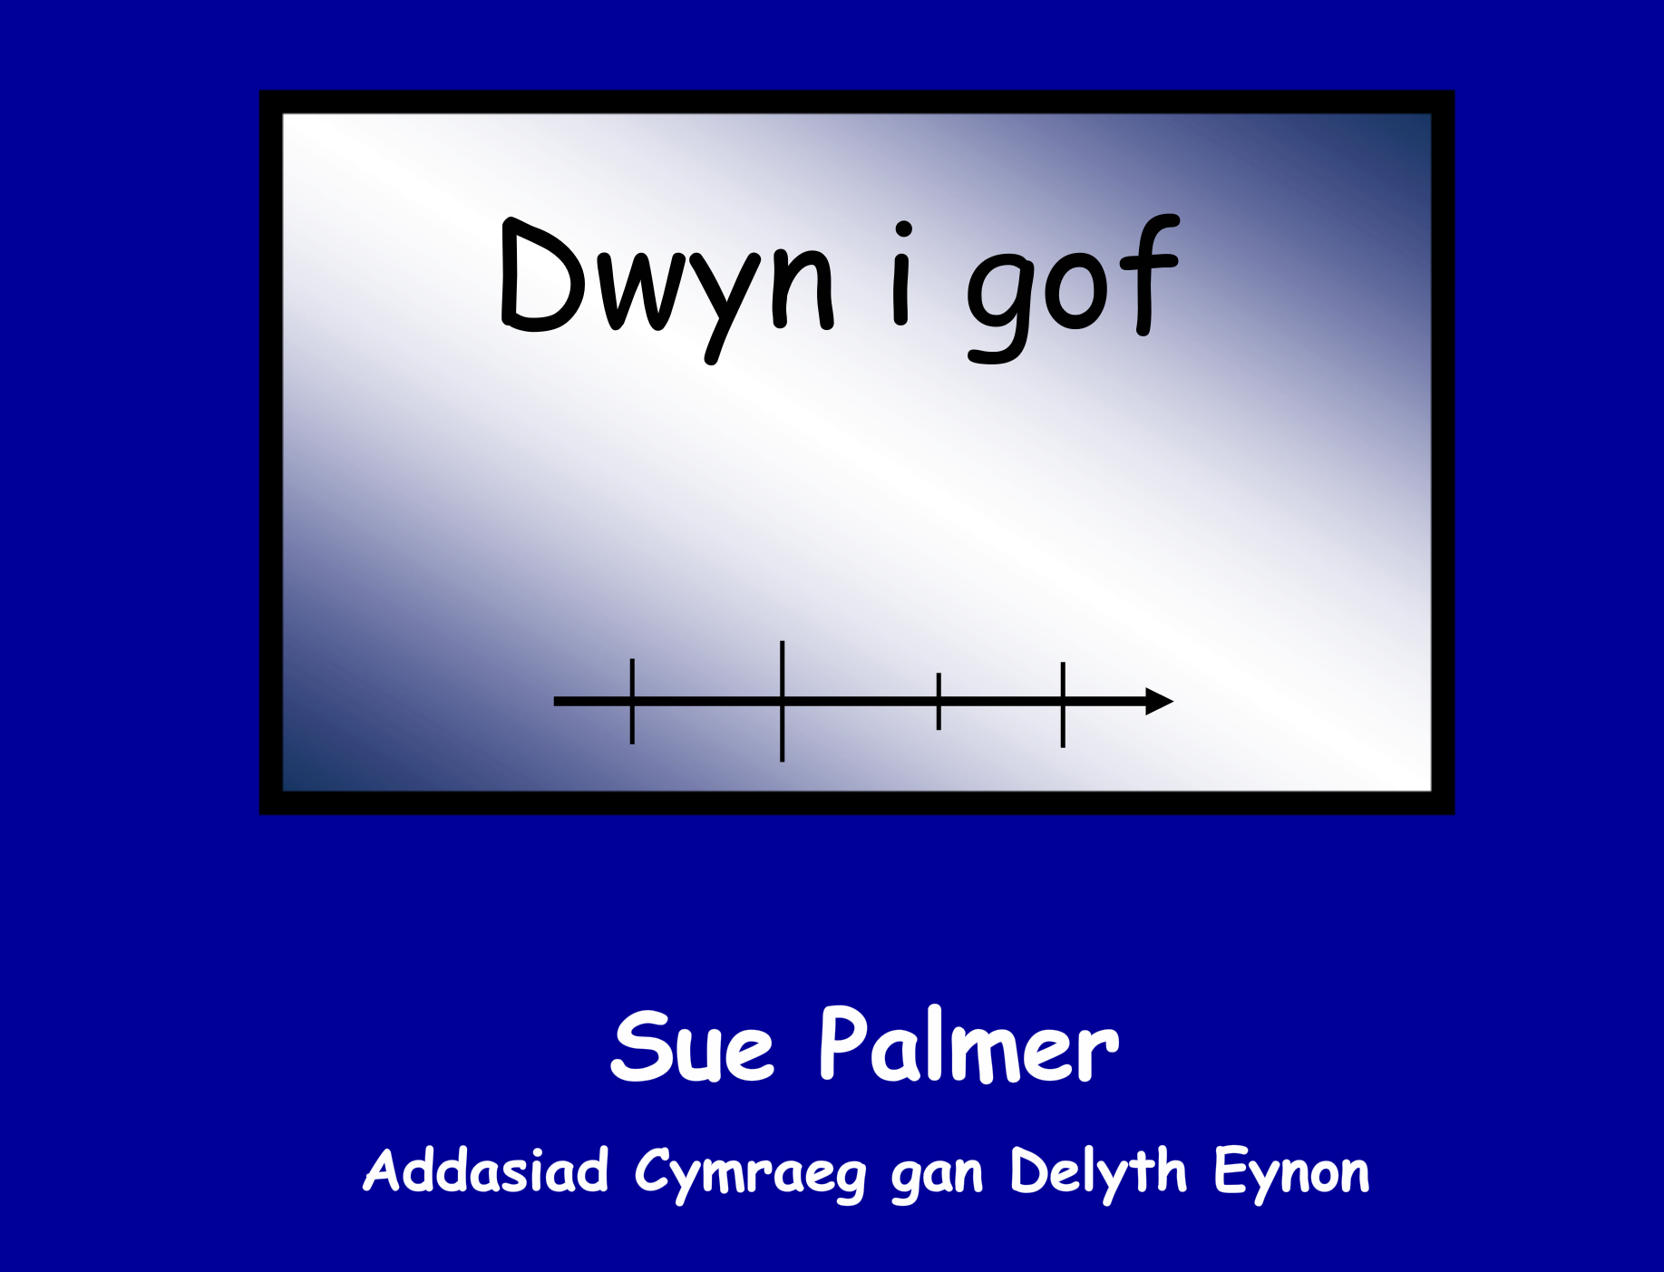
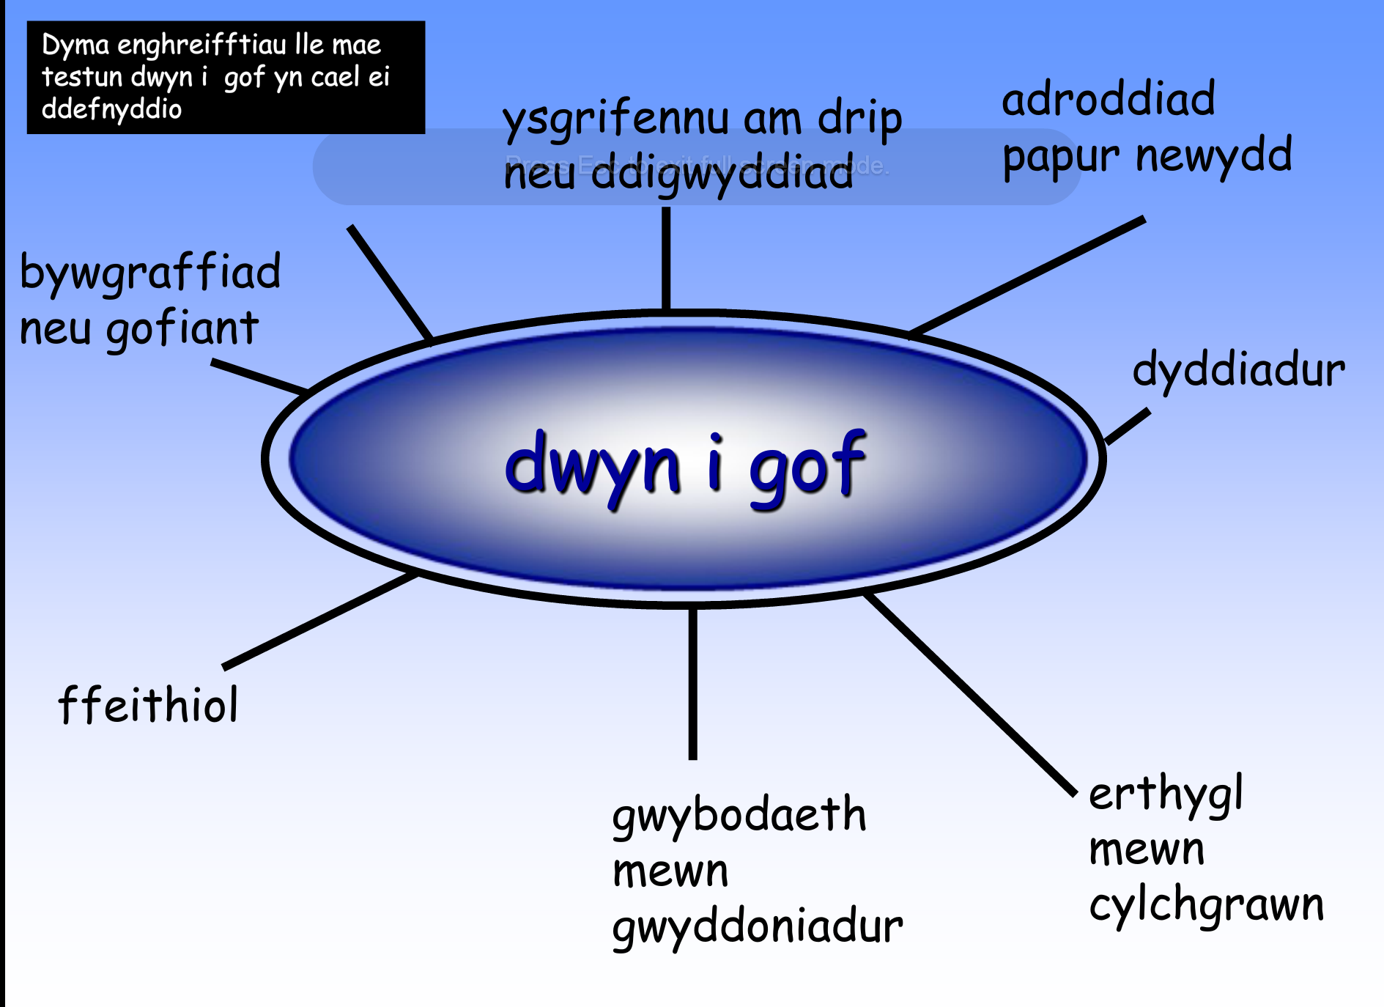
Llyfrau Mawr Sue Palmer wedi eu cyfieithu i’r Gymraeg gan Delyth Eynon

Slide 15
Ysgrifennu… siarad a darllen!
Writing… talk and reading!
Model tri cam:
  “Imitate
  Innovate
  Invent”
Mae angen i’r disgyblion ysgrifennu araith perswadiol. Trafodwch sut allech ddefnyddio’r techneg ‘talk for writing’ i gynllunio ar gyfer hyn.
Three step model:
  Imitate
  Innovate
  Invent
You want your children to write a persuasive speech. Discuss how you could use the talk-for-writing approach to plan this outcome.

Slide 16

Mae ysgrifennu ffeithiol yr un mor greadigol!
Non fiction writing is just as creative!
‘Sssshhhhh... don't tell anyone... it turns out non-fiction is just as exciting as fiction! A police report on a missing unicorn; a letter to the Ministry of Stories; instructions for minotaurs on maze management; how to keep a hobgoblin happy.’
Pie Corbett
http://www.piecorbett.org.uk

Slide 17
Dulliau Ysgrifennu Ffeithiol
Fiction Writing Approaches
Atgoffwch eich hun o stori’r ‘Tri Mochyn Bach’.
Beth yw nodweddion y math yma o stori?
Gwyliwch Y Tri Mochyn Bach gan Roald Dahl.
  Sut fyddai disgyblion yn ymateb i hyn?
  Sut all hwn gael ei ddefnyddio fel adnodd ar gyfer dysgu?
Recall the fairytale ‘The Three Little Pigs’
Discuss the features of the fairytale that we might expect to see elsewhere too.
Now, watch Roald Dahl’s Three Little Pigs.
  How would pupils respond to this story?
  How could you use this as a stimulus in the classroom?

Slide 18

Syniadau!
Finding ideas to write about!
Beth yw manteision ac anfanteision y ffordd yma o weithio?
What are the benefits and drawbacks of this approach?
Syniadau ar gyfer gweithgareddau cychwynnol:
http://www.scholastic.com/teachers/story-starters/
Interactive story starter ideas:
http://www.scholastic.com/teachers/story-starters/

Slide 19
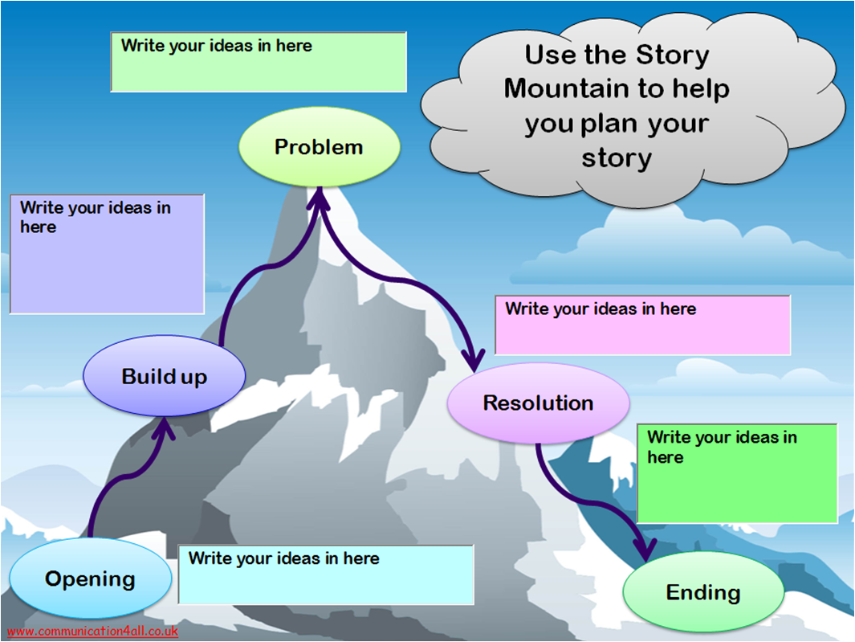
Deall Strwythur
Understanding Structure

Slide 20
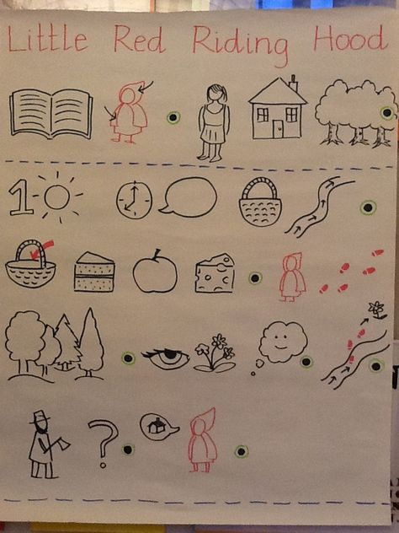
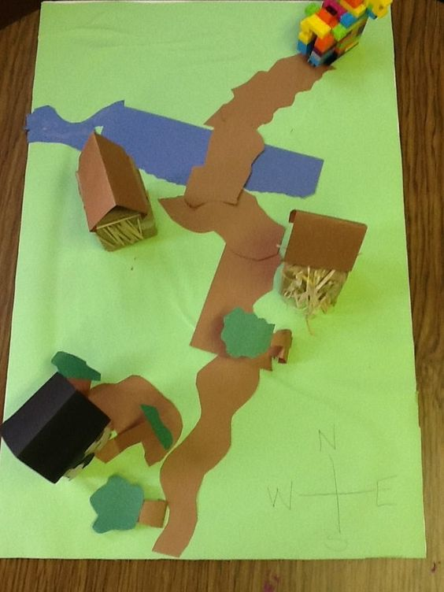
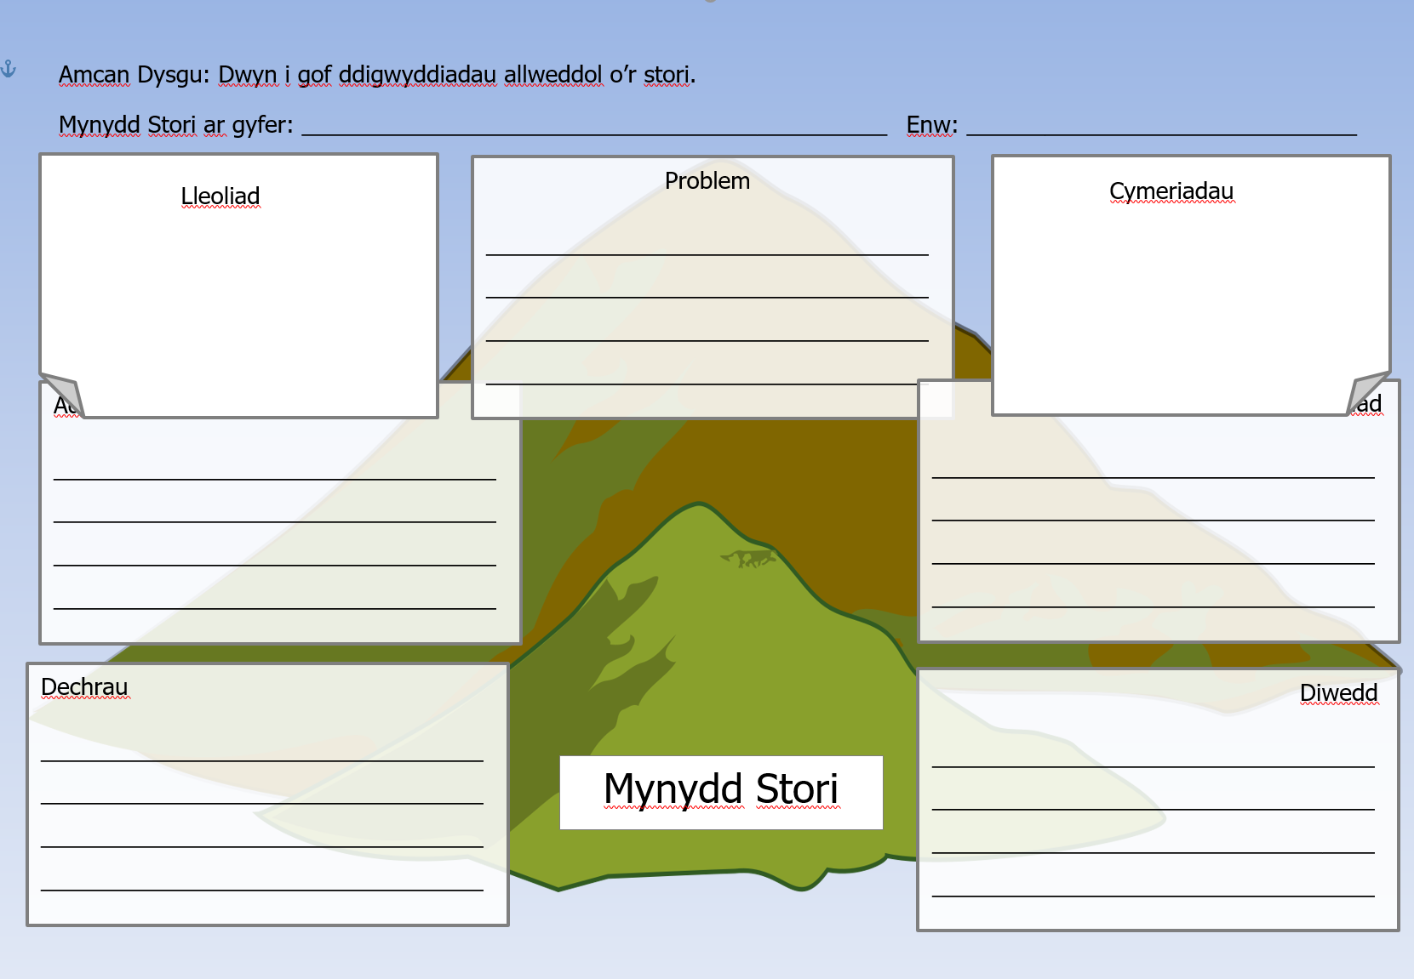
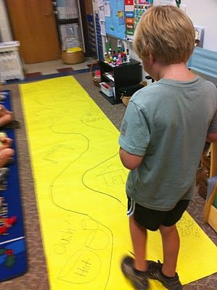
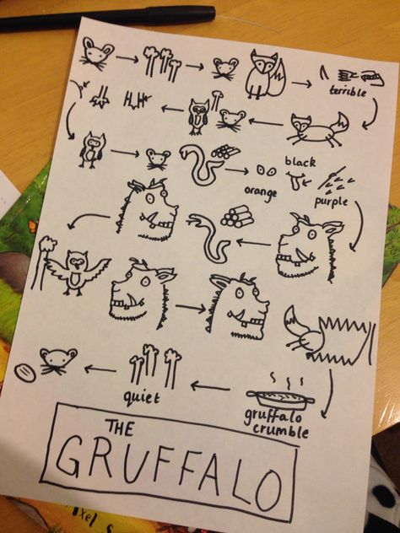
MAPIO STORI/
STORY MAPPING

Slide 21
Barddoniaeth
Poetry
    Mae darllen ac ysgrifennu barddoniaeth yn hwyl
Dim angen bod yn ddiflas!
Does dim angen dadansoddi pob rhan ohonno!
Plant yn modelu eu gwaith ar yr hyn maent wedi clywed ac wedi mwynhau
Poetry reading and writing is fun
Need not be boring!
You do not need to only do a “post mortem” on a poem!
Children model their own work on what they have heard and enjoyed

Slide 22
Barddoniaeth
Poetry
    Mae plant yn mwynhau gemau geiriau
    Ffordd ardderchog o annog plant i chwarae gyda iaith
    Paratoad ardderchog ar gyfer ysgrifennu barddoniaeth
Children love word games
Excellent way to encourage children to play with language
Excellent preparation for poetry writing

Slide 23
Creu barddoniaeth grŵp
Creating a group poem
Cwestiynau ac atebion
Meddyliwch am gwestiwn anghyffredin
E.e. “Beth sydd ar ddiwedd yr enfys?”
Pob person yn y grwp i feddwl am y ffordd mwyaf gwreiddiol o’i ateb
e.e. “atgof o fy hoff niwrnod erioed”
Questions and Answers
Think up an unusual question
e.g. ‘What’s at the end of a rainbow?’
Each person in the group thinks of the most original way to answer it
e.g. ‘A memory of my best-ever day’

Slide 24
Barddoniaeth Dodrefn
The Furniture Poem
Dewiswch un aelod o’r grwp i ysgrifennu am berson enwog.
Os fyddai’r person yn ddarn o ddodrefn, beth fydden nhw?
Os fyddai’r person yn ddilledyn, beth fydden nhw?
Mae’r cwestiynau’n parhau wedi’i seilio ar destunau fel y tywydd, amser o’r dydd, diwrnod yr wythnos, anifeiliaid, lliwiau ayb.
Choose one member of the group to write about a famous person.
If the person was a piece of furniture, what would they be?
If the person was an item of clothing, what would they be?
Questions continue based on topics such as weather, time of day, day of the week, animals, colours, etc.

Slide 25
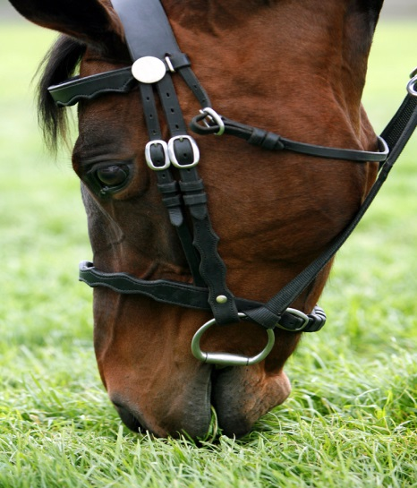
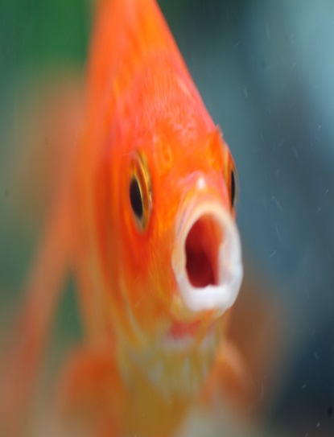
Parau odli
Rhyming pairs
    Crëwch eich parau odli eich hun
Cyngor: meddyliwch am yr ateb cyn y cwestiwn!
Create your own rhyming pairs
e.g. What do you call a cold horse?
A chilly filly!
What do you call a goldfish
A wet pet
Hint: compose the rhyming answer before the question!

Slide 26
Penillion arddodiaid
Preposition poems
Meddyliwch am destun
e.e. Hugan Goch Fach
Meddyliwch am 5 arddodiad
e.e. ar, o gwmpas, uwch ben, tu fewn, o dan
Defnyddiwch arddodiaid i ddechrau llinell newydd mewn pennill sydd ddim yn odli
Rhowch gynnig arni!
Think of a topic
e.g. Dr Who
Think of 5 prepositions
e.g. on, above, around, within, below
Use each preposition to begin a new line in a non-rhyming poem
Have a go!

Slide 27
Kit Wright
Gwrandewch ar The Magic Box
Trafodwch sut allai gael ei ddefnyddio mewn ystafell ddosbarth cynradd
Pa gysylltiadau traws - gwrcwlaidd sydd?
Sut allai hwn fod yn fan cychwyn am adnodd?
Listen to The Magic Box
Discuss how it could be used in a primary classroom
What cross-curricular links are there?
How could this be a starting point for a resource?

Slide 28

Perfformio barddoniaeth
Performing poetry
Gwyliwch Michael Rosen yn perfformio ei bennill
‘Hand on the Bridge’ ar Youtube
Watch Michael Rosen perform his poem
‘Hand on the Bridge’on Youtube

Slide 29
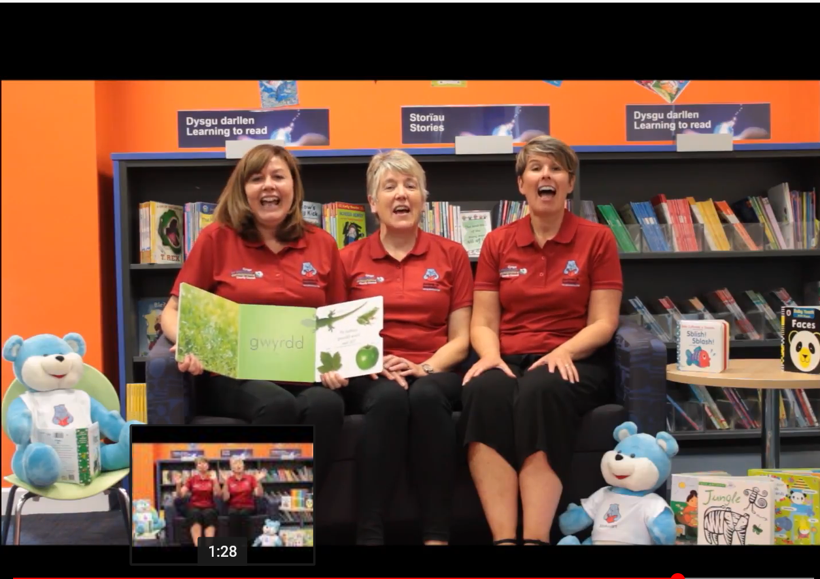
Rhigymau Cymraeg
Welsh Rhymes
Rhigymau Cymraeg Welsh Rhymes

Slide 30
Astudiaethau Achos
Case Studies
Datblygu dulliau creadigol i ddatblygu llythrennedd trwy ysgrifennu.
Sut mae’r dull hwn yn datblygu llythrenned/rhifedd?
Pwy sydd wedi elwa o’r dull hwn?
Ydy’r ffordd yma o weithio yn llwyddiannus? Pam?
Creative approaches to developing literacy through writing.
Case Study 1
Case Study 2
  How does this approach develop literacy/numeracy?
  Who has benefited from this approach?
  Why is this approach successful?

Slide 31
Llyfryddiaeth
Bibliography
Corbett, P. Talk4Writing. Available at http://www.talk4writing.co.uk/ [Accessed 07.08.19
Estyn (2011) Strategy and guidance on inspecting literacy for pupils aged 3 to 18 years Cardiff: Her Majesty’s Stationers Learning Wales. Available at http://learning.wales.gov.uk/resources/nlnf/?lang=en [Accessed 06.08.18] andhttp://learning.wales.gov.uk/resources/nlnf/?skip=1&lang=cy
Michael Rosen performs ‘Hands on the Bridge’ Available on
http://www.youtube.com/watch?v=N4sCaAFkcwI [Accessed 07.08.18]
National Literacy Frameworks and Tests. Available at http://wales.gov.uk/consultations/education/nlnf/?lang=en [Accessed 06.08.18] and http://wales.gov.uk/consultations/education/nlnf/?skip=1&lang=cy
Palmer, S. (2001) How to teach writing across the curriculum at Key Stage 2. London: Fulton Publishers.
Palmer, S. (2003) How to teach writing across the curriculum at Key Stage 1. London: Fulton Publishers.
Palmer, P. & Corbett, P. (2003) Literacy: What Works? Cheltenham: Nelson Thornes.

