Slide 1
Skills for Life: Employability and future pathways
Sophie Morris 1700424

Slide 2
Introduction
What to expect?
What is Employability
Job Role
Qualifications
Responsibilities
Patience and Tolerance
Keeping Up To Date
Communication
Teamwork
Leadership and Organisation
Conclusion

Slide 3


What is Employability
Cottrell (2015) suggests that employability is a ‘concurrence’ of capability, preparedness for employment, and having the relevance to the current job market.
(Source: UK University Search, 2016)

Slide 4

Job role- Nursery Assistant
(Source: New Skills Academy, 2019)

Slide 5

Qualifications
NVQ Level 2
Updated CRB
Additional Training through work required
(Source: Pearson, 2019)

Slide 6
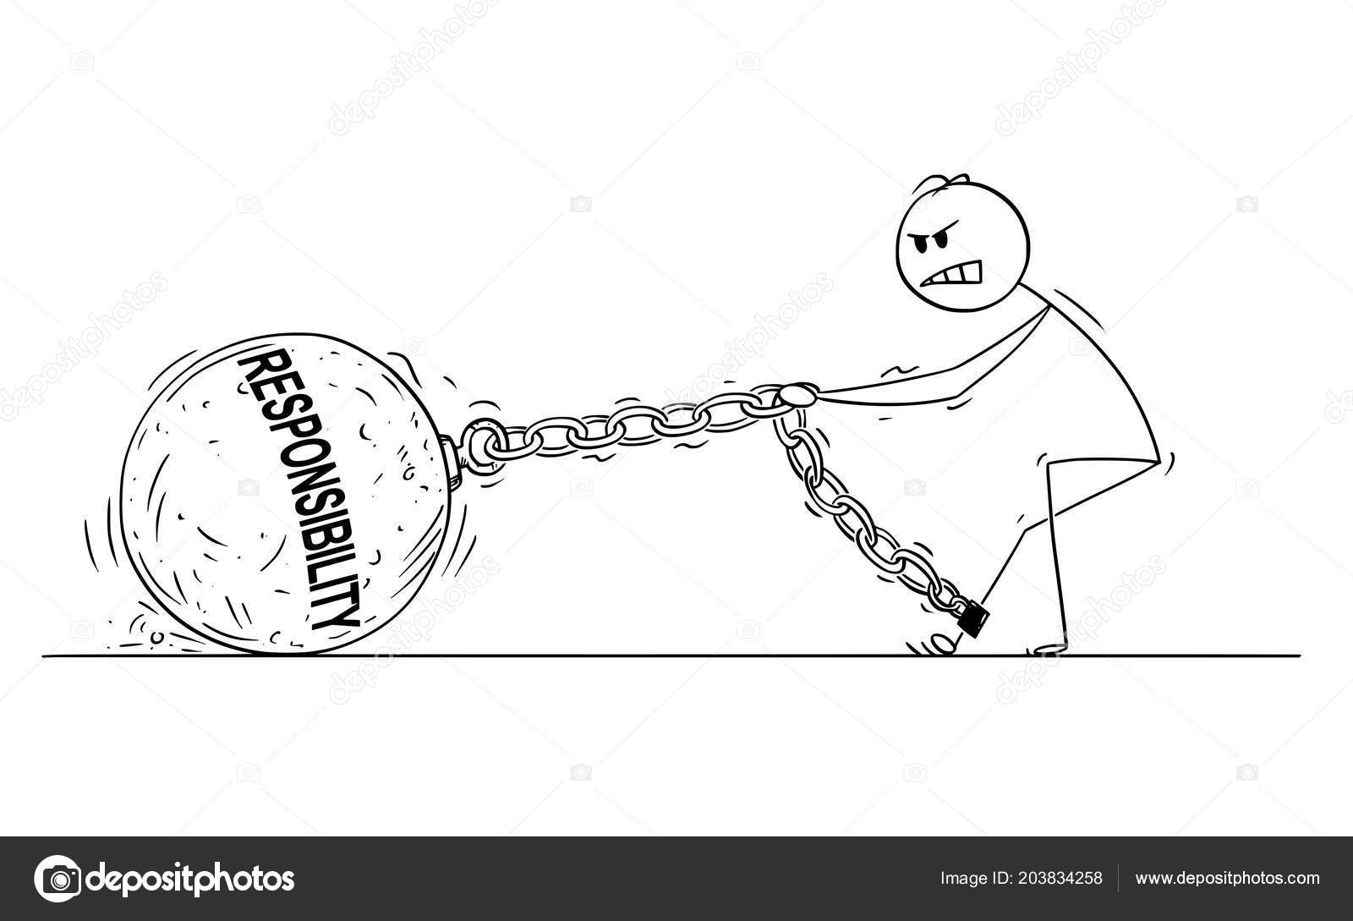
Responsibilities
Supervising children
Engaging children in learning and play
Keeping and updating records
Working with a team
Maintaining a high standard or operation
Attending staff meetings
(Job is Job, 2019)
(Source: Deposit Photos, 2018)

Slide 7

Patience and tolerance
Child Ventures (2016) that suggests that keeping calm and patient will allow children to learn from your actions
(Source: Juma, 2019)

Slide 8

Keep up to date
Trought (2017) who suggests that organisation is an essential personal attribute to the majority of employers.
(Source: Iconfinder, 2019)

Slide 9

Communication
(Source: Vector Stock, 2019)

Slide 10

What is communication?
Communication is a key element to everyday life and most jobs available today.
According to Forsyth (2011), strong communication opens an individual to numerous opportunities. Gross (2013) describes communication as fundamental to life chances.
The job description produced by Job is Job (2019) state that communication and listening is a key factor for this job, this can range from conversing with children and staff members, to service users and different employers
(Source: UNESCO, 2019)

Slide 11

Teamwork
(Source: Vantage Circle, 2018)

Slide 12

What is Teamwork?
Teamwork is defined by the Cambridge Dictionary (2019) as ‘the ability of a group of people to work well together’.
Explained within the description of the job, teamwork is mentioned throughout. Teamwork is used in many aspects used in the nursery, for example play, staff meetings and maintaining standards throughout.
(Source: Ritch, 2018)

Slide 13

Leadership and management
(Source: Ready, 2019)

Slide 14

What is leadership and management?
Leadership is defined by the Cambridge Dictionary (2019) as ‘a person or people in charge of an organization’ whereas management is defined as ‘the control and organisation’ of an object of structure.
Leadership and management is similarly described by Schedlizki and Edwards (2013) as an overall process in which an individual has influence over a group of individuals to overcome obstacles and achieve a common goal.
(Source: Pratt, 2018)

Slide 15

Conclusion
(Source: Khosla, 2018)

Slide 16

Thank you for listening
Any Questions?

Slide 17
References-
Cambridge Dictionary. (2019) ‘Leadership’ https://dictionary.cambridge.org/dictionary/english/leadership [Accessed: 13/10/10]
Cambridge Dictionary. (2019) ‘Management’ https://dictionary.cambridge.org/spellcheck/english/?q=managment [Accessed: 13/10/10]
Cambridge Dictionary. (2019) ‘Teamwork’ https://dictionary.cambridge.org/dictionary/english/teamwork [Accessed: 13/10/10]
Child Ventures. (2016) ‘Reasons Why Patience is Important in Childcare’ https://childventures.ca/blog/2016/11/reasons-patience-important-childcare/ [Accessed: 12/10/19]
Cottrell, S. (2015) Skills for Success Personal Development and Employability New York: Macmillan Publishers
Deposit Photos. (2018) ‘Businessman Pulling Responsibilities’
Ebbeck and Waniganayke (2003). Early Childhood Professionals. Amsterdam: Elsevier Publications.
Forsyth, P. (2011) Brilliant Communication. London: Marshall Cavendish Business.

Slide 18
Gibbs, G. (1988) Learning by Doing: A Guide to Teaching and Learning Methods. London: FEU.
Gilbert, P. (2005) Leadership: Being effective and remaining human. Dorset: Russell House Publishing.
Gross, J. (2013) Time to Talk: Implementing outstanding practice in speech, language and communication. New York: Routledge.
https://depositphotos.com/203834258/stock-illustration-cartoon-of-man-or-businessman.html [Accessed: 14/10/19]
Iconfinder. (2019) ‘Group, Leadership, Organisation Icon’ https://www.iconfinder.com/icons/3139608/group_leadership_organisation_icon [Accessed: 14/10/19]
Job is Job (2019) ‘Nursery Assistant Job Description’ https://www.jobisjob.co.uk/nursery-assistant/job-description [Accessed: 10/10/19]
Johnson, N, R. (2016) ‘How to overcome your fear of public speaking’ https://www.britishcouncil.org/voices-magazine/how-overcome-fear-public-speaking [Accessed: 13/10/19]
Juma, N. (2019). ‘Everyday Power Patience Image’ https://everydaypower.com/patience-quotes/ [Accessed: 14/10/19]
Khosla, V. (2018) ‘The Conclusion’ https://codeburst.io/the-conclusion-86e6a4af9c8e [Accessed: 14/10/19]

Slide 19
Miller, L., Drury, R., and Cable, C. (2012) Extending Professional Practice in the Early Years. London: Sage Publications
National Day Nurseries Association (2019) ‘Shadow education secretary plans to reinvent state nurseries’ https://www.ndna.org.uk/NDNA/News/Latest_news/2018/Shadow_Education_Secretary_plans_to_reinvent_state_nurseries.aspx [Accessed: 14/10/19]
New Skills Academy. (2019) ‘Nursery Assistant Certificate Image’ https://newskillsacademy.co.uk/course/nursery-assistant-certificate/ [Accessed: 14/10/19]
Pearson. (2019) ‘Qualifications Image’ https://qualifications.pearson.com/en/about-us.html [Accessed: 14/10/19]
Piaget, J. (1936). Origins od intelligence in the child. London: Heinemann.
Pratt, M. (2018) ‘How to build the next generation of leaders’ https://www.cio.com/article/3294697/how-to-build-the-next-generation-of-it-leaders.html
Ready, D. (2019) ‘The Power of a Clear Leadership Narrative’ https://sloanreview.mit.edu/article/the-power-of-a-clear-leadership-narrative/ [Accessed: 14/10/19]
Ritch, K. (2017) ‘Five Lessons on Teamwork’ https://www.industryweek.com/teamwork/50-years-trenches-five-lessons-teamwork [Accessed: 14/10/11]
Schedlizki, D., and Edwards, G. (2013) Studying Leadership. London: Sage Publications.
Schon, D.A. (1983) The Reflective Practitioner: How Professionals Think in Action. New York: Basic Books.

Slide 20
Trought, F. (2017) Brilliant Employability Skills. Edinburgh Gate: Pearson Education Limited.
UK University Search. (2016) ‘Increasing your employability whilst at university image’ https://advice.milkround.com/increasing-employability-whilst-university [Accessed: 14/10/19]
UNESCO. (2019) ‘Project Communications and Visibility Image’ https://en.unesco.org/youth/toptips/planner/communication [Accessed: 14/10/19]
Vantage Circle. (2018) ‘The differences between teamwork and team building’ https://blog.vantagecircle.com/teamwork-and-team-building/ [Accessed: 14/10/19]
Vector Stock. (2019) ‘Man and Woman Communication Image’ https://www.vectorstock.com/royalty-free-vector/man-and-woman-communication-icon-vector-19898047 [Accessed: 14/10/19]

