Slide 1
Vygotsky’s Sociocultural Theory: Supporting Shona’s Development
Name : | SAMAN NAVEED
Student ID : | 2519576
Module Name: | Psychology in Health and Social Care
Module Code : | LCHS4010

Slide 2
Content
Introduction & Case Overview
Vygotsky’s Sociocultural Theory
Applying Key Concepts to Shona
Practical Strategies and Interventions
Nature and Nurture
Evaluation
Strengths of Vygotsky’s Theory
Limitations & Alternative Theory
Conclusion
References

Slide 3

Introduction & Case Overview
The presentation will emphasize Vygotsky's Sociocultural Theory (1978) to gain insight into Shona's developmental needs and how this can support her to grow emotionally, socially, cognitively and physically. Shona is a 3-year-old child and has recently started nursery and has been diagnosed with separation anxiety, limited verbal communication and challenges with joining in group play. The presentation will use Vygotsky's theory to address how social interaction and language influences her learning and development and support that can be provided (Vygotsky, 1978).

Slide 4
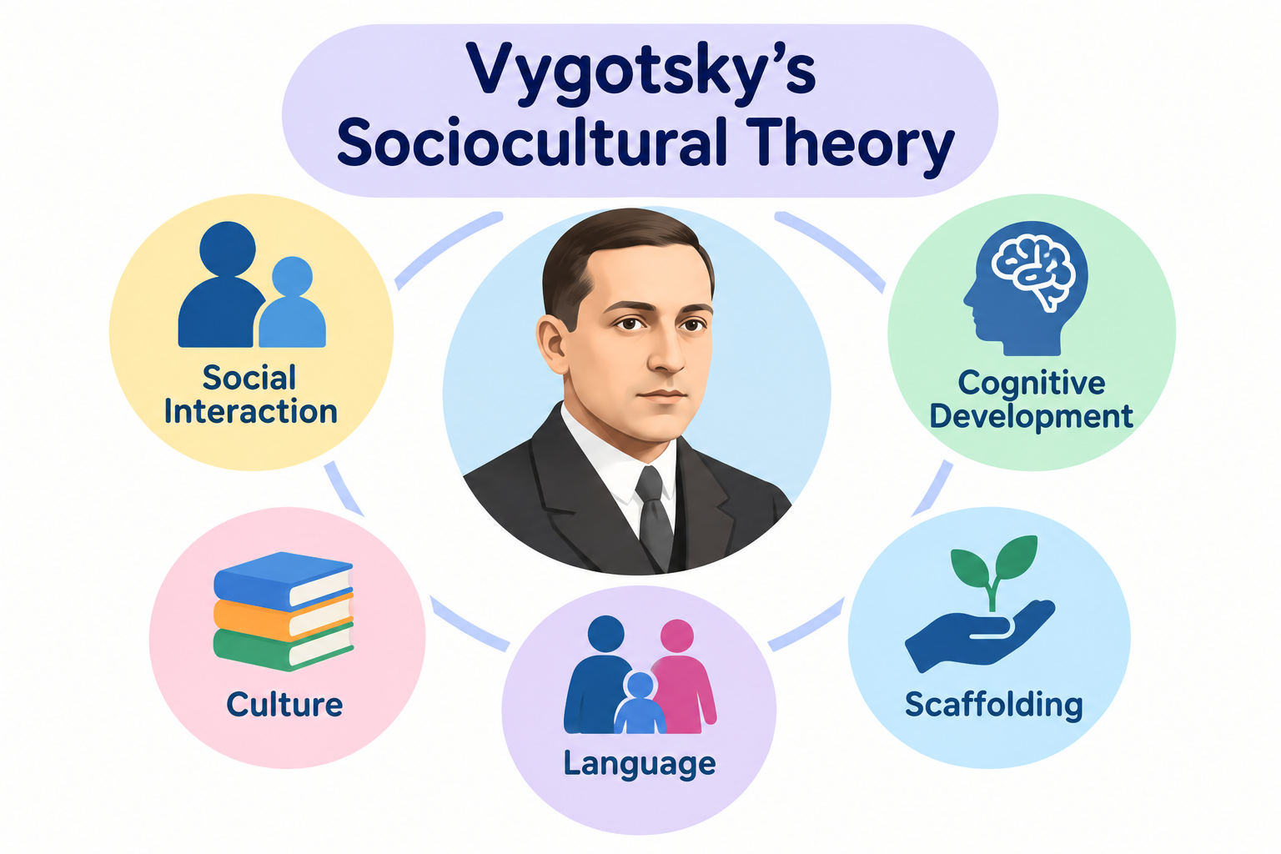
Vygotsky’s Sociocultural Theory
It is in the sociocultural theory of Vygotsky (1978) that children are recognized as developing through social interaction, language and culture. The More Knowledgeable Other (MKO), Zone of Proximal Development (ZPD) and scaffolding (temporary support by adult or capable peers that is slowly reduced) are key concepts. Language also assists children in thinking and self-regulating. The theory is very relevant to early childhood, as children learn through play, communication and interaction with adults and peers (Wood, Bruner and Ross, 1976).

Slide 5
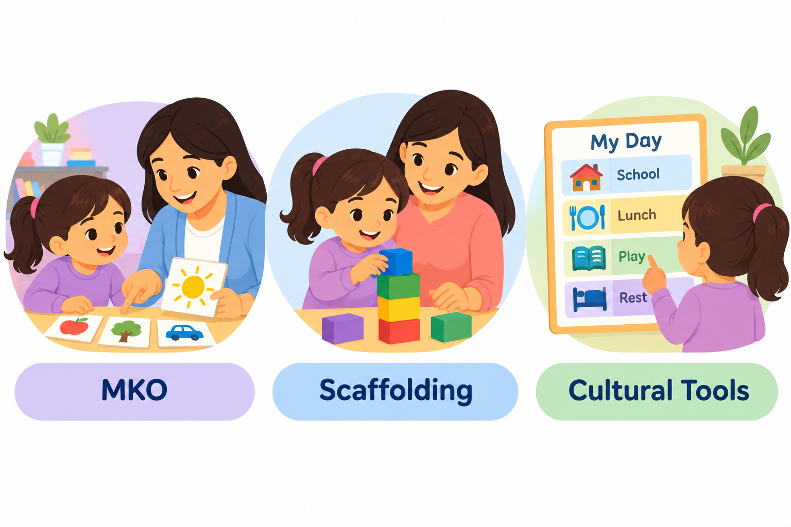
Applying Key Concepts to Shona
Shona’s anxiety when separated from carers may affect her ability to participate in learning. Vygotsky highlighted language and social interaction as having an important role in the development of self-regulation; Shona limited verbal communication may make it more difficult for her to use language as a tool for expressing emotions and supporting self-regulation (Vygotsky, 1978).
She may have a limited ability to engage in verbal communication which could limit opportunities for interaction and learning in her Zone of Proximal Development (ZPD). An adult or more knowledgeable peer can provide scaffolding by modelling and extending her language (Wood, Bruner and Ross, 1976).

Slide 6

Group Play and Wellbeing
Shona’s difficulty joining group play may limit opportunities for social learning. Play was considered an important context for the development of communication skills, self-regulation and social skills by Vygotsky (1978). She can begin to participate with scaffolding from practitioners and peers.
Impact on wellbeing:
Emotional: Cannot control feelings of anxiety.
Social: Less peer interaction.
Cognitive: Limited language may restrict learning opportunities.
Physical: Reduced participation in group activities may provide fewer opportunities for active play and physical development.
(Siraj-Blatchford et al., 2010)

Slide 7
Practical Strategies and Interventions
Language support: Key person models and expands Shona’s speech using scaffolding and ZPD.
Emotional support: Use emotion cards, simple language and visual timetables as cultural tools.
Group play: Use a supportive peer to model sharing, turn-taking and communication.
Parent support: Discuss strategies and foster Shona's home language.
Support from professionals is ensured by monitoring progress by Key person, SENCO and Speech and Language Therapist (Irvine, 2025).

Slide 8
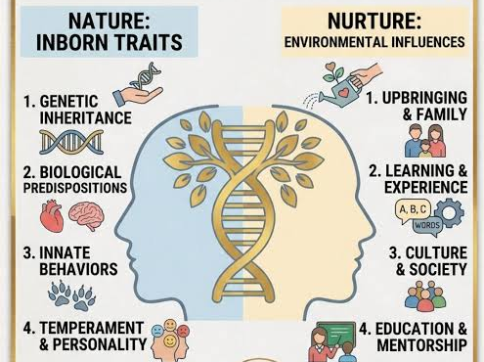
Nature and Nurture
1. Nature – Biological Influences
Temperament may influence Shona’s anxiety and willingness to interact.
Brain development provides potential for language and learning (Kagan, 2018).
2. Nurture – Environmental Influences
Development is influenced by social interaction, language, caregiving and nursery experiences.
Scaffolding and ZPD supported by peers and adults are beneficial for the learning and wellbeing of others (Vygotsky, 1978).

Slide 9
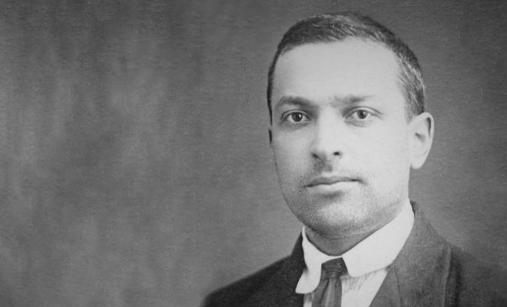
Evaluation
Strengths of Vygotsky’s Theory
Practical for early years: Scaffolding, ZPD and guided play support EYFS practice.
Emphasise social learning: Describes how adults and peers can help Shona to develop her language and group play.
Inclusive: Recognises the importance of culture, language and family in development.
Child centered: Is concerned with what Shona can do with the right support and not just her current skills (Phillips et al., 2026).

Slide 10
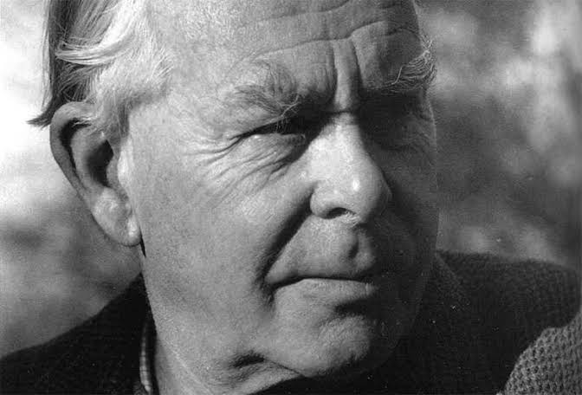
Limitations & Alternative Theory
Limitations:
Vygotsky places strong emphasis on social and cultural influences but gives less attention to biological factors such as temperament and neurological development.
Gives less attention to emotional development and attachment.
Alternative – Bowlby’s Attachment Theory:
Bowlby’s Attachment Theory (1969) provides an additional perspective for considering Shona’s emotional response to separation. The contribution of Vygotsky to learning theory is in understanding the role of social support in facilitating learning and the contribution of Bowlby to emotional reactions to separation. It is possible to get a more comprehensive picture by combining the two views.

Slide 11
Conclusion
Vygotsky’s theory assists the practitioner in supporting Shona by enabling him/her to understand the potential of social interaction, language and scaffolding to deepen Shona's involvement and growth. Use of an MKO, activities with language, and use of guided play and cultural supports including visual timetables can help her move forward in her ZPD and become more independent. Vygotsky however, does not focus on emotional attachment, an area where Bowlby can make a contribution. In summary, a proper social support and guided interaction could enhance Shona's emotional, social, cognitive and physical well-being.

Slide 12
References
Irvine, K., 2025. Measuring Childhood: The Good, the Bad and the Ugly. Debating Childhoods: Critical Perspectives on Early Childhood, p.96.
Kagan, J., 2018. Galen's prophecy: Temperament in human nature. Routledge.
Phillips, S.M., Jones, D., Howells, K., Bardid, F., Reilly, J.J. and Tucker, P., 2026. Movement behaviour and active play space standards: a review of early childhood education frameworks in the United Kingdom. International Journal of Child Care and Education Policy, 20(1), p.6.
Siraj-Blatchford, J., Smith, K.C. and Samuelsson, I.P., 2010. Education for sustainable development in the early years. Buenos Aires, Argentina: OMEP, World Organization for Early Childhood Education.
Vygotsky, L.S., 1978. Mind in society: The development of higher psychological processes.
Wood, D., Bruner, J.S. and Ross, G., 1976. The role of tutoring in problem solving. Journal of child psychology and psychiatry, 17(2), pp.89-100.

