Slide 1

CAREERS SERVICE
HERE TO HELP YOU REALISE A CAREER

Slide 2

CAREERS SERVICE
HERE TO HELP YOU REALISE A CAREER
STUDENT SERVICES
University life is an amazing opportunity to learn new things and discover yourself, but it can come with some challenges. Our Student Hwb services offer a professional support service providing high quality information, advice, guidance, practical and emotional support to enable all students to reach their full potential. The Student Hwb is a collection of practical professional services designed to enable and support all our students to reach their full potential. Through our services, students can access high-quality information, advice, guidance, opportunities, and support on wellbeing support, money support, learning support, careers and safeguarding.
CAREERS SERVICE
DISABILITY SUPPORT
FAITH & SPIRITUALITY
LEARNING SUPPORT
LIBRARY & LEARNING RESCOURCES
MONEY SUPPORT
REPORTING TO THE UNIVERSITY
STUDENT AMBASSADORS
STUDENT HWB
STUDENTS UNION
WELLBEING

Slide 3
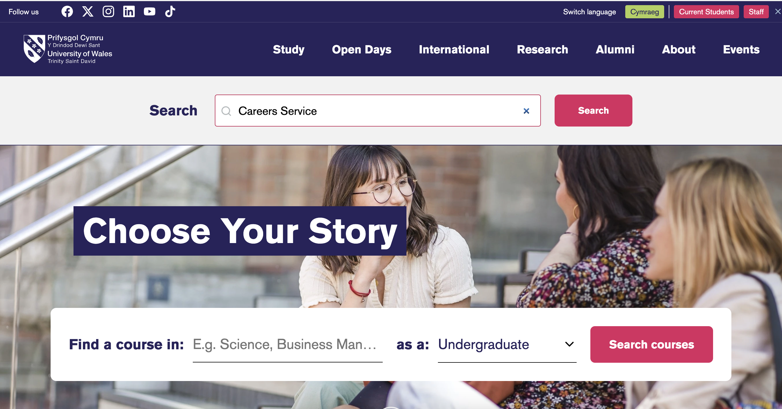

Slide 4
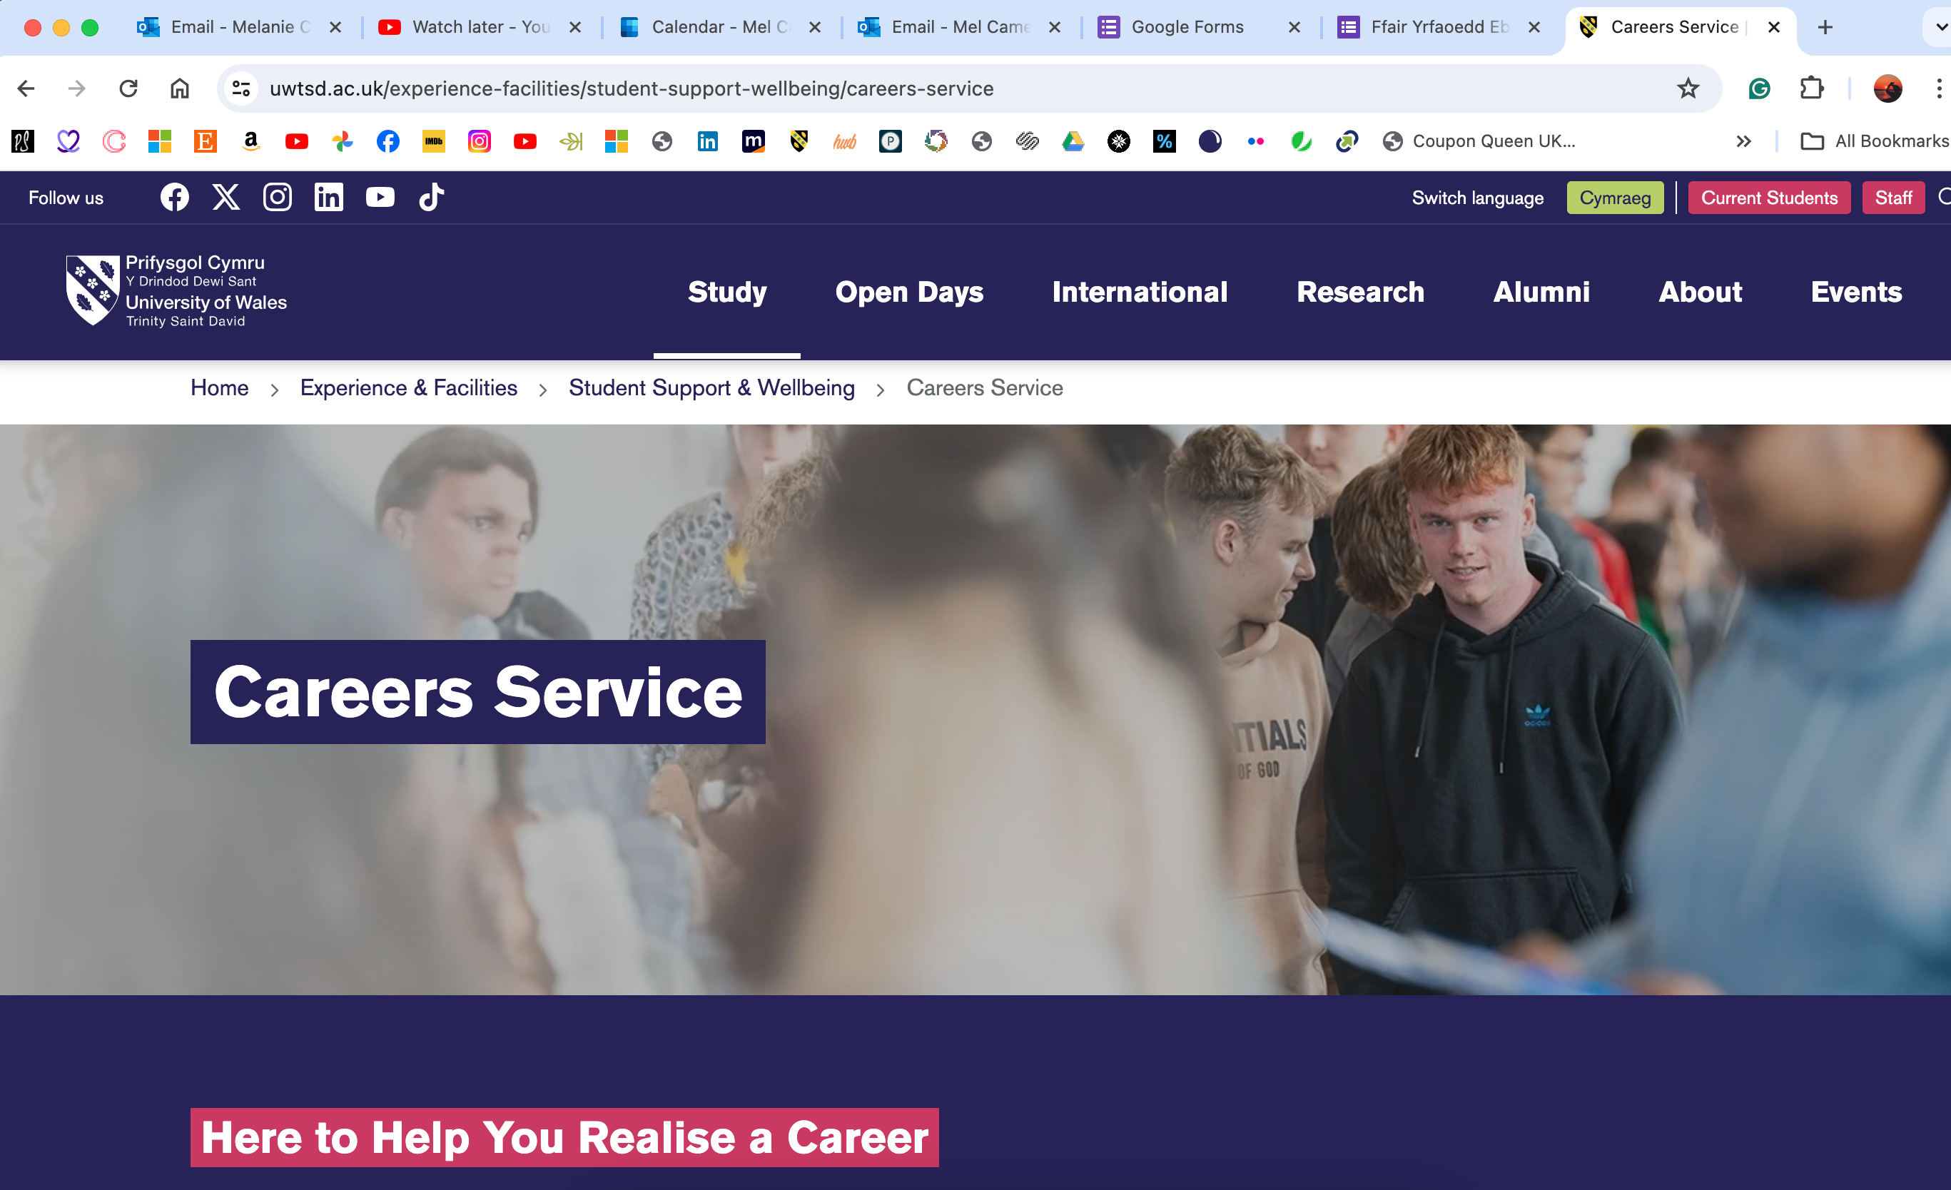

Slide 5
What do we do?
CAREERS SERVICE
HERE TO HELP YOU REALISE A CAREER
We offer one-to-one support for students across all disciplines and campuses, available in both English and Welsh.
Our services are available to students and graduates for up to three years after graduation.
We provide confidential and personalised Careers Information, Education, Advice, and Guidance.
Enjoy flexible services offered both in person and online via Microsoft Teams.
Careers events and workshops to enhance your employability.
We are open all year round, except on Bank Holidays and the closure days.

Slide 6
How can we help?
CAREERS SERVICE
HERE TO HELP YOU REALISE A CAREER
CV’s, Applications, Cover letters, etc
Job searching tips
Interview practice
Gaining relevant work experience
Postgraduate study
Signposting to other resources
Support in looking for training/education
Exploring your options
Impartial advice and guidance
Advice with self-employment
Job fairs
Access to ‘MyCareer’

Slide 7
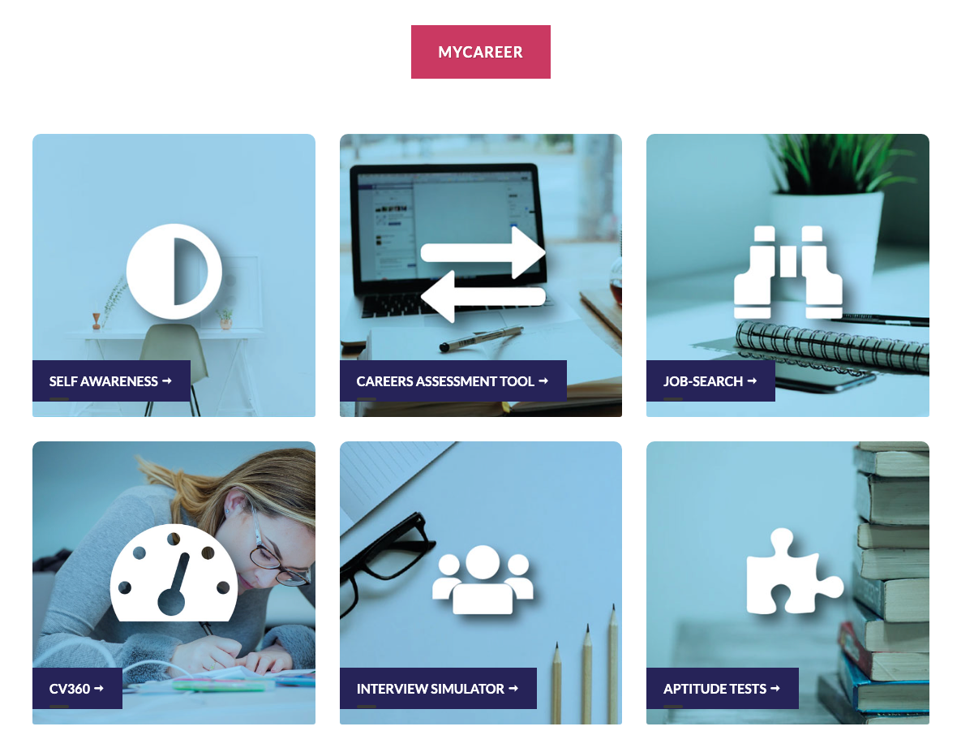
CAREERS SERVICE
HERE TO HELP YOU REALISE A CAREER
As a UWTSD Student you have 24/7 access to our online Careers Service platform, MyCareer.
Through this platform you can access Careers information, Career planners, self assessments, CV360 checker and MUCH more. You can continue to use this platform for up to three years after graduation.

Slide 8
CAREERS SERVICE
HERE TO HELP YOU REALISE A CAREER
WORKING ON YOUR SKILLS GAPS
You could work on improving your:
Work experience
Digital skills
Transferable skills
People skills - for example, through volunteering
Courses/Training
Communication or number skills
Interview skills

Slide 9
WORK EXPERIENCE
CAREERS SERVICE
HERE TO HELP YOU REALISE A CAREER

Slide 10

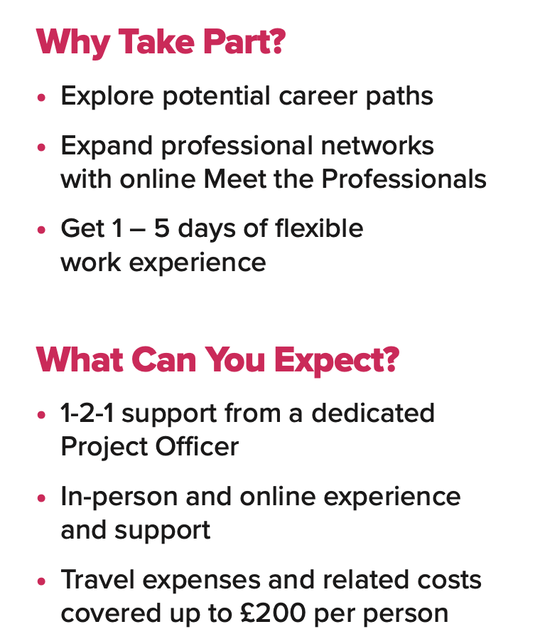
careers@uwtsd.ac.uk
CAREERS SERVICE
HERE TO HELP YOU REALISE A CAREER

Slide 11



CAREERS SERVICE
HERE TO HELP YOU REALISE A CAREER
There are several digital tools and technologies that can help you whilst studying at University. To access our list of recommended learning resources, you will need to log in to Moodle, our virtual learning environment.
These resources will help you assess and reflect on your own digital skills, identify areas for development, plan your personal digital skills development path and ensure your digital skills are fully recognised by earning digital badges that can be included on your CV and LinkedIn profile.
digitalskills.uwtsd.ac.uk/students/

Slide 12
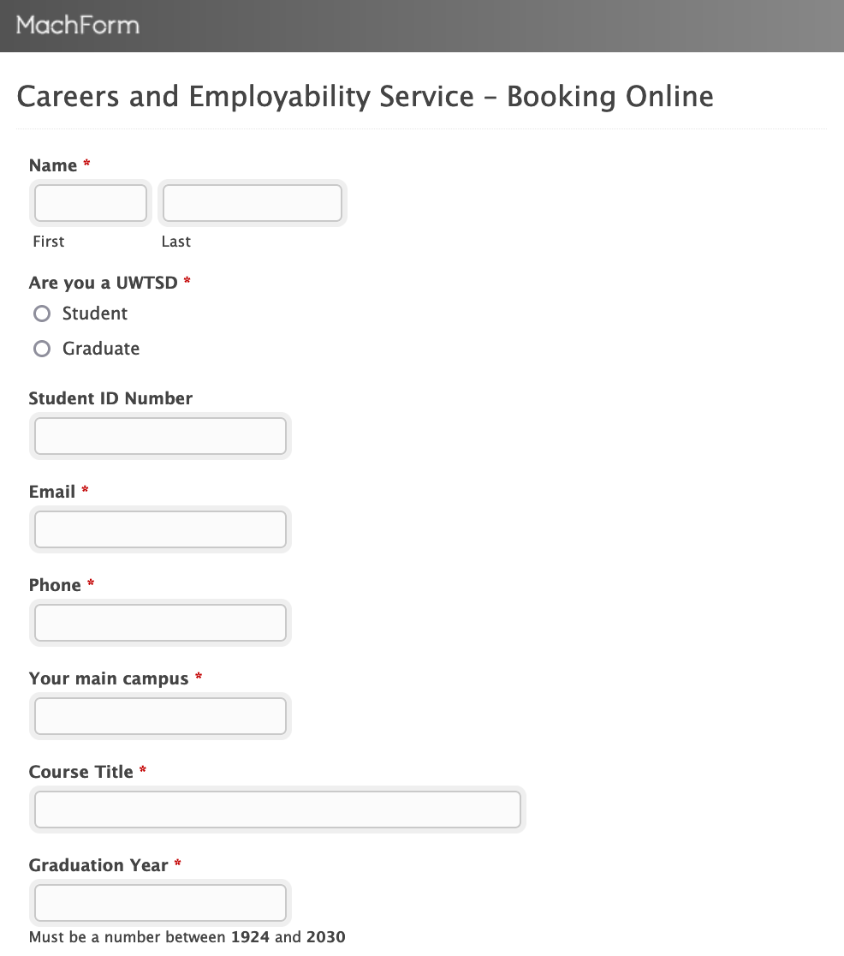
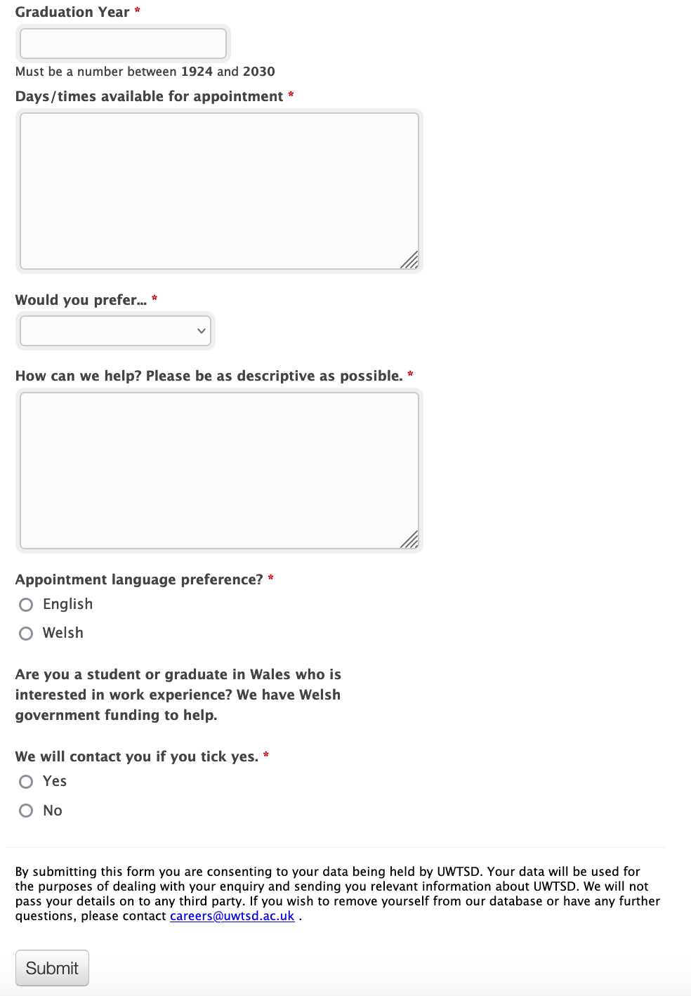
How to make an appointment…

Slide 13
CONTACT US; careers@uwtsd.ac.uk
CAREERS SERVICE
HERE TO HELP YOU REALISE A CAREER

Slide 14
QUESTIONS?
CAREERS SERVICE
HERE TO HELP YOU REALISE A CAREER

Slide 15
DIOLCH!
THANK YOU
CAREERS SERVICE
HERE TO HELP YOU REALISE A CAREER

