Slide 1
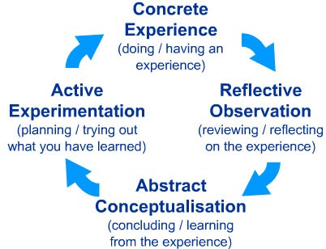
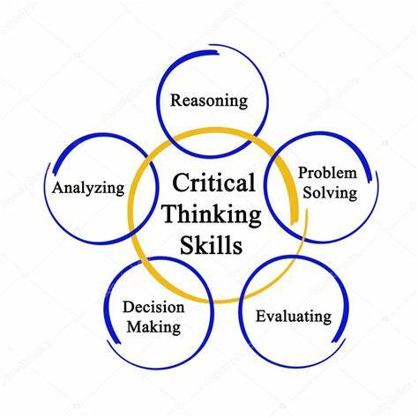
Amy Lewis 2212269 Word count:
Critical Thinking
Introduction:
Critical thinking skills are essential during academic studies. We use them at different levels, all of the time, sometimes without even realising. Developing logical ideas, and reasoning about a subject is critical thinking.
Cottrell (2017) states that these skills allow us to think clearer, clarify and construct arguments more effectively, and become more aware of what we see and hear.
Time Management:
For students in higher education, effective time management is critical (Cottrell, 2019).
It is important to ensure that you use your time effectively to avoid falling behind with your studies and establishing an unhealthy work life balance.
There are several ways to achieve good time management and keep on top of your studies. Creating a time table is an ideal place to start by allocating set times within your week for your studies, and giving yourself realistic goals and deadlines which fit into your weekly routine.
Prioritise which activities are the most important to complete first, do them and note the time it takes to complete them (Cottrell, 2019).
Moore (1994) suggests that it is important to use your time effectively to avoid procrastinating, and that you complete an activity once it is started, while remaining motivated. With good time management, you will be less stressed and feel a sense of achievement.
Note Taking:
Note taking is an essential skill when studying at a higher level. It is not possible to remember everything that is said during a lecture. Cottrell (2019) agrees, stating that even if you are concentrating, you can forget at least 50% - 60% of what is said during a lecture. When taking notes, be sure to use keywords. Write short, accurate notes and information which will enable you to further research and write your assignments in your own words. Note taking also helps you to retain information.
Research:
Researching and reading other peoples work from various resources is helpful to build on your thinking and writing skills.
According to Cottrell (2017), learning more about a subject enables you to assess if certain information, alternate explanations, and available options have been sufficiently covered.
Reflection:
Reflection is another important skill which enables students to identify and expand their strengths, any areas for development, and increases their learning. Regular self reflection helps you to assess your abilities and make any necessary corrections, and to see what elements are working well, and which ones are not.
Kolb (1984) initiated his four-stage model of learning. This included doing the activity, reflecting on the activity further, researching the activity, and then planning the next stage once you know where you can improve.
Conclusion:
To conclude this poster, the skills that have been chosen are an excellent starting point for academic studies.

