Slide 1
The Zoology of Mythological Creatures
Conrad Gesner, Mythology, and Modern Science

Slide 2
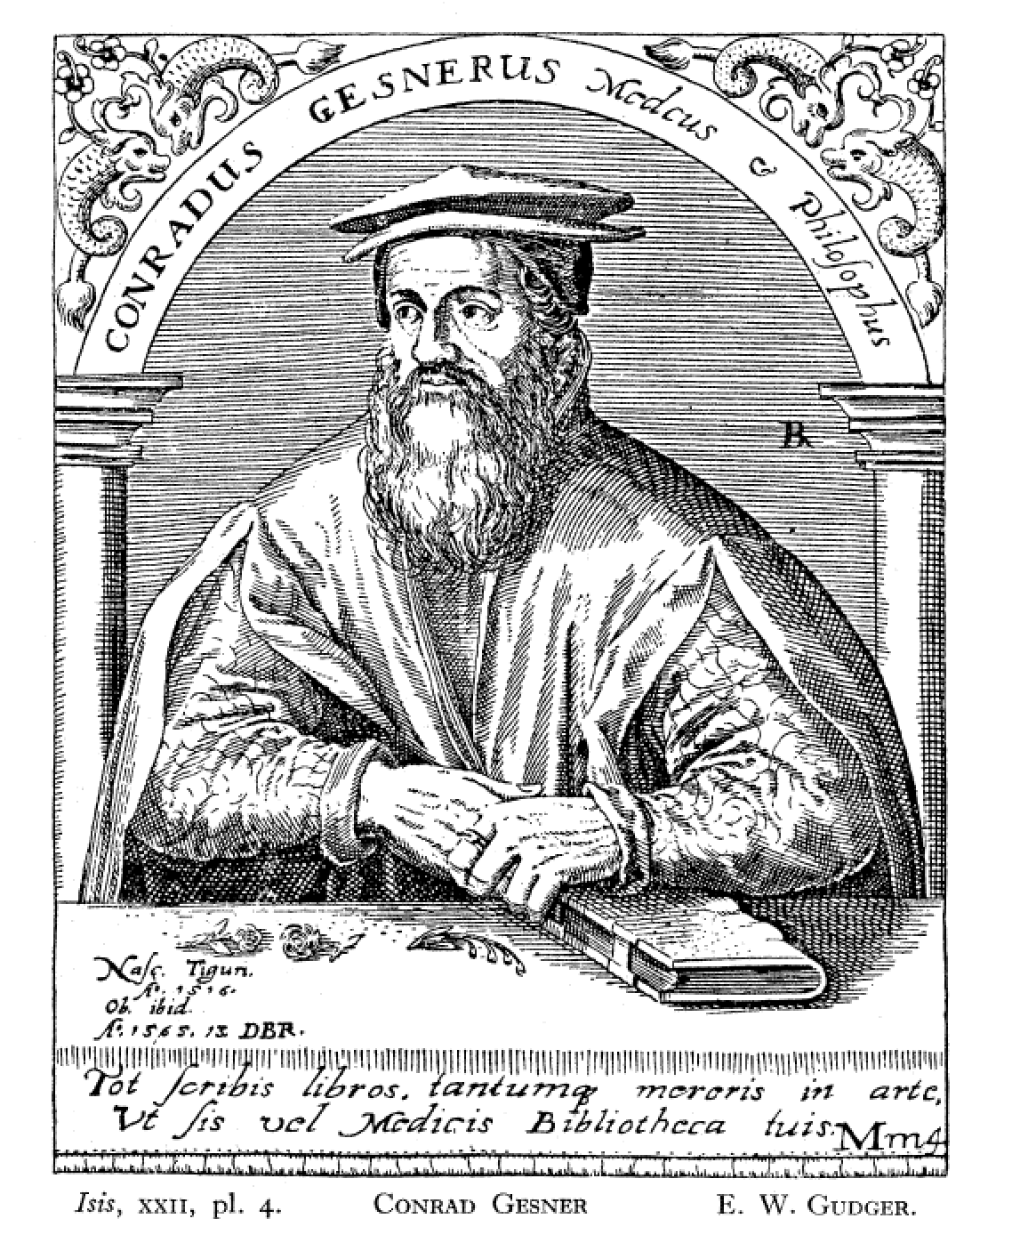
Conrad Gesner The Father of Zoolology:
Gesner was born in Zurich in 1516 and he died relatively young at the age of 49 in 1565.
He was well versed in many ancient languages, and during his life he accumulated a great knowledge of medicine as well as being quite knowledgeable in natural history.
His Historia Animalium, which comprised four great tomes, coming in at 4,500 pages, and containing hundreds of illustrated woodcuts is seen to be by far his greatest achievement

Slide 3
The Historia Animalium and the Fischbuch
The Historia Animalium lists a staggering number of animals, categorized in alphabetical order.
Fischbuch (or book of fish) contains Book 4 of the Historia Animalium which primarily covers ichthyology and studies many ocean animals.
This copy of the Fischbuch was created in 1575 and is translated from Latin to German.
The Fischbuch also contains within it, The Schlangenbuch, which covers various snakes, serpents and dragons.

Slide 4
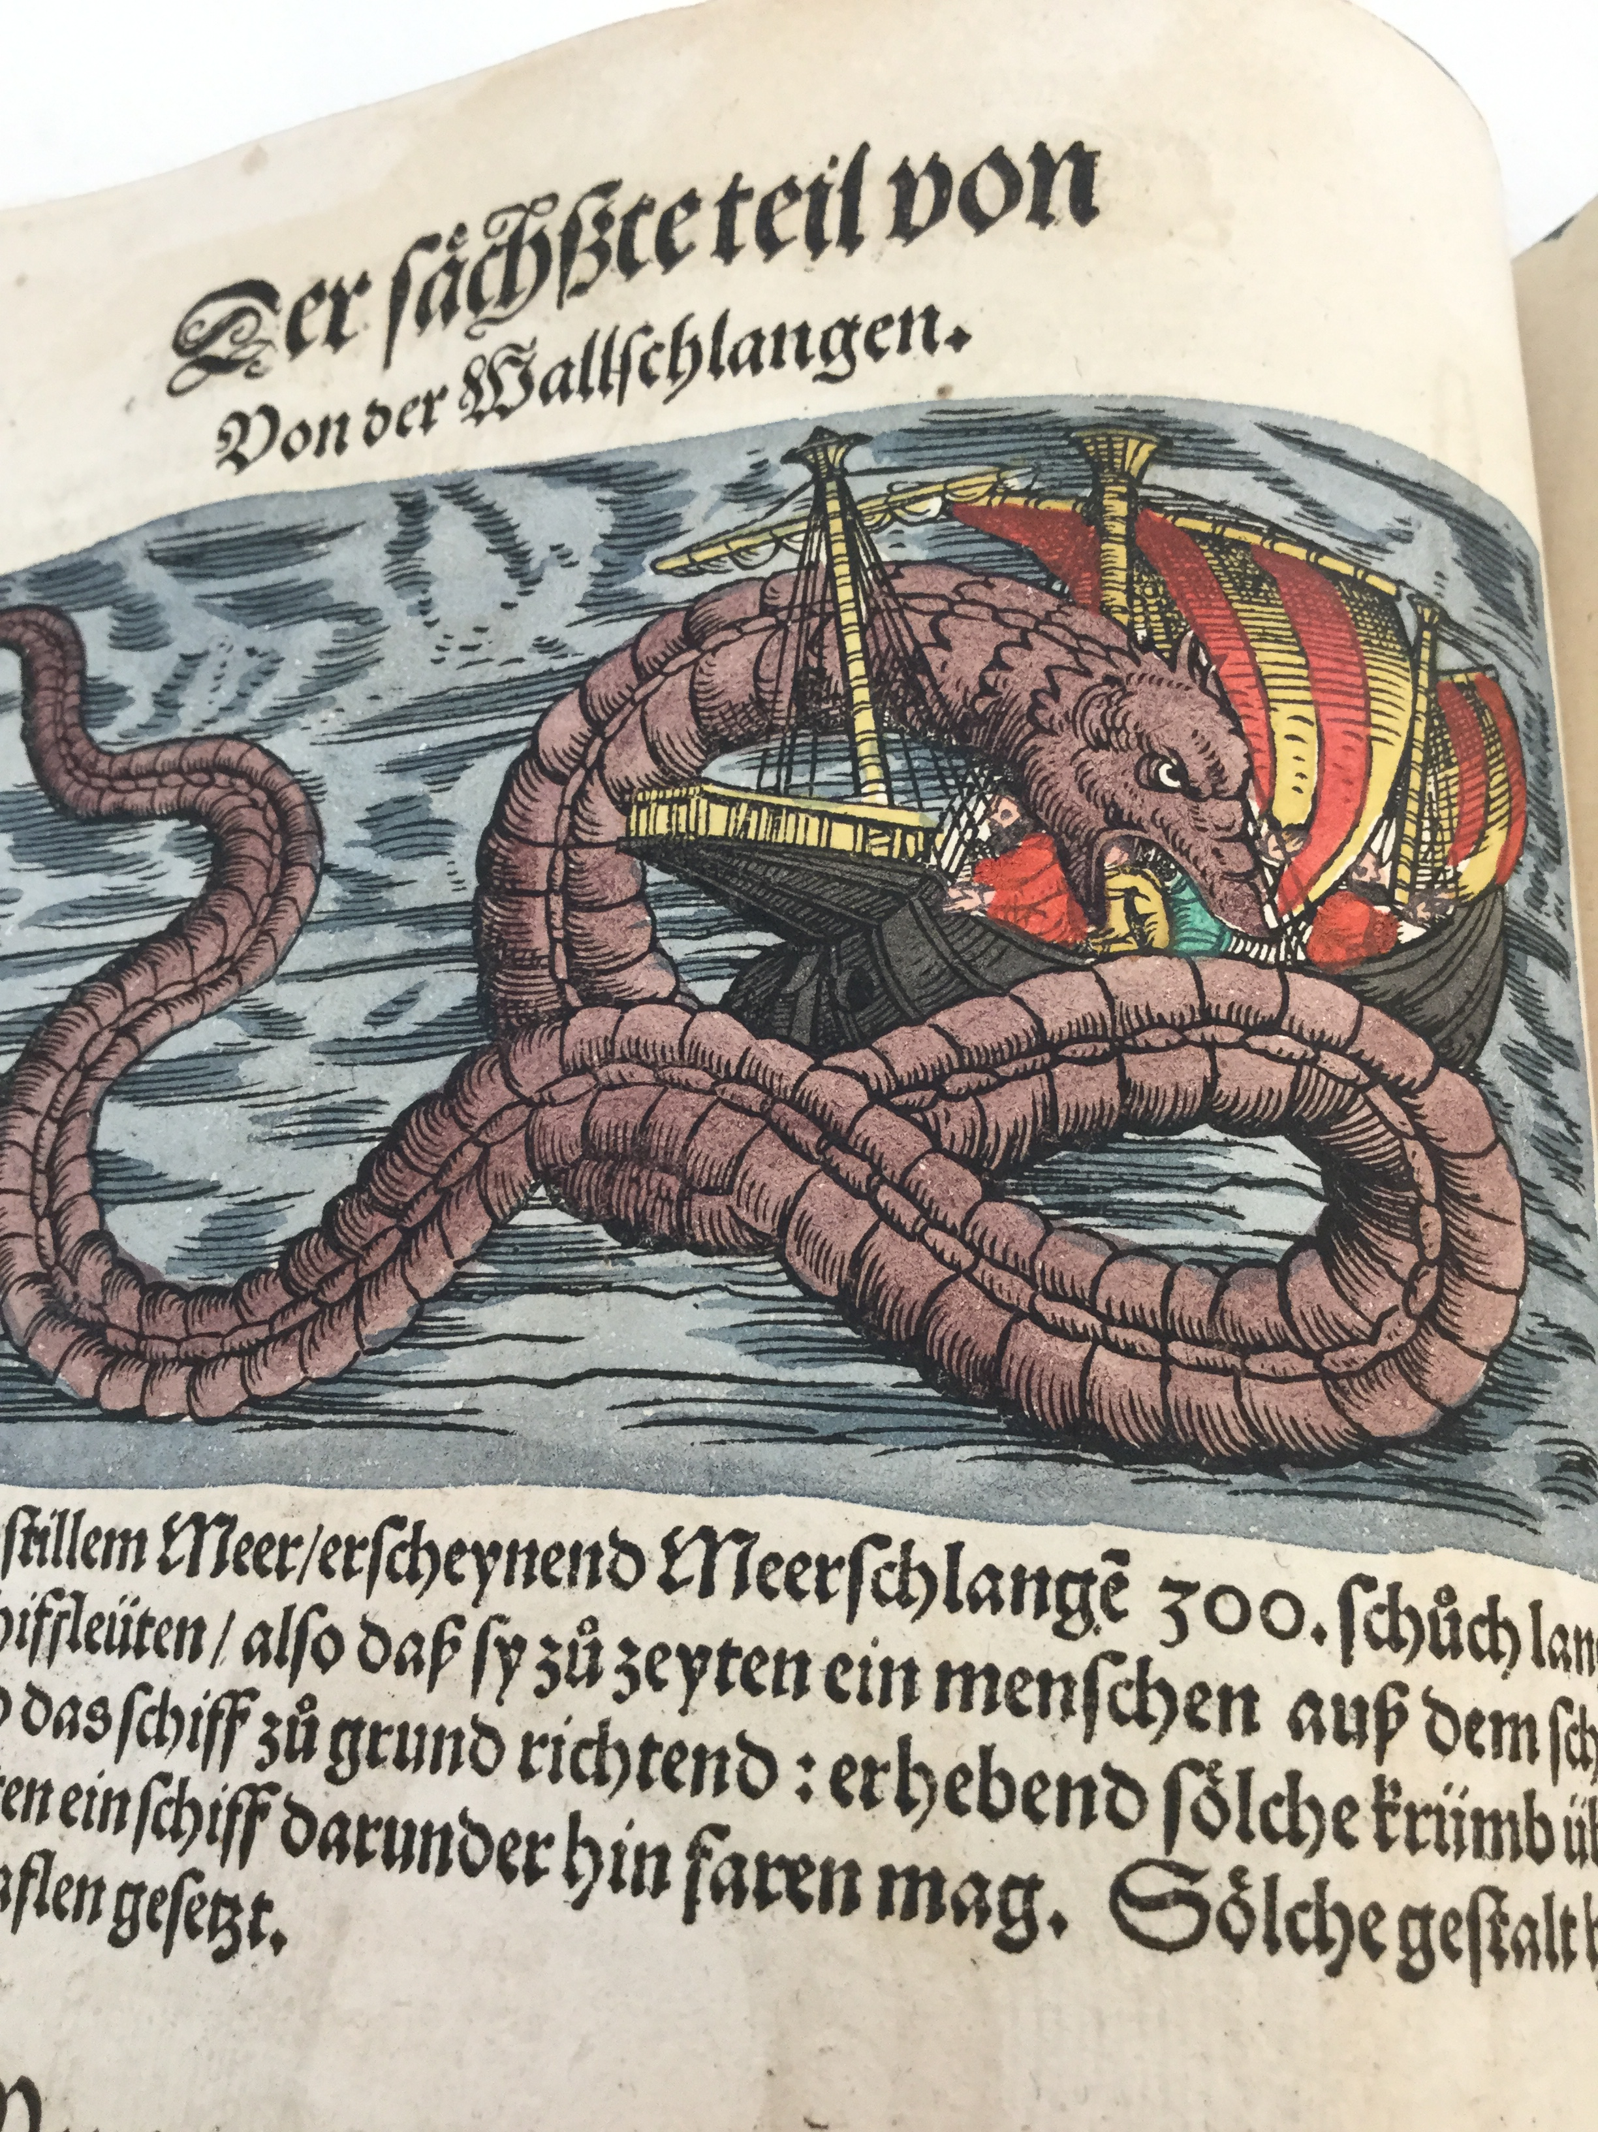
Painted Woodcut Illustration: all the woodcuts presented in the Fischbuch are woodcuts either done by Gesner himself, illustrated on his behave or taken from other scholarly sources of the day.
A woodcut was created by carving an image onto a plank of wood.
Woodcuts however are not as durable as type and they reverse the illustration. many of fishes are shown as being static and are not illustrated as they would have moved in life.

Slide 5
Painted Woodcut Illustration Cont.
Many of the woodcuts found in the Fishbusch are also beautifully hand painted. This would have been done under the supervision of Gesner or his publisher.
Painters at the time did not have a uniform range of colors at their disposal and so variation in the color of the fish and other creatures in the illustration may differ from how it would be colored in life.
Gesner, “lamented how colours were applied carelessly and perfunctorily as a result of the ‘avarice’ of the printer.”

Slide 6
The Sixteenth Century: ‘Here There be Dragons’
The world was still mysterious place.
Science and zoology as we know it today was still in its early infancy.
Few had tried to compile an encyclopedia of all known animals.
Gesner looked to older sources such as the works of classical philosophers such as Herodotus and Aristotle.
Medieval bestiaries were loaded with superstition and heavily rooted in folklore.
Travellers’ tales reliability was often shoddy at best.

Slide 7
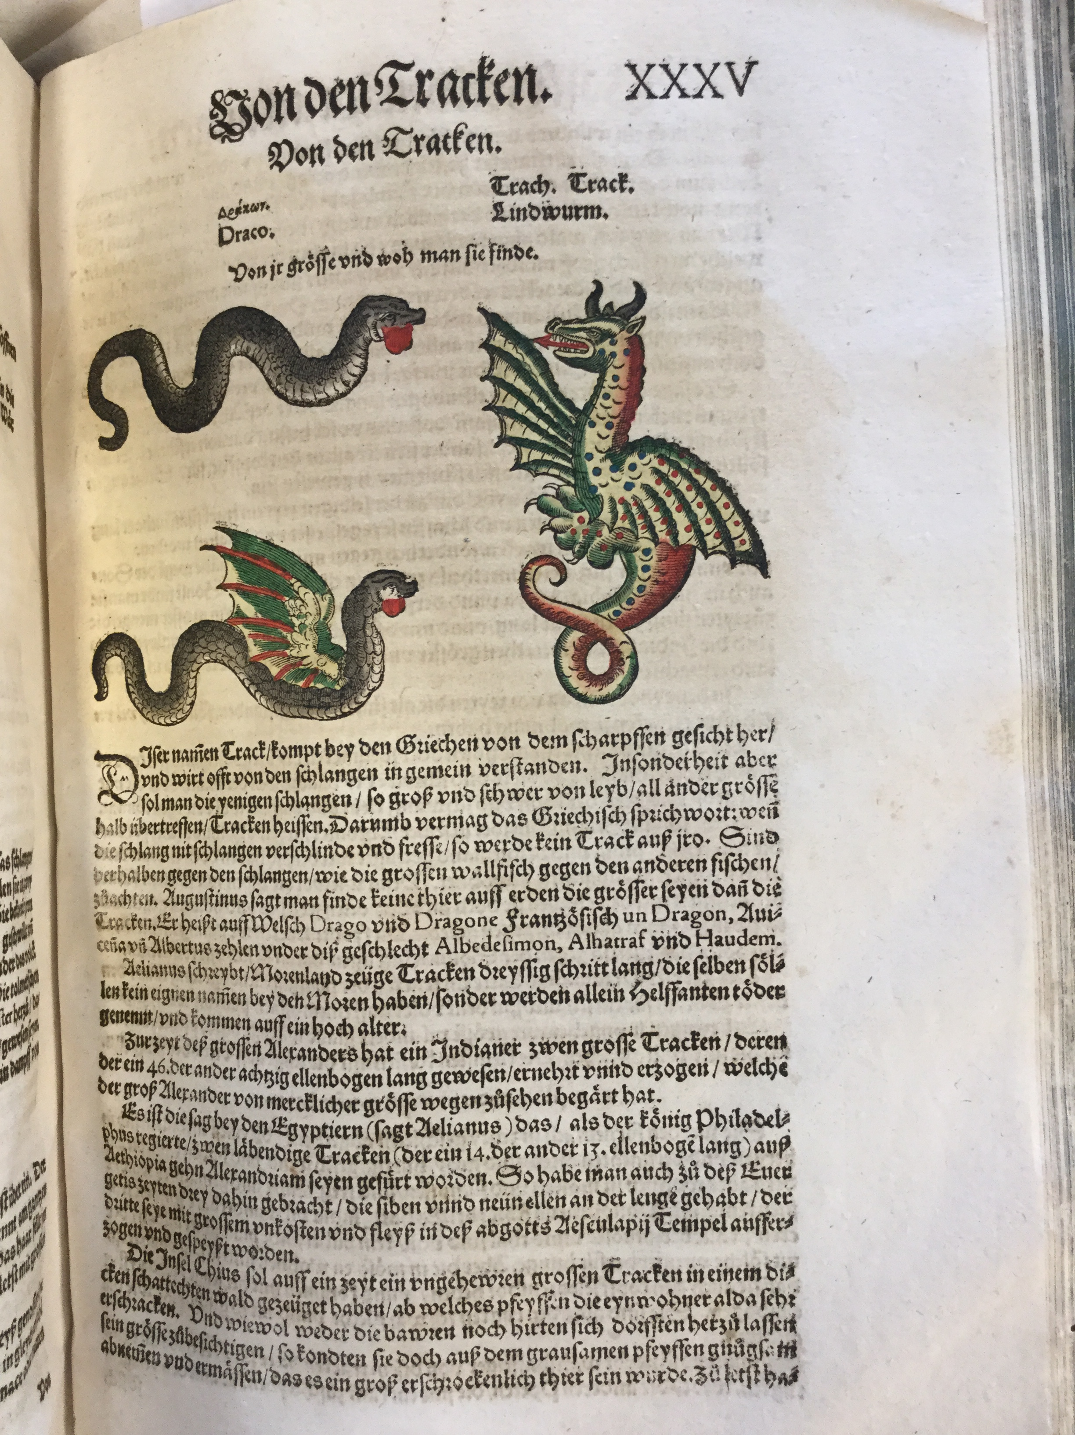
Dragons and other mythological creatures in Bestiaries:
-While Gesner tried to utilize the best sources available his work he nevertheless includes various errors and non-existent animals, of which the dragon is a perfect example.

Slide 8
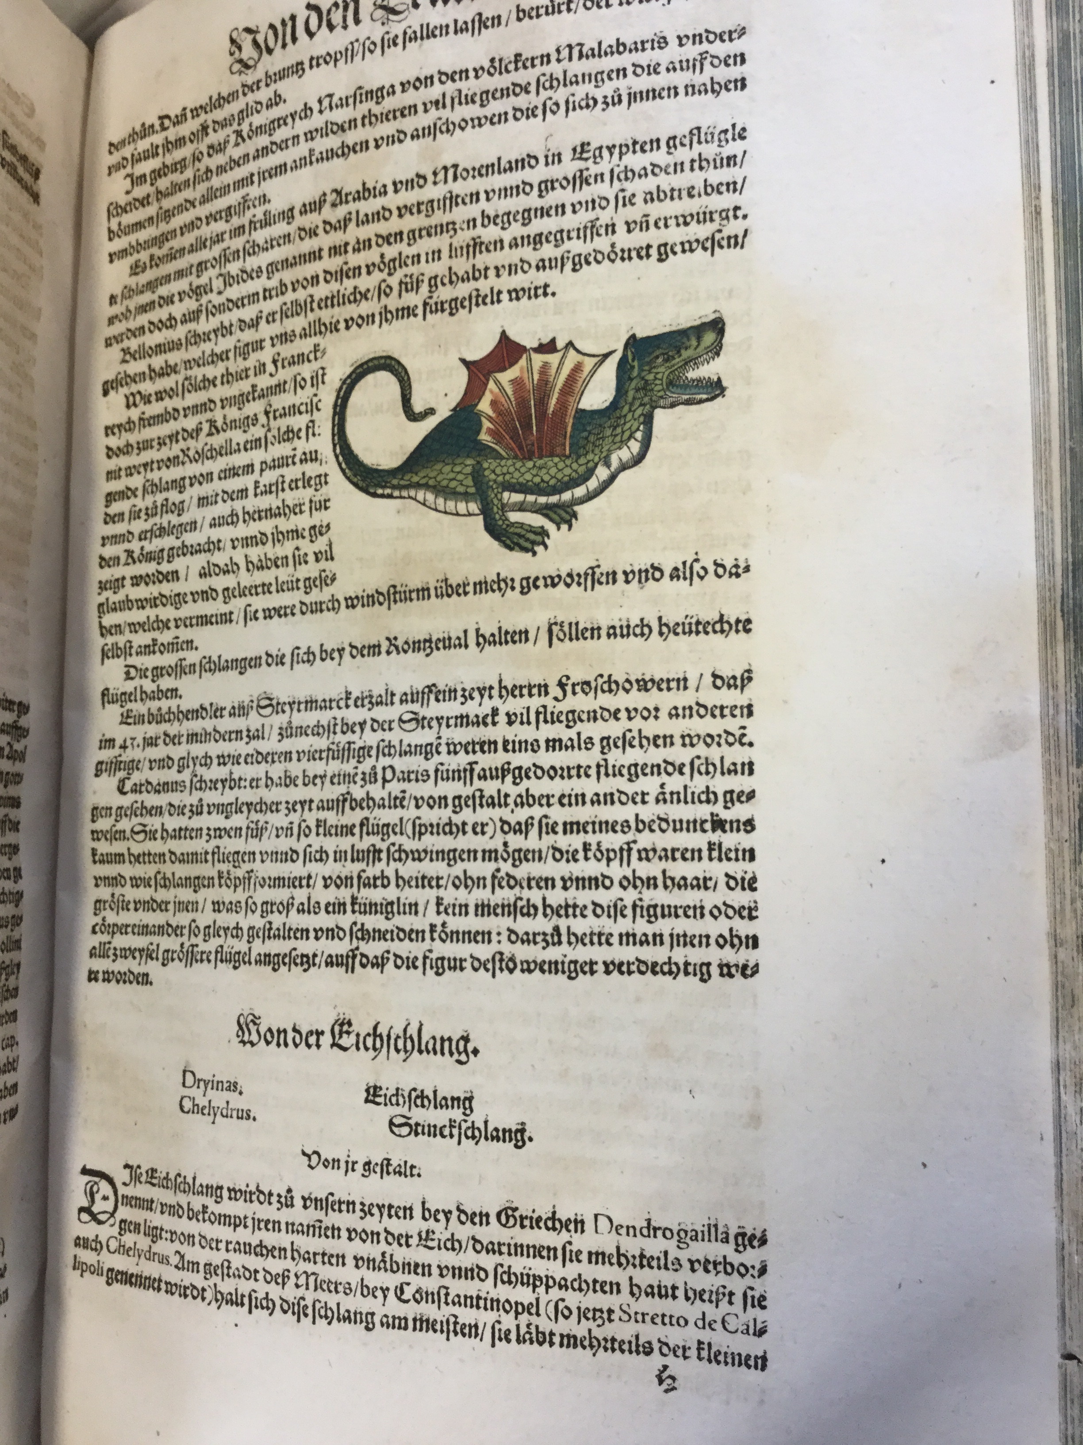
“Gessner’s encyclopedia set the standard for subsequent dragon descriptions.
It was the first to include dragon information from Aelian and Philostratus, as well as numerous other classical and later authors.
Gessner used Philostratus’s recognition of different kinds of dragons to resolve apparent contradictions in descriptions of dragons from previous literature (e.g., the dragon’s color, whether or not it was crested, whether or not it had feet, and whether or not it had wings). Gessner was the first encyclopedist to apply the term dragon to the bipedal snakes manufactured by travelers’ tales and taxidermists’ hands. He was also the first to consider Herodotus’s Egyptian flying snakes… to be a kind of dragon. Subsequent encyclopedists imitated him in all these respects.”- Senter, Mattox & Haddad pp.82-84

Slide 9
Conclusion
Gesner’s works mark the beginning in terms of scientific research, bridging the gap between medieval superstition and later scientific scholarship.
Gesner himself did not rail against the superstition and misinformation of his time but rather embraced it in his search to compile the largest encyclopedia of zoology of his day.
Such as task would have always been riddled with hearsay and misinformation.
Even today much of the ocean depths still remain alien and there are still many mysteries for biologists, ichthyologists and zoologists to discover and solve.

Slide 10
Bibliography
Daligan, S., Monsters of the Deep. The Devil and the Deep Blue Sea. Available at: http://www.uwtsd.ac.uk/rbla/online-exhibitions/the-devil-and-the-deep-blue-sea/monsters-of-the-deep/ [Accessed May 21, 2018]
Gudger, E.W., 1934. The Five Great Naturalists of the Sixteenth Century: Belon, Rondelet, Salviani, Gesner and Aldrovandi: A Chapter in the History of Ichthyology. Isis, 22(1), pp.21–40. Available at: http://www.jstor.org/stable/225322 [Accessed May 21, 2018].
Knight, D., 1977. Zoological illustration: an essay towards a history of printed zoological pictures, Folkstone: Dawson.
Kusukawa, S., 2010. The sources of Gessners pictures for the Historia animalium. Annals of Science, 67(3), pp.303–328.
Senter, Mattox & Haddad, 2016. Snake to Monster: Conrad Gessners Schlangenbuch and the Evolution of the Dragon in the Literature of Natural History. Journal of Folklore Research, 53(1), pp.67–124.
Uwtsd, Monsters of the Deep II. Fischbuch GESNER, C.1575. Available at: http://www.uwtsd.ac.uk/rbla/online-exhibitions/the-devil-and-the-deep-blue-sea/monsters-of-the-deep-ii/ [Accessed May 21, 2018].

