Slide 1
Community Care and Management of Longer-term Conditions
LCHS 7003
Term 1
End of life care
©Dr Aishat Bakre

Slide 2
Learning outcomes
Upon successful completion of this module, student should be able to:
Critically evaluate the physical, psychological, and social impact on individuals and families living with a long-term condition(s) and its treatment.
Critically assess the key areas of local and national political, health and social care agendas and initiatives relating to long term conditions.
Critically evaluate the skills, values and behaviours required to provide co-productive and traditional models of care as appropriate.
Critically analyse the contribution of empirical evidence and local, national, and international guidelines to informing the delivery of ‘whole person’ care and self-management support for individuals with long term conditions.

Slide 3
Module Summary
The module aims overall to develop student understanding of the theories, values and policies in managing patients with longer term conditions in different healthcare settings.
To gain an understanding of healthcare work across traditional primary/secondary/social care boundaries and collaborate with patients/carers and other professionals within the NHS, social and private/voluntary sector to continuously improve the information, support, care, and person-centred approaches to treatment of people living with long term conditions.

Slide 4

Notes:
Recap last week teaching

Slide 5
Aims of the Session
To understand
  The End-of-Life care
  How long end of life care usually last
  Who provides end of life care
  End of Life Care Pathway
  The term palliative care
  Who provide palliative care
  Priorities of EOLC care

Slide 6
What is End of Life Care?

Slide 7
End of life care
End-of-life care refers “to health care for a person nearing the end of their life or in the advanced stage of a terminal illness.
Generally speaking, people who are dying need care in four areas—physical comfort, mental and emotional needs, spiritual issues, and practical tasks”.

Slide 8
End of life care
End-of-life care refers to health care provided in the time leading up to a person's death.
End-of-life care can be provided in the hours, days, or months before a person dies and encompasses care and support for a person's mental and emotional needs, physical comfort, spiritual needs, and practical tasks.

Slide 9
End of life care
End of life care involve supporting people who are in the last months or years of their life.
It helps people to live as well as possible until they die and to die with dignity.
The people providing the care would ask about the wishes and preferences and take these into account as they work with the patient to plan the care.
(NHS, 2022)

Slide 10
End of life care
The care provider should also support the family, carers or other people who are important to the patient.
Patient are entitled/have the right to express wishes about where they would like to receive care and where they want to die.
Patient can receive end of life care at home, in a care home, hospice or be cared for in hospital, depending on the needs and preference.

Slide 11
Activity
Working independently using the below links explore how people in their end of life can receive care in their place of choice.
https://www.nhs.uk/conditions/end-of-life-care/care-at-home/
https://www.nhs.uk/conditions/end-of-life-care/hospice-care/
https://www.nhs.uk/conditions/end-of-life-care/care-in-a-care-home/
https://www.nhs.uk/conditions/end-of-life-care/where-you-can-have-care/hospital-care/
Feedback the findings to the whole class

Slide 12
How long does end of life care usually last?

Slide 13
Duration of End of life care
End of life care should begin when you need it and may last a few days or months, or sometimes more than a year.
People in lots of different situations can benefit from end of life care. Some of them may be expected to die within the next few hours or days.
Others receive end of life care over many months.

Slide 14
Who provides end of life care?

Slide 15
End of life care providers
Different “health and social care professionals may be involved in the end of life care, depending on the requirements”.
For example, medical doctors and nurses, patient GP, community nurses, hospice staff and counsellors may all be involved, as well as social care staff, chaplains (of all faiths or none), physiotherapists, occupational therapists or complementary therapists.
(NHS, 2022)

Slide 16
End of life care providers
GP has total responsibility for taking care of people with LTC. This can be at home or in a care home.
Community nurses usually visit them at home and family and friends may be closely involved in their caring.
(NHS, 2022)

Slide 17
When does end of life care begin?

Slide 18
Commencement of EOLC
End of life care should begin when you need it and may last a few days or months, or sometimes more than a year.
People are considered to be approaching the end of life when they are likely to die within the next 12 months, although this is not always possible to predict.
This includes people whose death is about to happen, as well as

Slide 19
Commencement of EOLC
People who:
“have an advanced incurable illness, such as cancer, dementia or motor neurone disease
are generally frail and have co-existing conditions that mean they are expected to die within 12 months
have existing conditions if they are at risk of dying from a sudden crisis in their condition
have a life-threatening acute condition caused by a sudden catastrophic event, such as an accident or stroke”
(NHS, 2022)

Slide 20
What is an End of Life Care Pathway?

Slide 21
The End of Life Care Pathway
The End of Life Care Pathway is “a document that leads the care plan for the final weeks of someone’s life”.
It is a “holistic, ‘whole-person’ approach to end of life care and dying, recommended to be used wherever someone wishes to die,
Whether it is a hospital, care home or in their own home”.
(Helping hands, 2022)

Slide 22
The End of Life Care Pathway
The pathway includes a commitment to honest discussions with the person at the start of their journey so that their wishes for care are respected at all stages.
This is sometimes also referred to as ‘dying well’.

Slide 23
What are the 6 stages of end of life care pathway?

Slide 24
End of life care pathway
There are six stages to the End of life care pathway which should be followed by clinicians and caregivers,
These include recognising
spiritual care for the person, support for their family and the carers themselves, as well as keeping them informed at every stage.

Slide 25
6 stages of end of life care pathway
Discussions as end of life approaches.
Assessment, care planning and review.
Coordination of care.
Delivery of high quality care in care homes.
Care in the last days of life.
Care after death.

Slide 26
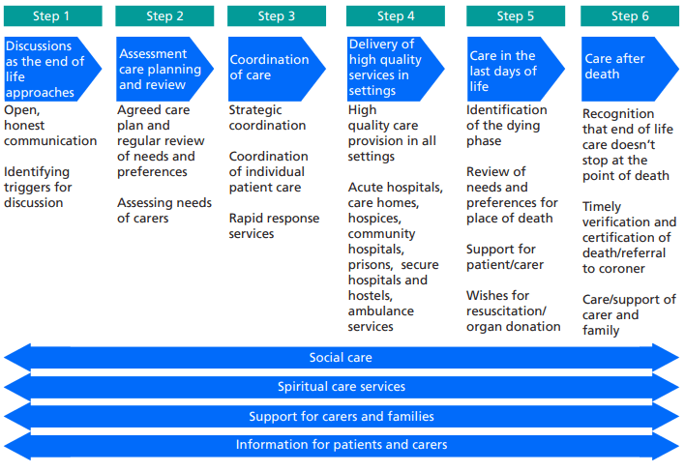

Slide 27
What are the 5 priorities for care in the last days?

Slide 28
5 priorities for care
The five priorities for care that customers and carers can expect to receive in the last few days and hours of life include.
Doctor must regularly see patient and if they believe death might occur very soon, they must explain this to the patient and the close relations.
Staff directly involve with the patient care should sensitively communicate with them.
Decision making regarding the care required should involve both the patient and the family.
An individual plan of care should be agreed by the patient and delivered with compassion.
Family needs must be met at all time

Slide 29
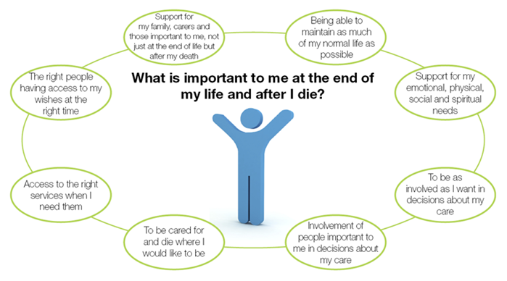

Slide 30
Examples of care in the last days for people with dementia?

Slide 31
End-of-life care and dementia
End of life care for dementia requires good person-centred care.
Living well with dementia also includes supporting a person with dementia to die well, or as they would have wished.
Be aware of the range of symptoms that a person with dementia may experience at the end of life.
Support family carers and help them to understand what is happening at the end of life.

Slide 32
Care in the last days of life with dementia
Dying is a natural part of life, and it is important to plan well for the last few days and hours of life.
People with dementia should be able to die in comfort, and we can do a lot to help manage symptoms.
The support we offer at this time must be in keeping with a person’s wishes, their spiritual views, culture and life history.
Family and friends will need emotional support too, and timely and accurate information.
Care staff need to know the person’s wishes for their death: where they would prefer to be when they die, who should be present, how pain might be treated, and so on.
A person’s spiritual and cultural needs are important throughout their life but may take on a particular significance at the end of their life.
We can only support a person nearing death properly if we know this information – and have recorded it accurately – so they have the best possible, and personalised, end-of-life care
(Morris and Collier, 2012)

Slide 33
Activity
Watch the video below
https://youtu.be/U4EJZ4T8TA8
Feedback what you learnt to the whole class
Notes:
End of Life Care: Achieving dignity for those with dementia - YouTube

Slide 34
What is palliative care?

Slide 35
Palliative care
Palliative care is an interdisciplinary medical caregiving approach aimed at optimising quality of life and mitigating suffering among people with serious, complex illness.
PC means care for the terminally ill and their families, especially those provided by an organised health service.

Slide 36
Palliative care
End of life care includes palliative care.
If a person have an illness that cannot be cured, palliative care makes them as comfortable as possible, by managing your pain and other distressing symptoms.
It also involves psychological, social and spiritual support for the person and their family or carers.
This is called a holistic approach, because it deals with the person as a "whole" person, not just the illness or symptoms.

Slide 37
Palliative care
Palliative care is defined by the World Health Organisation as an approach that improves the quality of life of patients (adults and children) and their families who are facing problems associated with life-limiting illness, usually progressive.
It prevents and relieves suffering through the early identification, correct assessment and treatment of pain and other problems whether physical, psychosocial or spiritual.

Slide 38
Palliative care
Palliative care is available when someone first discover that they have a life-limiting (terminal) illness.
Someone might be able to receive palliative care while still receiving other therapies to treat a condition.
(NHS, 2022)

Slide 39
Who provides palliative care?

Slide 40
Palliative care Providers
Many healthcare professionals provide palliative care as part of their jobs.
An example is the care you get from your GP or community nurses.
Some people need additional specialist palliative care.
(NHS, 2022)

Slide 41
Palliative care Providers
This may be provided by consultants trained in palliative medicine, specialist palliative care nurses, or specialist occupational therapists or physiotherapists.
Palliative care teams are made up of different healthcare professionals and can co-ordinate the care of people with an incurable illness.
As specialists, they also advise other professionals on palliative care.
(NHS, 2022)

Slide 42
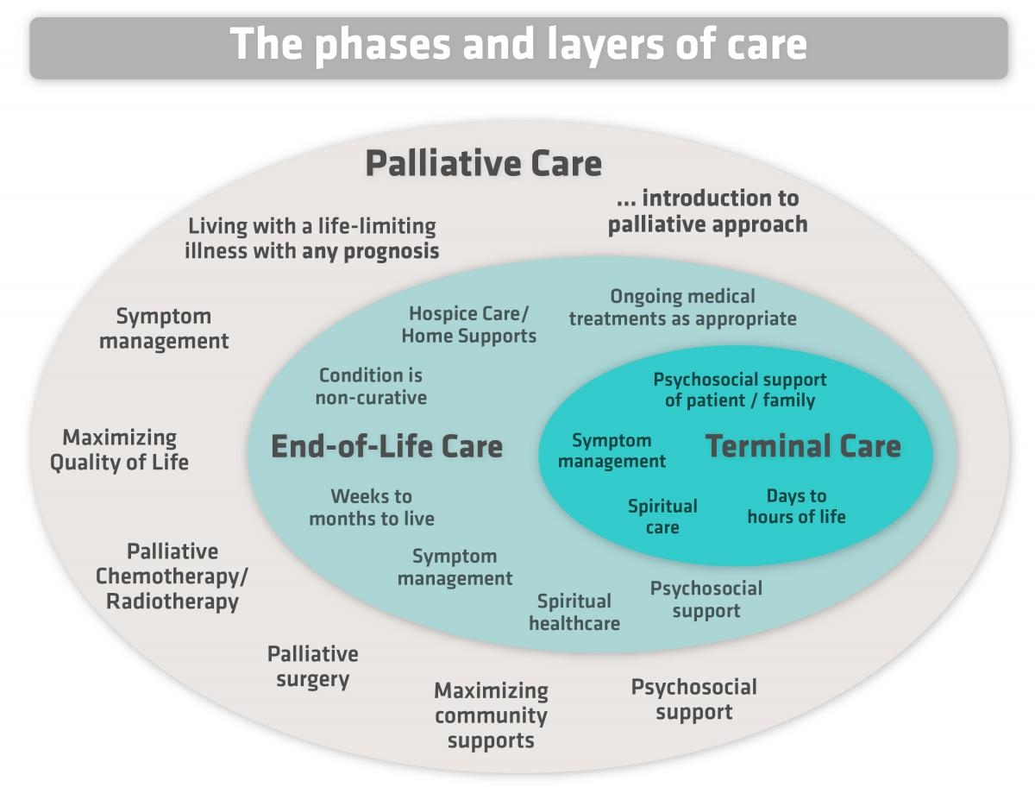
Notes:
Hospice palliative care

Slide 43
Activity
Watch the video below
https://www.scie.org.uk/socialcaretv/video-player.asp?v=palliative-care-or-end-of-life-care
https://www.youtube.com/watch?v=bM8LuiV5NF0
Feedback what you learnt to the whole class
Notes:
Let's talk about end-of-life care | Caring with Confidence: The Code in Action | NMC – YouTube
End of Life Care – YouTube
End of life care videos on Social Care TV:

Slide 44
Activity
Working independently using the below link explore the NICE guidance on “Care of dying adults in the last days of life”
https://www.nice.org.uk/guidance/ng31/ifp/chapter/About-this-information
Feedback what you have learnt to the whole class
Notes:
About this information | Information for the public | Care of dying adults in the last days of life | Guidance | NICE

Slide 45
Activity
Working independently using the below link study how health professionals manage pain and symptoms of people in their end of life.
https://www.nhs.uk/conditions/end-of-life-care/controlling-pain-and-other-symptoms/
Feedback the findings to the whole class
Notes:
Managing pain and other symptoms - NHS (www.nhs.uk)

Slide 46
Activity
Watch the video below
Every Moment Counts – National Voices
Feedback what you learnt to the whole class
Notes:
What to expect from end of life care – NHS
Being cared for in hospital - NHS

Slide 47
Activity
Watch the video below
https://www.youtube.com/watch?v=yB-i0F7m6qQ
Feedback what you have learnt to the whole class
Notes:
Let's talk about end-of-life care | Caring with Confidence: The Code in Action | NMC - YouTube

Slide 48
Palliative and End of life care
“Death and dying are unavoidable.
Being able to live as well as possible until we die is something that we all value.
The needs of people of all ages who are living with dying, death and bereavement, their families, carers and communities, must be addressed, taking into account their priorities, preferences and wishes”.
(NHS, 2022)

Slide 49
Personalised palliative and end of life care
Personalised care in “the last year(s) and months of life will result in a better experience, tailored around what really matters to the person, and more sustainable health and care services”.
(NHS, 2022)

Slide 50
What is lasting power of attorney?

Slide 51
Lasting power of attorney
End of life care also covers legal issues to help people plan ahead their future care.
This involve creating a lasting power of attorney (LPA) by officially appointing someone you trust/people of your choice to make decisions about your care if you are no longer able to do so yourself.

Slide 52
Lasting power of attorney
An attorney can also be appointed to decide on financial and property matters.

Slide 53
Advance Care Planning
End of life care is sometimes called advance care planning,
It involves patients thinking and talking about their wishes for how they want to be cared for in the final months of their life.

Slide 54
Advance Care Planning
Advance Care Planning gives people opportunity to think ahead, to describe what’s important to them and to ensure other people know their wishes for the future.
It is about helping people to live well right to the end of their life.

Slide 55
Advance care planning
Advance care planning discussion involves some key statements that include:
What is important to you?
What do you want to happen?
What do you not want to happen?
Who would speak for you?
(NICE, 2020)

Slide 56
Advanced Care Planning
The discussion may also include:
Living wills or Advance decision to refuse treatment
Do not attempt cardiopulmonary resuscitation (DNACPR) decisions

Slide 57
What are the five simple steps to achieve Advanced care planning?

Slide 58
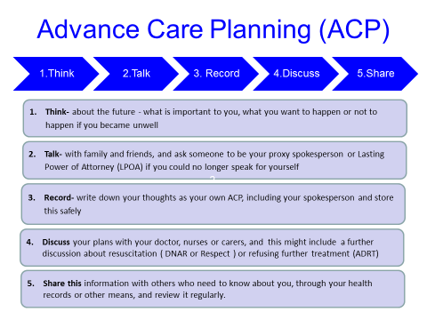

Slide 59
Activity
Watch the video below
https://www.goldstandardsframework.org.uk/advance-care-planning
Feedback the findings to the whole class

Slide 60


Slide 61
References
Morris, C., and Collier, F. (2012). End of Life Care : A Care Worker Handbook: Vol. First edition. Hodder Education Group. Available at: https://www.nice.org.uk/about/nice-communities/social-care/quick-guides/advance-care-planning (Accessed date 04th June 2023)
National health Service (2022) What end of life care involves Available at: https://www.nhs.uk/conditions/end-of-life-care/what-it-involves-and-when-it-starts/ (Accessed date 10th October 2022)
National health Service (2022) Dying Matters | Hospice UK Available at: https://www.hospiceuk.org/our-campaigns/dying-matters (Accessed date 10th October 2022)
National health Service (2022) What to expect from end of life care Available at: https://www.nhs.uk/conditions/end-of-life-care/what-to-expect-from-care/ (Accessed date 10th October 2022)
National health Service (2022) Managing pain and other symptoms. Available at: https://www.nhs.uk/conditions/end-of-life-care/controlling-pain-and-other-symptoms/ (Accessed date 10th October 2022)

Slide 62
Further Reading
National health Service (2021) Palliative and end of life care. Available at: https://www.england.nhs.uk/eolc/ (Accessed date 11th October 2022)
National health Service (2021) Personalised care. Available at: https://www.england.nhs.uk/personalisedcare/(Accessed date 11th October 2022)
National health Service (2021) Personalised palliative and end of life care. Available at: https://www.england.nhs.uk/eolc/personalised-care/(Accessed date 11th October 2022)
NICE (2021) Care of dying adults Available at: https://www.nice.org.uk/guidance/ng31 (Accessed date 11th October 2022)

