Slide 1
Defenders, Conquerors and Vanquished
Bactria and Parthia

Slide 2
Where does Bactria fit?
W.W. Tarn The Greeks in Bactria and India. 1938 and 1951
“in the history of India the episode of Greek rule has no meaning, it is really part of the history of Hellenism, and that is where its meaning resides” p. xx
A.K. Narain The Indo Greeks 1957
“Their history is part of the history of India and not of the Hellenistic states: they came, they saw, but India conquered.” p. 11

Slide 3
Expansion of the Seleucid Empire
Always lying in wait for the neighboring nations, strong in arms and persuasive in council, he acquired Mesopotamia, Armenia, 'Seleucid' Cappadocia, Persis, Parthia, Bactria, Arabia, Tapouria, Sogdia, Arachosia, Hyrcania, and other adjacent peoples that had been subdued by Alexander, as far as the river Indus, so that the boundaries of his empire were the most extensive in Asia after that of Alexander. The whole region from Phrygia to the Indus was subject to Seleucus. He crossed the Indus and waged war with Sandrocottus [Maurya], king of the Indians, who dwelt on the banks of that stream, until they came to an understanding with each other and contracted a marriage relationship. Some of these exploits were performed before the death of Antigonus and some afterward.
Appian Syrian Wars 55

Slide 4
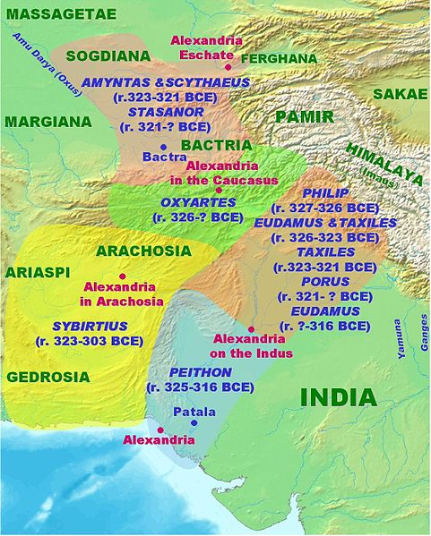
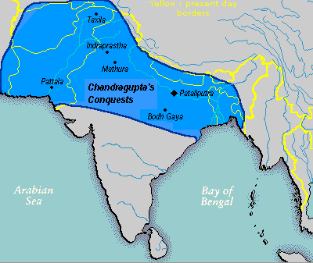

Slide 5
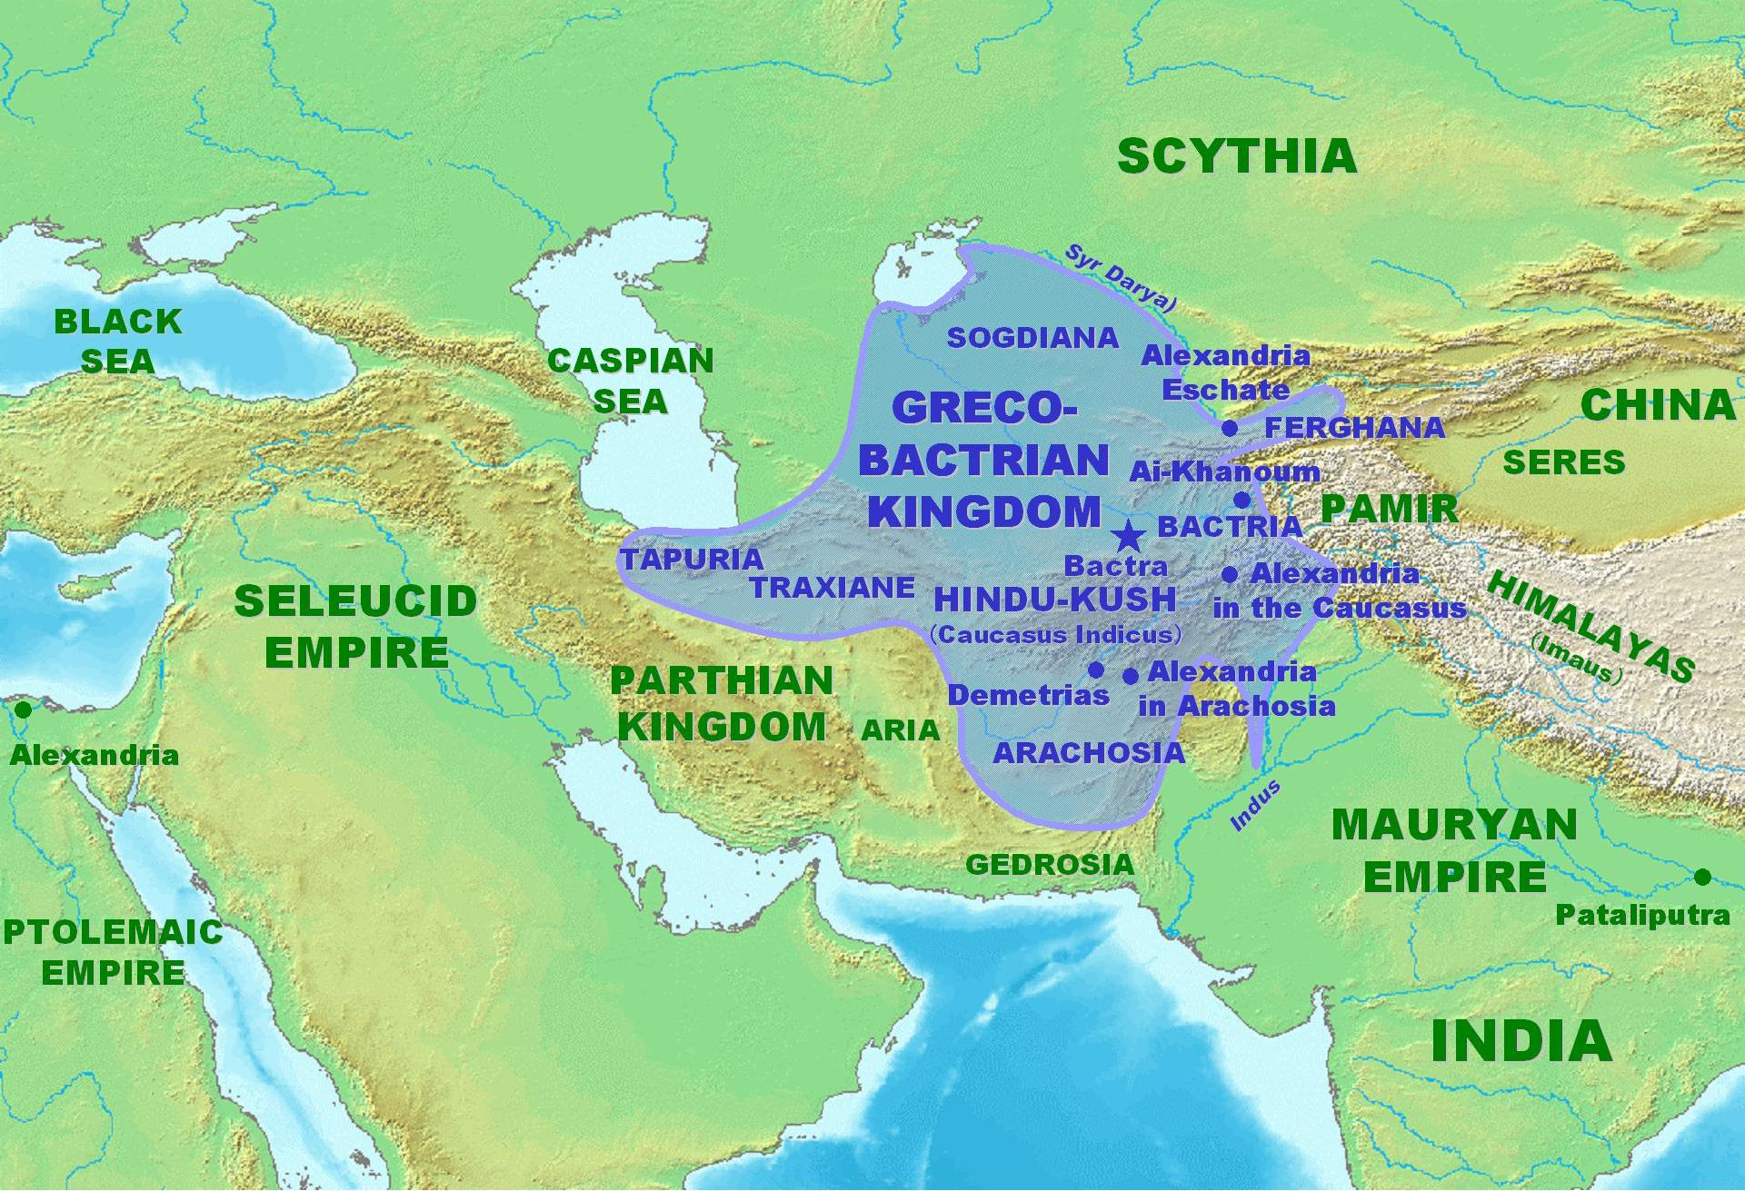

Slide 6
Bactria under the Seleucids
Apame and Seleucus
Demodamas
Antiochus and the eastern satrapies

Slide 7
Greeks in Bactria
At this spot are the altars which were raised by Hercules and Father Liber, as also by Cyrus, Semiramis, and Alexander; for the expeditions of all these conquerors stopped short at this region, bounded as it is by the river Jaxartes, by the Scythians known as the Silis, and by Alexander and his officers supposed to have been the Tanais. This river was crossed by Demodamas, a general of kings Seleucus and Antiochus, and whose account more particularly we have here followed. He also consecrated certain altars here to Apollo Didymæus.
Pliny NH 6.49

Slide 8
Antiochus and Stratonice
“I wish”, he said, “to divide it, in the interests of your future safety, and to give a part of it now to those who are dearest to me. It is fitting that all of you, who have advanced to such greatness of dominion and power under me since the time of Alexander, should co-operate with me in everything. The dearest to me, and well worthy to reign, are my grown up soon and my wife. As they are young, I pray they may soon have children to aid in guarding the empire. I join them in marriage in your presence and send them to be sovereigns of the upper provinces now. The law which I shall impose upon you is not the customs of the Persians and other nations, but the law which is common to all, that what the king ordains is always right.”
Appian Syrian Wars 61

Slide 9
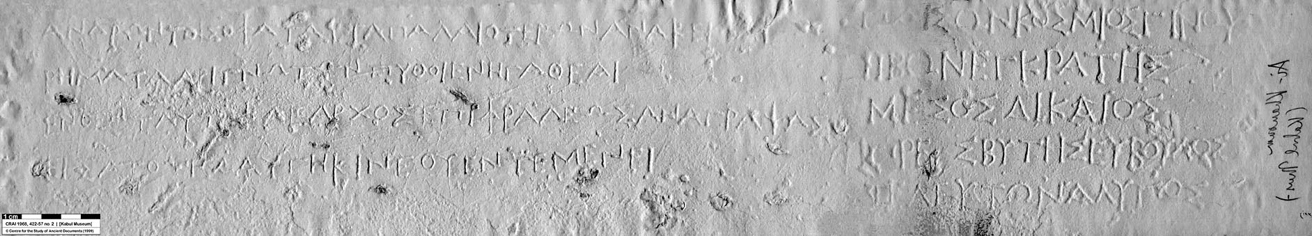
Greeks in Bactria
Klearchos of Soloi and Delphic Maxims:
As a child be well-behaved; as a young man self controlled; as a middle-aged man be just; as an old man a good counsellor; in death be not saddening

Slide 10
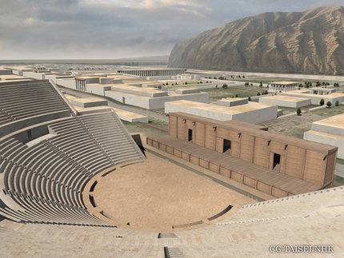
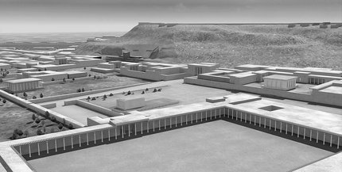
Ai Khanoum: A Greek city?

Slide 11


Slide 12
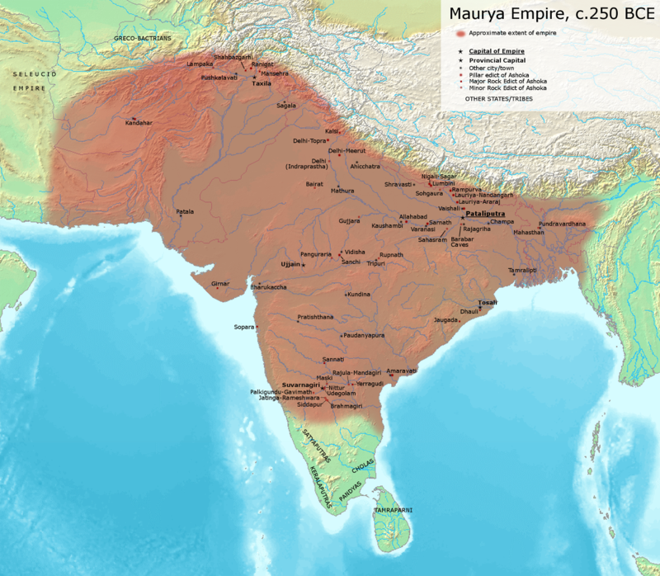

Slide 13
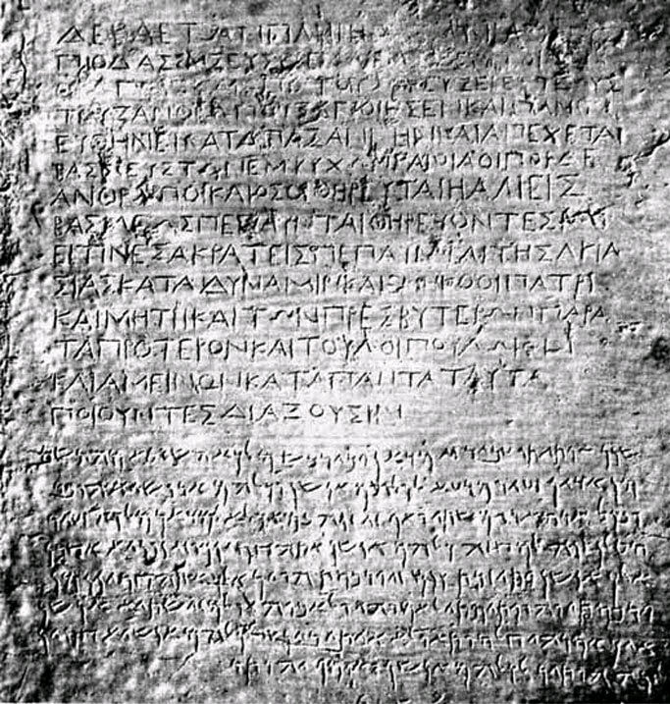

Slide 14
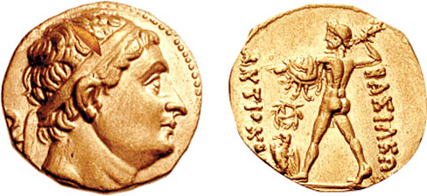
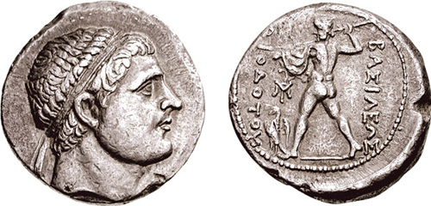
Diodotus I and II
At the same period, also, Theodotus, governor of the thousand cities of Bactria, revolted, and assumed the title of king; and all the other people of the east, influenced by his example, fell away from the Macedonians.
Justin 41.4
Notes:
239 revolt

Slide 15
Anabasis of Antiochus III
For Euthydemus himself was a native of Magnesia, and he now, in defending himself to Teleas, said that Antiochus was not justified in attempting to deprive him of his kingdom, as he himself had never revolted against the king, but after others had revolted he had possessed himself of the throne of Bactria by destroying their descendants. After speaking at some length in the same sense he begged Teleas to mediate between them in a friendly manner and bring about a reconciliation, entreating Antiochus not to grudge him the name and state of king, as if he did not yield to this request, neither of them would be safe; for considerable hordes of Nomads were approaching, and this was not only a grave danger to both of them, but if they consented to admit them, the country would certainly relapse into barbarism. After speaking thus he dispatched Teleas to Antiochus. The king, who had long been on the look-out for a solution of the question when he received Teleas' report, gladly consented to an accommodation owing to the reasons above stated. Teleas went backwards and forwards more than once to both kings, and finally Euthydemus sent off his son Demetrius to ratify the agreement. Antiochus, on receiving the young man and judging him from his appearance, conversation, and dignity of bearing to be worthy of royal rank, in the first place promised to give him one of his daughters in marriage and next gave permission to his father to style himself king. After making a written treaty concerning other points and entering into a sworn alliance, Antiochus took his departure, serving out generous rations of grain to his troops and adding to his own the elephants belonging to Euthydemus.
Polybius 11.39

Slide 16
Parthia
The Parthians, in whose hands the empire of the east now is, having divided the world, as it were, with the Romans, were originally exiles from Scythia. This is apparent from their very name; for in the Scythian language exiles are called Parthi. During the time of the Assyrians and Medes, they were the most obscure of all the people of the east. Subsequently, too, when the empire of the east was transferred from the Medes to the Persians, they were but as a herd without a name, and fell under the power of the stronger. At last they became subject to the Macedonians, when they conquered the east; so that it must seem wonderful to every one, that they should have reached such a height of good fortune as to rule over those nations under whose sway they had been merely slaves. Being assailed by the Romans, also, in three wars, under the conduct of the greatest generals, and at the most flourishing period of the republic, they alone, of all nations, were not only a match for them, but came off victorious; though it may have been a greater glory to them, indeed, to have been able to rise amidst the Assyrian, Median, and Persian empires, so celebrated of old, and the most powerful dominion of Bactria, peopled with a thousand cities, than to have been victorious in war against a people that came from a distance; especially when they were continually harassed by severe wars with the Scythians and other neighbouring nations, and pressed with various other formidable contests.
Justin 41.1

Slide 17
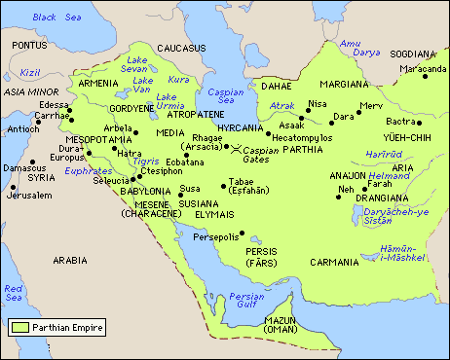

Slide 18
Rise of Parthia
At the same period, also, Theodotus, governor of the thousand cities of Bactria, revolted, and assumed the title of king; and all the other people of the east, influenced by his example, fell away from the Macedonians. One Arsaces, a man of uncertain origin, but of undisputed bravery, happened to arise at this time; and he, who was accustomed to live by plunder and depredations, hearing a report that Seleucus was overcome by the Gauls in Asia, and being consequently freed from dread of that prince, invaded Parthia with a band of marauders, overthrew Andragoras his lieutenant, and, after putting him to death, took upon himself the government of the country. Not long after, too, he made himself master of Hyrcania, and thus, invested with authority over two nations, raised a large army, through fear of Seleucus and Theodotus, king of the Bactrians. But being soon relieved of his fears by the death of Theodotus, he made peace and an alliance with his son, who was also named Theodotus; and not long after, engaging with king Seleucus, who came to take vengeance on the revolters, he obtained a victory; and the Parthians observe the day on which it was gained with great solemnity, as the date of the commencement of their liberty.
Justin 41.4

Slide 19
Parthian Conquests
Almost at the same time that Mithridates ascended the throne among the Parthians, Eucratides began to reign among the Bactrians; both of them being great men. But the fortune of the Parthians, being the more successful, raised them, under this prince, to the highest degree of power; while the Bactrians, harassed with various wars, lost not only their dominions, but their liberty; for having suffered from contentions with the Sogdians, the Drangians, and the Indians, they were at last overcome, as if exhausted, by the weaker Parthians. Eucratides, however, carried on several wars with great spirit, and though much reduced by his losses in them, yet, when he was besieged by Demetrius king of the Indians, with a garrison of only three hundred soldiers, he repulsed, by continual sallies, a force of sixty thousand enemies. Having accordingly escaped, after a five months’ siege, he reduced India under his power. But as he was returning from the country, he was killed on his march by his son, with whom he had shared his throne, and who was so far from concealing the murder, that, as if he had killed an enemy, and not his father, he drove his chariot through his blood, and ordered his body to be cast out unburied.
Justin 41.6

Slide 20
Parthians and Seleucids: Demetrius II
Young, inexperienced King
Unpopular at Antioch
His own mercenaries plundering the country for pay
Internal Rebellion (revolt of Tryphon)
Jewish Rebellion
Parthian Invasion

Slide 21
Antiochos VII Sidetes
Problems at the start of his reign:
  Demetrios II was forced to deal with Parthian invasion and is captured but still alive
  Tryphon is claiming the throne
  The Jews are in revolt

Slide 22
Antiochos VII Sidetes
Solutions:
Marry Cleopatra Thea (previously married to Balas and Demetrios II)
Attack Tryphon
Attack the Jews (John Hyrcanus)
With the internal problems solved, time to attack the Parthians!

Slide 23
The Parthian Campaign
Initial success by Antiochos Sidetes
The Parthian King releases Demetrios II to stir up trouble back home
Surprise Parthian attack and the death of Sidetes
Threat of Parthian invasion!!!

Slide 24
Parthian Expansion
After the death of Mithridates, king of the Parthians, Phraates his son was made king, who, having proceeded to make war upon Syria, in revenge for the attempts of Antiochus on the Parthian dominions, was recalled, by hostilities on the part of the Scythians, to defend his own country. For the Scythians, having been induced, by the offer of pay, to assist the Parthians against, Antiochus king of Syria, and not having arrived till the war was ended, were disappointed of the expected remuneration, and reproached with having brought their aid too late; and when, in discontent at having made so long a march in vain, they demanded that “either some recompense for their trouble, or another enemy to attack, should be assigned them,” being offended at the haughty reply which they received, they began to ravage the country of the Parthians. Phraates, in consequence, marching against them, left a certain Himerus, who had gained his favours in the bloom of youth, to take care of his kingdom. But Himerus, unmindful both of his past life, and of the duty with which he was entrusted, miserably harassed the people of Babylon, and many other cities, with tyrannical cruelties. Phraates himself, meanwhile, took with him to the war a body of Greeks, who had been made prisoners in the war against Antiochus, and whom he had treated with great pride and severity, not reflecting that captivity had not lessened their hostile feelings, and that the indignity of the outrages which they had suffered must have exasperated them. As soon therefore as they saw the Persians giving ground, they went over to the enemy, and executed that revenge for their captivity, which they had long desired, by a sanguinary destruction of the Parthian army and of king Phraates himself.
Justin 42.1

Slide 25
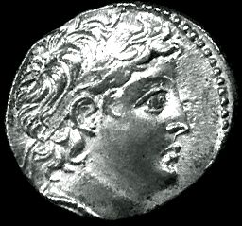
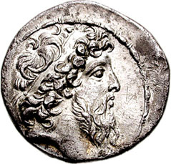
Demetrios II (2nd reign)
Still unpopular
Married to a Parthian, appears in Parthian style
Cleopatra Thea now hates him
Loss of the east, and the Jews are independent

Slide 26
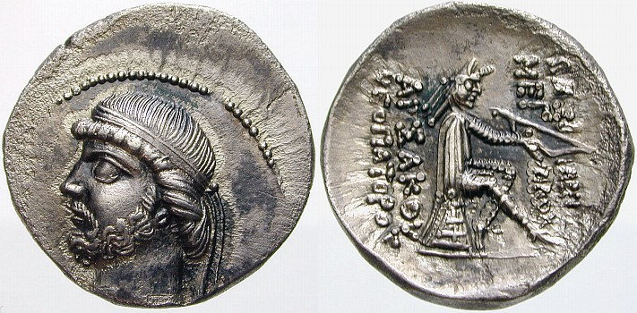
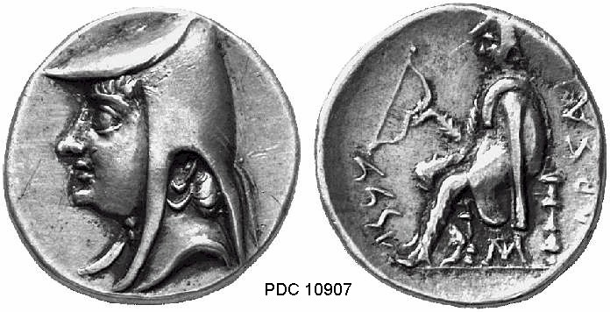
Parthian Coinage
Arsaces I
Phraates II

Slide 27
Parthia and Rome
While this was going on, it happened that Hyrodes was at last reconciled with Artavasdes the Armenian, and agreed to receive the latter's sister as wife for his son Pacorus, and there were reciprocal banquets and drinking bouts, at which many Greek compositions were introduced. For Hyrodes was well acquainted both with the Greek language and literature, and Artavasdes actually composed tragedies, and wrote orations and histories, some of which are preserved. Now when the head of Crassus was brought to the king's door, the tables had been removed, and a tragic actor, Jason by name, of Tralles, was singing that part of the "Bacchae" of Euripides where Agave is about to appear.While he was receiving his applause, Sillaces stood at the door of the banqueting-hall, and after a low obeisance, cast the head of Crassus into the centre of the company. 3 The Parthians lifted it up with clapping of hands and shouts of joy, and at the king's bidding his servants gave Sillaces a seat at the banquet. Then Jason handed his costume of Pentheus to one of the chorus, seized the head of Crassus, and assuming the role of the frenzied Agave, sang these verses through as if inspired:
"We bring from the mountain
A tendril fresh-cut to the palace,
A wonderful prey."
This delighted everybody; but when the following dialogue with the chorus was chanted:
(Chorus) "Who slew him?"
(Agave) "Mine is the honour"
Pomaxathres, who happened to be one of the banqueters, sprang up and laid hold of the head, feeling that it was more appropriate for him to say this than for Jason. The king was delighted, and bestowed on Pomaxathres the customary gifts, while to Jason he gave a talent. With such a farce as this the expedition of Crassus is said to have closed, just like a tragedy
Plutarch Life of Crassus 33

Slide 28
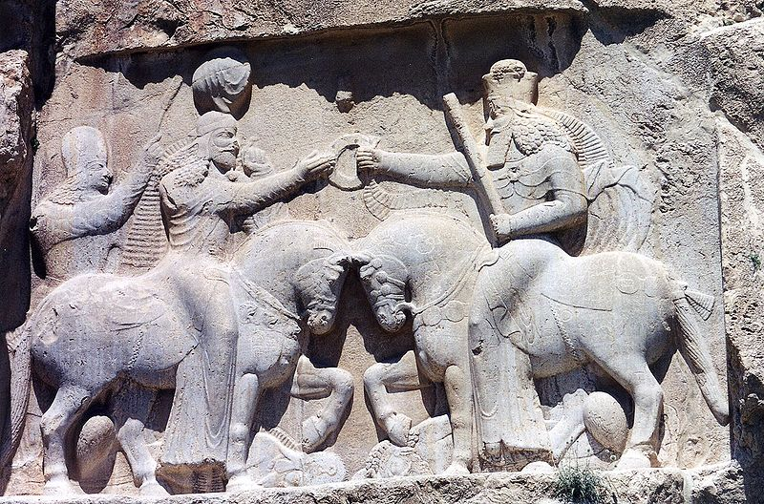
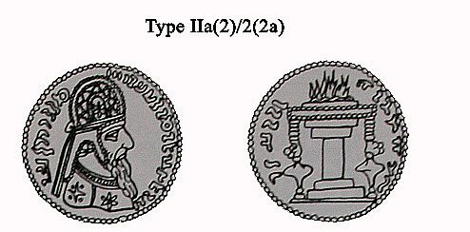
End of the Parthian Empire
224 AD Ardashir (a petty dynast from Persis/Fars) defeats Ardavan IV (Artabanus IV)

Slide 29
Follow-up Reading
Holt, F.L. 1999. Thundering Zeus: The making of Hellenistic Bactria. UC Press.
Boyce, M. “On the Zoroastrian Temple Cult of Fire” Journal of the American Oriental Society, Vol. 95, No. 3 (Jul. - Sep., 1975), pp. 454-465

