Slide 1

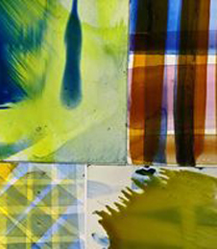
Explorative Research & Praxis
PART 2 – SEMESTER 2

Slide 2
M7X02015 - Explorative Research & Praxis
PART 2
(Semester 2)
October 30th 2020
Start Date
End Date for Accelerated Study
March 18th 2021
May 7th 2021
End date for F/T & P/T Study

Slide 3
The Exploratory Research and Praxis Module is designed to enable you to develop ideas through practical experimentation and philosophical exploration.
Focus on expansive creative development

Slide 4

A body of either theoretical and/or practical research and development work collated into a ‘portfolio’ (digital and /or analogue) consisting of multiple elements with a clear diagnostic and reflective element that includes references and analysis. This will evidence the on-going investigation, development and definition of the exploratory proposition generated in Semester 1 and may consist of the following as appropriate to the individual student’s medium pathway (A=ART | D=DESIGN):
What are we aiming for……..
A substantial body of explorative research that shows developments in thinking and practice………
Practical experimentation –Doing – creating – designing – making-
Philosophical exploration –reading –theorizing – concepts – thinking
The convergence of these things….

Slide 5
WHERE DO WE GO FROM HERE……
Reflect on work so far.
Reflect on last 3 modules and any emerging themes……Think of some key words….
Reflect on ways of working / processes and thinking…… HOW DO YOU WORK BEST?..... Is the way that you have worked so far successful?
Do you have a good balance of theory and practice so far…………..

Slide 6
Research & Practice
There are circumstances where the best or only way to shed light on a proposition, a principle, a material, a process or a function is to attempt to construct something, or to enact something, calculated to explore, embody or test it’
Bruce Archer (The Nature of Research 1995, p.11)
This is the PRAXIS BIT!!

Slide 7
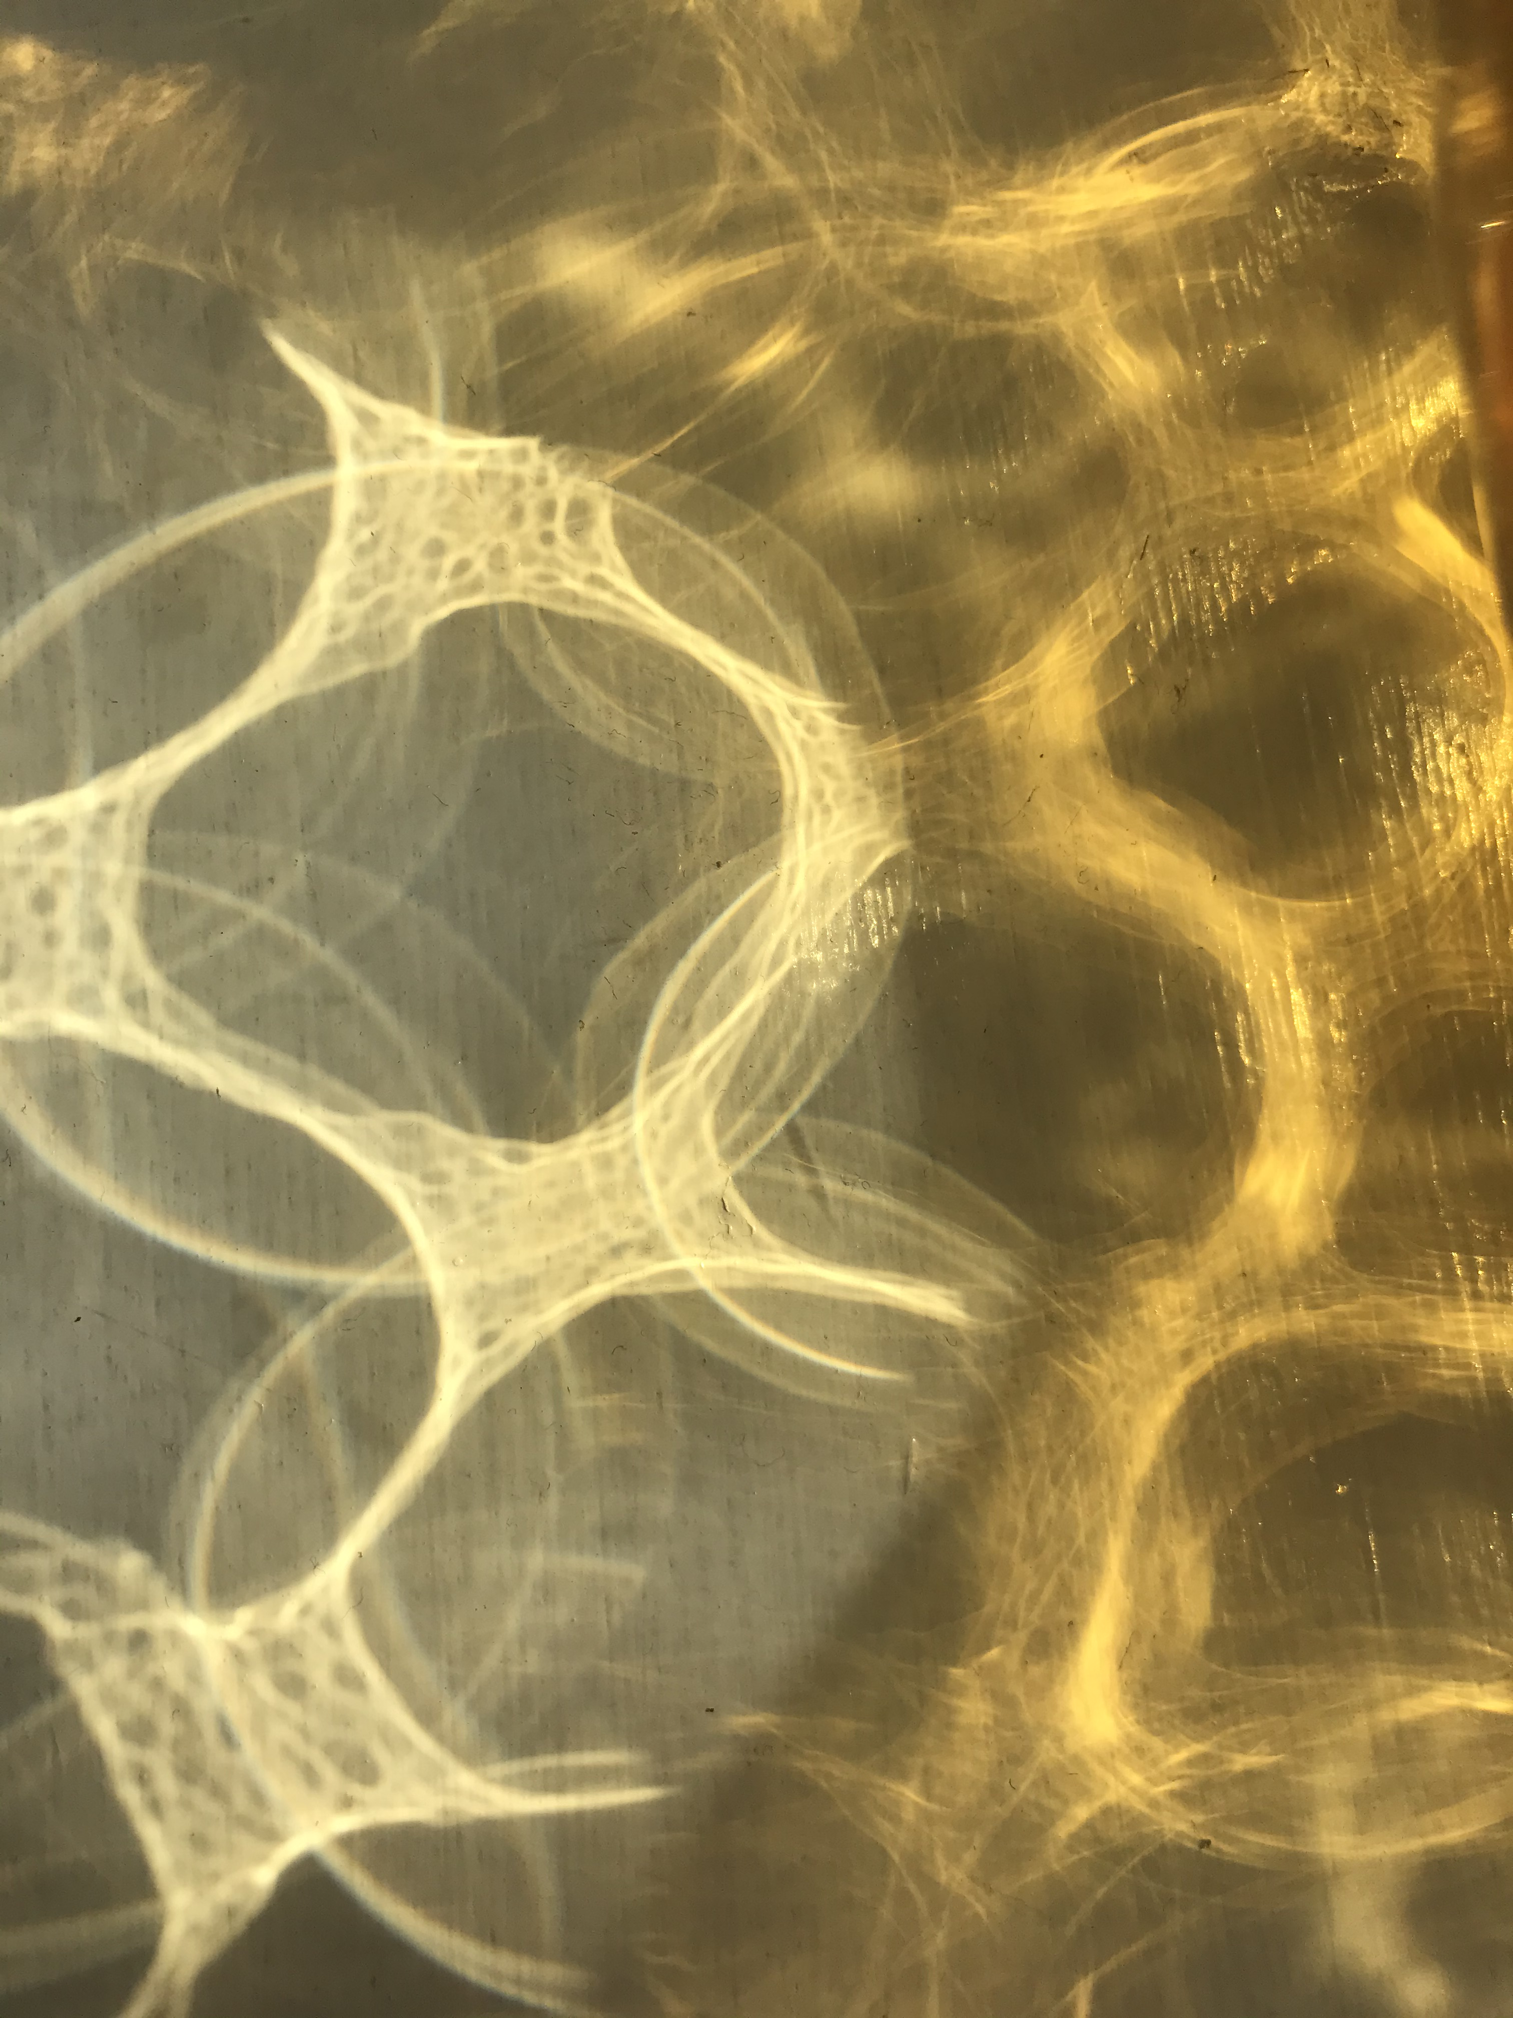
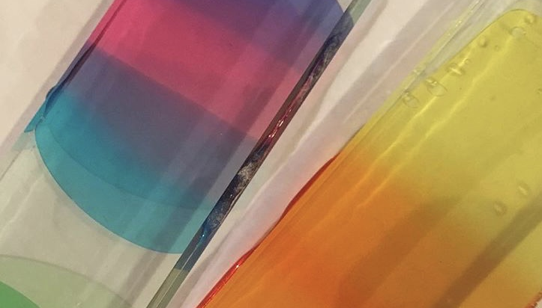
Approach to Experimentation
Space to play – risk taking
Not to have a pre-meditated outcome…… explore…… and record
Everything is relevant…. Can be useful ….. successes and mistakes are as important as each other.
Happy accidents…… e.g. stitching something and then liking the back of your work more !!!
Embracing failure – chance – and then researching this (e.g. link with Marilyn’s lecture)
Triggers and freedom….. See this as 3 x size of thought experiment.
lateral thinking – research it and explore it.
Test in as many ways as possible…… short activities and longer tasks
Be productive with time……. Change of pace……organization and multitasking….
Consider working in series……. Several pieces at once….no pressure……. Prepare grounds…. material drying time and work with plenty of materials around you.
Innovative materials and inventive….. E.g. using household emulsion on secondhand books to make sketchbooks

Slide 8
Approach to Experimentation
lateral thinking and connecting ideas and research.
FLOW between types of research and thinking and doing.
Enjoy successes and mistakes –
Useful texts include
Failure- Documents of Contemporary Art (2010) White Chapel Gallery. (Lisa Le Feuvre)
& Art and Fear (2002) by David Bayles.
Enjoy no pressure to produce finished outcomes unless you choose to.
Think about your intuition and subconscious thought - Self reflection is key.

Slide 9
Ways to research…..
Reading
Reading – articles, books, journals….
Watching
Watching films, documentaries…
Seeing
Seeing….. Exhibitions, sites, locations…. Places of interest and other artwork….. Online talks, conferences and gallery tours.
Collecting
Collecting materials and objects to feed ideas….
Drawing, writing and photographing
Drawing, writing and photographing…..
Sampling and playing
Sampling and playing with materials and techniques …..includes individual sampling as well as workshop menu

Slide 10
DOCUMENTATION – Explore what works best for you………Is it working for you so far?..............
Keeping a Blog is essential to this module
You can do this in a number of ways depending on your discipline and how you work
(again this is something to explore and reflect on)
If you enjoy and like working digitally and that suits your work and then regularly updating a digital blog is straight forward. Just remember to have regular entries to track your process.
If you are a more practical and materials-based person, consider exploring and creating by hand and then photographing and uploading your work on a weekly basis (ideally just before your weekly tutorial)
By doing this you are exploring your material making further, with the play between the real and 3D and the 2D imagery you upload.
There is a lovely contrast between an image of a spontaneously drawn / made / written sketchbook or journal against the crispness of the digital screen.
Or, you may wish to work with a combination of theses documentation techniques.

Slide 11
Within your blog you should document…..
Your creative journey and process and include and refer to all aspects of your research.
DOCUMENT PROCESS……SHOW DEVELOPMENT… CREATIVE JOURNEY
Hard copy sketchbooks, notebooks, journals and artwork should be photographed, scanned or filmed. Think about key pages in your workbooks that you can then discuss and refer to in your blog…. This select process and reflection is key.
All reading lists, references and academic dialogue (PRIVATE)
Digital files, blogs, website……
All artwork…. 2D / 3D / virtual
Film and sound
Collected research… text, imagery, digital or hard copy

Slide 12
Is your documentation of this module working so far?

Slide 13
Delivery
Speed Tutorials x2 (aimed to kick start your practice again)
Seminars (tutor led) 4 sets each Friday. Option to attend all.
Seminars (student led) could be developed from Collaborative Dialogues connections.
Tutorials 1:1 and group delivered within pathways.
Pairings /collaborative / skills swap opportunities
Research Seminars
Formative Reviews: Scheduled in core timetable
Optional Workshops

Slide 14
Timetables and Workshops
Your timetable (with meeting links) is in your Module Handbook which can be found in teams files and on Moodle.
This consists of CORE TIMETABLE and OPTIONAL WORKSHOPS.
Your core timetable covers seminar groups (specific to your pathways) and the OPTION of joining other seminar groups to listen in if you wish.
A series of Research Seminars on a Friday 1-2pm
A workshop timetable from which you can select OPTIONAL workshops depending on your research and practice.

Slide 15
Example of core Timetable

Slide 16
Example of Workshop Menu

Slide 17
Workshop delivery
Online activities that allow live interaction and or instruction and demonstration of techniques and processes that can be used within your working practice
Pre-recorded sessions and workshops that allow you to practice and learn techniques and explore within your own work.
Click and Collect / Bureau type services that allow you to collect materials, prepare and work on at home and then return if required for processing…….

Slide 18
Semester 2 – Online workshops……….
Digital sessions – James is available for trouble shooting every Wednesday and his Photoshop and Illustrator sessions from last term are recorded.
Film and Editing tutorials – Pre recorded
Intro to Glass – discuss click and collect options
Photography – discuss click and collect options
Stitch and Dialogue – Online live delivery
Drawing and Pattern – Pre recorded
Intro to Digital Cutting – discuss click and collect options
Intro to RISO / Lino / Screen – discuss click and collect options.
Introduction to 3D CAD – online live
Model Making – online live
Thinking through Painting – online live
Design Thinking workshops.
Additional online workshops are in progress e.g. life drawing and CNC / 3D Printing demos and more……
Timetable and links in module handbook.

Slide 19
Workshop staff for Semester 2……….
James.davies@uwtsd.ac.uk – Digital and IT support
Daniel.butler@uwtsd.ac.uk – Waterjet & laser cutting
Lyndon.davies@uwtsd.ac.uk – Ceramics and casting
Kylie.boon@uwtsd.ac.uk – Film and Editing
Catherine.brown@uwtsd.ac.uk – Glass, Ceramics and Design Crafts
Colin.telford@uwtsd.ac.uk - Glass
Sarah.tierney@uwtsd.ac.uk - Photography
Hamish.gane@uwtsd.ac.uk - Photography
Shellie.holden@uwtsd.ac.uk - Textiles
Catherine.hammerton@uwtsd.ac.uk – Textiles & Surface Pattern Design
Matthew.archer@uwtsd.ac.uk - Product Design and CAD
R.stuckey@uwtsd.ac.uk – Architecture and Model Making
Glenn.Sherwood@uwtsd.ac.uk – Riso printing
Morwenna.chapman@uwtsd.ac.uk - Printmaking
Adam.Howell@uwtsd.ac.uk - Sound
D.Jarvis@uwtsd.ac.uk – Product / Industrial Design
R.way@uwtsd.ac.uk - Design

Slide 20
Planning your timetable
Go through the timetables in your handbook and start to map in your seminars, praxis talks and optional workshops in your calendar.
This module offers opportunities to make a bespoke timetable, with a mix of CORE and optional delivery.
Discuss your choices of workshops with your pathway tutor and your rationale for selection.

Slide 21
First Research Seminar -

Slide 22
Recap
For assessment produce a substantial body of explorative research that shows developments in thinking and practice.
Practical experimentation –Doing – creating – designing – making-
Philosophical exploration –reading –theorizing – concepts – thinking
The convergence of these things….PRAXIS
Your final portfolio of work should be digitally presented within your BLOG or other means, with material outcomes to accompany (if relevant) but should be thoroughly documented and professionally presented for assessment.

Slide 23
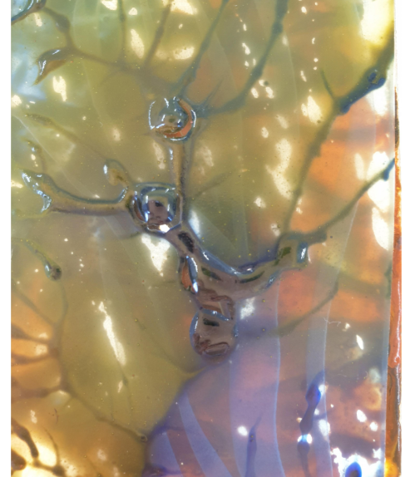
Finally…….Have fun!!!!
Look for newness
Explore
Take risks
Question
Be curious
Stretch yourself
Be innovative
Grow your mind
Develop yourself

