Slide 1
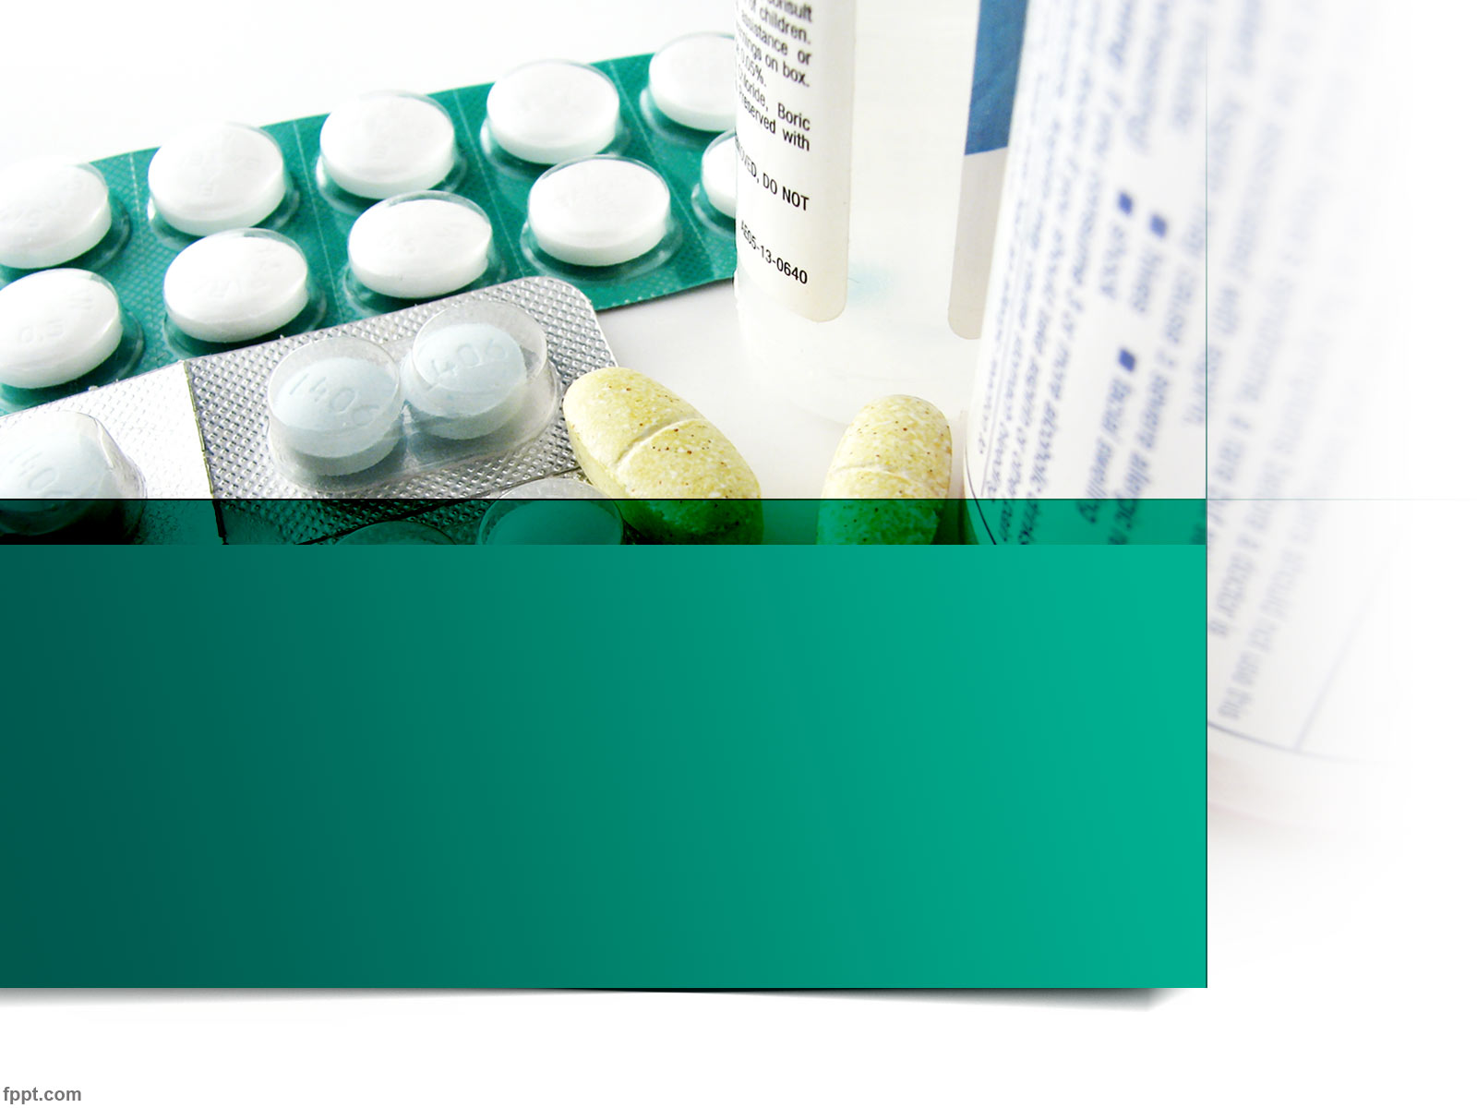
Drugs and Behaviour
Dr Stuart Jones.

Slide 2
Aims of the Lecture.
To Recap on Neurons and Neurotransmitter.
To explore 5 groups of synaptic transmitters.
To define the term Ligand.
To explore the role of Endogenous Ligands.
Exploring Neuroscientific research in relation to endogenous ligands.

Slide 3
Aims of the Lecture.
To discuss and define the term “Drug”
To discuss how are drugs effective (e.g. how drugs work).
To explore the relationship between Drugs and Behaviour in a variety of classification of drugs.
To examine Neuroscientific studies exploring the role of how drugs might influence behaviour.

Slide 4
People have tasted, sipped, chewed, swallowed all kinds of substances.
  Animal, Vegetable and Mineral.
Learning from these experiences.
Not just the need of nourishment.
  Relieve pain, control anxiety, pursue pleasure.
    Almost every species does this (Siegel, 1989).

Slide 5
Neurochemistry – Branch of Neuroscience concerned with the chemical composition and processes of the nervous system.
Neuropharmacology – Also known as Psychopharmacology – Scientific field concerned with the discovery and study of compounds that selectively affect the functioning of the nervous system.

Slide 6
Recap.
Neurons release a chemical known as a Neurotransmitter – communicates with target cells (usually neurons).
Criteria for substance acting as a neurotransmitter.
  Exists in the presynaptic axon terminals.
  Presynaptic cell contains appropriate enzymes.
  Substance released in significant quantities when action potentials reach the terminals.
  Specific receptors recognise the substance.
  Application of the substance produces changes in the postsynaptic potentials.
  Blocking release of the substance prevents presynaptic nerve impulses from altering the activity of the post synaptic cell.

Slide 7
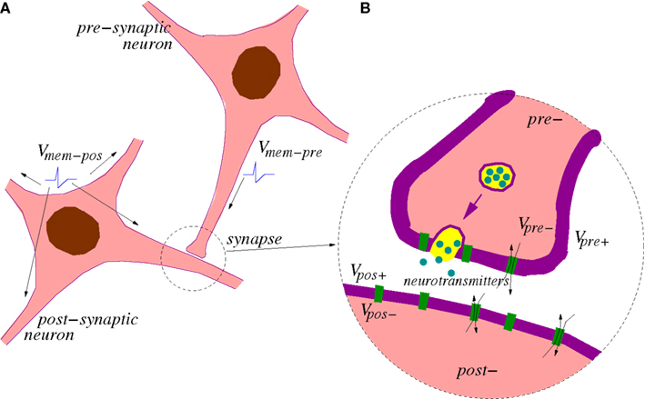

Slide 8
Recap on Neurotransmitters.
Introduction to NT’s.
http://www.youtube.com/watch?v=haNoq8UbSyc
Introduction to Neurones – Inhibitory / Excitatory potential.
http://www.youtube.com/watch?v=LT3VKAr4roo

Slide 9
Excitatory Response
Stimulation of a excitatory presynaptic neuron will produce an all or nothing ACTION POTENTIAL that spreads to the Axon Terminal.
Excitatory Postsynaptic Potential (EPSP).
  A potential that is caused by excitatory presynaptic impulses – more likely for the post synaptic neuron will fire an action potential.
Combined effect of many excitatory synapses is required to elicit an action potential in a postsynaptic neuron.

Slide 10
Inhibitory Response
Looks exactly like an excitatory pre synaptic neuron.
Post synaptic quite different.
Inhibitory Postsynaptic Potential (IPSP)
  Less probability that the post synaptic neuron will fire an action potential

Slide 11
IPSP
Result from the opening of chloride ions (Clˉ) to enter the cell.
Chloride Ions are negatively charged and high levels of chloride ions will make the post synaptic cell negative.
Important to note that Excitatory and Inhibitory neurons get their name from their actions on postsynaptic neurons – NOT on their effects on behaviour.
  Although both play a vital role in the neural processing of information and behaviour.

Slide 12
Excitatory or Inhibitory?
What determines whether a synapse excites or inhibits the postsynaptic cell?
The Neurotransmitter.
  Some will generate EPSP others generate IPSP.
The BALANCE between the number of excitatory or inhibitory signals the postsynaptic neuron receives will determine the likelihood of an action potential.

Slide 13
Synaptic Transmitters.
Amines.
  e.g. Acetylcholine.
  Monoamines – Norepinephrine/Noradrenaline, Epinephrine/Adrenaline, Dopamine, Serotonin, melatonin.
Amino Acids.
  Gamma-aminobutyric acid, Glutamate, Glycine, Histamine.
Neuropeptides.
  - Opioid peptides – Enkephalins: Met-enkephalin, Leu-enkephalin,
  - Endorphins: B-endorphin.
  - Dynorphins: Dynorphin A.

Slide 14
Synaptic Transmitters.
Peptides.
  Oxytocin, Substance P, Cholecystokinin, Vasopressin, Neuropeptide Y, Hypothalamic releasing hormones.
Gases.
  Nitric Oxide, Carbon Monoxide.

Slide 15
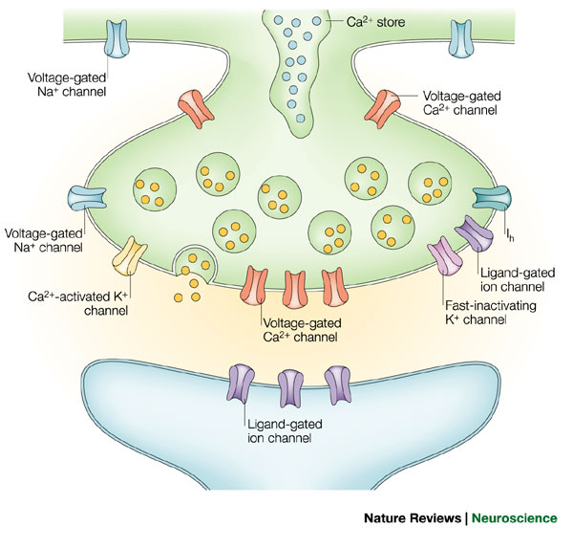
Neurotransmitters affect their targets by interacting with receptors.
Binds to the receptor changing its shape to open an ion channel (fast ionotropic receptor).
Or
Alters chemical reaction with the target cell (slow metabotropic receptors).
http://www.youtube.com/watch?v=Du-BwT0Ul2M

Slide 16
Receptor subtype – Any type of receptor having functional characteristics that distinguish it from other types of receptors from the same neurotransmitter.
Drug development capitalises on the existence of receptor subtypes.
  Drugs can selectively affect a receptor subtypes – producing specific effects associates with that receptor.

Slide 17
Ligand.
Ligand = Substance that binds to a receptor.
Effects of a Ligand.
1) When bound to a receptor, a ligand classified as an agonist initiates the normal effects of the receptor.
2) Antagonist – ligand which binds to a receptor and does not activate it – blocks other ligands.
3) Inverse Agonist – Initiates an effect that is reverse of the normal function of the receptor.

Slide 18
Endogenous Ligands.
Acetylcholine (ACh).
First chemical identified as a Neurotransmitter.
  Stimulates Muscle Contraction.
Basal forebrain includes major groups of cholinergic (ACH-containing) cells.
Losses – evident in Alzheimer's disease.
  Cholinergic hypothesis

Slide 19
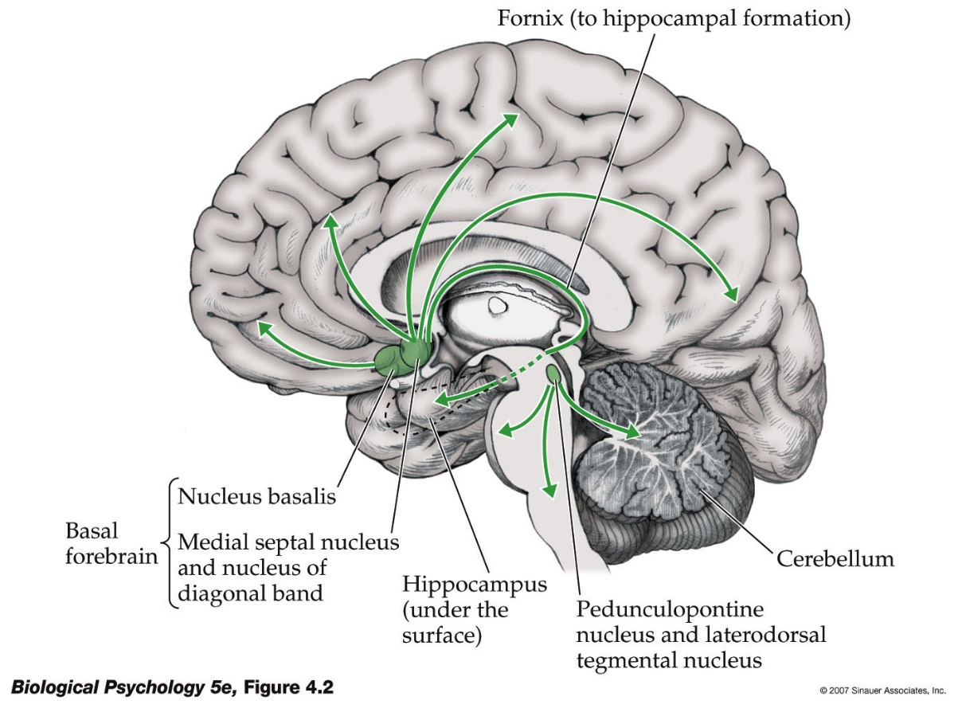
Cholinergic Pathways in the Brain.
http://www.youtube.com/watch?v=0-KmO0Lg7Kw

Slide 20
Acetylcholine and Memory…
Francis et al 1999 Review highlighted the cholinergic hypothesis in relation to Alzheimer's disease (AD).
Studies revealed deficits in the enzyme responsible to ACh synthesis.
Cholinergic hypothesis – degeneration of cholinergic neurons in the basal forebrain and subsequent loss of cholinergic neurotransmission in cerebral cortex contributes significantly to the deterioration of cognitive functioning seen in AD patients.

Slide 21
Neuroscientific studies on Ach and Memory
Goekoop et al 2005.
28 patients with mild cognitive impairment (MCI) – Memory losses.
  Often a precursor to Alzheimer's disease.
Required to do a series of memory tasks at 3 stages.
  Working Memory tasks and facial encoding and retrieval tasks.
Under FMRI conditions.

Slide 22
Goekoop et al 2005….
Stage 1 – Baseline.
Stage 2 – One week later, after a single dose of Galantamine.
Stage 3 – A further week later after multiple doses of Galantamine.
Galantamine = Drug used in MCI patients to improve memory – which prevents the REUPTAKE of ACh.

Slide 23
Goekoop et al 2005
Findings…..
Significant improvements in memory scores between stage 1 and stage 3.
Significant alterations in FMRI, more activation in Cholergenic pathways.
Critique of this study?

Slide 24
Monoamines.
Catecholamines
  E.G. Dopamine
Indoleamines.
  E.g. Melatonin and Serotonin.
Catecholamines.
  Dopamine
  Mesostriatal Pathway and Mesolimbocortical Pathway.
    Mesostriatal Pathway – Motor Control.
    Mesolimbocortical pathway – Reward and Reinforcement (Nader et al, 1997); Verbal Learning (Fried et al, 2001); Schizophrenia.

Slide 25
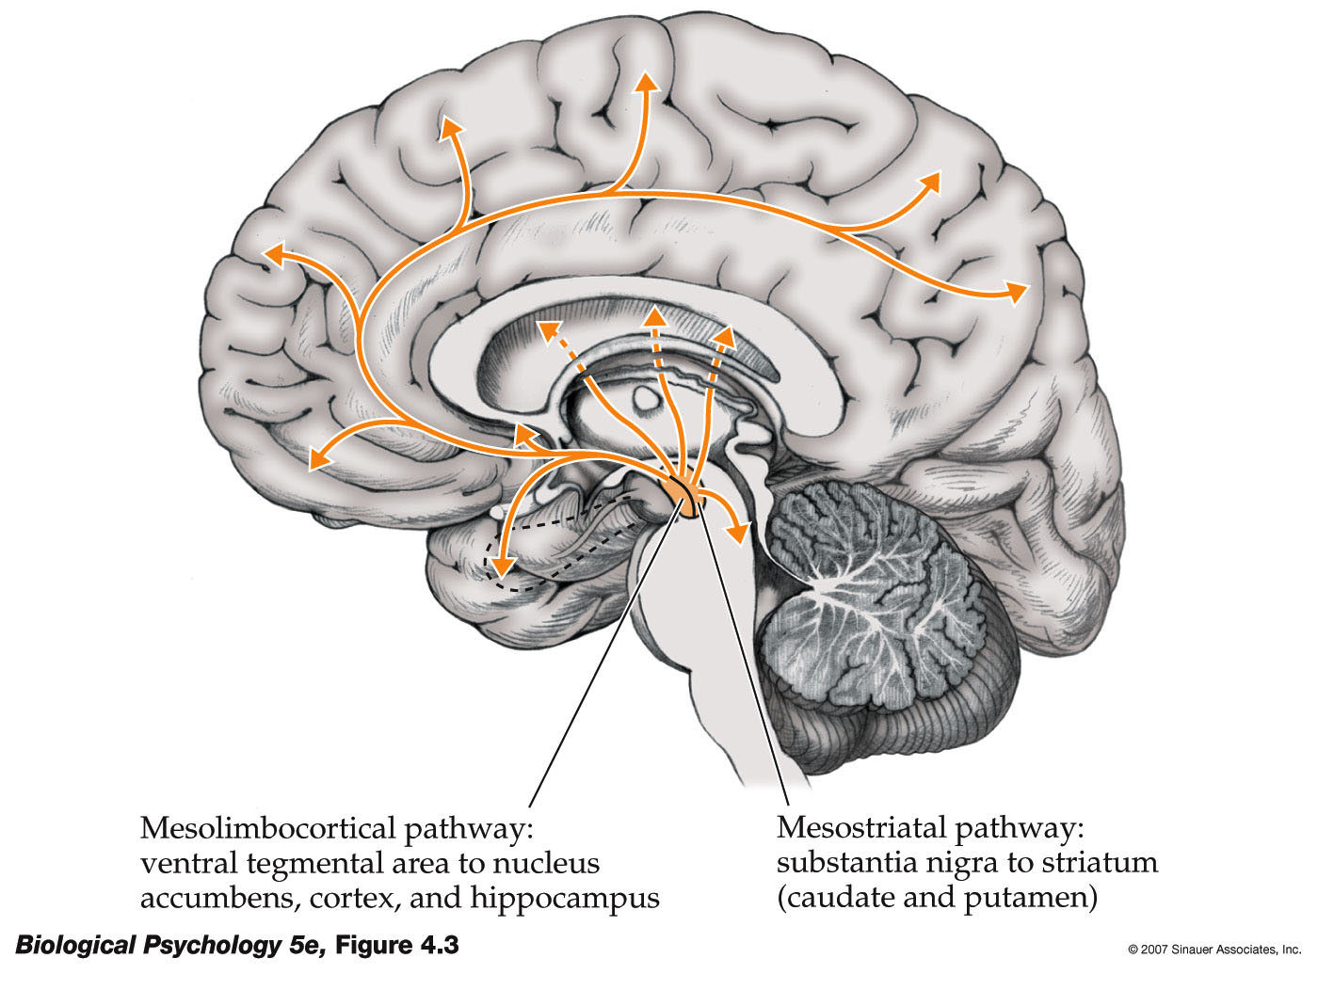
Dopaminergic Pathways in the Brain.
http://www.youtube.com/watch?v=ZjH8_hHtumo

Slide 26
Dopamine and Reward related memory.
Wittman et al 2005.
FMRI study.
  Compared encoding and retrieval of reward related (financial) stimuli compared to non-reward related stimuli.
Greater activation during encoding stage in reward related areas for reward stimuli.
In follow up, greater success and greater activation in hippocampus (long term memory) for reward related stimuli compared to non-reward related stimuli.

Slide 27
Norepinephrie/Noradrenaline.
  Organised into 3 clusters in the Brain Stem.
  Locus Coeruleus in the Pons.
  Lateral Tegmental System (midbrain).
  Dorsal Medullary Group.
Many behavioural and Physiological Processes.
  Mood, Overall Arousal and Sexual Behaviour.

Slide 28
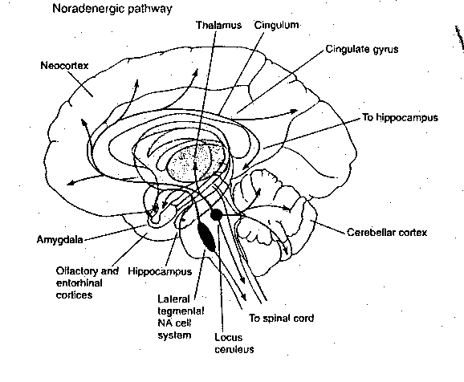
Noradrenigic Pathways in the Brain.

Slide 29
Differences between Adrenaline and Noradrenaline.
Chemically distinct - adrenaline is produced by the body via a modification of noradrenaline.
Secondly, they are used in slightly different places. Noradrenaline = postganglionic neurones of the sympathetic nervous system. Adrenaline = adrenal medulla.
Role of Adrenaline as a NT less known.

Slide 30
Serotonin (5HT).
5HT Cell bodies concentrated in the Raphe Nuclei.
Only 200,000 human neurons are Serotonergic – but influence is widespread.
Sleep States, Mood, Sexual Behaviour, Anxiety.

Slide 31
Serotonin.
Serotonin and Depression a Debate.
http://www.youtube.com/watch?v=sWE3UGl7KFk
Serotonin Deficiency Neuroscience.
https://www.youtube.com/watch?v=bX0_AB9Sqt8

Slide 32
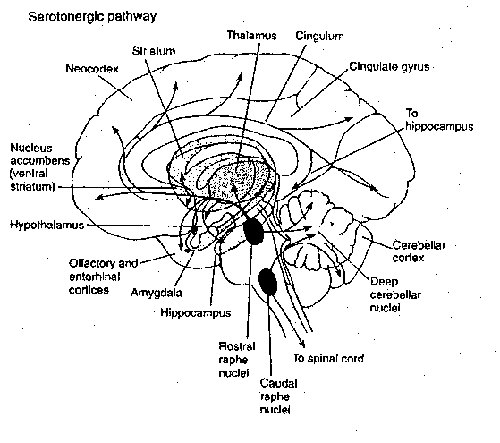
Serotonergic Pathways in the Brain.

Slide 33
Morris Miller et al 2013.
FMRI study to examine the effect of SSRI’s on emotional word processing on patients with Major Depressive Disorder.
  SSRI = Selective Serotonin Re-uptake inhibitors.
    Escitalopram
17 un-medicated MDD patients were presented 60 words (20 positive, 20 negative, 20 neutral) and were asked to identify 10 words that….
  Represented them when down / depressed
  Represented them when happy
  10 personally relevant neutral words when neither happy or down.
  Under FMRI conditions.

Slide 34
Required to repeat the task following 8 weeks of standardised Escitalopram treatment.
Findings –
Lower midbrain, dorsolateral prefrontal cortex, para cingulate, anterior cingulate, thalamus and caudate nuclei correlated significantly with greater improvement following escitalopram treatment.
More positive responses in 2nd condition – quicker time to answer the 10 positive emotions.

Slide 35
Amino Acids.
Glutamate and Aspartate = Excitatory Neurotransmitters.
Glutamatergic Transmission involved in learning and memory.
Glutamate associated with Excitotoxicity – Exacerbates the effects of stroke.
  http://www.youtube.com/watch?v=tvnjeMiHSI8

Slide 36
Gamma-aminobutyric acid (GABA) and Glycine = Inhibitory transmitters.
GABA receptors are in classes:
GABA_{A} - ionotropic, producing fast, inhibitory effects
GABA_{B} - metabotropic, slow inhibitory effects through neurogliaform interneurons
GABA_{C} - ionotropic with a chloride channel
GABA agonists, like Valium, are potent tranquilizers.

Slide 37
Peptides.
Peptides have a prominent role as neurotransmitters.
1) Opioid Peptide – Mimic opiate drugs such as Morphine – include dynorphin.
2) Those found in Spinal Cord = e.g. Substance P.

Slide 38
Gases.
Neurons use gas molecules that dissolve in water to communicate information.
Nitric Oxide (NO).
Produced in other areas of the Neurons – e.g. Dendrites.
Doesn’t interact with membrane bound receptors – diffuses into target cell.
Retrograde Transmitter – diffuses post synaptic neuron back to the presynaptic neuron.

Slide 39
Drugs, The brain and Behaviour.
Stuart Jones.

