Slide 1
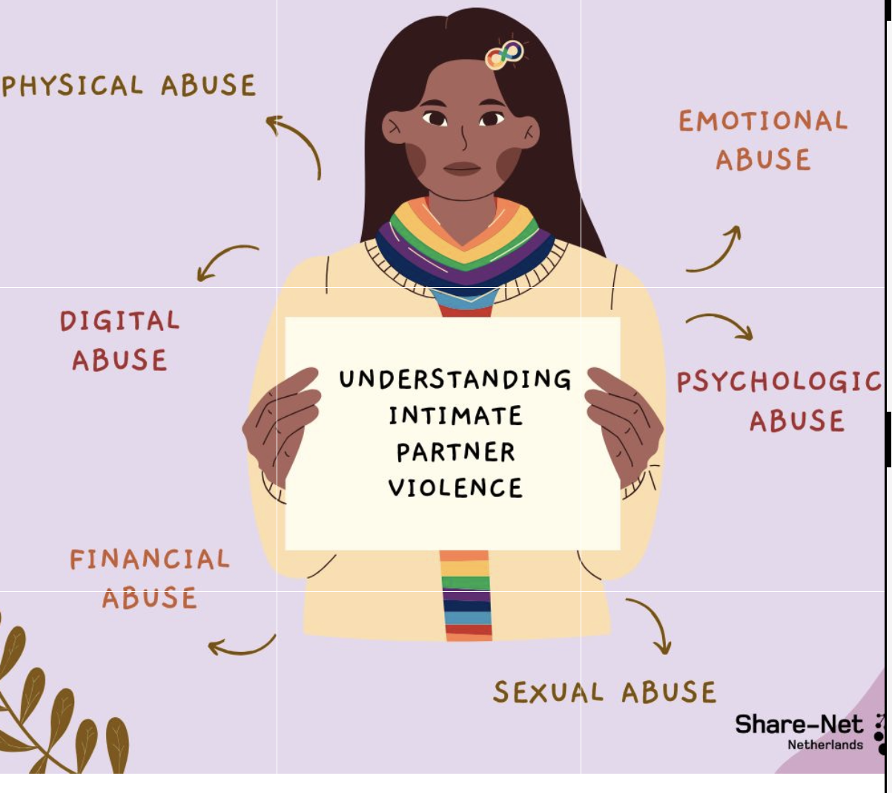

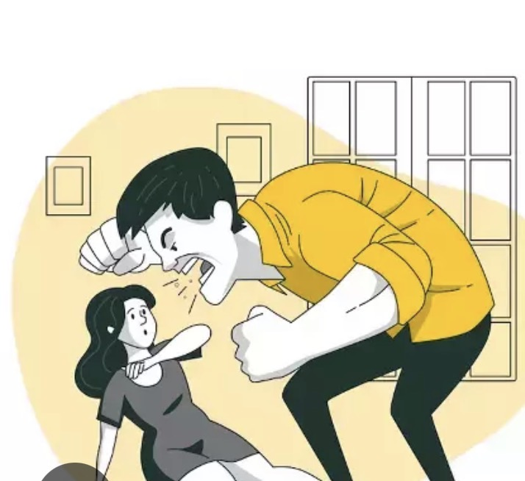
Title:
The Impact of Socioeconomic and Cultural Inequalities on the Long-Term Health Outcomes of Domestic Violence Survivors in the UK
Research question
How Do Socioeconomic and Cultural Inequalities Impact the Health Outcomes of Intimate Partner Violence Survivors Across the Lifespan?
Name: Imtiaz Begum: 2123180
Module: Practice Based research: LCHS7008
Lecturer: Dr Zeno Leung

Slide 2

Contents
Prevalence Of Domestic Violence
Cultural and Social Inequalities
Rationale for the study
Research Aim
Research Objectives
Research Impact
Reference List

Slide 3

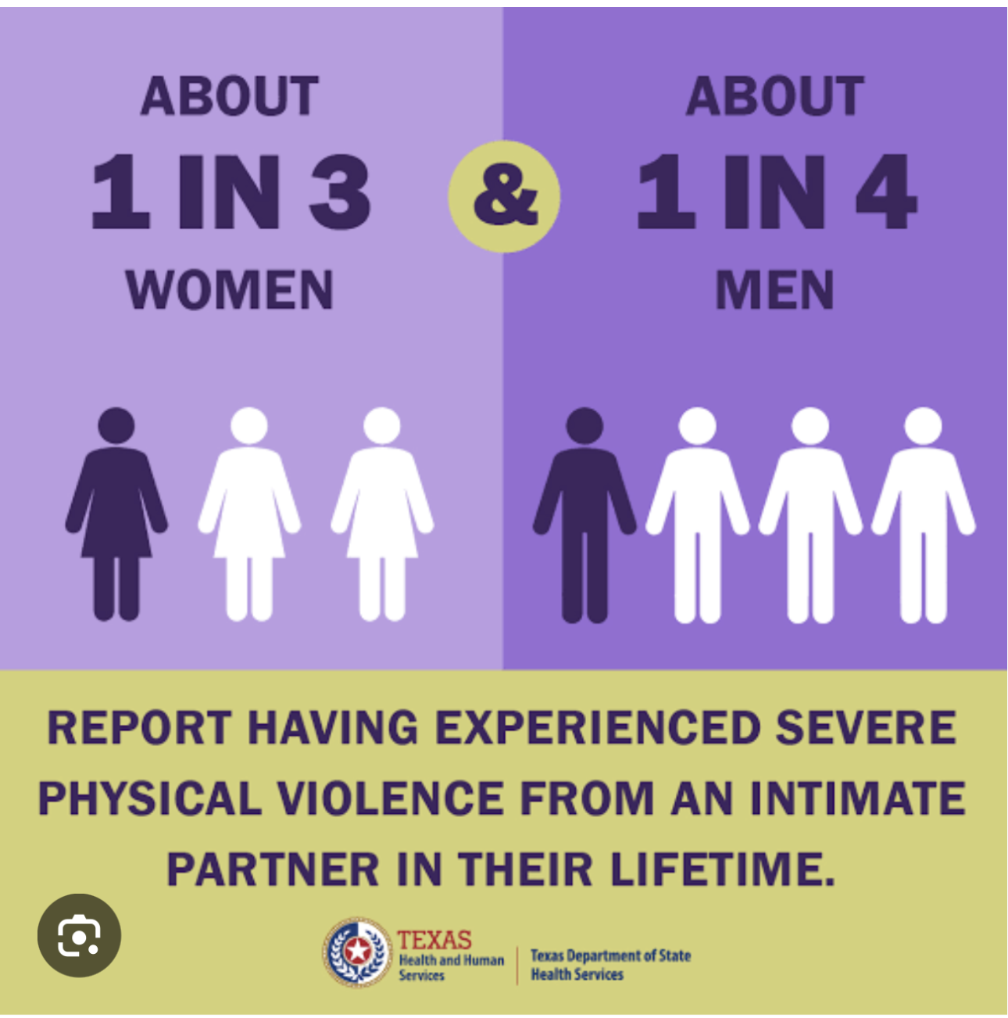
Prevalence of Domestic Violence
Global Statistics (WHO, 2021)
The World Health Organisation (2021) reports that approximately 1 in 3 women globally (around 30%) have experienced physical or sexual violence from an intimate partner during their lifetime (WHO, 2021),
Women who have been in a relationship face a high risk, with approximately one in three reporting experiences of intimate partner violence (WHO, 2021).
13% of women aged 15–49 years who have ever been in a relationship experienced violence from an intimate partner (Sardinha et al., 2022).

Slide 4
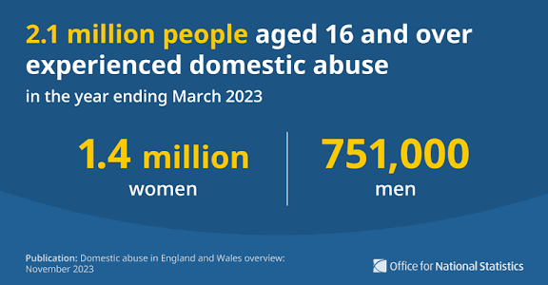
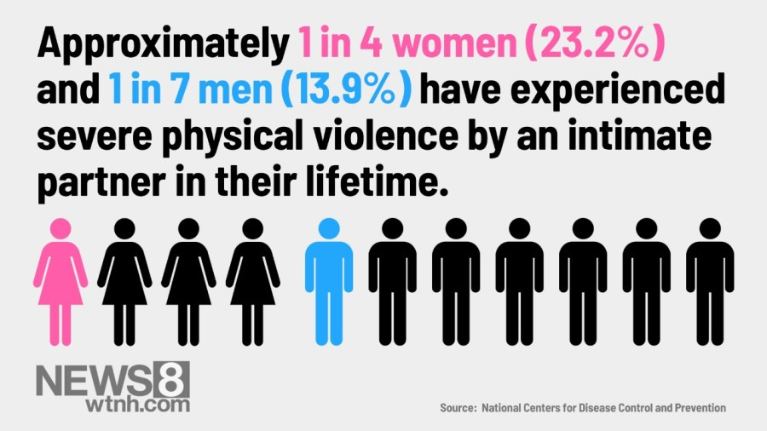
UK Statistics (ONS, 2023–2024)
Around 2.1 million adults (aged 16+) experienced domestic abuse in England and Wales in the year ending March 2023, including 1.4 million women and 751,000 men (ONS, 2023).
The latest data (year ending March 2024) estimates 2.3 million adults, with 1.6 million women and 712,000 men affected (ONS, 2024).
1 in 4 women and 1 in 7 men will experience domestic abuse at some point in their lifetime (Women’s Aid, 2024).

Slide 5
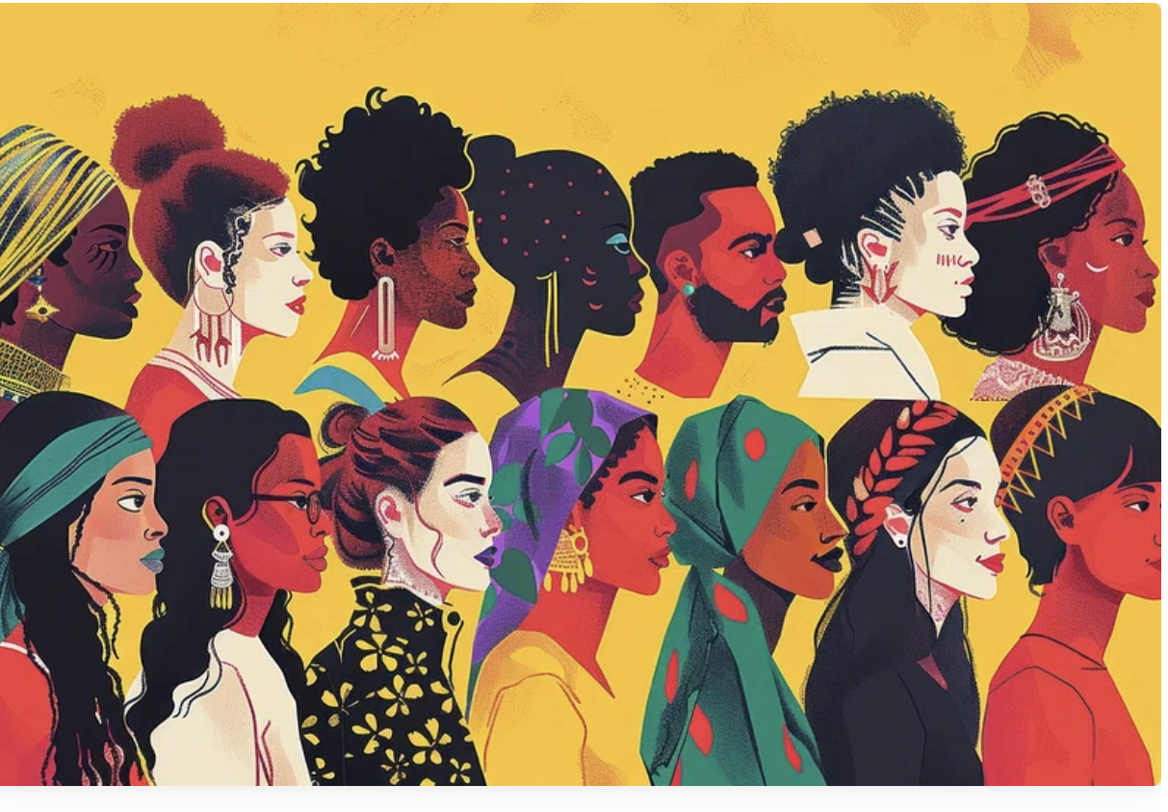
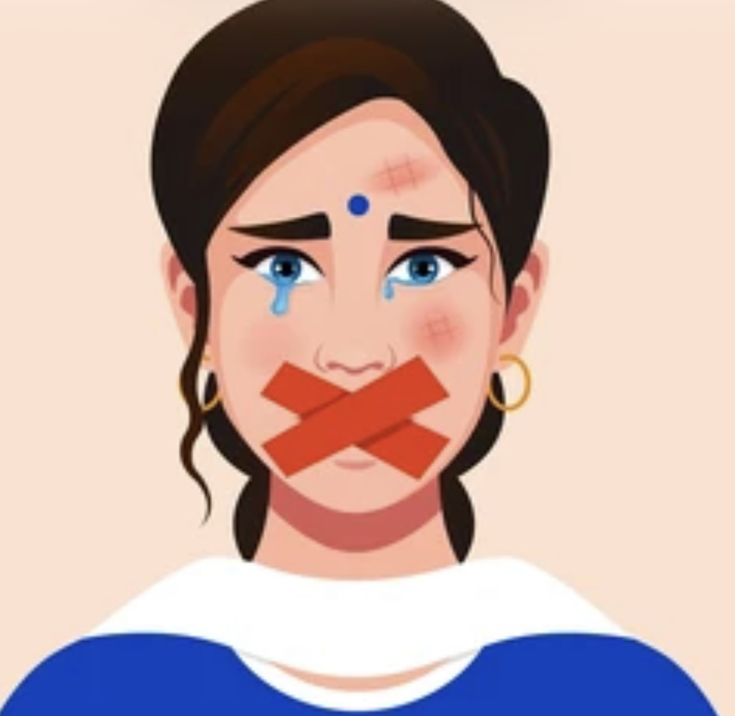
Cultural and Social Inequalities
Many survivors do not report abuse due to fear, homelessness, or financial instability (SafeLives, 2022; Women’s Aid, 2024).
Cultural stigma can discourage survivors from disclosing or leaving abusive relationships (GOV.UK, 2017).
Language barriers and limited awareness restrict access to support (Women’s Aid, 2024).
Survivors from ethnic minority backgrounds may face discrimination in services (ONS, 2023).
These inequalities intensify physical and mental health consequences (Flynn et al., 2025; WHO, 2021).

Slide 6
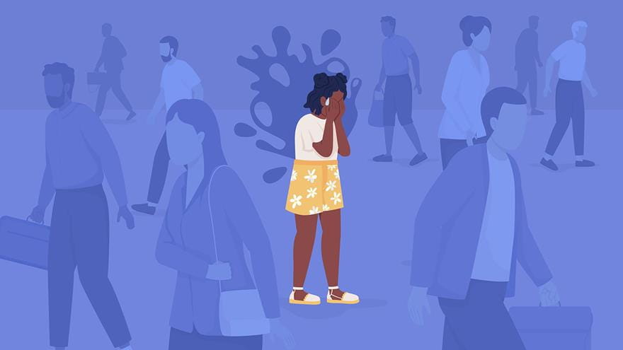
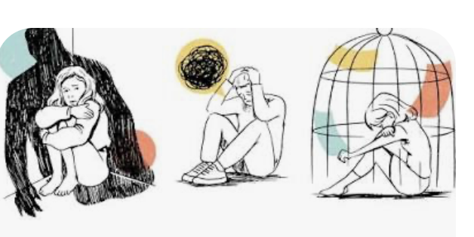
Rationale for the Study
This study examines how socioeconomic and cultural inequalities influence the short- and long-term health and social impacts of domestic violence on survivors (Campbell, 2022; Women’s Aid, 2021).
Domestic violence is a major public health concern contributing to mental illness, chronic conditions, and reduced wellbeing (WHO, 2021).
Socioeconomic and cultural inequalities, such as poverty, stigma, and language barriers, increase vulnerability and limit access to support
(Khalifeh et al. 2013, Scottish Government, 2024).
Survivors from ethnic minority and marginalised
groups often face additional barriers and stigma when
seeking help.
(Home Office, 2021, Walby and Towers, 2018).

Slide 7
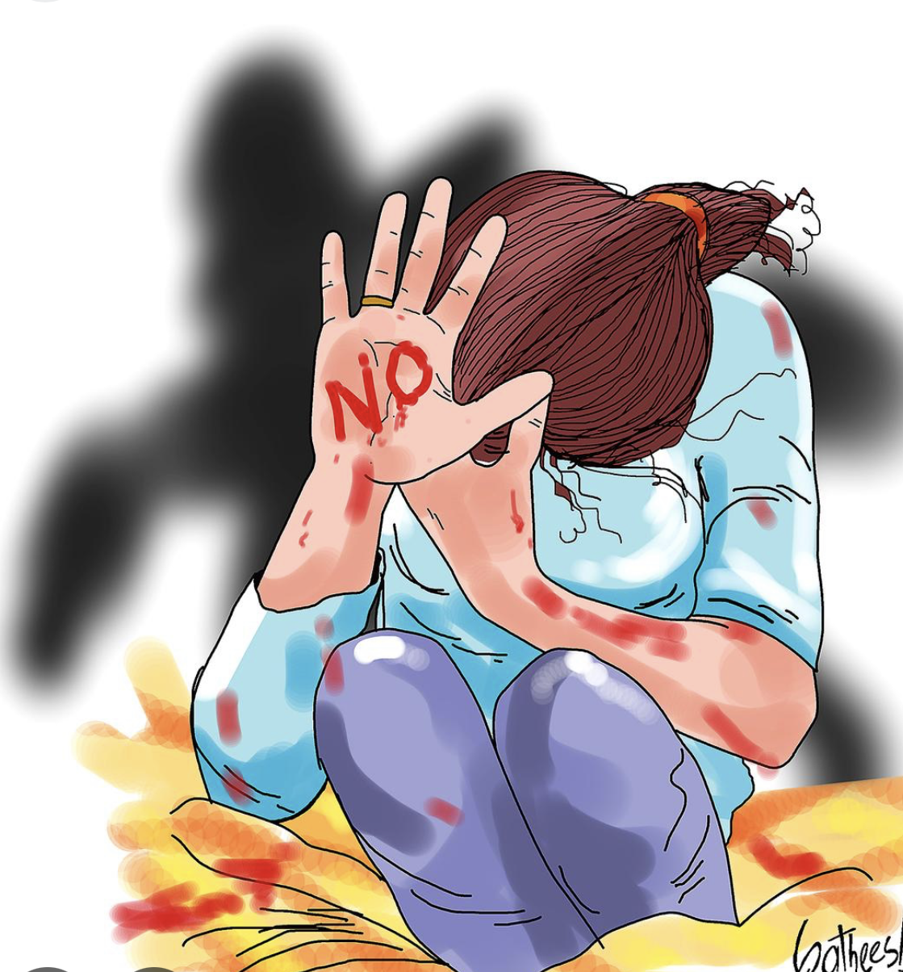
Research Aim
Research Question:
How Do Socioeconomic and Cultural Inequalities Impact the Health Outcomes of Intimate Partner Violence Survivors Across the Lifespan?
Aim:
This study critically examines how socioeconomic and cultural inequalities shape the physical, psychological, and social health outcomes of survivors of intimate partner violence across the lifespan. It will explore both immediate and long-term consequences, including mental health challenges, chronic health conditions, and social wellbeing, while analysing patterns and disparities across different populations.
The study will also review the availability and accessibility of support services for survivors, highlighting gaps in care and raising awareness of the challenges they face.

Slide 8
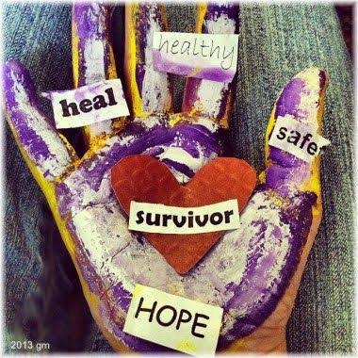
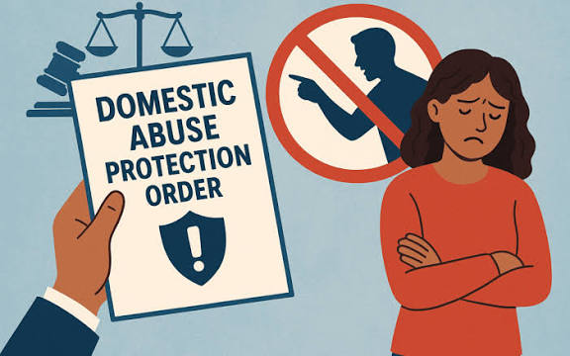
Research Objectives
Examine the short- and long-term health outcomes of domestic violence survivors (SafeLives, 2016).
Explore how socioeconomic and cultural inequalities influence the occurrence and experiences of domestic violence (Public Health England, 2020).
Identify barriers to accessing health and social care services, including stigma and under-reporting (Women’s aid, 2024).
Examining the availability and accessibility of support services for domestic violence survivors and the extent to which socioeconomic and cultural inequalities are addressed (BMC Public Health, 2025).

Slide 9
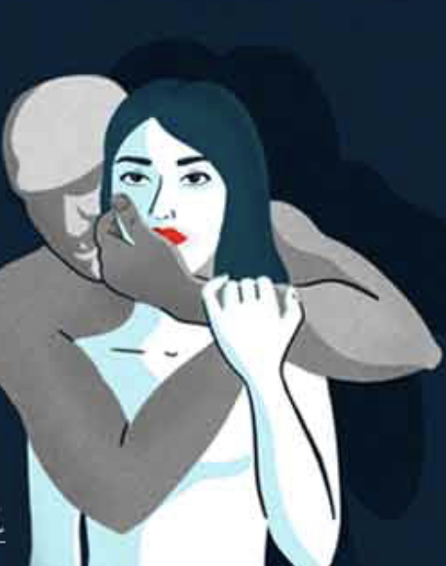
Research Impact
The research will benefit domestic violence survivors by highlighting the short- and long-term health impacts and improving understanding of their physical, emotional, and social needs.
It will raise awareness of the physical, emotional, and social challenges faced by survivors.
The study will explore what support is currently available and identify ways it can be improved.
Addressing cultural and social inequalities to make support services inclusive, culturally sensitive, and responsive to all survivors.
Promoting wellbeing and fair support for all survivors of intimate partner violence.

Slide 10
References
BMC Public Health (2025) ‘Effectiveness of UK-based support interventions for domestic violence’, BMC Public Health, 25, 21891. Available at: https://bmcpublichealth.biomedcentral.com/articles/10.1186/s12889-025-21891-5 (Accessed: 2 October 2025).
Campbell, J.C. (2022) ‘Health consequences of intimate partner violence’, The Lancet, 399(10338), pp. 229–240. Available at: https://www.thelancet.com/journals/lancet/article/PIIS0140-6736(21)02343-6/fulltext (Accessed: 3 October 2025).
Flynn, A., Elliott, L. and Ratna, K. (2025) ‘Health inequalities and the impact of intimate partner violence on survivors’ wellbeing’, Journal of Public Health, 47(2), pp. 156–169.
GOV.UK (2017) Violence against women and girls: National strategy 2016–2020. Available at: https://www.gov.uk/government/publications/violence-against-women-and-girls-strategy-2016-to-2020 (Accessed: 9 October 2025).
Home Office (2021) Domestic Abuse Act 2021. Available at: https://www.womensaid.org.uk/get-involved/campaign/domestic-abuse-bill/ (Accessed: 3 October 2025).

Slide 11
Khalifeh, H., Hargreaves, J., Howard, L.M. and Birdthistle, I. (2013) ‘Intimate partner violence and socioeconomic deprivation in England: Findings from a national cross-sectional survey’, American Journal of Public Health, 103(3), pp. 462–472.
Office for National Statistics (ONS) (2023) Domestic abuse prevalence and trends, England and Wales: year ending March 2023. Available at: https://www.ons.gov.uk/peoplepopulationandcommunity/crimeandjustice/articles/domesticabuseprevalenceandtrendsenglandandwales/yearendingmarch2023 (Accessed: 7 October 2025).
Office for National Statistics (ONS) (2024) Domestic abuse prevalence and trends, England and Wales: year ending March 2024. Available at: https://www.ons.gov.uk/peoplepopulationandcommunity/crimeandjustice/articles/domesticabuseprevalenceandtrendsenglandandwales/yearendingmarch2024 (Accessed: 7 October 2025).
Public Health England (2020) Violence and abuse: health needs assessments. London: PHE. Available at: https://www.gov.uk/government/publications/violence-and-abuse-health-needs-assessments (Accessed: 25 September 2025).
SafeLives (2016) Safe and well: Mental health and domestic abuse. Available at: https://safelives.org.uk/wp-content/uploads/Safe-and-well-Mental-health-and-domestic-abuse-spotlight-report.pdf (Accessed: 2 October 2025).
SafeLives (2022) Insights national dataset: Evidence on domestic abuse survivors. Available at: https://safelives.org.uk (Accessed: 9 October 2025).
SafeLives (2023) Impact report 2022–2023. Available at: https://safelives.org.uk/wp-content/uploads/SafeLives_Impact_Report_2022-23.pdf (Accessed: 6 October 2025).

Slide 12
Sardinha, L., Stockl, H., Maheu-Giroux, M., Meyer, S.R. and García-Moreno, C. (2022) ‘Global, regional, and national prevalence estimates of physical and/or sexual intimate partner violence against women’, The Lancet, 399(10335), pp. 803–813. Available at: https://doi.org/10.1016/S0140-6736(21)02664-7.
Scottish Government (2024) Minoritised ethnic women’s experiences of domestic abuse and barriers to help-seeking: Summary of evidence. Available at: https://www.gov.scot/publications/minoritised-ethnic-womens-experiences-domestic-abuse-barriers-help-seeking-summary-evidence/ (Accessed: 6 October 2025).
Walby, S. and Towers, J. (2018) ‘Untangling the concept of coercive control: Theorizing domestic violent crime’, Criminology & Criminal Justice, 18(1), pp. 7–28. doi: 10.1177/1748895817743541.
Women’s Aid (2021) Mental health and domestic abuse: A review of the literature. Available at: https://www.womensaid.org.uk/wp-content/uploads/2021/12/FINAL-WA-literature-review.pdf (Accessed: 2 October 2025).
Women’s Aid (2024) Nowhere to turn 2024. Available at: https://www.womensaid.org.uk/wp-content/uploads/2024/07/Nowhere-to-Turn-2024-report-Accessible.pdf (Accessed: 23 September 2025).
Women’s Aid (2024) The Domestic Abuse Report 2024: The Annual Audit. Available at: https://www.womensaid.org.uk/the-domestic-abuse-report-2024/ (Accessed: 9 October 2025).

Slide 13
World Health Organization (2021) Devastatingly pervasive: 1 in 3 women globally experience violence. Available at: https://www.who.int/news/item/09-03-2021-devastatingly-pervasive-1-in-3-women-globally-experience-violence (Accessed: 25 September 2025).
World Health Organization (2021) Violence against women: Key facts. Available at: https://www.who.int/news-room/fact-sheets/detail/violence-against-women (Accessed: 24 September 2025).
World Health Organization (2021) Violence against women prevalence estimates, 2018. Geneva: WHO. Available at: https://www.who.int/publications/i/item/9789240022256 (Accessed: 9 October 2025).

Slide 14
Image References
The following images were used in this presentation to support key points and enhance understanding.
Infographic illustrating domestic violence awareness (Pinterest)
Diagram illustrating forms of intimate partner violence (Google Images
Infographic showing domestic abuse prevalence (1.4 million women, 751,000 men) (ONS)
Visual representation of prevalence: 1 in 4 women affected by domestic abuse (Google Images)
Illustration depicting cultural inequality and stigma in domestic violence contexts (Google Images)
Infographic showing barriers to seeking help among survivors (Google Images)
Awareness poster: Stop domestic violence (Google Images)
Illustration representing hope and survivor resilience (Google Images)
Graphic explaining domestic abuse protection orders (Google Images)
Illustration showing the emotional impacts of domestic violence (Google Images)

