Slide 1
CertHE SfWP HSC T3GH1
Assessment Component 1
Task 1: Group Presentation
Group: 1
Presentation/Submission Date: 05/08/2021 (week 8)
STUDENT NAMES:
Comfort Bentil-Tumi | 2008733
Aramide Adijat Ajao | 2009073
Augustine Okoroba | 2009076
Kawther Chible | 2008114

Slide 2


Introduction
Late Adulthood (65+)
Notes:
Comfort
Human Development can be divided into four main areas, known as PIES (Physical, Intellectual, Emotional and Social).
This PowerPoint would be discussing these areas of later adulthood (65+). Integrity vs Despair(Wisdom). Using Erickson’s psychosocial theory in relation to health and social care, to describe, explain, predict and control human behaviours that may occur within the late adulthood stage.

Slide 3

The Lifespan Development stages
What is Life span development?
There are six developmental stages of lifespan development.
Within the stages there are 4 developmental parts as stated in the introduction.
Middle Adulthood
45-65 years
Late Adulthood 65+ years
Infancy
0-2 years
Childhood
3-8 years
Adolescence
9 -18years
Adulthood
19-45 years
Notes:
Comfort: The lifespan development of individuals is a synthesis of biological and psychosocial perspective changes funded in 1994 by Stockholm university and some lectures.
The six stages developed are infancy, childhood, adolescence, early adulthood, middle age and late adulthood reflecting on these stages their biological, cognitive and psychosocial changes that occur during a person’s life.

Slide 4

The Physical changes in late adulthood.
Comfort
Late adulthood is approximately in the mid 60s to end of life.
Loss of skin elasticity
Loss of Muscle cells.
Bones more brittle
Metabolic changes
Loss of eyesight and hearing
(Seegmiller and Boss, 1981, pp.434-40)
How can analysing these be useful to Health and social care?
(Health Guide, 2021)
Notes:
Comfort: Some physical changes that naturally occur at old age are,
Loss of elasticity that occurs due to the reduction of collagen in the skin, loss of muscle cells, brittle bones due to a reduction of vitamins and much more. Due to this elders may be “slowed down” be in need of wheelchairs, walkers or canes, specific dietary needs and have broken or unhealed bones”. In Erickson's book, ‘the life cycle completed’ he describes the late adulthood stage as fragile communities at best.
Therefore, how does learning and acknowledging this relate to health and social care.
Knowing these natural changes make adults fragile we can better ourselves in how to care of those 65 years and above and make sense of their behaviour. For example, Erickson mentions in his book that health care advisors can “promote exercise, to maintain health and mobility”.p95 ;make wheelchairs readily available, assessing the need for glasses, hearing aids and prepare soft foods that are accommodating to the dietary needs.
Furthermore, it can help to prepare the right environment for their safety down to the smallest things. Erickson wrote and I quote “I am persuaded that if retired elders could have regular if not daily massage, it would be amazingly beneficial, refreshing and relaxing”. (Erickson, 1997, pp. 95-97)

Slide 5

COGNITIVE DEVELOPMENT IN LATE ADULTHOOD.
Augustine Okoroba
At the age of 60s onward, adult psychological development begins to change. Older adults retain the ability to reflect on the past.(Berk,2007).
Working memory.
-Temporary information is held for processing.
- It becomes difficult for older person to multi-task
Due to decline in cognitive development.
(Salthouse,1996)
Long-term memory.
-An older person remembers events, names stored in
Long-term memory all his life if the information is stored
More effectively.
Notes:
Augustine
According to Berk (2007) It becomes difficult for older person to multi-task Due to decline in cognitive development.
There is a decrease of the 5 senses and short-term memory difficulties.
Development of neurological diseases, such as Dementia and Alzheimer’s disease which impact on cognitive functions.
The Alzheimer's Society (2021) reports that in the UK there are 800,000 with dementia.
- Decline of working memory, difficulties in recalling information.
Long-term memory: -An older person remembers events, names stored.

Slide 6

Cognitive development in late adulthood
In 2015, about 46 million people were affected by Dementia, which resulted in about 1.9 million death.
Human cognitive changes during old age.
About 10% people develop the disease at some point in their lives.
Dementia is a term used to describe the general long-term and the gradual inability to think and remember details in an individuals life. Dementia often occurs during old age or late adulthood. 3% of people between 65-74 have dementia.
Notes:
Augustine
At the age of 60s onward, adult psychological development begins to change. Older adults retain the ability to reflect on the past (Berk, 2007).
Working memory.
-Temporary information is held for processing.
- It becomes difficult for older person to multi-task
Due to decline in cognitive development.
(Salthouse,1996)
Long-term memory.
-An older person remembers events, names stored in Long-term memory all his life if the information is stored More effectively.
-It becomes difficult for older person to multi-task Due to decline in cognitive development.
Long-term memory -An older person remembers events, names stored Abnormal loss of cognitive functioning
Dementia- Causes emotional problems, difficulty in speaking and decreases in motivation.
The longer more people live, the more dementia is becoming common in the population.
Aging and transitioning into late adulthood (old age), may cause some changes in the sensitivity of the senses. This can be difficulty hearing and seeing. According to (Berk, 2007) Older individuals will may eventually find it difficult using memory strategy to recall details
The aging process causes changes in the brain which may lead to symptoms of dementia.
Common symptoms of dementia include emotional problems or difficulties with language.
-Older adults find it difficult to visualize things at the
Same time such as driving and monitoring the environment,
because it brings about divided attention (Mcdowd, et al)
Problem Solving- It become difficult for older people to
Solve problem more quickly.
-They rely on information from friends and family to deal with issues (Strough et al 2003)

Slide 7

The Emotional and social changes during late adulthood .
Most people entering their late adulthood are able to happily adjust to retirement, however others may experience difficulties with emotion whilst managing the transition.
Erickson International (2016)
Notes:
Aramide:
Emotional changes that may happen during late adulthood is feeling unhappy or regretful about the life you have lived.
“Late adulthood” is another term for “old age”
Another emotional change that may happen is feeling frustrated because of the stereotype formed against older people. Feeling grief because of loss of partner, family members, friends.
Loss of independency because of ageism.
Aramide: However, when people begin to enter the “old age” in their sixties and beyond, the ageing process may then lead to changes physically, cognitively, and social needs, this is when life begins to come to its final stages known as late adulthood.
Aramide: Retirement. More time for social activities. Social changes are caused by the loss of spouse and other significant others.

Slide 8

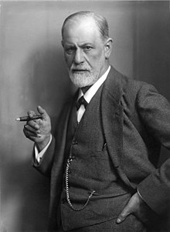
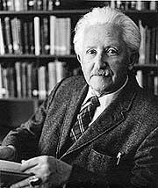
Eric Erickson’s Psychosocial Theory
Erick Erickson developed Freud psychosexual theory into a psychosocial theory.
There are Eight developmental stages in Erickson's theory.
Sigmund Freud
Erick Erickson
(Hertz et al, 2021, p.78)
Notes:
Comfort: Erickson’s psychosocial theory is a development of Freuds psychosexual theory. Freuds psychosexual theory ends at adolescence whilst Erickson’s expands his theory to the late ages of adulthood. Hence, my choice of theory to analyse the physical changes that occur at the late adulthood stage.
According to Erikson’s theory each stage is dominated by two main opposite tendencies, a negative and a positive tendency. For instance, in late adulthood the two forces are INTEGRITY (positive) and Despair (negative)
According to Erick Erickson Ego integrity vs despair is the eight and final stage of the Erick Erickson’s stage theory of psychological development.
This stage will likely begin at the age of 65 and ends at death.
Erickson theory believes that during this time, individuals tend to contemplate their accomplishment and may develop a sense of self criticism. This is the stage where individual start to look back at the lives they have lived. Reflection during this stage contributes whether an individual is happy about leading a successful live or not. Individuals who feel like they have not achieved their goals may develop feeling bitter and unhappy.

Slide 9
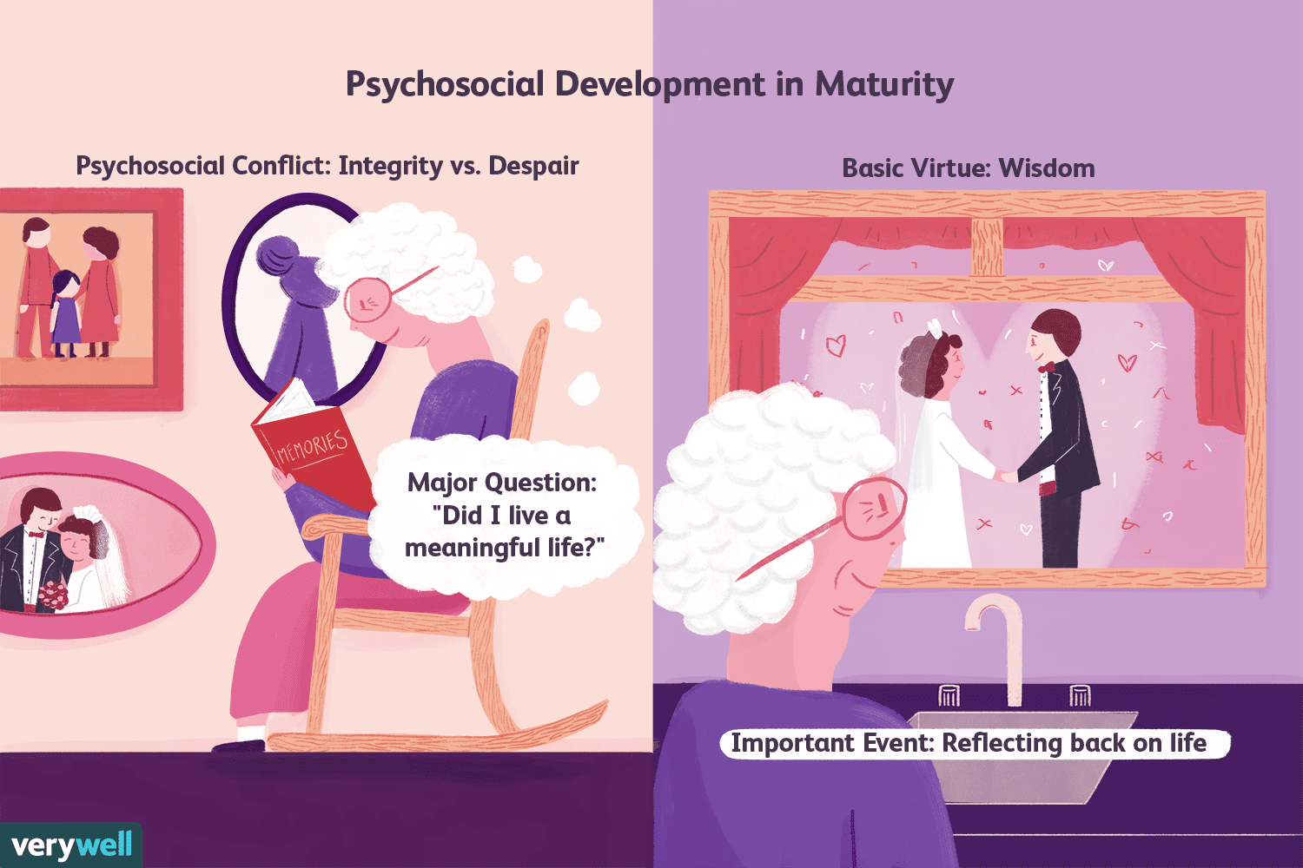
Integrity Vs Despair
Erikson suggests that at late adulthood an individual ought to find meaning and satisfaction on their life than rather becoming bitter (Cherry, 2011).
He identified that finding integrity has benefits of peace and fulfilment, ego integrity which is regarded success in the stage and attainment of wisdom (Cherry, 2011).
Notes:
Kawther: According to Erickson, the psychosocial crisis that occurs in the later adulthood stage is that of either integrity or despair. In this stage late adults will reflect on their life and feel a sense of either satisfaction or regret.
This is triggered by factors such as retirement, loss of spouse, onset of terminal illness and loss of friends. (McLeod, 2018)
The main attributes that describe integrity are satisfaction.
The key attributes to despair are depression, bitterness, regret, hopelessness and feelings of unproductiveness (Mcleod, 2018)
Health care providers ought to assist late adults to find satisfaction in their life and stop them becoming bitter to find peace and fulfilment.

Slide 10



Stage 8: Ego Integrity vs. Despair
Erikson’s Theory
Late Adulthood Stage (Social Aspect) (Kawther Chebli)
This stage is critical in one’s life as it might be a turning point in his/her life in regard to social, emotional , and mental status. At this stage, one discovers whether or not he/she is leading a successful life. In other words, it is meant for reviewing one’s accomplishment throughout life.
(Mcleod, 2013)
Notes:
Kawther:
This stage is critical in one’s life as it might be a turning point in his/her life regarding social, emotional , and mental status. At this stage, one discovers whether he/she is leading a successful life. In other words, it is meant for reviewing one’s accomplishment throughout life.
On the other hand, if an individual has a sense of regret and that his/her life has been wasted and developed a sense of despair and hopelessness, he/she might reach a point where they no longer care about life, become isolated, avoid interaction with the community, and might eventually become paranoid. This is also known as “Disdain” (Hearn, et al., 2012).

Slide 11
Benefits of integrity
Wisdom
- Older people have the knowledge to deal with difficulties they face in life.
- They have the experience to help others to solve
Issues in life.
-They also have the emotional wisdom to empathize
With others
Notes:
Augustine
According to Erikson:
Benefit of integrity is wisdom,
Peace and fulfillment.
Ego integrity.
When integrity is not achieved and there is despair, this will lead to depression, lack of self-esteem, dissatisfaction and regret.
On the other hand, if an individual has a sense of regret and that his/her life has been wasted and developed a sense of despair and hopelessness, he/she might reach a point where they no longer care about life, become isolated, avoid interaction with the community, and might eventually become paranoid. This is also known as “Disdain”
(Hearn, et al., 2012)

Slide 12
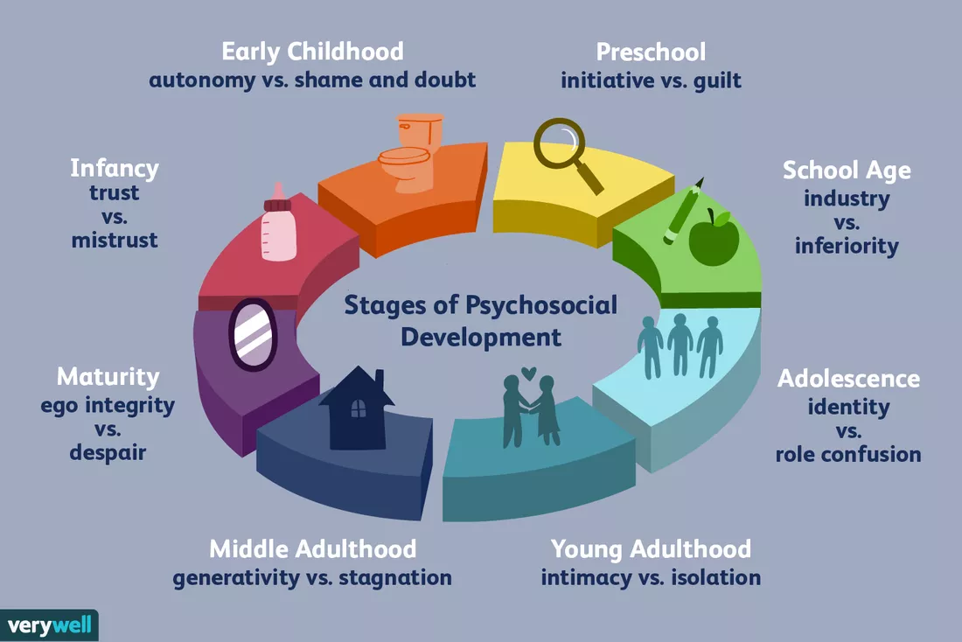
Reasons why we choose Eric Erikson’s Psychosocial Theory for late adulthood.
Eric Erikson is the only theorist that expanded his theory of psychosocial to the late adulthood (65+).
This theory can be applied in healthcare with service users 65+.
It can support us too understand the development of mental health disorder, such as depression in elderly.
(Cherry, 2021)
Notes:
Aramide
Among all the theories for example, Piaget’s theory of cognitive development and that of Freud’s psychosexual theory of development, Eric Erikson is the only theorist that expanded his theory of psychosocial to the late adulthood (65+). This is the reason why we chose Erikson to discuss the later adulthood in relation to healthcare.
Furthermore, Cherry (2021) quoted that “Erikson’s theory differed from many others because it addressed development throughout the entire lifespan, including old age”.

Slide 13

How do we apply Eric Erikson’s Psychosocial Theory in healthcare practice?
This theory can help professionals to predict that all those service users who do not solve the conflict between integrity and despair are more likely to experience depression and will require psychological support and intervention.
Notes:
Kawther
In healthcare practice, Eric Erikson’s psychosocial theory can be used to assist in developing a comprehensive and holistic plan of care for the elderly.
It is critical for carers to understand Erikson’s Psychosocial theory in order to respond appropriately to their patients. For example, nurses can gather information about their patients by using Erikson’s theory and provide patient centred care (Emfondren, 2011). Those service users who will not solve the conflict between integrity and despair, will require support.

Slide 14

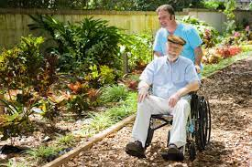
Conclusion
How does psychology impact to the developmental stages of humans?
It is essential to understand the various stages of PIES of the late adulthood, in order to be able to work effectively with them as a health care provider.
( Health Guide, 2021)
Notes:
Kawther
Conclusion
Understanding the four PIES of 65+ age group gives information to healthcare workers about the traits, behaviours and social settings surrounding them. It allows carers to provide the best possible care available and ensures a smooth-running environment for them.
Thanks for listening.

Slide 15
References
All Answers. November 2018. Application of Erikson's Psychosocial Development Theory in Patient Care Plan. [online]. Available from: https://nursinganswers.net/essays/application-of-eriksons-psychosocial-development-theory-in-patient-care-plan.php?vref=1 [Accessed 29 July 2021]
Alzheimer's Society (2021) The dementia guide: Planning ahead. Available at: https://patient.info/doctor/dementia-pro#:~:text=According%20to%20figures%20provided%20by%20the%20Alzheimer%27s%20Society%2C,65-69%20years.%202.4%25%20in%20people%20aged%2070-74%20years. (Accessed: 21 July 2021)
Berk,( 2007); Lumenlearning.com/wmopen-lifespandeveloment/chapter/cognitive-development-in-late-adulthood/
Cherry, K., 2021. Understanding Erikson's Stages of Psychosocial Development. [online] Verywell Mind. Available at: https://www.verywellmind.com/erik-eriksons-stages-of-psychosocial-development-2795740 [Accessed 29 July 2021].
Emfondren, 2011. Erikson's: Developmental Theory and Its Impact on Nursing. [online] Emfrondren.blogspot.com. Available at: http://emfrondren.blogspot.com/ [Accessed 29 July 2021].
Erickson International (2012) The five pillars of emotional intelligence’ Erickson Coaching International [blog] (Accessed: 21 July 2021)
Erickson, E.H. (1982), the life cycle completed. New York, NY: international university press.
Erikson, E. and Erikson, J., 1998. The life cycle completed. W. W. Norton, pp.1-111.
Freepik, 2021. Sick Senior Man With Cup Of Tea. [online] Freepik. Available at: https://www.freepik.com/premium-photo/sick-senior-man-with-cup-tea_11151778.htm [Accessed 29 July 2021].
Hearn, S., Saulnier, G., Strayer, J., Glenham, M., Koopman, R. and Marcia, J.E., 2012. Between integrity and despair: Toward construct validation of Erikson’s eighth stage. Journal of Adult Development, 19(1), pp.1-20.
Hertz, d.et al (2021) Inside out outside in. New York: Rowman& Littlefield.
Mcdowd. JM Attention and aging: A functional perspective. In: Craik flm, salthouse TA, editors. The handbook and cognition 2.
McLeod, S. (2018). Erik Erikson’s stages of psychosocial development. [online] Simply Psychology. Available at: https://www.simplypsychology.org/Erik-Erikson.html.
Salthouse, TA. (1996); https://www.ncbi.nlm.nih.gov/pubmed/8759042 [Accessed 15.07.21]
Strough, J., McFall, J., Flinn, J. and Schuller, K., 2008. Collaborative everyday problem solving among same-gender friends in early and later adulthood. Psychology and Aging, [online] 23(3), pp.517-530. Available at: https://www.researchgate.net/publication/23274150_Collaborative_Everyday_Problem_Solving_Among_Same-Gender_Friends_in_Early_and_Later_Adulthood [Accessed 29 July 2021].

