Slide 1
Occupational psychology
Lecture one
Introduction
Recruitment and selection

Slide 2

What is Occupational Psychology?
Notes:
Please use the post it notes in front of you - use the purple to write down at least one thing you think occupational psychology IS - and use the green to write down at least one thing you think occupational psychology DOES.

Slide 3
What is Occupational
Psychology?
Area of applied psychology relating to people at work
Concerned with human behaviour in work and organisational settings
BPS – Applying the science of psychology to people at work
Increasing exploration of the links between work and non-work (Borough & O’Driscoll, 2010)
Notes:
Touched upon in Applied Psychology. Many interchangeable terms that will be seen – in the core text labelled as work psychology – but will use occupational psychology for the most part in this module.
So what is Occupational Psychology? It is, as the name initially suggests, an area of applied psychology that relates to people at work and in organisations. Within the UK, the term Occupational Psychology is the official title and is protected by law. Occupational psychology is concerned with human behaviour in work and other organisational settings. As defined by the BPS, Occupational Psychology is about applying the science of psychology to people at work; where work is generally considered to be paid employment.
There is an increasing exploration of the links between work and non-work, such as the increasing blurring boundaries between work and non-work hours. This is something we will spend a whole lecture on towards the end of the series, and something that you may definitely want to think about if you are considering entering in to a career where psychology is the main focus – whether it be academia or research, or something else!

Slide 4
Overview
Occupational psychology takes concepts, theories and techniques from many sub-disciplines and APPLIES these to the workplace
    Social, cognitive, developmental, etc
Some of the areas we will be covering will be topics you have learned about previously
    But, don't think that you can ignore these areas because you already know them
    We will be applying them in a very different way to how you have covered them before

Slide 5
Brief history lesson…
Occupational psychology was mainly about the study of individual differences
Emphasis on investigating and explaining attributes that relate to performance at work, such as abilities, skills, traits and personality of a person
    E.g., productivity, creativity and performance
Notes:
From its inception, occupational psychology was mainly about the study of individual differences. The emphasis was on investigating and explaining attributes that relate to performance at work, such as a person ability, skills, traits and personality. Different attributes, attitudes, personality traits, etc will affect work behaviour such as productivity, creativity and performance in different ways.

Slide 6
Issues we will be looking at during this module
Recruitment and selection processes
    Strengths and limitations
    Design and validation processes
Psychometric testing
    Personality and intelligence – from a different perspective!
Leadership and motivation
Addiction to work
Attitudes at work
Stress
The 21st Century Workplace

Slide 7
Occupational psychology
origins

Slide 8
Origins of Occupational Psychology
At least two distinct roots (Arnold et al., 2010):
  1) ‘fitting the man to the job (FMJ) and fitting the job to the man (FJM)’
      FMJ – focuses on the PERSON
      FJM – focuses on the JOB
  Both concern the relationship between an individual and their work
Notes:
Occupational psychology has at least two distinct roots within applied psychology. On resides in a pair of traditions that have often been termed ‘fitting the man to the job and fitting the job to the man’. The FMJ tradition manifests itself in employee selection, training and vocational guidance. These endeavours hace in common an attempt to achieve an effective match between job and person by concentrating on the person!
The FJM tradition focuses instead on the job, and in particular the design of the tasks, equipment and working conditions that suit a person’s physical and psychological characteristics.
Both of these traditions concern the relationship between an individual and their work

Slide 9
Origins of Occupational Psychology
At least two distinct roots (Arnold et al., 2010):
2) Human relations (HR)
      Concerned with the complex interplay between individuals, groups, organisations and work
      Emphasises social factors at work
      The Hawthorne Studies
Notes:
The other root of occ psychology can be loosely labelled as Human Relations or HR. HR is concerned with the complex interplay between the individuals, groups, organisations and work. It therefore emphases social factors at work much more than FMJ and FJM. The importance of human relations was highlighred in some famous research now known as the Hawthorne Studies

Slide 10
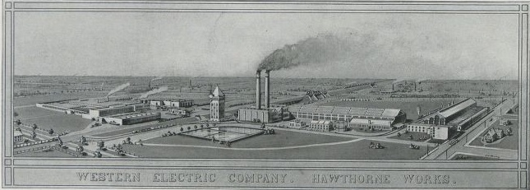
The Hawthorne Studies
Mayo and Roethlisberger (1924)
Originally designed to assess the effect of lighting conditions on productivity
Notes:
The Hawthorne Studies were conducted in about 1924 by Elton Mayo and Fritz Roethlisberger. They were conducted on workers at the Hawthorne plant of the Western electric company and were part of a refocus on managerial strategy incoporating the socio-psychological aspects of human behaviour in organisations
Originally the studies looked into whether workers were more responsive and worked more efficiently under certain environmental conditions, such as improved lighting. One group (experimental group) were subjected to the change in lighting and the other group (control group) were not. It was found that workers were more responsive to social factors – such as the people they worked with on a team and the amount of interest their manager had in their work – than the factors (lighting) that the researchers had deliberately manipulated.

Slide 11

The Hawthorne Studies
Why did these results occur?
Workers were highly responsive to additional attention from their managers
Although financial motives are important, social factors are equally important in defining the worker productivity
Notes:
Why did these results occur? The researchers only deliberately manipulated the lighting conditions for both groups. They found that productivity increased very slightly but it was clear that there were other factors other than the illumination of the lights that were determining productivity.
The Hawthorne studies helped conclude that workers were highly responsive to additional attention from their managers and the feeling that their managers actually cared about, and were interested in, their work. The studies also concluded that although financial motives are important, social factors are equally important in defining the worker productivity.

Slide 12
Why Occupational Psychology?
Kiechel (1993) noted that individuals can expect to change jobs as many as ten times and work for as many as five organisations during their working life.
Notes:
What makes us equipped and able to take on different roles? What are the sorts of things that can be covered or researched by occupational psychologists that give us answers to these questions?

Slide 13

Occupational Psychologists as Teachers, Researchers and Consultants
Personnel selection and assessment
Training
Performance appraisal and career development
Organisational development and change
Human-machine interaction
Counselling and personal development
Design of environments and work - Health and safety
Employee relations and motivation
Notes:
/here we will list eight areas (or knowledge dimensions) that occupational psychologists operate in as teachers, researchers and consultants. This has been adapted from information from the Qualification in Occupational Psychology published on the BPS website.
Personnel selection and assessment for all types of job by a variety of methods, including tests and interviews. How to hire the best person for the job according to their traits, intelligence, levels of motivation, perhaps.
Training: identifying training needs for staff or employees and the design, delivery and evaluation of that training.
Performance appraisal and career development: looking to identify key aspects of job performance; the design of systems for accurate performance assessment and development; training in the use of appraisal and development interventions such as personal development plans.
Organisational development and change: analysis of systems and relationships at work; leadership and negotiation skills; analysis and change of organisational culture and/or climate
Human-machine interaction: analysis and design of work equipment and environments to fit human physical and cognitive capacities. Are machines taking over? Can a machine perform just as well (if not better) than a human? What are the things that are different?
Counselling and personal development: techniques of listening and counselling regarding work- and career related issues; assessment and analysis of people’s career interests and aspirations
Design of environments and work - health and safety: the assessment of existing and preferred features of the environment such as light levels, workspace positioning and sources of danger, risk or stress.
Employee relations and motivation: allocation and design of jobs that are as motivating and satisfying as possible; team-building; negotiating and bargaining; techniques for analysing and improving inter-group relations.
These are the content areas of occupational psychology. It is expected that qualified occupational psychologists will not only know about these areas, but also possess generic skills such as questionnaire design, interviewing, report writing, presentation skills and data analysis methods that they have developed when using their knowledge. In addition in several of these areas they need to have substantial experience of conducting problem diagnoses, research, consultancy, intervention, evaluation and be able to deliver training.

Slide 14

Some questions occupational psychologists ask….

Slide 15
What is the best way to select people to work in jobs?
How best can people be motivated to work to their highest level?
How does stress arise in individuals in a work environment?
    Why should we be concerned?
    How can this be treated?

Slide 16
Does job satisfaction matter? And, if so, what are the main factors in ensuring good job satisfaction?
The effect of technology on occupations
    How has this changed work and roles?
    What are the costs and benefits?

Slide 17
Personnel selection methods
Pros and cons…

Slide 18

Recruitment and Selection
Recruitment: Attempt to attract good people to apply for the job
  Universities, job fairs, conferences, etc
Selection: The process of identifying from the pool of recruited applicants those to whom a job will be offered

Slide 19

100 recruited
20 applicants
8 interviews
2 offers
1 hire

Slide 20
Why does selection matter?
Personnel psychology is one of the most prominent topic areas in work and occupational psychology, and research findings have had a major impact on recruitment practice.
Most of the world works as a capitalist society (like it or not!)
  Businesses survive or go bust based on their performance
If the best is twice as good as the worst, you want the best!
  But how do you know who that is?
We can't 'clone' our best workers
  …. Or can we?

Slide 21
This is what the selection process attempts to do
  Examine the data to find the 'ideal' person for the job
  And then see if potential employees meet that ideal (or choose the person who comes closest to it)
Employment legislation and guidelines requiring valid and fair selection procedures
This is the defining role of Occupational Psychologist
  The scientist-practitioner
  Applying scientific principles to the procedure

Slide 22
The ‘Selection Headache’
Selection is difficult!
  Predicting future performance over a period of years, and even decades, from limited information
  Time and cost constraints
  Ethics
  Legislation
  Impression management

Slide 23
The ‘Selection Headache’
Occupational Psychologists are scientist-practitioners and aim to apply scientific principles to this procedure.
Predicting which of several job candidates is likely to perform the job most effectively is a forecasting problem…
But the guiding principle is: past performance is the best predictor of future performance

Slide 24
How do we decide who to employ?
To make a selection scientifically we need a plan!
Criterion :- definition of good performance
Predictor :- anything that relates to the criterion
Whilst there may be lots of predictors, we need predictors that will be
Useful
Cost-efficient

Slide 25
Design and Validation in Selection
Job analysis of the target role
Develop a competency model
Advertise vacancies
Attract pool of applicants
Brief applications on selection process
Select OUT unsuitable applicants
Create person specification
Choose selection methods
Pilot and validate selection methods
Evaluate reliability, validity, financial utility, fairness
Evaluate candidate reactions
Select IN candidates
Identify selection criteria
Make selection decisions
Provide feedback to candidates
The personnel selection, design and validation process
Patterson and Ferguson (2007)
Notes:
This diagram provides an outline of the main elements involved in designing and implementing a personnel selection procedure. The process begins with a JOB ANALYSIS to define a COMPETENCY MODEL and create a PERSON SPEC. This information is used to identify the SELECTION and ASSESSMENT CRITERIA and may also be useful for ADVERTISING the job role.
The job analysis information is used to decide which SELECTION METHODS to use to access applicant behaviour related to the selection criteria ( see sheet of selection methods on Moodle).
Selection methods can be PILOTED where possible validated and candidates reactions can be assessed.
In ATTRACTING A POOL OF APPLICANTS, prospective candidates will engage in self-selection where they can make an informed judgment about whether the particular role suits their skills and abilities. Once candidates have applied, a SELECTION OUT process may take place based on eligibility (e,g., essential criteria such as educational qualifications), before the SELECTING IN process is undertaking using the chose selection methods.
Following the SELECTION DECISIONS and the accepted applicants enter the organisation (provided they accept the organisations offer). FEEDBACK to candidates (both successful and unsuccessful) may be provided which is useful for development, although many organisations have practical and legal reasons for not always providing detailed feedback

Slide 26
Design and Validation in Selection
A thorough job analysis is the foundation of an effective selection process and is used to guide choice of selection methods
Outputs should:
    Detail tasks and responsibilities of target job
    Provide information about behavioural characteristics required of the job holder
Notes:
A thorough job analysis is the foundation of an effective selection process and is used to guide choice of selection methods. The outputs from a job analysis should detail the tasks and responsibilities in the target job and also provide information about the particular behavioural characteristics required of the job holder. The analysis may, for example, suggest that certain personality and dispositional characteristics are desirable, together with specific previous work experience, technical qualifications and levels of general intelligence and specific abilities (e.g., numerical ability).

Slide 27
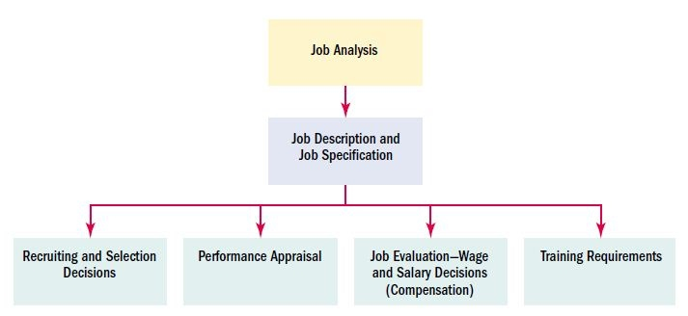
Uses of Job Analysis Information
What they do, how they do it, why they do it, what skills/ education/ training is required, physical demands, etc
Notes:
Going back to the very beginning, job analysis is a procedure by which pertinent information is obtained about the job in question. What it boils down to is a detailed and systematic study of information relating to the operations and responsibilities of that job. Or more specifically, what the worker does, how they do it, why its done, skills involved, what education and/or training is required, its relationships to other jobs, any physical demands, any environmental conditions to consider, etc etc!!
From this information, the job description and the job specification can be developed and constructed. These both lead the way to who gets recruited and ultimately selected, the issues and areas that will be raised in subsequent performance appraisals, decisions about wages and salary, and will help to outline any training requirements (be they immediate or future requirements).
Recruiting and selection decisions – by indicating the specific requirements of the job in question (i.e., the skills and knowledge that an individual must have to complete the job effectively) it provides a realistic basis for hiring, training, placement, transfer and even promotions within the company itself.
Performance appraisal: job analysis helps in establishing clear cut standards which may be compared with the actual contribution of each individual. For example, during a performance appraisal a worker is told to develop his skills in a particular area in accordance with the outline of his job. The following year, the next appraisal shows that he did not meet this target therefore his contribution is questioned.
3) Wage and salary administration: Indicating the qualifications required and any risks or hazards that are involved helps in salary and wage administration within the company.
4) Job analysis helps to determine the content and subject matter of training courses

Slide 28
A reminder about Reliability and Validity

Slide 29
1 - Reliability
Consistency or stability of a measure
2 - Validity
Refers to the accuracy and precision of the measurement
See pages 152-161 in your core text books…
Notes:
You will be conducting reliability analyses on the measures that you choose for your report assessment – so be sure to read up on these in your own time!!

Slide 30




Slide 31
Types of Selection Methods
Arnold, Chapter 5!
Notes:
An introduction to the major personnel selection methods that are available for use. Most of the methods are well-known but some you may not have heard of before.
Each of these methods has its own strengths and weaknesses, and none is perfect! You may conclude that some methods are better used together, and that the basic aim of selection should be to use tests that complement one another rather than duplicate each other, for example.

Slide 32

Interviews

Slide 33
1. Interviews
Important features:
  Follows a pre-planned structure
  Questions are directly related to the job
Keenan (1995): Interviews have long been the most popular form of personnel selection
Criticised for being subjective, unreliable and vulnerable to bias, but Huffcutt et al. (2001) – criterion-related validities for interviews compared favourably with other forms of selection
Notes:
The first method we will look at is interviews. Many interviews can and will involve more than one interviewer. When several interviewers are involved, the term panel interview is used. The most important features of an interview are the extent to which a pre-planned structure us followed and the proportion of questions that are directly related to the job.
Interviews have long been the most popular form of personnel selection. They are used by nearly every organisation and for selecting employees at all levels. However, despite this popularity, interviews have been criticised for being subjective, unreliable and vulnerable to bias! This was probably a fair criticism 30 years ago – interviews for often little more than an informal chat! But in a meta-analysis, Huffcutt et al in 2001 concluded that criterion-related validities for interviews compared favourably with other forms of personnel selection such as cognitive ability tests.

Slide 34
Interview questions should be derived from job analysis data
Interviews can be important and valid IF:
  Questions are based on a job analysis
  Questions are consistent across interviewers and interviewees
  The interviewers use a consistent set of criteria to evaluate interviewee responses.
Notes:
When using a predictor such as an interview, the specific areas that are to be investigated in the interview should be derived from the job analysis data. This information provides a basis for deciding which factors (e.g., numerical ability, communication skills, organisational skills, etc) might be important for job success.

Slide 35
Pros and Cons
More detailed answers than questionnaires
Allows for clarification
Interviews as recruitment devices – build rapport and sell the job to the applicant
Subject to LOTS of biases
Usually time-consuming
Untrained interviewers may distort data
Interviewees may try to show only what they think is desirable

Slide 36
Variables that can affect interviews
Negative information has a greater impact (reasons not to hire)
Primacy effect – first impressions are crucial
Recency effect – Specific details are best remembered when presented near the end of the interview
Contrast effect – average applicant rated higher if followed a poor candidate, and lower if followed a good candidate
Attractiveness effects – ‘beautiful is good’
Other effects - race, age, sex, voice, gestures, accents, agreeableness with interviewer…

Slide 37
Types of structured interview
Situational interview
  Uses critical incidents to develop questions
  Questions follow the “what would you do in this situation” format
  Every applicant is asked identical questions
Patterned Behaviour Description Interview
  Also uses critical incidents
  Questions follow the “tell me about the last time you were in this situation” format
  Interviewers choose from a fixed pool of questions
Notes:
Behavioural description interviews ask interviewees to describe previous behaviour in past situations that are relevant to the job they are being interviewed for. This type of interviewing is based upon the central premise that past behaviour predicts future behaviour. In essence, interviewers are looking for evidence that an individual has demonstrated behaviour that would suggest they are capable of similar behaviour in a job situation. This type of interviewing forms the foundation of much of the competency-based interviewing that is popular today. For example, an interviewer may ask the interviewee “ can you please describe a time when you have been able to persuade someone to something that they had initially been unsure about?” This could provide an opportunity to demonstrate behavioural indicators for a competency concerned with persuasion and negotiating skills.
In contrast, situational interviews are based on goal-setting theory. These interviews present interviewees with hypothetical job-related situations and ask them to indicate how they would respond. They are based on the assumption that intention to behave predicts future behaviour. For example, imagine you are applying for a job (any job you like!) and your interviewer asks you how you would respond in a specific situation. The response that you give will be compared with the responses provided by a group of experts who have been asked to indicate the type of responses they would expect from a good, average and poor performers in this role. What situational interviewing doesn’t do, however, is take into account previous or different levels of experience between candidates.

Slide 38
Psychometric Tests
MEASURE
MIND
“a standardised sample of behaviour which can be described by a numerical scale or category system”
QUANtitative!!
Notes:
In the 1980’s Cronbach described psychometric tests as providing a ‘standardised sample of behaviour which can be described by a numerical scale or category system’. In other words, psychometric tests offer a quantitative assessment of some psychological attribute (such as verbal reasoning ability, general intelligence, numerical reasoning ability, etc). For personnel selection purposes, psychometric tests may be divided into two categories: Cognitive Ability Tests (eg general intelligence, spatial ability, etc) and personality measures).
Before any psychometric test is administered, the organisation should conduct a job analysis to identify the job requirements and duties. Tests that are chosen afterwards should, therefore, be chosen to measure aptitudes and abilities that are directly related to the specific job.

Slide 39

Cognitive Ability Tests
(Intelligence)
Notes:
In the past 30 years, there has been an explosion in the use of cog ability tests for selection purposes. For many companies conducting large scale recruitment programmes, ability tests are relatively cost effective selection tools. Unlike most other selection techniques, to purchase and administer psychometric tests in many countries you have to demonstrate a specific level of competence in administration, scoring tests and interpreting test scores (eg, BPS certificates of competence in occupational testing).

Slide 40
Cognitive Ability Tests (Intelligence)
Cognitive ability – Intelligence
  Multi- or single- dimension?
Single dimension: g score – general intelligence
  Successful in predicting performance on many jobs
Multiple dimension: different aspects of intelligence unrelated to one another
  Math scores may predict programming skills better than language scores do

Slide 41
e.g.,
What cognitive abilities would best predict success as a lawyer?
Air traffic controller?

Slide 42
Ones et al. (2005): a meta-analysis of meta-analyses
Evidence for the validity of cognitive ability tests in predicting job performance is overwhelming
All jobs require some cognitive ability to learn the job and perform effectively
Ones and Viswesvaran (2003):
    High-complexity jobs 0.58
    Low-complexity jobs 0.23
Notes:
Ones et al performed a meta-analysis of meta-analyses and found that the evidence for the validity of cognitive ability tests in predicting job performance is overwhelming. In this respects, many researchers argue that cognitive ability tests are perhaps the best and most widely applicable predictor in personnel selection because all jobs require some cognitive ability to learn the job and perform effectively. Ones and Viswesvaran in 2003 also suggested that the predictive validity of cotnigive ability tests tends to be higher for high-complexity jobs (at 0.58) – jobs such as, believe it or not, a professor in occupational psychology, than for low-complexity jobs (at 0.23) such as a taxi driver. These are still significant regardless of the level of complexity with higher complexity jobs simply requiring denser processing of information than lower complexity jobs.

Slide 43
Superiority of GMA
Schmidt and Hunter (1998) – four reasons for the superiority of GMA over other methods
1) Versatility, high validity and lowest application costs
2) Strongest research evidence
3) Best predictor of job-related learning - .56
4) Strongest theoretical foundation
Notes:
The average predictive validity coefficient in .51 for middle complexity level jobs which maps the greatest proportion of the workforce. Also .58 for managerial jobs, .51 for medium complexity jobs, .40 for semi-skilled jobs and .23 for completely unskilled jobs.

Slide 44
Pros and Cons
Highly reliable
  Validity also rises with increasing complexity of the job
Combinations of CA tests have higher validities than individual tests alone
Can be administered in group settings
Low cost
Differences in scores for minority groups
    Non-minorities typically score one SD above minorities
Gender differences may need to be considered
    E.g., scores on mathematics
Candidates reactions to them can be negative
Notes:
One major pro of cognitive ability tests is that research shows they are highly reliable – and that validity of the test also increases as the level of complexity of the job increases, too!
Combinations of cognitive ability tests have been shown to have higher validities than individual tests alone and these can be administered in group settings. This saves on the time invested in testing the candidates and therefore the cost!
However, some of the cons for cognitive ability tests can be seen in the differences in scores between majority and minority groups – non-western cultural groups, for example. Research has shown that non-minority groups (in this case the western groups) tend to score typically one SD score above the minorities.
It is sometimes necessary to recognise that gender can have a major impact on some cognitive ability tests. Men typically score far higher on mathematic or numerical tests than females – so this may be something that needs to be accounted for.
Finally, candidates can have very negative reactions to be doing they are going to be completing a cognitive ability or an intelligence test!

Slide 45

Personality Inventories

Slide 46
Personality Inventories
Assess personality traits believed to be necessary for job performance
Examples:
  Cattell’s 16 PF
  Five factor model – Extraversion, Neuroticism, Agreeableness, Conscientiousness, Openness to experience
  MMPI – Minnesota Multiphasic Personality Inventory
Particularly useful if tailored specifically for the job in questions
Notes:
Personality inventories seek to assess personality traits that are believed to be necessary for job performance. Think back to your intro to psych module last year where these different types of personality tests were first introduced.
Cattell’s 16 personality factors – a personality test that identifies 16 personality factors (or source traits). This test seeks to measure individual differences on each of the 16 dimensions and provide a comprehensive personality description.

Slide 47
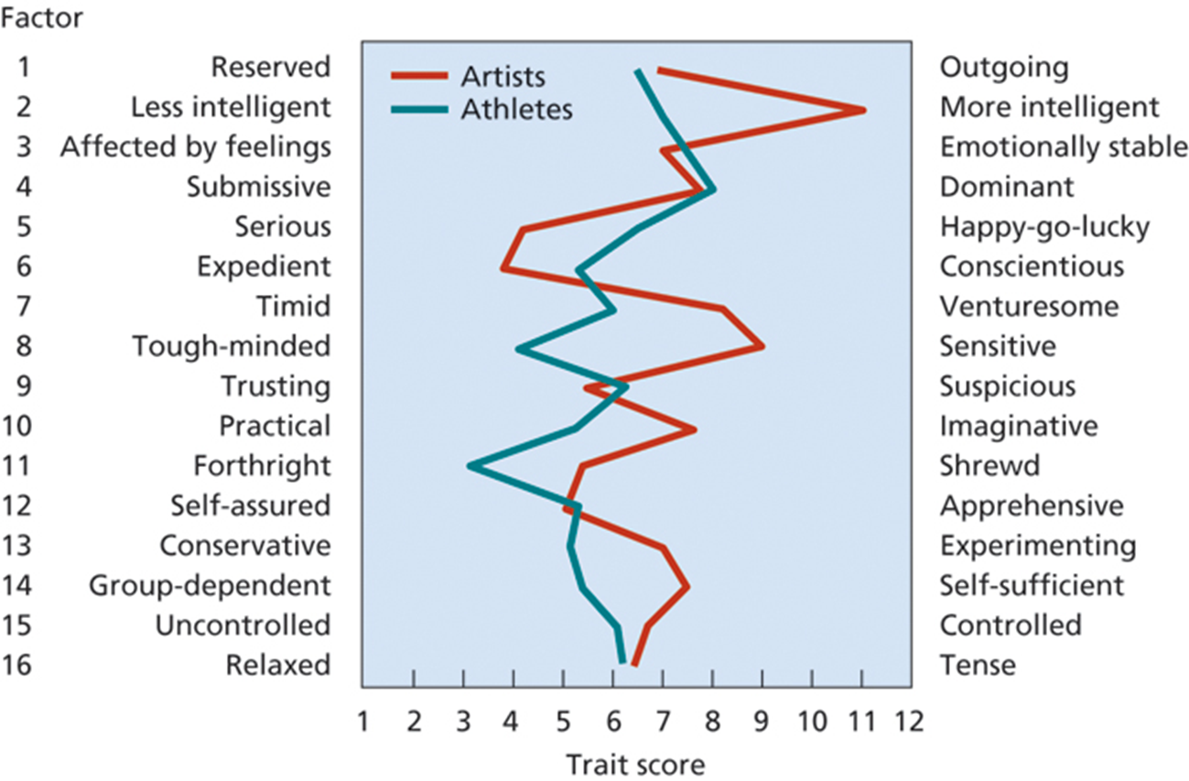
Cattell’s 16 Personality Factors
Notes:
For example, this shows a comparison of average scores obtained by creative artists and Olympic athletes. Artists present as more intelligent, more sensitive and more serious than athletes, but less forthright and tough-minded.

Slide 48
Personality Inventories
Assess personality traits believed to be necessary for job performance
Examples:
  Cattell’s 16 PF
  Five factor model – Extraversion, Neuroticism, Agreeableness, Conscientiousness, Openness to experience
  MMPI – Minnesota Multiphasic Personality Inventory
Particularly useful if tailored specifically for the job in question
Notes:
The Five factor model (proposed by McCrae and Costa) suggests that there are five higher-order factors that capture the basic structures of the whole of personality, and that all 5 factors can yield both desirable and undesirable personality traits (very important to remember this when engaging with the literature and assessing which traits present as the best or worst for certain types of job!)
The MMPI is the most widely used and researched standardised psychometric test of adult personality and psychopathology. There are two forms – the MMPI-2 which has 567 true/false questions and the MMPI-2_RF (published in 2008) which has only 338 true/false items. But, despite there being fewer questions and taking about half the time to complete, the MMPI-2-RF isn’t used as widely as the MMPI-2 because of the MMPI-2’s existing large research base and familiarity with psychologists. The MMPI is considered a protected psychological instrument, meaning it can only be given and interpreted by a psychologist trained to do so – i.e., you will not be able to find the test online!
Each of these tests have their own merit, and each of them can be very useful if they are tailored specifically to the job in question.

Slide 49
The Five-Factor model and job performance: Research findings
Barrick, Mount and Judge (2001):
    Conscientiousness (in particular) and neuroticism are the best personality predictors of job performance across all occupations
    Extraversion and agreeableness are important in jobs requiring a high degree of interpersonal work
    Less consistent evidence for Openness to experience
Salgado et al. (2003):
    Conscientiousness is a valid predictor of performance across most jobs and organisational settings; criterion-related validity 0.23

Slide 50
Ones et al. (2007):
    Unlike ability testing, the predictive validity of personality measures for ‘overall job performance’ is not seen across all occupational settings and areas
    E.g., for managerial roles, the ‘achievement’ and ‘dependability’ facets of conscientiousness predict job performance
Notes:
In a more recent debate, ones et al cite meta-analytic data to suggest that, in contrast to ability testing, to predictive validity of personality measures for ‘overall job performance’ is not seen across all occupational settings and areas. Instead, only the trait of conscientiousness is predictive of ‘overall job performance’ over a range of occupations; the predictive traits for other occupations vary along with the occupations themselves. For example, for managerial roles, it is the ‘achievement’ and ‘dependability’ facets of conscientiousness that predict job performance. It is important to understand that validity can be explored at the facet level, and that results are criterion dependent when doing so. For the other personality factors (to conscientiousness) the relationship with job performance tends to depend upon the nature of the job being carried out

Slide 51
Pros and Cons
Can reveal more information about applicant’s abilities and interests
Can identify interpersonal traits that may be needed for certain jobs
‘Faking’ to present themselves in a socially acceptable manner
    Are self reports accurate and unbiased?
Training and experience may have a greater impact on job performance than personality
Notes:
Personality measures can reveal a lot more about the applicant’s abilities and interests that they would openly state, and they can identify interpersonal traits that may be needed for certain jobs. One important issue with personality measures is the issue of ‘faking’ – distorting answers or answering questions in a way that the applicant thinks will be more socially desirable or acceptable. Most research suggests that distortion does not undermine the validity of personality tests, however there continues to be an ongoing debate about this.
And finally, training and experience may in fact have a far greater impact on job performance for certain jobs than an individuals personality type or traits.

Slide 52

Assessment Centres
Group approach normally used for evaluating candidates for promotion to upper management
Multiple assessments of individuals using different methods, and involving multiple observers
Can last between ½ to three days

Slide 53
Assessment Centres
Profile the applicants ability across a range of competencies
Appeal of AC’s – good levels of criterion-related validity and face validity (Hough & Oswald, 2000)
Criteria for AC’s:
    Explicit dimensions from job analysis
    Multiple techniques
    Multiple, trained assessors
    Systematic procedure to record and rate specific behaviours
Notes:
Assessment centres profile an applicants ability across a range of competencies and job-related contexts. The appeal of assessment centres lies in their generally good levels of criterion-related validity and face validity. Meta-analytic studies show the average validity of assessment centres to be very good.
There are certain criteria that an assessment process must fulfil in order to be defined as an assessment centre. 1) they must have explicit dimensions (or competencies) that are derived from a job analysis which define the key knowledge, skills and abilities required by a candidate in order to perform the role that they are being assessed for. 2) multiple techniques to provide information relevant to the dimensions to be assessed and the context in which those dimensions are to be demonstrated. 3) multiple, trained assessors to observe and evaluate each candidate. And 4) a systematic procedure to record and rate specific behaviours as they occur.

Slide 54
Pros and Cons
When properly designed, AC’s are more reliable than traditional testing methods
Highly adaptable to all types of positions/jobs
AC’s test what a person can do, not what they know
Can provide feedback to candidates re: their own strengths and weaknesses
Costs are high for AC’s
Some candidates feel uncomfortable in AC’s – role playing
Difficult for candidates to prepare for an assessment centre
    Experience, not books, is the best teacher

Slide 55
Work Samples
Logic: take the content of a job, shrink it down to a manageable time period, and let applicants demonstrate their ability in performing the replica of the job
High face validity
Examples:
  Actors
  Athletes
  Typists
Notes:
Work samples or job simulations provide alternatives to the approach of psychometric testing. High face validity = applicants respond favourably to work sample tests in selection.
Can be more expensive to develop.

Slide 56
Situational Exercises
Applicant given a sample problem and assessed on problem solving ability
  Leaderless group discussion: present a group of applicants with a problem to see if a leader emerges
  In-basket Test: fill applicants ‘in-basket’ with a number of job-related tasks and rate performance

Slide 57
Graphology
Handwriting analysis
Assess the aspects of one’s personality based on the style of their handwriting
Nearly equivalent to phrenology
No evidence of validity!
Notes:
Not used to any great extent in the UK – thankfully, however many European companies make extensive use of graphology.

Slide 58
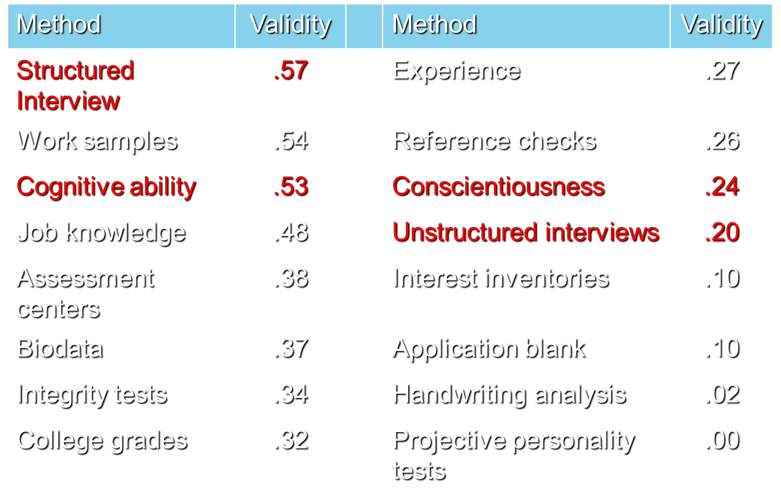
Validity Coefficients for Selection Techniques

Slide 59
Validity Coefficients for Selection Techniques
1.0 | Certain prediction
0.9
0.8
0.7 | Assessment centres for development
0.6 | Skilful and structured interviews
0.5 | Work sampling
 | Ability tests
0.4 | Assessment centres for job performance
 | Biodata
 | Personality assessment
0.3 | Unstructured interviews
0.2
0.1 | References
0.0 | Graphology
 | Astrology
Pilbeam and Corbridge (2006)
Notes:
Pilbeam and corbridge provide a summary of the predictive validity of selection methods based on the findings of various research studies. However, they suggest that these validity measures should be treated with caution because they can be affected by the performance indicators used, and by the way the tools were applied.

Slide 60
Typical Selection System
Multiple methods typically applied
One model for the selection process:
    Applicant submits resume and/or completes application form for Human Resources
    HR reps screen application/resume for disqualifying factors (minimum qualifications)
    Applicant is administered one or more tests
    Applicant is interviewed by hiring manager or supervisor of the vacant job
    Applicants are ranked based on results of testing and/or interviews
    Final selection is made by hiring manager/supervisor in conjunction with HR

Slide 61

Any questions??

Slide 62
And now the part you’ve all been waiting (patiently) for….
Module Assessments!

Slide 63
Module Assessments
2,500 word essay
  Critically discuss the individual and organisational causes and consequences of ‘work addiction’
2,000 word research report
  To what extent to individual differences predict performance on a stress-inducing cognitive task?

Slide 64
1) essay
Standard academic essay: structure of introduction, main body, conclusion
Your essay MUST include empirical literature to support any points you make re: any individual or organisations causes of work addiction, as well as the consequences to the individual and/or the organisation.

Slide 65
2) Research Report
In groups, you are required to design, collect data and report a research study that aims to explore the question set in the proforma.
Full proforma is on Moodle
You will be conducting a multiple regression analysis – this has been covered in RDA so will not be covered here.

Slide 66
Seminar today…
Research, theory and practice
  Exploring types of research methods and tests use in Occ Psych.
  Begin to consider the design and measures you will be using for the research report assessment.

Slide 67
Next week…
Next week’s lecture will focus on psychometric testing and individual differences
Your seminar next week will be focused around the evaluation of personality measures.

