Slide 1

Integration of Health, Wellbeing and Sustainable Development
Critical examination of policy, legislation, service delivery and health inequalities in UK health and social care.
Module name and code: Health, Wellbeing and Sustainable Development, BMHP6030
Lecturer’s name: Olufemi Oluranti
Assignment title: Component 1, Presentation
Student’s name and number: Teodora Evgenieva, 2324070
01
Notes:
This presentation will examine what is meant by ‘health and wellbeing and sustainable development' in the context of health and social care in the UK. It takes into account the impact of these concepts on policy, legislation and service delivery. Prevention and inequalities and access to care are also discussed. A public health case example in the UK is presented to demonstrate in practice how the integration can occur. The presentation concludes with the recommendations for more equitable and sustainable services.

Slide 2
Roadmap and presentation aim
1
Describe
2
Apply
3
Evaluate
4
Recommend
Connect these ideas to UK health and social care practice.
Use secondary evidence to judge strengths, limits and inequalities.
Suggest evidence-based improvements for fairer services.
Define health, wellbeing, sustainable development, models and policies.
02
Notes:
The presentation is based on the following approach: describe, apply, evaluate and recommend. I will describe the basic concepts and theory that will be used. I will then link these thoughts to UK policies, legislation and service delivery. The success of the current approaches will be critically examined. Lastly, recommendations for enhancing equity / access will be made.

Slide 3

Key concepts: what is being integrated?
Health
Integration means policy and service delivery must treat people as whole persons within social and environmental systems.
Physical, mental and social functioning, not only the absence of illness; in practice it requires prevention, treatment, dignity and support(Gavurova and Megyesiova, 2022).
Wellbeing
A holistic quality-of-life concept including emotional, social and practical ability to live well, participate and cope with change (Coren et al., 2022).
•
Prevention matters as much as treatment.
•
Wellbeing requires social participation and mental health support.
Sustainable development
Sustainability asks whether services are fair, affordable and future-ready.
•
Meeting health needs today while protecting the social, economic and environmental resources needed by future generations (Shulla et al., 2021)
.
03
Notes:
Health is more than just the absence of disease - it is physical, mental and social wellbeing. Wellbeing also takes into account emotional, social and overall quality of life. Sustainable development is concerned with present needs and protecting the future generations. These ideas are interlinked in contemporary health and social care. As a combination, they help to sustain a more proactive, comprehensive and individual approach.

Slide 4
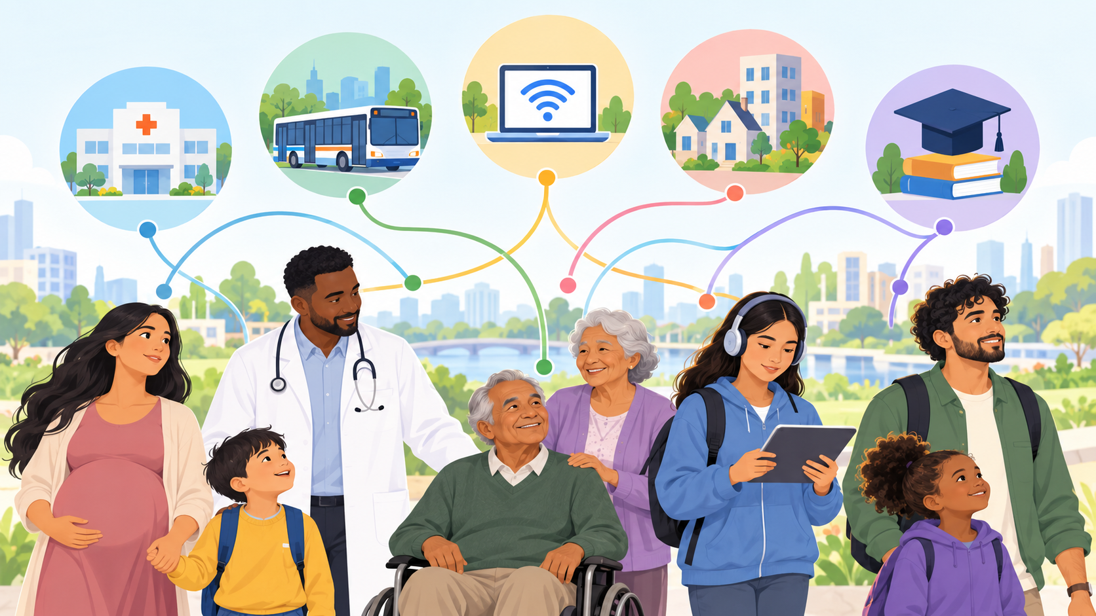
Why integration matters in health and social care
Core argument
Health outcomes are produced by clinical care plus wider determinants such as income, education, housing, discrimination, transport and digital access (Ford et al., 2021).
Therefore, a sustainable approach uses health services, social care, local government and communities together.
•
Better prevention can reduce avoidable demand.
•
Person-centred care can improve dignity and engagement.
04
Notes:
Income, housing and education are other social determinants that impact health. These factors may impact on health outcomes and access to services. So, healthcare cannot be limited to curing the disease once it has developed. Integrated care is integrated treatment, prevention and broader social support. This can contribute to minimising inequalities and enhancing the wellbeing of the population in the longer term.

Slide 5
Theoretical perspectives: compare and apply
Biopsychosocial model
Holistic model
Ecological model
Biology, psychology and social context interact. Useful for chronic illness, mental health and long-term condition support.
Care considers physical, emotional, social and sometimes spiritual dimensions of need.
Health behaviour is shaped by individual, family, community, organisational and policy levels.
Strength: person-centred.
Limit: can be difficult to resource fully.
Strength: supports dignity and prevention.
Limit: may lack measurable boundaries.
Strength: explains inequalities.
Limit: requires cross-sector action.
(Ventres, 2021)
(Coren et al., 2022)
(Levin-Zamir et al., 2021)
Critical point: no single model is enough; effective services combine individual care with action on the wider determinants of health.
05
Notes:
Biological, psychological and social factors are taken into account in the biopsychosocial model. The holistic model is a focus on the person not the disease. The ecological model takes into account individual, community and wider environmental factors. Every model has its advantages and every one of its disadvantages if they are used in isolation. They both play a supportive role to a robust foundation of integrated health and social care.

Slide 6
SDGs and “Health in All Policies”
SDG 3: Good Health and Well-being
SDG 3 connects with poverty, inequality, sustainable communities and climate because these conditions affect health risks, access and resilience (Siddiqi et al., 2023)
SDG 1
SDG 10
Poverty
Reduced inequalities
SDG 11
SDG 13
Sustainable communities
Climate action
Health in All Policies asks non-health sectors to assess health impacts before decisions are made (Stein and Dorner, 2024)..
06
Notes:
SDG 3 is directly related to good health and wellbeing. Health is also associated with poverty and inequality and sustainable communities. This indicates that there are many sectors in which health outcomes can be affected, other than health. Health in All Policies encourages incorporating health impacts in areas such as housing and transport. The strategy helps to prevent and facilitates a more sustainable long-term decision making.

Slide 7
Policy and governance: UK examples
Policy / framework
How it applies
Evaluation
Marmot Review / health equity
Frames inequalities as avoidable differences shaped by wider social determinants.
Strong equity lens; implementation is limited when wider investment is weak.
NHS Long Term Plan and Core20PLUS5
Moves attention towards prevention, mental health, integration and targeted inequality reduction.
Clear priorities; risks remain if local capacity, workforce and data systems vary.
Public Health Outcomes Framework and NICE guidance
Uses indicators and evidence-based guidance to support quality, prevention and population health.
Useful for accountability; indicators can miss lived experience and local barriers.
(Alderwick et al., 2022)
(Gkiouleka et al., 2022)
Policy message: governance must convert aims into resources, workforce capacity, data sharing and local accountability.
07
Notes:
The Marmot's approach has been very much social determinants and health inequalities. Improving population health, integration and prevention are also a key emphasis of the NHS Long Term Plan. NICE guidance helps to inform best practice and standard of care. But, the effectiveness of policy may also be dependent upon fundings, staffing and enactment at the local level. There is thus a need for good governance to implement the policy intentions to actual improvement.

Slide 8
Using legislation effectively
Relevant legislation
Describe
What does the law/policy aim to do?
•
Equality Act 2010: supports non-discrimination and equitable access.
•
Apply
How does it support SDG 3 or service access?
Health and Care Act 2022: strengthens integrated care and partnership duties.
•
Mental Health Act: legal framework for treatment and rights in mental health care.
Evaluate
What inequality remains despite the law?
•
Tobacco regulations: regulate tobacco and e-cigarettes to support prevention.
Recommend
What extra policy or practice change is needed?
Example: equality law may reduce formal barriers, but deprived areas can still face poorer access due to workforce, transport and digital barriers.
(Arık et al., 2021)
08
Notes:
The Equality Act 2010 helps to protect against discrimination in the health and social care services. Today’s new Health and Care Act 2022 will take steps to improve health and care integration. Other laws, such as the Mental Health and Tobacco laws, have an impact on protection, prevention and access. But laws can't fix all health disparities. However, there can still be practical barriers as a result of deprivation, transport and digital exclusion.

Slide 9

Service delivery: what integration looks like in practice
Prevention
Community care
screening, immunisation, MECC and lifestyle support
multidisciplinary teams, social prescribing and local assets
Telehealth
Wellness programmes
remote monitoring and convenient consultations
mental health, physical activity, nutrition and smoking cessation
Critical evaluation
Digital and community-based delivery can improve convenience, but it may widen inequalities when people lack devices, confidence, language support or accessible transport.
(Sounderajah et al., 2021)
(Farre et al., 2023)
09
Notes:
Services can be integrated and encompass prevention, community-based, and telehealth and wellness programmes. These can enhance services to be more convenient and person-centred. In addition, community based care can help to minimize unnecessary use of hospital services. But there are potential challenges when digital is used for exclusion practices. Services should then offer flexibility and accommodate various population needs.

Slide 10

Case example: NHS Diabetes Prevention Programme
Describe
Behaviour-change support for adults at high risk of type 2 diabetes through diet, weight and physical activity support.
(Whelan and Bell, 2022)
Apply
Supports SDG 3 by targeting prevention and earlier intervention before diabetes develops.
(Ravindrarajah et al., 2023)
Evaluate
The programme may reduce some risks, but completion and benefit can differ by socioeconomic status, age and disability.
(Chatzi et al., 2023)
Recommend
Offer flexible times, culturally appropriate materials, transport/digital support and follow-up for non-attenders.
(Parkinson et al., 2024)
10
Notes:
The NHS Diabetes Prevention Programme is an example of a preventive public-health initiative. It is beneficial to those who may be more susceptible to the onset of Type 2 Diabetes. The programme encourages healthier eating, more physical activity and behaviour change. It demonstrates the potential to lessen the burden of health care services in the future. But there can be social group differences in participation and completion.

Slide 11
Equity, evaluation and recommendations
Remaining challenges
Recommendations
•
Deprivation and transport barriers affect access.
1
Target resources using inequality data
Use local dashboards and deprivation indicators to identify who is not accessing services.
•
Ethnic inequalities and language needs reduce trust and engagement.
2
Co-design with communities
Design health promotion with patients, carers and voluntary groups.
•
Digital exclusion limits telehealth benefits.
3
Make digital care inclusive
Provide non-digital routes, translated materials and digital support workers.
•
Funding and workforce gaps restrict holistic care.
4
Strengthen prevention and social determinants
Link healthcare with housing, education, employment and community wellbeing.
Conclusion: effective integration means combining policy, legislation, theory and service delivery so that prevention and wellbeing reach the groups most at risk of exclusion.
11
Notes:
Deprivation, ethnic differences, digital exclusion and pressures on the workforce are significant obstacles. Services should identify through local data, groups who are accessing or doing worse than others. Engaging the community in the process can contribute to the creation of culturally and practically relevant services. Accessible alternative non-digital services should be always provided with the digital service. There is also a need for increased coordination among health, housing, education and community services.

Slide 12
References
Alderwick, H., Hutchings, A. and Mays, N. (2022) “A cure for everything and nothing? Local partnerships for improving health in England”, BMJ, 378, e070910. Available at: https://doi.org/10.1136/bmj-2022-070910
Arık, A. et al. (2021) “Socioeconomic disparities in cancer incidence and mortality in England”, Scientific Reports, 11, 13804. Available at: https://doi.org/10.1038/s41598-021-93241-3
Chatzi, G. et al. (2023) “Could diabetes prevention programmes result in the widening of sociodemographic inequalities in type 2 diabetes?”, Journal of Epidemiology and Community Health, 77(9), pp. 565–570. Available at: https://doi.org/10.1136/jech-2022-219654
Coren, E. et al. (2022) “An examination of the impacts of volunteering and community contribution at a community festival through the lens of the Five Ways to Wellbeing”, International Journal of Community Well-Being, 5, pp. 137–156. Available at: https://doi.org/10.1007/s42413-021-00154-2
Farre, A. et al. (2023) “Exploring the use of digital technology to deliver healthcare services with explicit consideration of health inequalities”, Digital Health, 9. Available at: https://doi.org/10.1177/20552076231196326
Ford, J.A. et al. (2021) “Reducing health inequalities through general practice: protocol for a realist review”, BMJ Open, 11, e052746. Available at: https://doi.org/10.1136/bmjopen-2021-052746
Gavurova, B. and Megyesiova, S. (2022) “Sustainable Health and Wellbeing in the European Union”, Frontiers in Public Health, 10, 851061. Available at: https://doi.org/10.3389/fpubh.2022.851061
Gkiouleka, A. et al. (2022) “Allied health professionals: A promising ally in the work against health inequalities—A rapid review”, Public Health in Practice, 3, 100269. Available at: https://doi.org/10.1016/j.puhip.2022.100269
12

Slide 13
References
Levin-Zamir, D. et al. (2021) “Health promotion preparedness for health crises”, Global Health Promotion, 28(2), pp. 27–37. Available at: https://doi.org/10.1177/1757975921998639
Parkinson, B. et al. (2024) “Level of attendance at the English National Health Service Diabetes Prevention Programme and risk of progression to type 2 diabetes”, International Journal of Behavioral Nutrition and Physical Activity, 21, 6. Available at: https://doi.org/10.1186/s12966-023-01554-7
Ravindrarajah, R. et al. (2023) “Referral to the NHS Diabetes Prevention Programme and conversion from nondiabetic hyperglycaemia to type 2 diabetes mellitus in England”, PLOS Medicine, 20(2), e1004177. Available at: https://doi.org/10.1371/journal.pmed.1004177
Shulla, K. et al. (2021) “Effects of COVID-19 on the Sustainable Development Goals (SDGs)”, Discover Sustainability, 2, 15. Available at: https://doi.org/10.1007/s43621-021-00026-x
Siddiqi, S. et al. (2023) “Implementation of health and health-related sustainable development goals”, BMJ Global Health, 8, e011395. Available at: https://doi.org/10.1136/bmjgh-2022-011395
Sounderajah, V. et al. (2021) “A national survey assessing public readiness for digital health strategies against COVID-19 within the United Kingdom”, Scientific Reports, 11, 5958. Available at: https://doi.org/10.1038/s41598-021-85514-w
Stein, K.V. and Dorner, T.E. (2024) “From Health-in-All-Policies to Climate-in-All-Policies”, International Journal of Environmental Research and Public Health, 21(1), 110. Available at: https://doi.org/10.3390/ijerph21010110
Ventres, W.B. (2021) “Personalizing the biopsychosocial approach: ‘Add-ons’ and ‘Add-ins’”, Journal of the American Board of Family Medicine, 34(5), pp. 1030–1032. Available at: https://doi.org/10.3122/jabfm.2021.05.200647
Whelan, M. and Bell, L. (2022) “The English National Health Service Diabetes Prevention Programme: A scoping review of existing evidence”, Diabetic Medicine, 39(7), e14855. Available at: https://doi.org/10.1111/dme.14855
12

