Slide 1
Digital Literacy
- Asifa Iffat

Slide 2
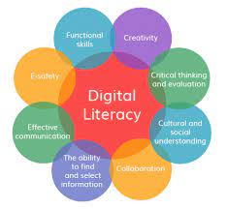

What is Digital Literacy?
Digital literacy is the ability of an individual to communicate and use various different digital platforms.
It is the ability to produce text, images, audio, and designs using technology

Slide 3
Why is Digital Literacy important in learning?
Digital literacy is important in education because it is not limited to the physical limitations and so allows opportunities for things like worldwide research. These opportunities are extremely advantageous because they help expand our individual knowledge as well as providing us with different perspectives on things.

Slide 4

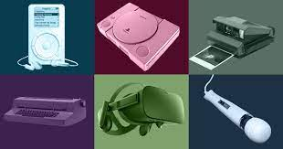


Examples of Digital Literacy
Everyday examples include using day to day devices such as using phones to check emails

Slide 5
Advantages and Disadvantages of Digital Literacy in learning
Advantages | Disadvantages
Encourages individual learning | Cyberbullying
Encourages communication and therefore teamwork | Lack of social contact
Remote learning opportunities | Remote learning can reduce active participation from students
Gives children and adults opportunities to express themselves through | Dangers to privacy

Slide 6
Conclusion
I

Slide 7
References:
‌Twinkl. (2022). What is Digital Literacy? - Answered - Twinkl Teaching Wiki. [online] Available at: https://www.twinkl.co.uk/teaching-wiki/digital-literacy [Accessed 7 Feb. 2023].

Slide 8
Thank you

