Slide 1

Programmme : BA(Hons) Business Management
Module : Entrepreneurship
Module code : LCBB5013
Assignment Title : Business Plan Presentation
Lecture’s Name : Dr Amer Kareem
Student ID : 2024350

Slide 2
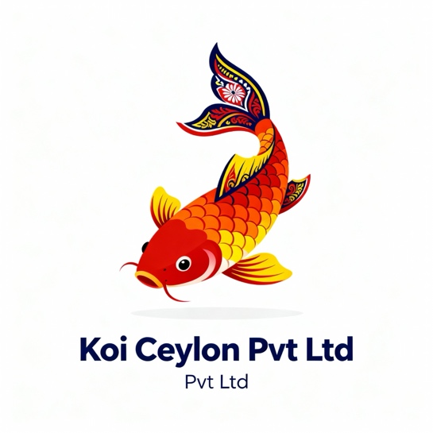
Koi Ceylon Pvt Ltd
Pioneering Premium Koi Export to European Markets

Slide 3
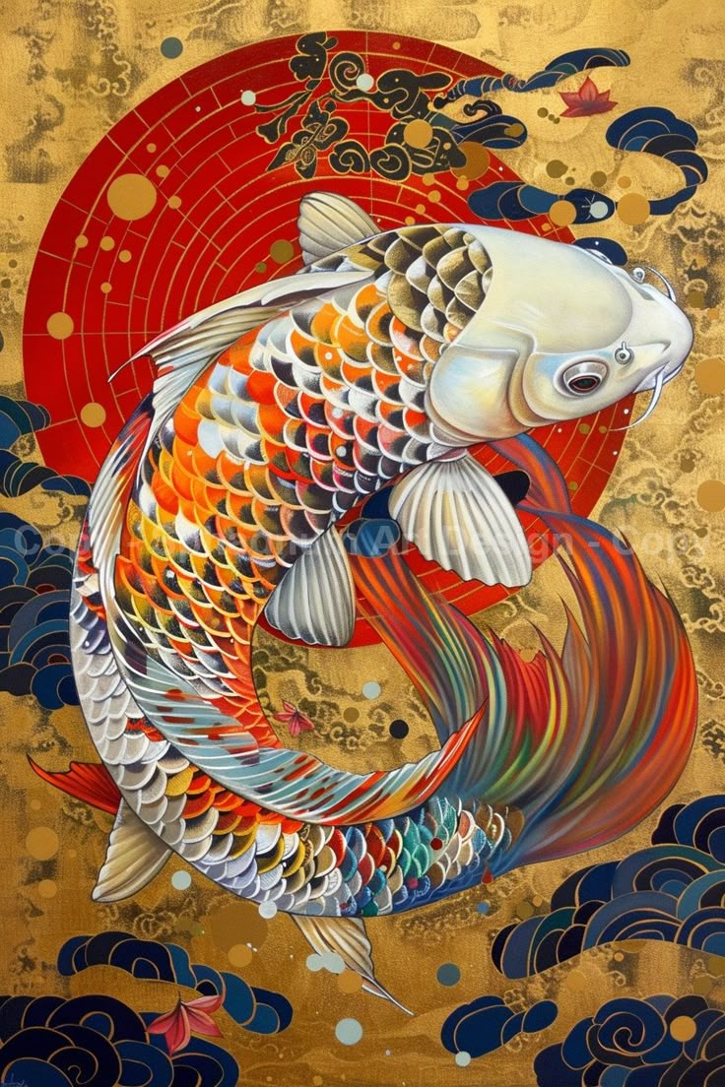
Business Vision and Mission
To be the best Sri Lankan exporter of high quality, ethically-sourced koi fish to European markets, which is renowned in terms of quality excellence and sustainable aquaculture environment. | Koi leadership in the European ornamental koi market. Quality and disease free products- reputation of being uncompromising. Eco-sustainability and corporate ethics. Strategic alliances with European retailers and buyers in the long term.
To offer healthy, aesthetically pleasing and active koi fish to the European consumers and to advance sustainable aquaculture and generate economic opportunities in Sri Lanka. | Provide high quality and disease free koi that has been bred in the perfect tropical climate of Sri Lanka. Exploit natural resources, breeding skills and professional management. Provide secure and dependable logistics and customized customer services. Build trust by being transparent, quality assuring, and ethical in conducting businesses. Contribute to the growth of the local community by creating employment opportunities and transferring knowledge.
Vision
Mission

Slide 4
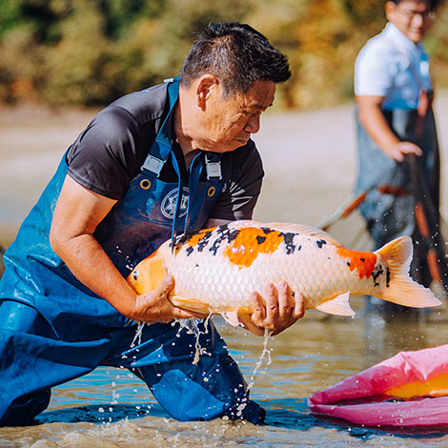
Product/ Service
Premium Ornamental Koi Fish: Koi Ceylon is a producer of decorative quality koi that has colorful and bright hues with unique designs and better body structure that has been bred through advanced breeding methods and genetics.
Disease-Free & Healthy: The health screening and quality control methods are of extra rigorous procedures imposed on all the koi in order to guarantee high survival rates during export and adaptation to new environments.
Multiple Size Categories: Small, Medium, Large and Jumbo versions of products to meet the needs of individual collectors, landscapers and commercial retailers.
Custom Breeding Options: Special color markings and rare breeds are offered as custom orders to satisfy the desire of the high-end collector.
Trustworthy Exporting Service: Stringent logistics and competent transportation permits fresh and quality koi to be in superb state with thorough care needs..
Ethical & Sustainable Production: Koi are reared in an ideal tropical climate of Sri Lanka with harmless and environmentally friendly aquaculture practices and ethics.

Slide 5
Short-term and Long-term objectives
Short term
Establish Quality Breeding Facilities: Establish quality breeding plants in Sri Lanka that has good breedstock and appropriate infrastructure so that quality production of high grade koi is maintained.
Launch First Export Shipments: Launch export shipments to the European clients which are selected carefully to gain market presence and create initial customer base.
Build Quality and Reliability Reputation: develop a good reputation of koi market in Europe in terms of disease free quality koi and quality service.
Secure Export Certifications: Perform all the health certifications, export permits as well as compliance papers to make operations easy.
Long term
Expand Export Volume & Market Reach: Grow volumes of exports and gain representation in various customer markets and segments within Europe.
Develop New & Rare Koi Varieties: Build improved breeding methods to produce unique, rare and exotic koi species that have superior color and design.
Establish Strategic Partnerships: Forge direct contact with the key European retailers, wholesalers, landscape companies, and distribution channels.
Achieve Market Recognition: Create visibility and credibility in the brand by gain prominence in European aquarium trade fairs and koi shows.
Support Local Community Development: Provide jobs, offer aquaculture education, and practice sustainability and help in the Sri Lankan economy development.

Slide 6
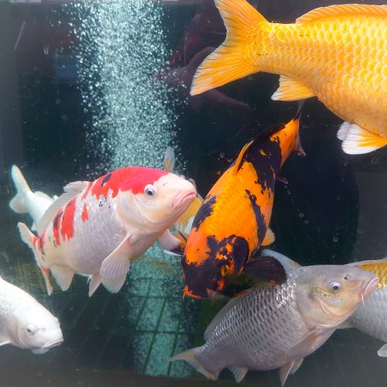
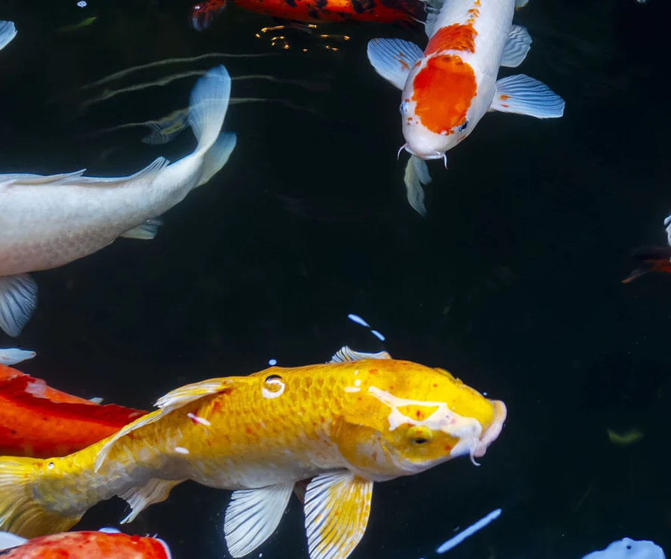
Unique selling point (USP)
Premium Koi in Tropical Sri Lanka: Sri Lanka produces high-quality koi in their perfect tropical climate that provides them with a distinct competitive edge in the market because the nation is not historically regarded as a koi producer (Industry Capability Report, 2025).
Disease-Free and Quality Assured: Strict health inspections would lead to the disease-free shipment and a great survival rate at the export (Thilakarathna, 2024).
Rare Breeds & Customization: Uncommon colorations and bespoke varieties to be commissioned at the whim of the high end collector (EMR, 2025).
The company has established ethical and sustainable practices & Sustainable
Practices: Environmentally-friendly breeding and traceable supply chain will be attractive to the environmental attentive European consumers (EDB, 2025).
Direct Export-Reliable Service: Direct access to the European market including safe logistics and individual approach to customers, which distinguishes us among the global competitors (Andrian et al., 2024).

Slide 7
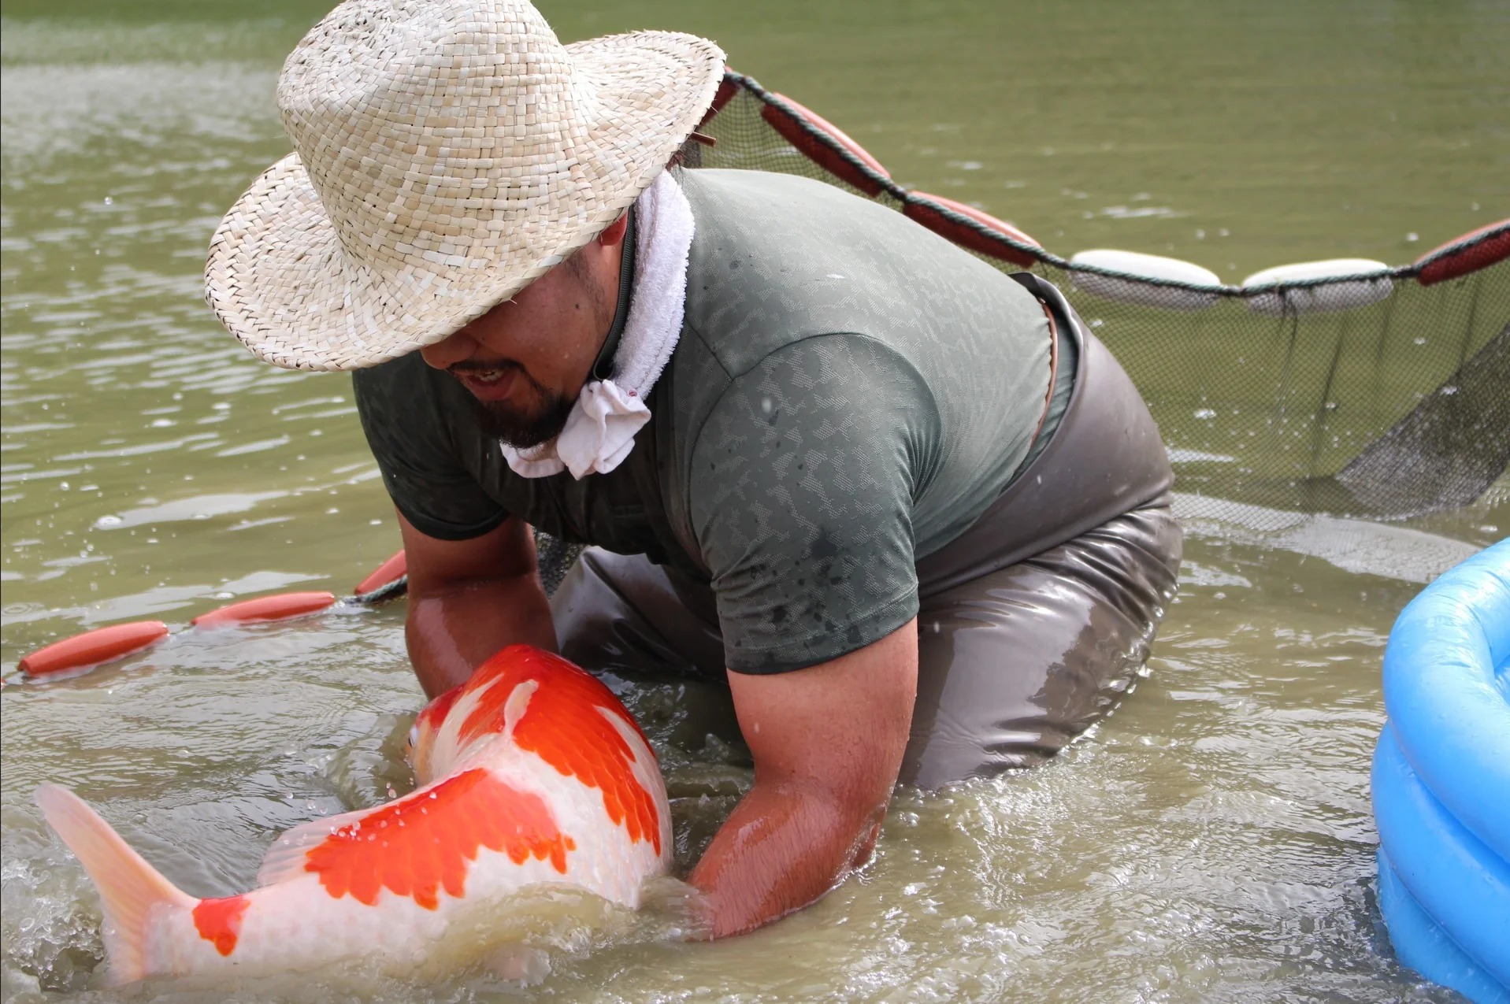
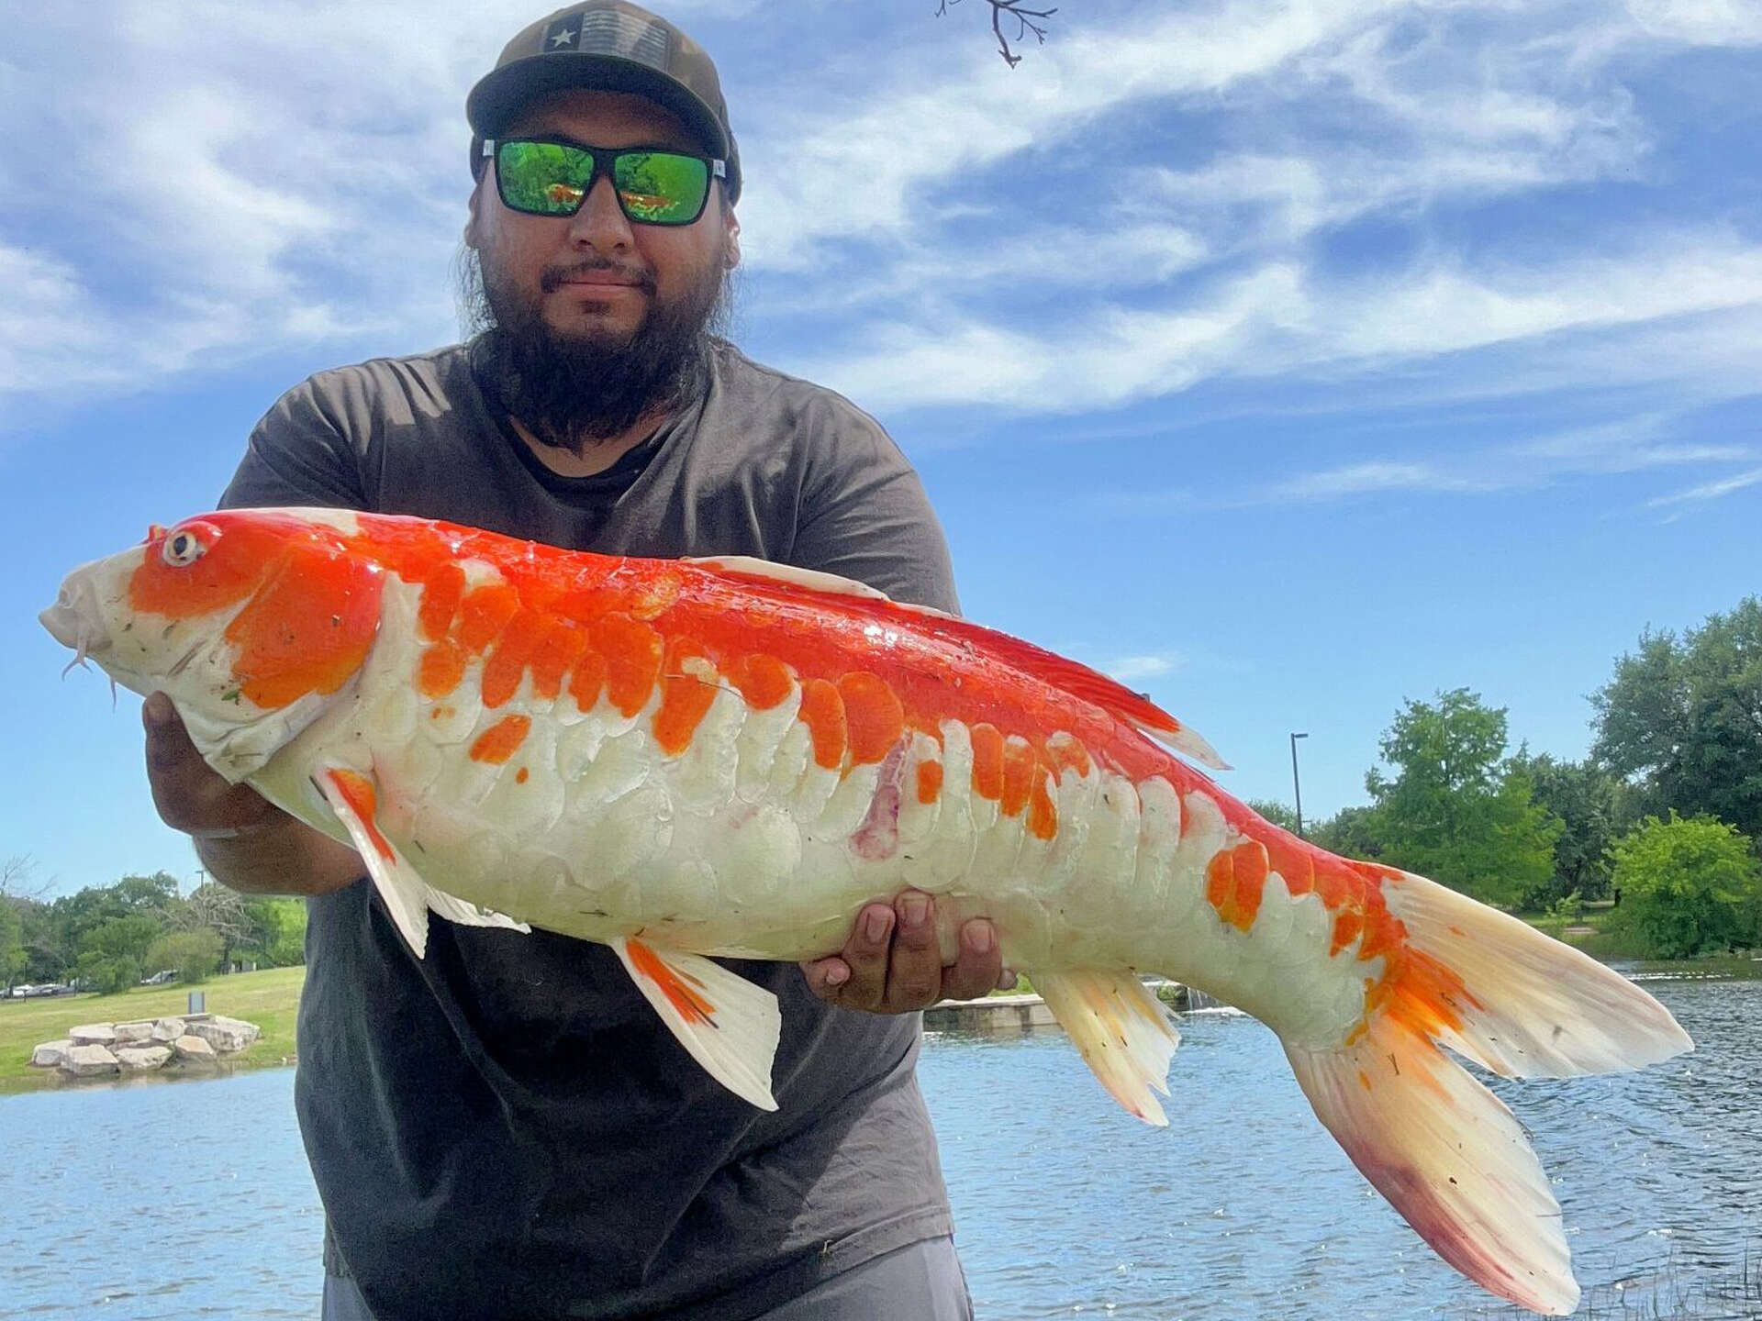
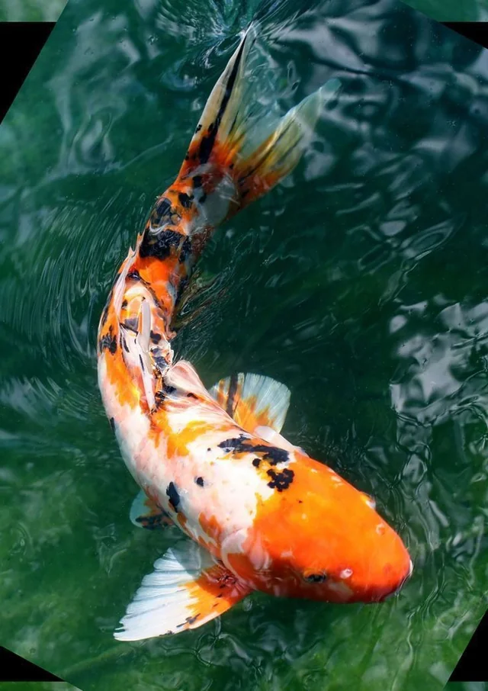
PESTEL analysis
Factor | Key Insights | Citation
Political | Government benevolence in terms of good policies, training, understandable export. International standards are guaranteed by regulatory compliance with DFAR and NAQDA. Export potential is enhanced by EU trade relations. | (EDB, 2025; Industry Capability Report, 2025)
Economic | The exports of Sri Lankan ornamental fish make it about US$8.7 million yearly to more than 40 countries. Koi is a fast-growing niche. Increased prices of broodstock, feeds, and air transportation are the major problems. | (Thilakarathna, 2024; EDB, 2025)
Social | Koi is the representation of peace and prosperity to Asian and the developing European societies. Good creation of job in breeding, retail and logistics. Increasing the demand of ethically-sourced and traceable products. | (Andrian et al., 2024; Thilakarathna, 2024)
Technological | The use of sophisticated water management, disease surveillance and genetic breeding tools are the key. There is technology gap in comparison to Japan, yet local R&D as well as industry partnerships bridges the gap. | (Industry Capability Report, 2025)
Environmental | Natural benefits exist in Sri Lanka due to biodiversity, climatic and water conditions. The increasing market need of sustainable products that are eco-friendly is a benefit to business. | (Thilakarathna, 2024; Industry Capability Report, 2025)
Legal | Certain health certifications, export permits, and water-quality tests, are obligatory. Regulations are provided by CITES and Wildlife Act which stabilize and regulate endemic species export. | (Industry Capability Report, 2025)

Slide 8
SWOT analysis
STRENGTHS | WEAKNESSES
Good tropical climate and biodiversity which are favourable to aquaculture (Thilakarathna, 2024). | Absence of specialized breeding skills compared to other competitors such as Japan ( Industry Capability Report, 2025)
Training, R&D, and export facilitation (EDB, 2025) by the government. | Broodstock, feed and air shipping are expensive (Industry Capability Report, 2025).
The high-quality products (EMR, 2025) disease-free, ethically-certified. | Poor branding of industries and insufficient resources on research (Thilakarathna, 2024).
OPPORTUNITIES | THREATS
Intense market in Europe (DHR, 2025) and other global markets that require koi fish and ornamental fish. | High level of competition with the established (Japan, Southeast Asia) (EMR, 2025)
Sustainability breeding and genetic breeding innovation of the rare/custom koi (Koi Global Market Report, 2025). | The expensive cost of airline delivery and scarce logistics (Industry Capability Report, 2025)
Export businesses are facilitated and supported by the government incentives and funds (EDB, 2025). | Tough EU biosecurity and animal welfare laws that need to be constantly updated (GOV.UK, 2025).
Direct market penetration with less intermediaries (EMR, 2025) | Environmental risks: destruction of habitats, availability of water resources (Industry Capability Report, 2025)

Slide 9
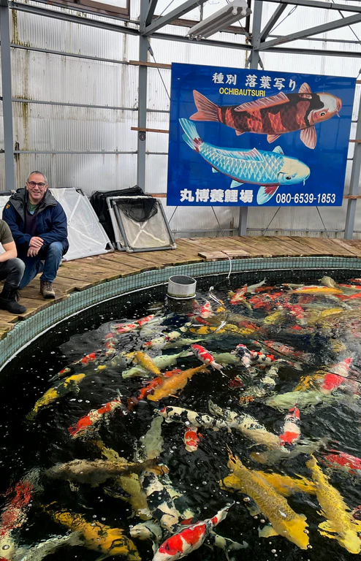
Porter’s five analysis
Force | Level | Key Analysis
Competitive Rivalry | Moderate | There are several exporters in Sri Lanka, although producers of koi of high quality are small. Niche market gives the specialist breeders the competitive advantage in terms of high quality and market relationships.
Threat of New Entrants | Moderate | Expertise development, capital investment in infrastructure and unique brand building are some of the barriers. The entry is open to the prepared companies possessing technical knowledge.
Threat of Substitutes | Low | There are also conventional aquarium fish as substitutes, although the cultural value, luxury status and collectorism of koi make it more desirable among serious collectors and landscape architects.
Bargaining Power of Buyers | High | The advantages of sourcing are high because of strict certification and diversified purchasing by the European wholesalers and retailers. The factors that can be used to reduce power include trust-building and providing unique and rare breeds.
Bargaining Power of Suppliers | Moderate-High | Feed, broodstock, and health suppliers are becoming important in the region due to the higher quality of breeders. The relations with suppliers and the availability of quality materials are becoming critical.

Slide 10
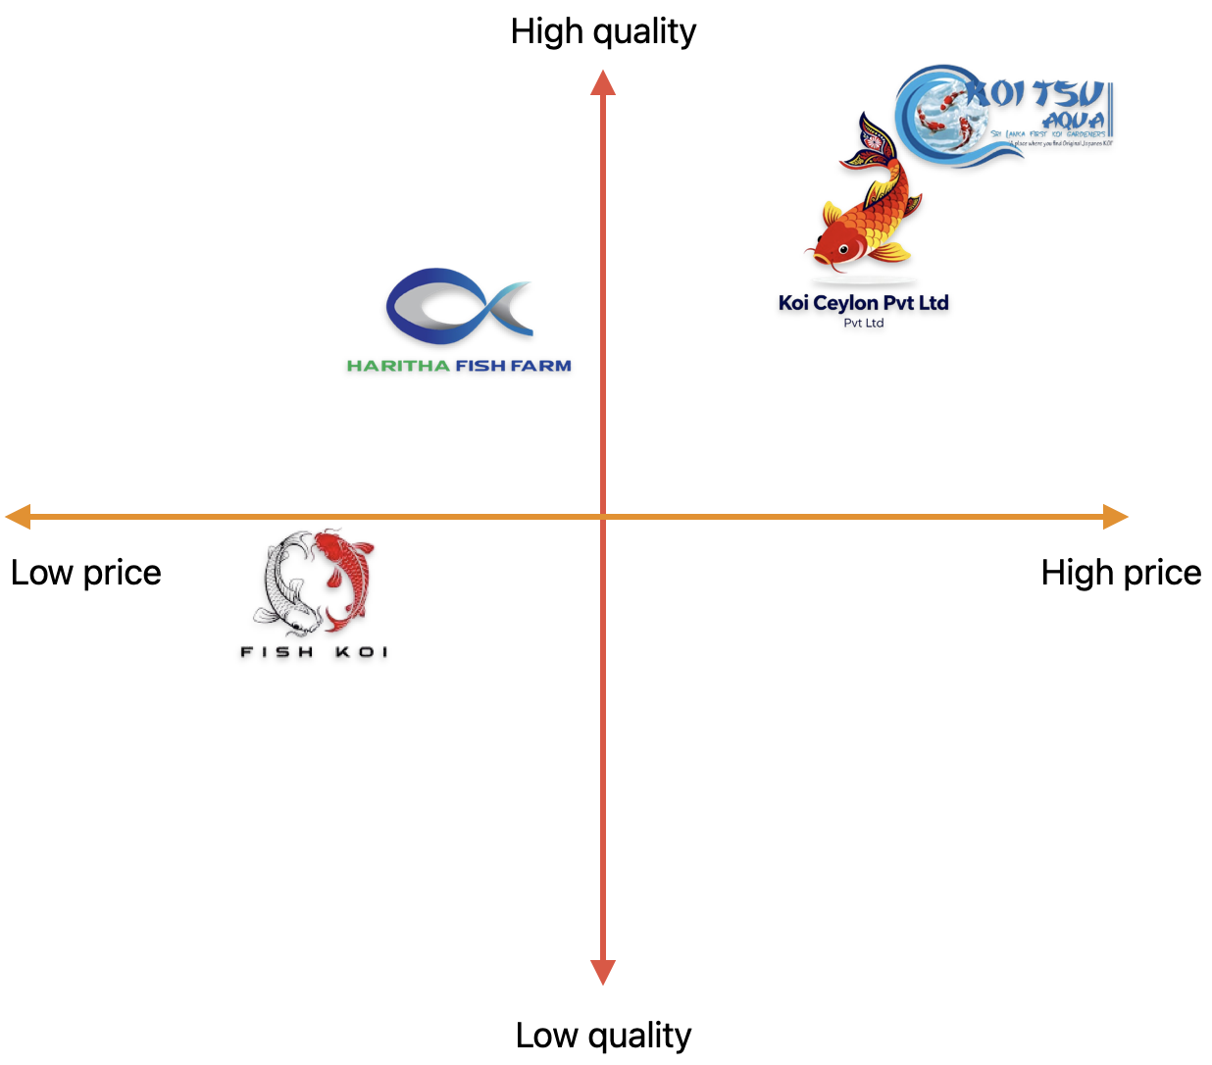
Market segmentation and Target audience
Hobbyists and Collectors of the Best: Homeowners who have garden ponds are interested in obtaining high-quality and unique varieties of koi fish without diseases and having their own color schemes and rare breeds of koi as an aesthetic element (DHR, 2025; EMR, 2025).
Retailers and Commercial Landscapers: The specialty retailers, garden managers and professional landscapers who need large amounts of standard-grade koi to stock their pond and landscape landscapes (DHR, 2025; EMR, 2025).
Internet Purchasers and ReefKEeps: Targeted online consumers and small pet shops that provide accessible and affordable koi to everyday aquarium hobbyists who are also interested in conveniently ordering and receiving products and having quality service and support (DHR, 2025; EMR, 2025).
Sustainability-Focused Buyers: Customers in Europe, who put an emphasis on the morally-sourced, environmentally-friendly koi with a clear traceability and environmental friendliness label (Thilakarathna, 2024; EMR, 2025).

Slide 11

Marketing mix
Shipment to European wholesalers, retailers and specialty dealers through secure air and freight logistic. The market is extended through online ordering systems and collaboration with local garden stores and pet shops (EMR, 2025).
High-grade quality, healthy koi in several size selections (small, medium, large, jumbo) with bespoke-coloured orders and exclusive breeds according to the preferences of the collectors (DHR, 2025; EMR, 2025).
Place
Product
Promotion
Price
4ps
Combined online and offline campaigns: social media promotion (Instagram, Facebook), attendance at tradeshows, koi show, teaming with social media influencers, Google advertising, content marketing (blogs, care guidelines, customer reviews) (DHR, 2025; EMR, 2025; Koi Global Market Report, 2025).
Pricing strategy, division of markets: high-quality koi will be sold at premium prices to high-end collectors and landscape firms, average price koi will be sold at competitive prices to retailers and hobbyists, and with seasonal prices when purchasing in large quantities (DHR, 2025; EMR, 2025).

Slide 12
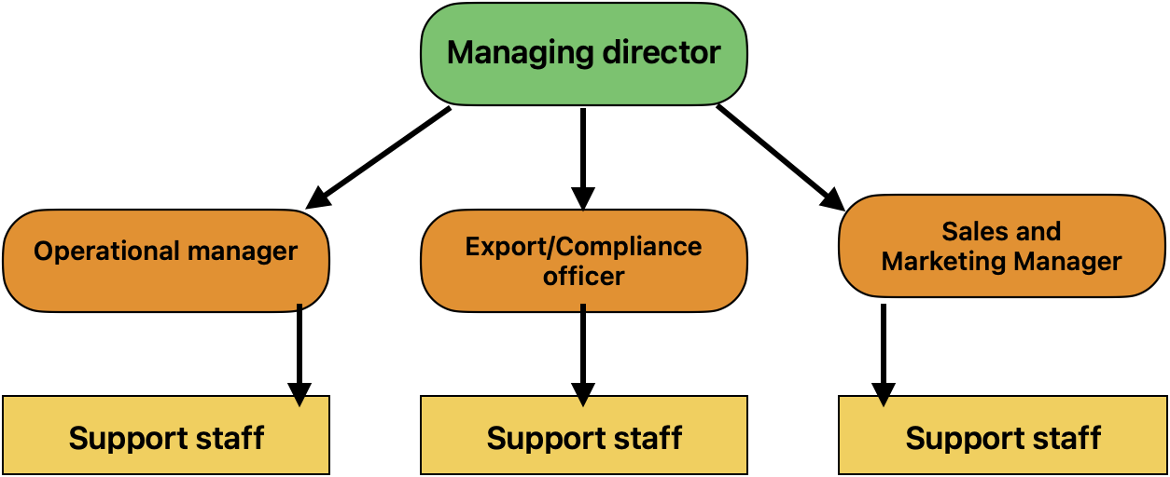
Legal structure and Management team
Company Incorporation: Private Limited Company.
Koi Ceylon Pvt Ltd is a Private Limited Company that provides limited liability, professional credibility in the European business ventures, and the acquisition of capital easily (GOV.UK, 2025).
Compliance & Certifications
The company has all the export licenses, EU health certifications and follows the DFAR standards and the EU animal welfare measures with strict biosecurity measures (Industry Capability Report, 2025).
Management Team
A lean workforce with Managing Director, (business strategy) as its head, Operations Manager (breeding and logistics), Export-Compliance Officer (legal documentation) and Sales and Marketing Manager (customer relation) with technical and administrative staff.
Organizational Efficiency
This design guarantees a transparent degree of accountability, effective decision-making, and proper compliance management and allows scaling up the operations (Industry Capability Report, 2025).

Slide 13
Financial Highlights
Start-up Costs & Investment: The facility needs USD 25,000-50,000 to set up facilities, equipment, broodstock purchases, disease control systems, manpower, export paperwork and marketing. The sources of funding are owner equity, bank loans, and government grants in the export businesses (Industry Capability Report, 2025).
12-Month Operating Forecast: The monthly operating costs will be around USD 2,000 (feed, wages, utilities, transport, exports). The sales revenue will be USD 5,000/month and the gross profit of USD 3,000/month with a net profit estimated at USD 15,000-20,000/year ( Industry Capability Report, 2025).
Financial Viability: A high level of financial forecasts prove the profitability of the first year of operations when there is positive cash flow and the possibility to reinvest in the development of the facility, more advanced breeding methods, and expansion to the market (Industry Capability Report, 2025).
Long-Term Financial Growth: It is likely that increased volumes of exports, high prices on rare breeds, and the diversification of the market in various European countries will lead to greater revenues and higher profit margins over a period of more than two years (DHR, 2025; EMR, 2025).

Slide 14
References
Andrian, K.N. et al. (2024) A comprehensive review of current practices, challenges, and future perspectives in Koi fish Cyprinus carpio var. koi cultivation, Veterinary World, 178, pp. 1846–1854. Available at: https://doi.org/10.14202/VETWORLD.2024.1846-1854.
Ceylon Koi Society (2025) Welcome to the home of Koi hobbyists of Sri Lanka. Available at: https://www.ceylonkoisociety.com (Accessed: 22 November 2025).
DHR (2025) Koi Market Size, Growth Statistics Forecast Report - 2033. Available at: https://www.datahorizzonresearch.com/koi-market-56579 (Accessed: 22 November 2025).
EDB (2025) Export Potential of Ornamental Fish Industry in Sri Lanka - EDB Sri Lanka. Available at: https://www.srilankabusiness.com/aquarium-fish/exporter-information/ornamental-industry-export-potential.html (Accessed: 22 November 2025).
EMR (2025) Koi Market 2025-2034 Forecast Size, Growth Insights. Available at: https://www.expertmarketresearch.com/reports/koi-market (Accessed: 22 November 2025).
GOV.UK (2025) Importing or moving live fish and shellfish - GOV.UK. Available at: https://www.gov.uk/guidance/import-or-export-live-fish-and-shellfish (Accessed: 22 November 2025).
Haritha Fish Farm (2025) Haritha Fish Farm. Available at: https://www.harithafishfarm.com (Accessed:
22 November 2025).
Industry Capability Report (2025) Industry Capability Report. Available at: https://www.srilankabusiness.com/ebooks/industry-capability-report-ornamental-fish-industry-2025.pdf (Accessed: 22 November 2025).
Koi Global Market Report (2025) Koi Global Market Report 2025 - Research and Markets. Available at: https://www.researchandmarkets.com/reports/5895233/koi-global-market-report (Accessed: 22 November 2025).
Thilakarathna, N. (2024) The Ornamental Fish Industry in Sri Lanka. Available at: https://highrayz.com/the-ornamental-fish-industry-in-sri-lanka (Accessed: 22 November 2025).

Slide 15
THANK YOU

