Slide 1
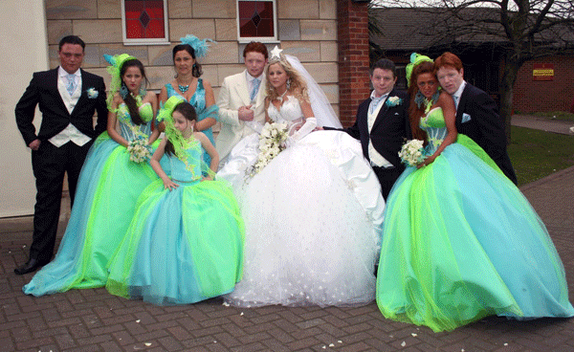

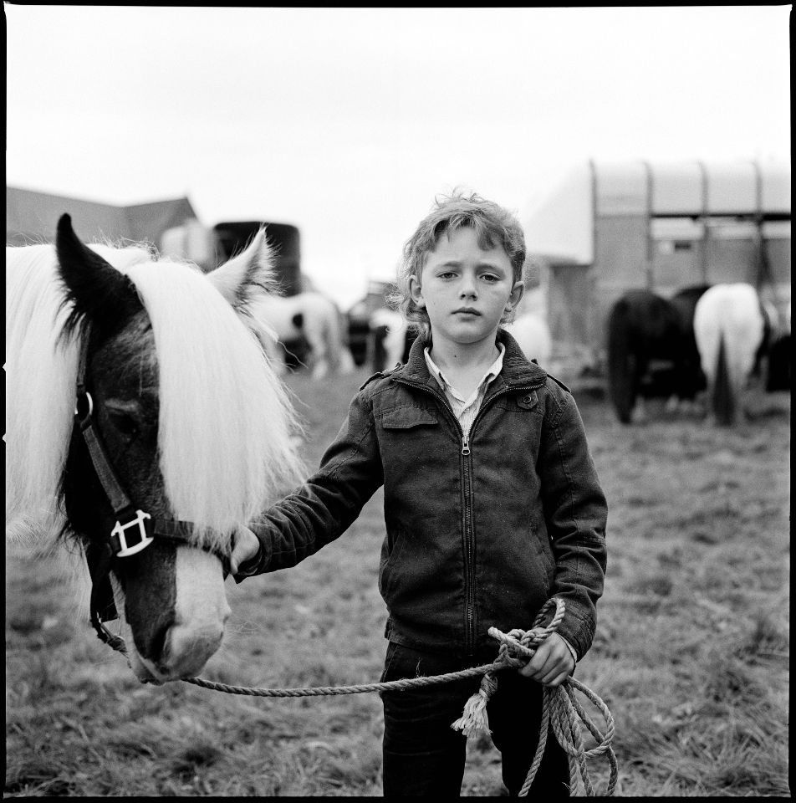

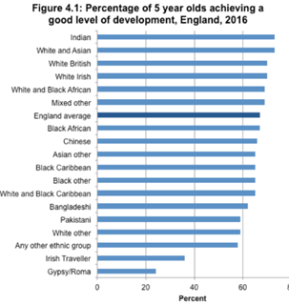

Gypsy-Traveller Culture
M5X02165 – Culture, Identity and Education
Victoria Lee - 1903949
What is culture?
Gypsy-Traveller Culture
Statistics
These biases are potentially hindering education, causing a lack of enthusiasm from teachers (Derrington and Kendall, 2008).
Although there are failings within the educational systems, it is not the sole reason for poor attainment parental or cultural attitude is also a barrier to education.
Estyn (2019a) have found that around half of the parents in this community decide to take their children out of school prior to reaching secondary school. This could be for a number of reasons, including:
Concerns about drug use
Bullying
Cultural dilution
Inappropriate curriculum
(Fernsham-Smith, 2014)
Bhopal(2004) suggest that these apprehensions could be based on judgements from their own experience, although Casey (2014) indicates that this attitude has shifted slightly in recent years.
In 1892, James Buckham, a writer in the Journal of Education suggested that culture was ‘well-nigh indefinable’. Since then, there have been various attempts at defining culture from the perspective of educators, psychologists and theorists.
Some examples include:
In 1985, anthropologists, Kruper and Kruper (cited in Giles and Middleton, 2008) broadly define culture as the way in which a societal groups live their lives.
Welsh Marxist theorist Williams (1976) argued that each person belongs to more than one culture, for example, nationality and religion.
Hall and Hall (1990) suggest that culture is outlined by principles and values that underline the basic beliefs and rules that people live by. However, they also indicated that some of these guidelines may not solely be observed by one culture alone.
More recently, culture has been defined as something that has continually developed alongside the human nature to survive and thrive, continually adapting to the world (Matsumoto, 2007).
With Durham and Kellner (2006) supporting this theory, indicating that culture evolves with each generation.
(Unknown, 2019, ‘Aspects of Culture’, available at: shutterstock_300876815.jpg (1643×1080) (pcdn.co))
Although normally known as Roma, Gypsies or Travellers, there are a variety of cultures that are encompassed within this term for instance, Romani Gypsies, Irish Travellers and Occupational Travellers (Bhopal, 2011).Each of these cultures have similarities that include nomadism (Lally, 2015) as well as strong family and community ties (The Traveller Movement, 2021).
Many of these cultures also have a visible gender divide, even from a young age, with the men seen as the providers and the women as the nurturers of the family (Okely, 1983). Most Gypsy-Traveller women continue the tradition of staying at home and fulfil the role of housewife and looking after the children. Some still following the Mochadi Law, which are strict rules that guide their cleaning practices, which is often contrary to the media portrayal (Friends, Family and Travellers, 2009). The men go out to work, from a young age, learning to follow in the footsteps of their fathers or grandfathers (Women and Equalities Committee, 2019).
(Left: The Mirror, no date, ‘Gypsy Kids’ available at: Gypsy-Kids.jpg (615×680) (mirror.co.uk) Right: Unknown, no date ‘One Boy and His Horse’ available at: b8775b247855dde8d925525db48ac756.jpg (952×960) (pinimg.com))
Even though there are comparisons that can be made, the differences between the cultures are varied and can involve several:
Customs,
Languages
Religions (Le Bas, 2019).
A major difference is also that not all of these groups are classed as ethnic travellers, some are simply considered to be cultural travellers. Under the Equality Act (2010) Cultural Travellers, such as New Age Travellers (Parliament, Houses of Commons, 2019) are not legally protected by the Equality Act (2010), although every person is covered by the Human Rights Act (1998).
The Office for National Statistics (2014) stated there were approximately sixty-three thousand people in the United Kingdom that identified as Gypsy or Irish Traveller.
This was the first opportunity that this ethnic minority were recognized in the Census, prior to this, they would have been recorded under “White Other” (Webb, 2019).
Amnesty International (2013) estimated that there are approximately three hundred thousand travellers in the United Kingdom.
Two thirds of this community are now choosing to live in standard housing.
The Race Disparity Audit (2017) provides eye-opening information about the reality of the struggle that people, especially children, from the Gypsy-Traveller community face. This is evident in all aspects of life, from healthcare to education (Travellers Times, 2016).
Negative Media and Societal Attitude
Attainment
The Disparity Audit (2017) described the attainment gaps of children from the Gypsy-Traveller community, proving they are significantly lower than the average child. This could be due to several problems including attendance, attitude, bullying or higher rates of exclusion (Gilmore, McDonagh, Garrett, Kirkby and Stapleton,
2020).
(Race Disparity Audi, 2017)
(The Guardian, no date, Gypsy Wedding. Available at: gypsy5_1805748a.gif (600×420) (telegraph.co.uk))
People’s perceptions of Gypsy-Travellers are often influenced by negative media (Holland, 2016), leading to stereotyping, prejudice and causing a further divide within the wider community.
Television shows such as ‘My Big Fat Gypsy Wedding’ and ‘The Truth About Traveller Crime’ broadcast on Channel Four, portray this community in a desperately exaggerated capacity for the purposes of entertainment. The use of derogatory language inciting hate crime and potentially, damaging the future of the children of this culture. Unfortunately, due to a history of poor relationships between the Gypsy-Traveller community and the police, it is unlikely that any hate crime would be reported (Women and Equalities Committee, 2019).
Impact on Identity
Our identity will be shaped from the culture that we grow up in, culture will have an influence on each aspect of your life, from the decisions that are made to the paths you take. Our life experiences will continue to define our personality, attitudes, and beliefs (Kidd and Teagle, 2012).
(Unknown, no date, ‘Who Am I?’ available at: maxresdefault.jpg (1280×720) (ytimg.com))
Conclusion
The Gypsy-Traveller community continue to be a marginalised ethnic and cultural group. In general, they are living within wider communities cohesively, however, as with any culture, there will be small pockets that the media choose to focus on in order to continue the negative discourse and provoke conflict. The new strategies should empower the Gypsy-Traveller community to gain improved access to facilities and with time, enable more children to remain in education, thus improving the socio-economic outcomes for the culture as a whole.
Attitudinal Impact on Education
Most Gypsy-Traveller children feel that their culture is looked down upon and that they are treated as less deserving of their education (Anti-Bullying Alliance,2020). Many Gypsie-Traveller pupils are victims of subjectivity, from their peers and the school staff (Simbo, Bennett and Pidcock, no date).

Slide 2

Reference list
Amnesty International (2013) Travellers’ Rights. Available at: Travellers' Rights | Amnesty International (accessed: 09th January 2021).
Anti-Bullying Alliance (2020) Bullied, Not Believed and Blamed. Available at: GRT report - FINAL_0.pdf (anti-bullyingalliance.org.uk) (accessed: 04th January 2021).
Bhopal, K (2004) ‘Gypsy Travellers and Education: Changing Needs and Changing Perceptions’, British Journal of Educational Studies, 52(1), pp. 47-64. Available at: Gypsy Travellers and Education: Changing Needs and Changing Perceptions on JSTOR (uwtsd.ac.uk) (accessed: 08th January 2021).
Bhopal, K (2011) ‘This is a School, it’s not a Site: Teachers’ Attitudes towards Gypsy and Traveller Pupils in Schools in England, UK’ British Educational Research Journal. 37(3), pp 465-483. Available at: https://www.jstor.org/stable/25822380 (accessed: 04th January 2021).
Buckham, J (1892) ‘What is Culture?’ Journal of Education, 36(24). Available at: WHAT IS CULTURE ? (uwtsd.ac.uk) (accessed: 3rd January 2021).
Cabinet Office (2018) Race Disparity Audit. Available at: Microsoft Word - Revised RDA report March 2018.docx (publishing.service.gov.uk) (accessed: 02nd January 2021).
Casey, R. (2014) '"Caravan wives" and "decent girls": Gypsy-Traveller women's perceptions of gender, culture and morality in the North of England', Culture, Health & Sexuality, 16(7), pp. 806–819. Available at: ‘Caravan wives’ and ‘decent girls’: Gypsy-Traveller women's perceptions of ...: EBSCOhost (uwtsd.ac.uk) (accessed: 04th January 2021).
Cemlyn, S (2008) ‘Human Rights and Gypsies and Travellers: An Exploration of the Application of a Human Rights Perspective to Social Work with a Minority Community in Britain’, British Journal of Social Work, 38, pp. 153–173. Available at: BCL38(1).book(bcl349.fm) (uwtsd.ac.uk) (accessed: 08th January 2021).
Channel Four (2020) The Truth about Traveller Crime. Available at: The Truth About Traveller Crime - On Demand - All 4 (channel4.com) (accessed: 09th January 2021).
Derrington, C. and Kendall, S (2008) ‘Challenges and Barriers to Secondary Education: The Experiences of Young Gypsy Traveller Students in English Secondary Schools.’ Social Policy and Society, 7(1), pp. 119-128. Available at: Challenges and Barriers to Secondary Education: The Experiences of Young Gypsy Traveller Students in English Secondary Schools - ProQuest (uwtsd.ac.uk) (accessed: 03rd January 2021).
Durham, M.G & Kellner, D.M (2006) Media and Cultural Studies: Keyworks. Oxford: Blackwell Publishing.
Equality Act (2010) Available at: Equality Act 2010 (legislation.gov.uk) (accessed: 03rd January 2021).
Estyn (2019a) Provision for Secondary School-Aged Gypsy, Roma and Traveller Pupils. Available at: Thematic survey report (gov.wales) (accessed: 11th January 2021).
Estyn (2019b) More Gypsy, Roma and Traveller Pupils Attend School, but Further Support Needed. Available at: More Gypsy, Roma and Traveller pupils attend school, but further support needed | Estyn (gov.wales) (accessed: 10th January 2021).
Fensham-Smith, A (2014) Gypsy and Traveller Education: Engaging Families – A Research Report. Available at: 141125-gypsy-traveller-education-engaging-families-summary-en.pdf (gov.wales) (accessed 04th January 2021).
Friends, Families and Travellers (2009) Supporting Gypsies and Travellers Living with Domestic Violence. Available at: 10_06_09 DV leaflet.pdf (gypsy-traveller.org) (accessed: 07th January 2021).
Friends, Families and Travellers (2020) Crystals Vardo. Available at: FFT_Teaching-Materials-2020_v12.pdf (gypsy-traveller.org) (accessed: 04th January 2021).
Giles, J. and Middleton, T (2008) Studying Culture: A Practical Introduction. United Kingdom: Wiley.
Gilmore, V., McDonagh, C., Garrett, J., Kirkby, A. and Stapleton, P (2020) Friends, Families and Travellers and the Traveller Movement Joint Submission to the Committee on the Rights of the Child. Available at: Committee-on-Rights-of-the-Child.pdf (gypsy-traveller.org) (accessed: 03rd January 2021).
Greenfields, M. and Smith, D.M (2010) ‘Housed Gypsy Travellers, Social Segregation and the Reconstruction of Communities.’ Housing Studies, 25(3), pp. 397-412. Available at: Housed Gypsy Travellers, Social Segregation and the Reconstruction of Commu...: EBSCOhost (uwtsd.ac.uk) (accessed: 10th January 2021).
Hall, E.T. and Hall, M.R. (1990) Understanding Cultural Differences. Yarmouth: Intercultural Press.
Holland, S (2016) Challenging the Negative Media Reporting of Gypsies and Travellers. Available at: CCW27176-Childrens-Commissioner-for-Wales-proof-English-1.pdf (childcomwales.org.uk) (accessed: 02nd January 2021).
Kidd, W. and Teagle, A (2012) Culture and Identity. 2nd Ed. Basingstoke: Palgrave MacMillan.
Lally, S (2015) ‘Gypsies and Travellers: Their History, Culture and Traditions’. Community Practitioner, 88(1), pp. 30-33. Available at: Gypsies and Travellers: their history, culture and traditions - ProQuest (uwtsd.ac.uk) (accessed: 03rd January 2021).
Le Bas, D (2019) ‘Roads from the Past: A Short History of Britain’s Gypsies, Roma, and Travellers’ Travellers Time, Available at: Roads from the Past: A Short History of Britain's Gypsies, Roma and Travellers | Travellers Times (accessed: 06th January 2021).
Matsumoto, D (2007) ‘Culture, Context and Behaviour.’ Journal of Personality, 75(6), pp 1287-1320. Available at: untitled (davidmatsumoto.com) (accessed: 02nd January 2021).
Office for National Statistics (2014) Census Analysis: What does the 2011 Census tell us about the Characteristics of the Gypsy and Irish Travellers in England and Wales? Available at: 2011 Census analysis - Office for National Statistics (ons.gov.uk) (accessed: 04th January 2021).
Okely, J (1983) The Traveller-Gypsies. Cambridge: Cambridge University Press
Parliament. House of Commons (2019) Gypsies and Travellers (HC08083) London: The STationaryt Office.
Pembrokeshire County Council (no date) Specialist Services and Provision. Available at: Gypsy Traveller Education - Pembrokeshire County Council (accessed: 11th January 2021).
Simbo, T., Bennett, L., and Pidcock, L (no date) Gypsy, Roma and Traveller Children in the Welsh School System: Promoting Equality and Tackling Racism. Available at: Layout 1 (squarespace.com) (accessed: 09th January 2021).
The Traveller Movement (2021) About Us: Gypsy, Roma, Traveller History and Culture. Available at: The Traveller Movement - Gypsy Roma Traveller History and Culture (accessed: 02nd January 2021).
Travellers Times (2016) Marc Willers QC Calls Time on ‘The Last Acceptable Racism’. Available at: Marc Willers QC calls time on ‘the last acceptable racism’ | Travellers Times (accessed 08th January 2021).
UNCRC (1992) Convention on the Rights of the Child. Available at: UNCRC_summary-1_1.pdf (unicef.org.uk) (accessed: 11th January 2021).
Webb, E (2019) ‘An Invisible Minority: Romany Gypsies and the Question of Whiteness’. Romani Studies, 29(1), pp 1-25. Available at: An invisible minority: Romany Gypsies and the question of whiteness - ProQuest (uwtsd.ac.uk) (accessed: 04th January 2021).
Welsh Government (2020) Black, Asian and Minority Ethnic Communities, Contributions and Cynefin in the New Curriculum Working Group. Available at: Numeracy Employer Engagement Grant: (gov.wales) (11th January 2021).
Welsh Government (2018) Enabling Gypsies, Roma and Travellers. Available at: Enabling Gypsy, Roma & Traveller (gov.wales) (accessed: 04th January 2021).
Williams, R (1976) Keywords: A Vocabulary of Culture and Society. New York: Open University Press
Women and Equalities Committee (2019) Tackling Inequalities faced by Gypsy, Roma and Traveller Communities. Available at: Tackling inequalities faced by the Gypsy, Roma and Traveller communities (parliament.uk) (accessed: 09th January 2021).

