Slide 1

MODULE NAME Presentation
MODULE CODE LCLM4004 LON
STUDENT NAME Ryan Nico Jasper
STUDENT ID 2531287
LECTURER Charles Obinwa
Assignment 1: Presentation

Slide 2
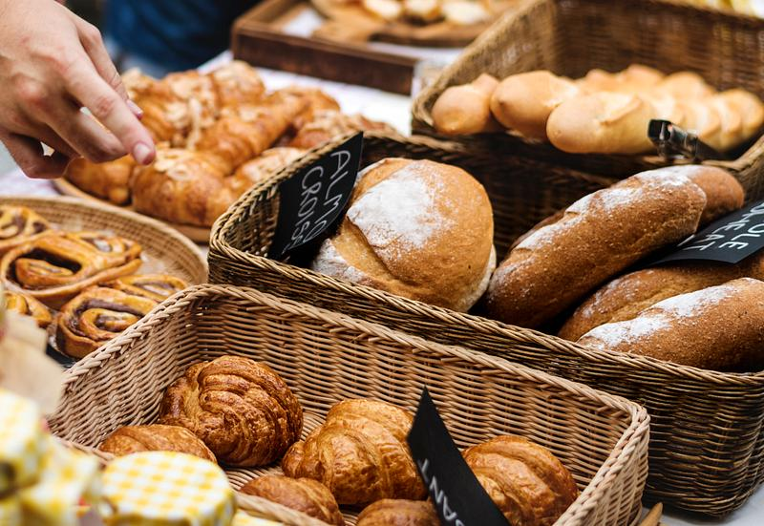
OVERVIEW
Introduction
Company background
Problem: nature and scope
PESTLE ANALYSIS: Basil’s Bakery
Cause and effect analysis: Fishbone diagram
Conclusion
References

Slide 3
Introduction
What the presentation is about?
This presentation analyses Basil's Bakery, a small independent bakery in Coventry, UK. It examines the reasons why the business has experienced stagnant sales since the COVID-19 pandemic and evaluates the internal and external factors affecting its performance. The presentation also proposes solutions to improve business growth and long-term sustainability.
Definitions of the concepts you are going to use:
5W2H Model – A problem-solving framework that asks What, Why, Where, When, Who, How, and How Much to understand a business issue and identify solutions. PESTEL Analysis – A strategic tool used to examine the Political, Economic, Social, Technological, Environmental, and Legal factors that influence a business. Fishbone (Cause-and-Effect) Diagram – A quality management tool that identifies the root causes of a business problem by grouping causes into different categories.

Slide 4
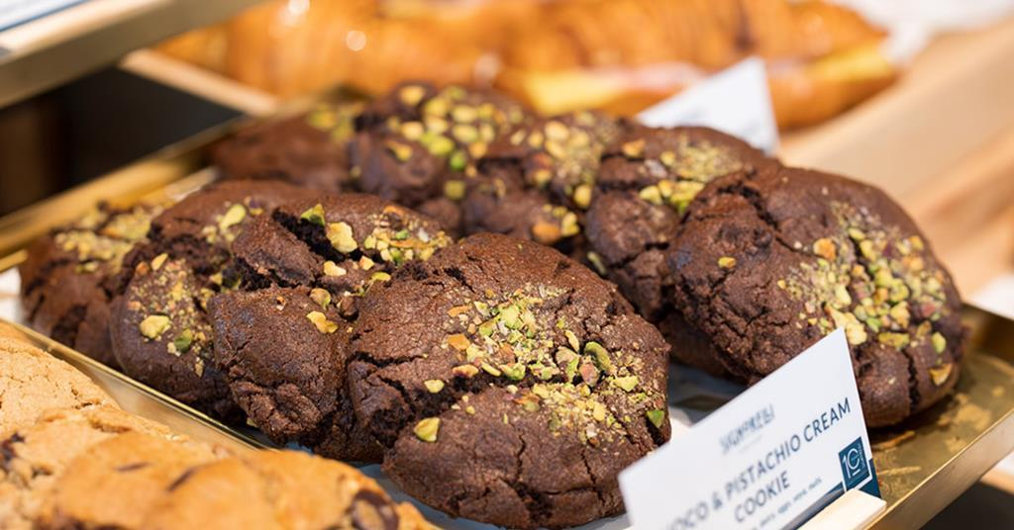
Company background
Basil’s Bakery
Founded in 2015
Owners: Basil
Sells Organic Breads, Cakes and Pastries
Add more information from the case study
Founded in 2015.Located in Coventry, UK.Owned by Basil, an artisan baker. Sells organic breads, cakes and pastries.Serves shoppers, retail, office and warehouse workers.
Sales have remained 25% below 2019 levels since 2023.Facing lower customer numbers and rising operating costs.
Looking for ways to increase sales and grow the business.

Slide 5
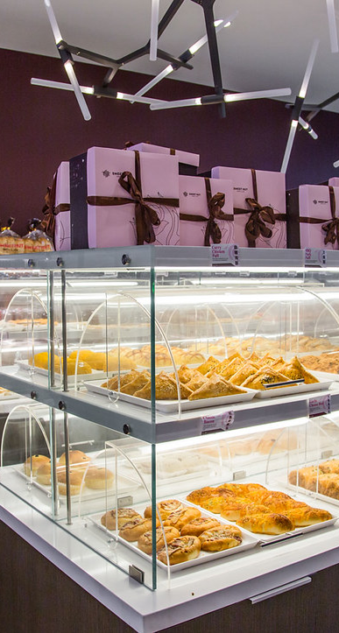
Problem: nature and scope
5W2H
What: Sales have stagnated and remain 25% below 2019 levels.
Who: Basil, employees and customers.
Where: Basil's Bakery, Coventry retail park, UK.
When: Since the COVID-19 pandemic (2020–2025).
Why: Lower footfall, shop closures, home working and rising cost
How: Fewer customers and higher operating costs reduce sales and profit.
How much: Sales are approximately 25% below 2019 levels.
Ryan Bico Jasper

Slide 6
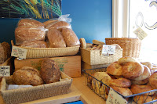
PESTLE ANALYSIS: Basil’s Bakery
POLITICAL 2 ideas for each factor:
Government food safety regulations.
Business rates and taxation policies.
ECONOMIC:
Rising costs of rent, utilities and insurance.
Inflation has increased the cost of organic ingredients.
SOCIAL:
More people work from home.
Fewer visitors to the retail park.
Technological no delivery service available.
Limited pre-order/phone ordering system.
Ryan Nico Jasper

Slide 7
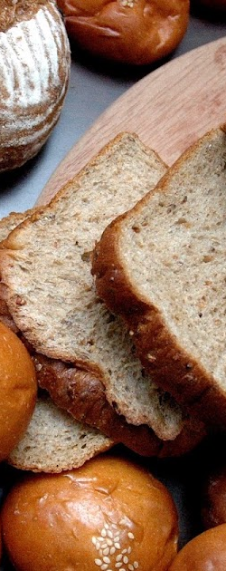
PESTLE ANALYSIS: Basil’s Bakery
TECHNOLOGICAL :
No delivery service available.
Limited pre-order/phone ordering system.
LEGAL :
Compliance with food hygiene regulations.
Employment and health & safety laws.
ENVIRONMENTAL :
Organic ingredients affected by poor crop yields.
Sustainable sourcing increases cost
Ryan Nico Jasper

Slide 8
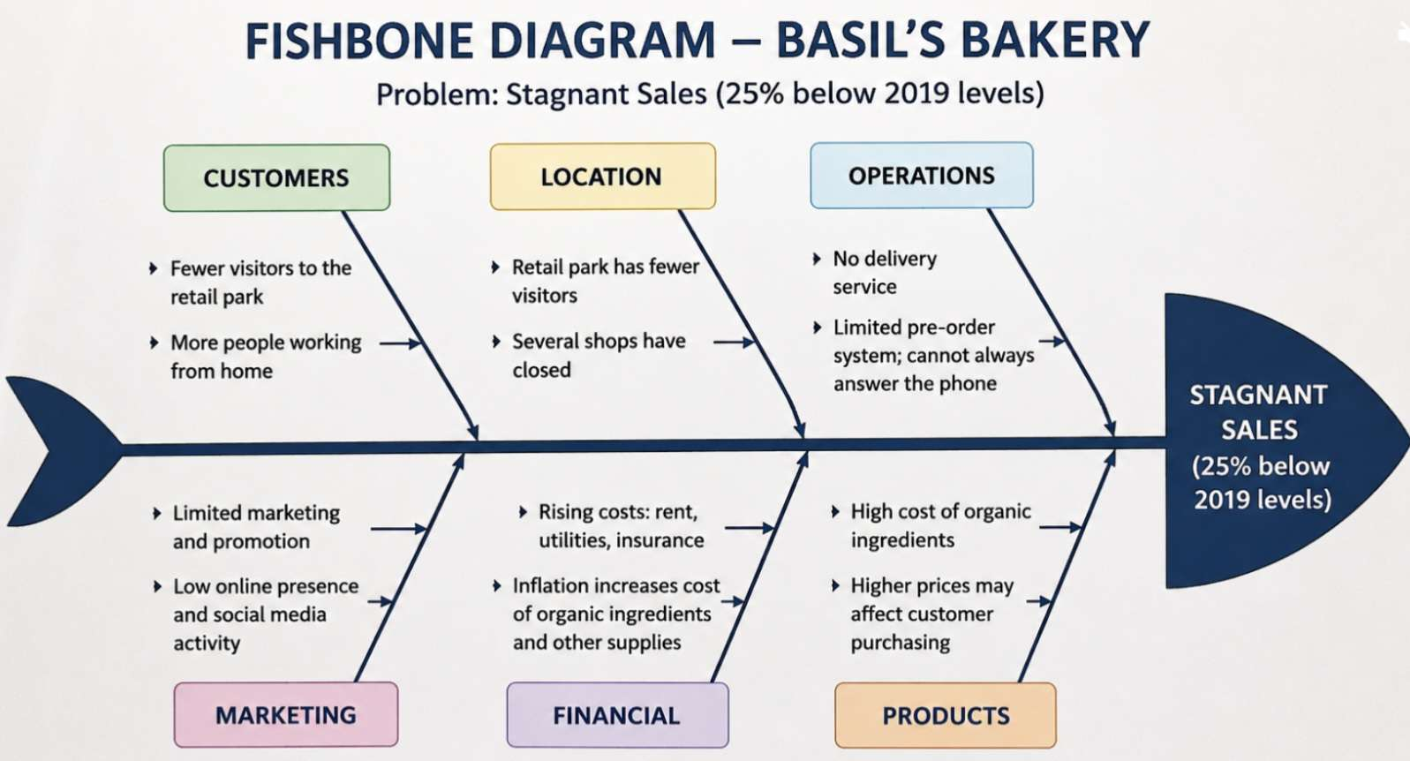
Cause and effect analysis (Fishbone diagram)
`

Slide 9
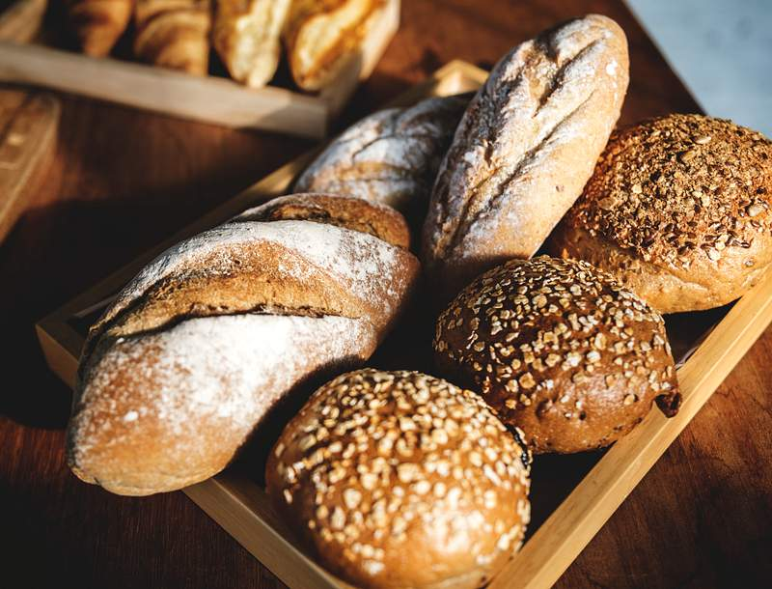
Conclusion
Basil's Bakery is facing declining sales and rising operating costs.
The main causes are lower customer footfall, home working, shop closures and inflation.
The PESTLE and 5W2H analyses identified the key internal and external challenges.
Introducing online ordering, delivery and improved marketing could increase sales.
By adapting to customer needs, Basil's Bakery can improve profitability and achieve long-term sustainability.

Slide 10
References
Harvard-style sources: Kotler, P. and Keller, K.L. (2022) Marketing Management. 16th end.
Harlow: Pearson Johnson, G. Scholes, K. and Whittington, R. (2020) Exploring Strategy. 12th end.
Harlow: Pearson. Chartered Institute of Personnel and Development (CIPD) (k knowledge/factsheets/pestle-analysis-factsheet (Accessed: 12 July 2026).
Mind Tools (2024) Fishbone e Diagram (Cause and Effect Analysis).
Available at: https://www.mindtools.com (Accessed: 12 July 2026).
Office for National Statistics (ONS) (2025) Inflation and cost of living in the UK. Available at: https://www.ons.gov.uk (Accessed: 12 July 2026).

Slide 11

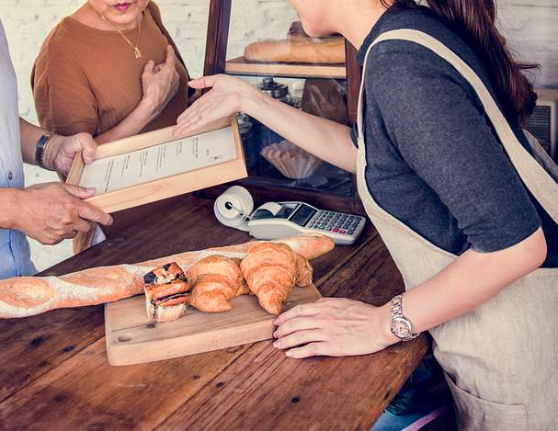
Questions

