Slide 1

Academic Writing
LCLM4001

Slide 2
In the session today
Composition of sentences
Composition of paragraphs
Using data
Planning your assignments
-

Slide 3
How sentences work.
Different types of sentence
Simple sentences
Compound sentences
Complex sentences
Notes:
Previous cohorts of students have highlighted the need for this level of support.

Slide 4
Simple sentences
Simple sentences have a subject (the person or thing doing the action) and a verb, sometimes followed by a phrase of other information. Together these make sense as a unit.
Plants require sunlight and water.
Nurses work long hours.
Simply sentences can be useful when stating a fact or statistic.
Simple sentences can have impact.

Slide 5
Simple Sentences
SUBJECT + VERB (+ OBJECT and MODIFIER).
A complete thought or idea.
Key: Blue, bold = subject; green underline = verb, purple, italics = object,grey, regular font =prepositional phrase
EXAMPLES:
She wrote.
She completed her literature review.
He organized his sources by theme.
They studied Harvard rules for many hours.

Slide 6
Compound sentences
These are two simple sentences joined usually by and or but. There will be TWO VERBS in this combined sentence.
Social care requires resilience and managers must support their workforce.
Can you create a compound sentence that describes a job role?
When would you use a compound sentence?
Notes:
Compound sentences are useful for joining basic ideas or for extending a basic description.

Slide 7
Compound Sentences
Key: independent clause = blue, bold; comma or semicolon = pink,
regular font; coordinating conjunction = green, underlined
Here are a few examples:
She completed her literature review, and she created her reference list.
He organized his sources by theme; then, he updated his reference list.
They studied APA rules for many hours, but they realized there was still much to learn.
Using some compound sentences in writing allows for more sentence variety.

Slide 8
Complex sentences
These sentences have a main clause and subordinate clauses. A main clause is a unit of meaning built around a verb. A subordinate clause also contains a verb but it would not make sense if it was written on its own but often provides depth of description to the main clause.
Employment legislation protects the rights of workers, especially when they are not treated according to UK law.
Can you identify the main clause and subordinate clause in the complex sentence above?
When would a complex sentence be useful in your writing?
Notes:
Complex sentence are the most common sentences used in academic writing, as these sentence allow the writer to add depth and detail to the broad points made.

Slide 9
Complex Sentences
Key: independent clause = blue, bold; comma = pink, regular font; dependent
clause = green, italics
Although she completed her literature review, she still needed to work on her methods section.
  Note the comma in this sentence because it begins with a dependent clause.
Because he organized his sources by theme, it was easier for his readers to follow.
  Note the comma in this sentence because it begins with a dependent clause.
They studied Harvard Referencing rules for many hours as they were so interesting.
  Note that there is no comma in this sentence because it begins with an independent clause.
Using some complex sentences in writing allows for more sentence variety.

Slide 10
Identify the following sentences
I study Business.
I live in Birmingham but work in Warwick.
Even though he studies hard, he still failed the test.
The economy improved and unemployment fell by20 percent.
Whenever it rains, I always take an umbrella.
In the UK, every Saturday at 11am, I go to the gym.

Slide 11
Sentences Activity – 30 mins.
Using a source for your task 2 Academic report assignment.
Write a simple sentence.
  Can you extend this simple sentence with and or but to become a compound sentence?
  Using your first simple sentence, can you add a subordinate clause to form a complex sentence that adds depth or detail to your original point?
  Are you able to add an in-text citation to your final sentence?
Notes:
This activity could be done individually, as a small group or as a whole group. In class students should share their ideas with their lecturer and online students should email their lecturer with their attempts.
Remind students that these sources are available in Week 2 – Your four sources folder.

Slide 12

How paragraphs work
A paragraph is a unit of text which usually contains several sentences.
Topic Sentence
Supporting Sentences
Concluding Sentence
Let’s look at an example together.
Notes:
Supporting Sentences – Can include:
Reasons
Examples
Facts
Statistics
Quotations.

Slide 13
Example adapted from Oshima and Hogue (2010, p17)
Supporting sentences
Topic sentence
Gold, a precious metal, is prized for two important characteristics. First of all, gold has a lustrous beauty that is resistant to corrosion. Therefore, it is suitable for jewellery, coins, and ornamental purposes. Gold never needs to be polished and will remain beautiful forever. For example, a Macedonian coin remains as untarnished today as the day it was made 25 centuries ago. Another important characteristic of gold is its usefulness to industry and science. For many years, they have been used in hundreds of industrial applications, such as photography and dentistry. The most recent use of gold is in astronauts’ suits. Astronauts wear gold-plated heat shields for protection when they go outside spaceships in space. Silver is also very valuable. In conclusion, gold is treasured not only for its beauty but also for its utility.
Concluding Sentence
Notes:
Elicit Topic, Supporting, and Concluding Sentences from students.

Slide 14
Example adapted from Day (2018, p168)
Coronary heart disease (CHD) is a problem that is increasing in many countries as a result of changes in modern lifestyle. In the United States, for example, CHD now causes more than half of human deaths (Paolo,2016). Many factors increase the risk of CHD, all with a common outcome – the build up of fatty deposits within coronary arteries, known as atherosclerosis (BHF, 2021). Atherosclerosis is one of the effects created by cholesterol build up on the artery walls, suggesting diet is likely to be a contributory factor in CHD, (Paolo, 2016). Other lifestyle choices, such as smoking and lack of exercise, are also predisposing factors, (BHF, 2021).
Notes:
Read through the paragraph and identify which sentences provides an outline of the topic, which sentences develop the topic further and decide if the final sentence concludes the topic or links to further discussion. Consider highlighting each as you discuss.
If you want to explore the PEE (Points, Evidence, Explanation) style of paragraphing you can but please ensure that this is shown as achieving the same aims, for novice students the ‘explain’ element may feel challenging which is why we have emphasised the ‘conclude’ or ‘link’ element that is crucial for basic paragraphing.

Slide 15
Paragraph activity- 30 Mins
Complete the ‘Paragraph activity’,
Highlight or annotate which sentences outline, develop or conclude the topic being discussed.
Notes:
This activity will be found on Moodle as a pdf printable (for in class students to be given) and a word version that is editable for online students to complete and email. A moodle version is available that can be completed directly on Moodle.

Slide 16

Using data

Slide 17

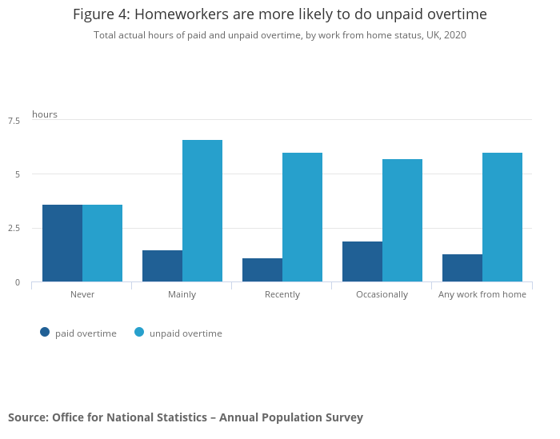
Using data in your work
Data refers to numerical results from research.
We can include data in a sentence or as a graph, table or image.
You must always cite and reference the source of your data.
Using data can support and develop your points and helps you to achieve higher marks for criterion 3.
Figure 1 – Graph to show Unpaid Overtime worked by homeworkers, (ONS, 2021)
Notes:
If needed, display the assignment brief and highlight the criterion 3 expectation to use data to support and justify the points made in their writing.
Source data taken from ONS website https://www.ons.gov.uk/employmentandlabourmarket/peopleinwork/labourproductivity/articles/homeworkinghoursrewardsandopportunitiesintheuk2011to2020/2021-04-19

Slide 18
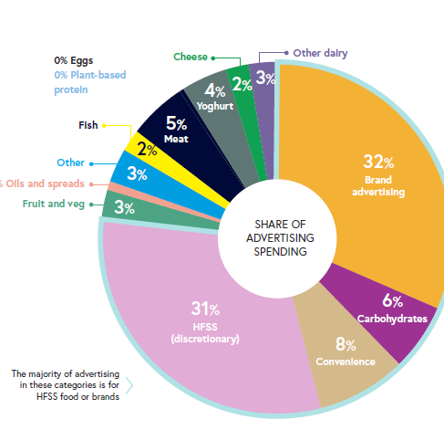
Can you build a sentence around data?
Using the pie chart displayed here, can you identify a statistic to build a sentence with?
For example, 4% of advertising spending is spent on yogurt.
Can you build a sentence around the statistic you have identified?
Figure 1 – Pie chart to show the share of advertising spending, source: Cancer Research UK (2019)
Notes:
This activity can be done individually, as a small group or as a whole group. Sentences can be written out or verbally suggested. How many different sentences can be developed from this same pie chart?
Data taken from ONS 2021 https://www.ons.gov.uk/employmentandlabourmarket/peopleinwork/earningsandworkinghours/bulletins/genderpaygapintheuk/2021

Slide 19

Activity – Using data - 30mins
Complete the using data activity.
Reflect – do you feel confident about using data in your written work?
Notes:
This activity will be found on Moodle as a pdf printable (for in class students to be given) and a word version that is editable for online students to complete and email, alternatively there is an Online accessible Moodle version available in week 4.

Slide 20
Beginning your assignment

Slide 21
Before you begin.
Godwin (2019,p9) outlines seven pieces of information that you need prior to beginning your assignment.
Deadline
Word Count
Format/structure
Percentage worth
Learning outcomes
Professional outcomes
Assessment criteria

Slide 22



Divide your word count
10%
introduction
80%
main body
10%
conclusion
These are only guidelines and sometimes you will vary this distribution of words, just ensure that you plan how you want to organise your wordcount.

Slide 23
Dividing up the main body
word assignment 1000 = 100 intro, 800 main body, 100 conclusion
Main body – 1600
2 x 400 word sections – (divided into paragraphs).
Or
4 x 200 word sections - (divided into paragraphs).
Or
5 x 150 word sections - (divided into paragraphs).

Slide 24
Plan your task timeline
Gathering information
Processing information
Creating the text
Editing and reviewing
Final checks
Submit
Notes:
Could mention GANTT CHARTS – Students can create their own chart using a Table in Word, or a Spreadsheet in Excel

Slide 25
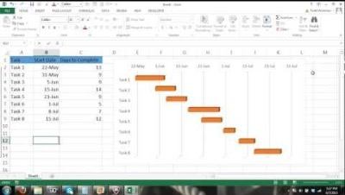
Create a GANTT Chart for Task 2 Assignment
Using Excel Spreadsheet:

Slide 26
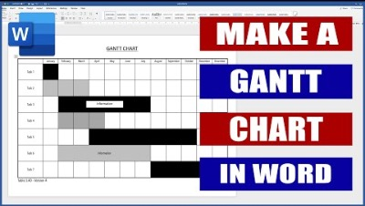
Create a GANTT Chart for Task 2 Assignment
Using MS Word

Slide 27
Activity – Assignment planning –
30 mins
Plan your composition timeline and wordcount for your task 2 academic report.
Notes:
This activity will be found on Moodle as a pdf printable (for in class students to be given) and a word version that is editable for online students to complete and email.

Slide 28
Next week – Assessment &Workshops
30min quiz assessment – in class – on paper – 15questions.
Task 2 WORKSHOP - you will have the opportunity to begin drafting your task 2 academic
Lecture support will provide feedback on your ideas and drafts.
Any key academic writing concepts that you wish to revisit can be revised with lecture support.
Also, Presentation Skills Workshop
  - In your BMSW4003_BIRM you have a presentation assessment in week 6, so we will be providing you with some pointers on how to present effectively.

Slide 29
References
Cancer Research UK (2019) as cited in NFS Evidence (2021) National Food Strategy, Evidence, [online report] Available at https://www.nationalfoodstrategy.org/ (accessed 1st Oct 2021)
Day, T (2018) Success in Academic Writing, 2nd edition, London: Palgrave
McMillan, K. and Weyers, J. (2014) Academic Writing for Success, Harlow: Pearson

