Slide 1
A Contemporary
Strategy Formulation Framework for Avon
Prepared & Presented by Ade Sobola of
Ade & Associates

Slide 2
DAVID’s STRATEGY FORMULATION FRAMEWORK IN ACTION for AVON
Avon was founded by David H. McConnell, in 1886, the company produces beauty products, fashion and home products
Avon empowers women for Representatives
keen on relationship marketing that is face-to-face but have adapted digital-technology to their
Charities and Foundation
Notes:
Fred David’s SFF explained and aligned to the Turkish Airlines business strategy formulation

Slide 3
INTRODUCTION
-E-Business:-original social-seller, a door-to-door, face-to-face business-model which is a form of B2B, but the IoT era is forcing Avon to adopt the digital- B2B model
-Strategy:- For Avon’s Strategic management understanding their strategic position before making strategic choices (Johnson et al 2011).
-Financial:- Operating at a loss (Bloomberg, 2019a;c) Underperforming in so many key sectors when compared to Loreal (Avon-Products, Inc, 2018).

Slide 4
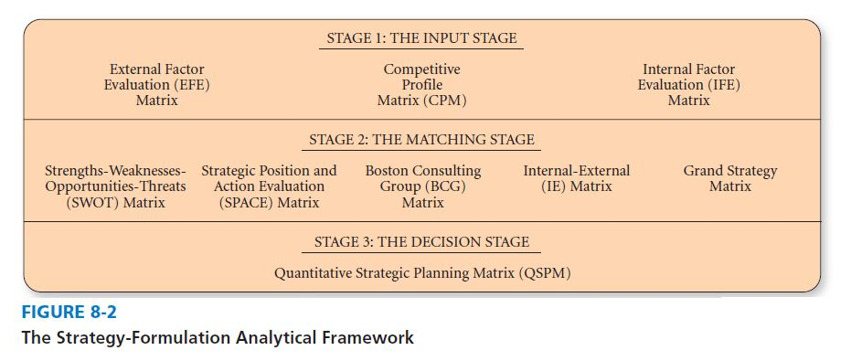
The Strategy-Formulation Analytical Framework
David's strategy formulation framework (SFF) is a tool that helps strategists to generate feasible alternatives that could assist the company in its goal. Hence, this paper will utilise the SFF to update Avon's business strategy.
@Fred David 2015

Slide 5


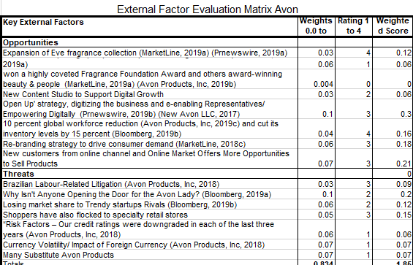


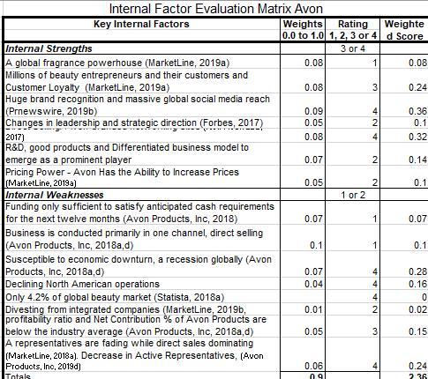

The Input Stage
EFE
IFE
Competitive Profile Matrix
The Nature of the Cosmetics Industry

Slide 6
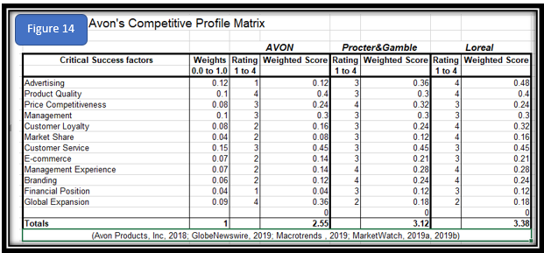
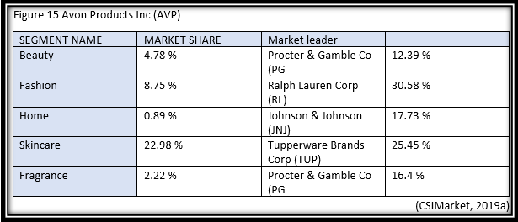
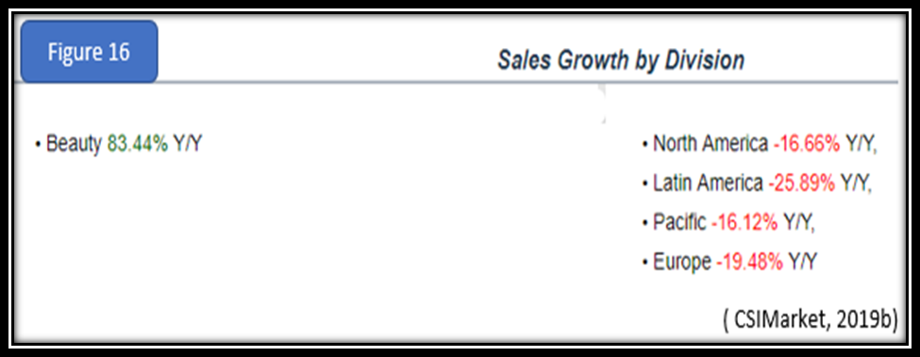
The Input Stage

Slide 7
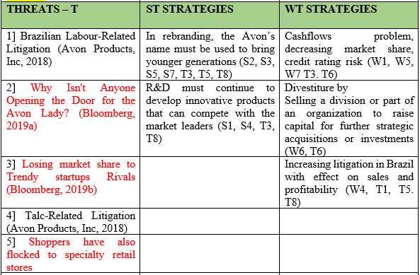
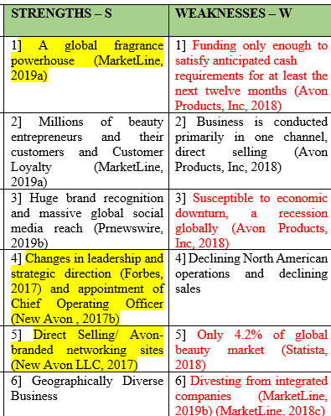
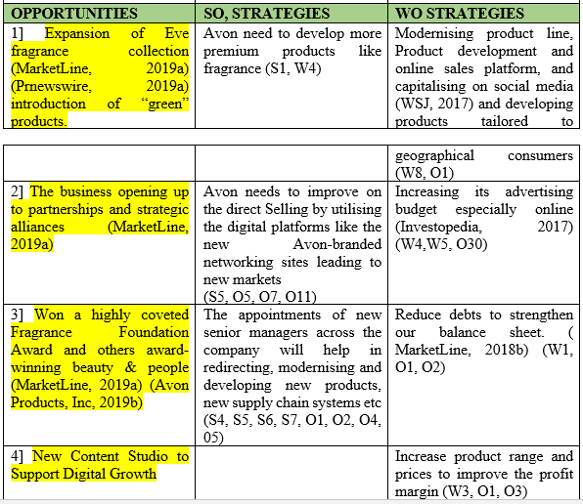
Avon’s Strengths-Weakness-Opportunities-Threats (SWOT) Matrix

Slide 8
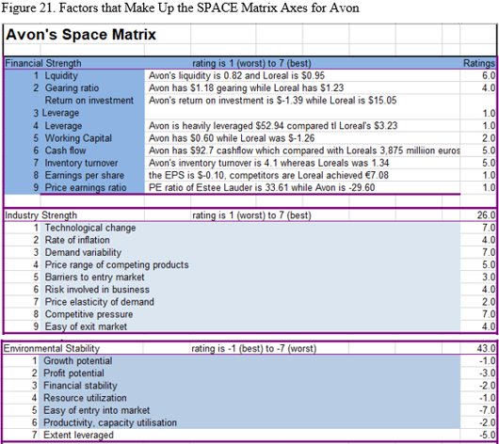
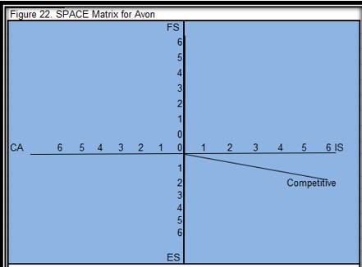
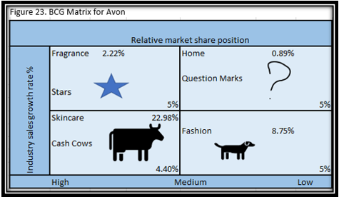
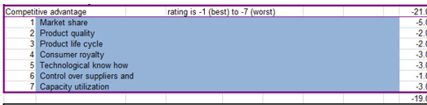

Slide 9
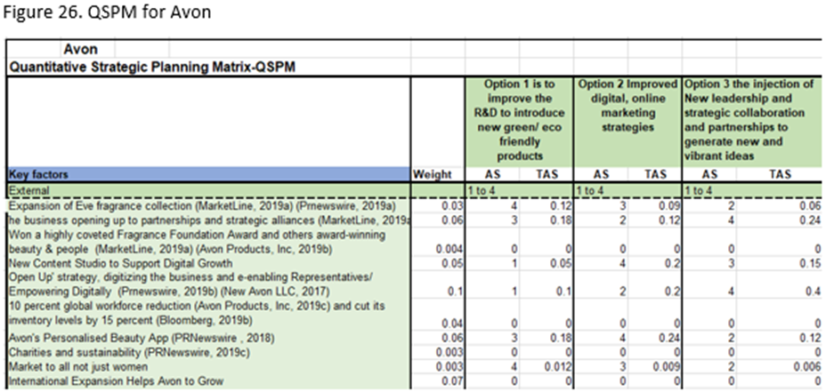
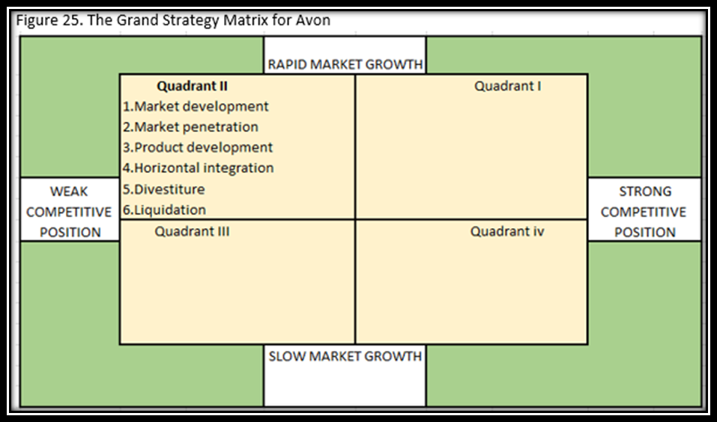
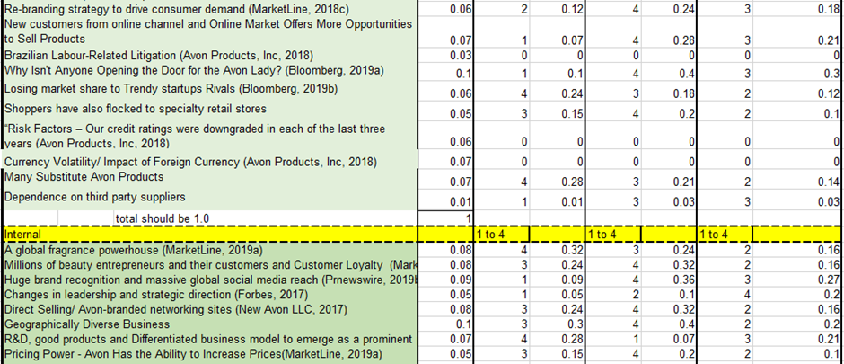
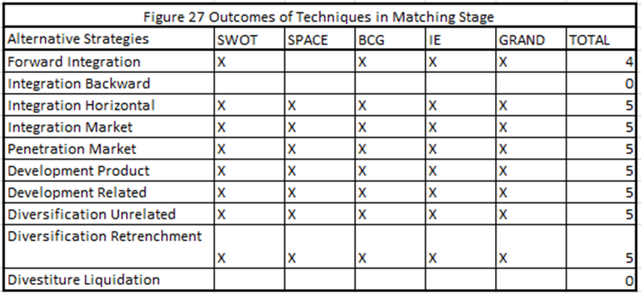
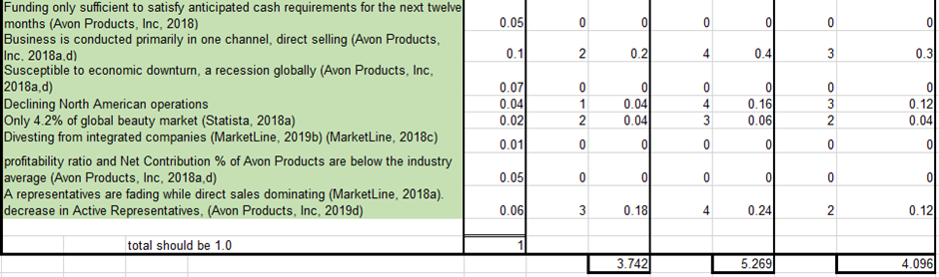
Decision Stage:-QSPM for Avon

Slide 10
ADVANTAGES OF SFF & THE LIMITATIONS SFF
Advantage
SFF makes it possible to evaluate several strategies simultaneously
SFF is a tool that shows a step by step stages and allows the previous factors into the next stage in the strategic analysis of the decision-making process
Limitation
Relies on the consultant’s intuitive judgement and assumptions.
QSPM depends on the quality of the prerequisite information and matching analysis and materials it is based on
SFF could also be limited by regional culture, organisational culture and political climate such as BREXIT
CONCLUSION
REFERENCES

