Slide 1

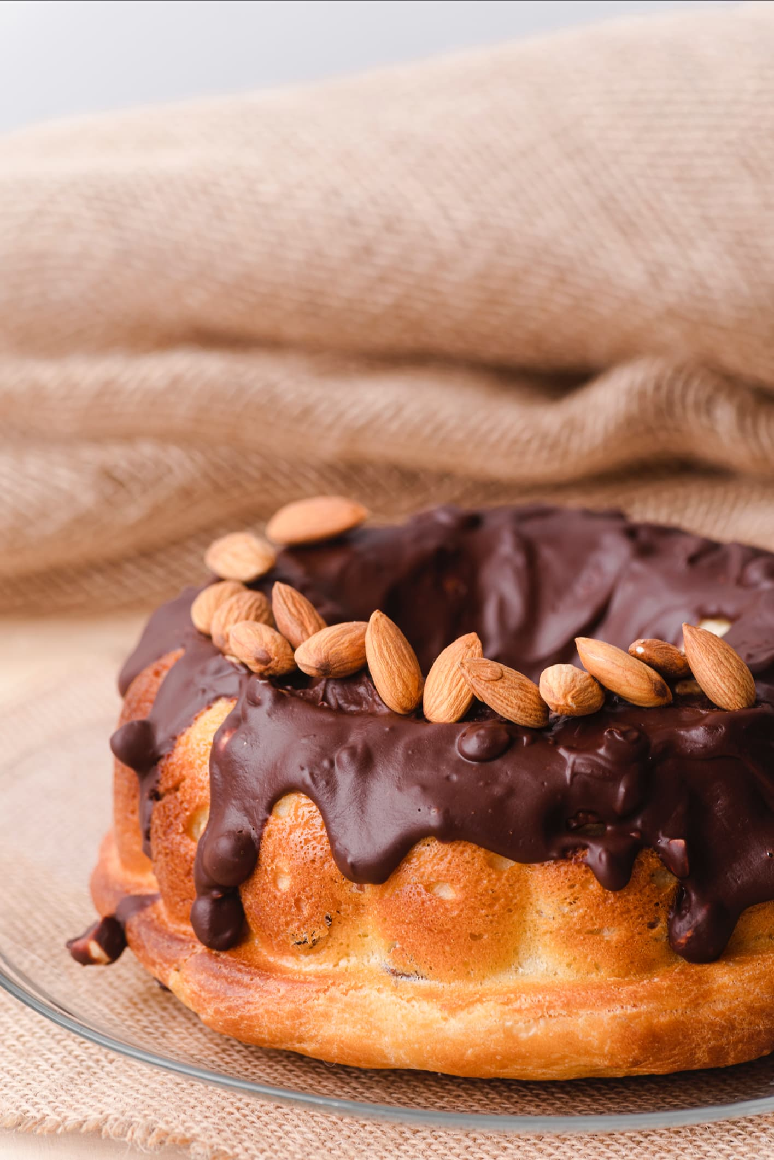
SweetBalance
"A Taste of Joy and Health in Every Bite.“
By Salma Farache
(New Atlas ,2024)

Slide 2
Introduction – The Heart of the Idea
" SweetBalance” a dessert business born from both culture and compassion.
Based on a chocolate and Arabic dessert brand inspired by my Lebanese heritage.
Inspired by my volunteer experience.
Especially with children who have diabetes and elderly people facing food restrictions.
Dessert could bring joy, dignity, and a sense of normalcy.
In this Journey I have applied what I learned in this Module especially in :
Market Research
Digital Marketing
Financial Planning
Entrepreneurship
This experience helped me develop both business and digital skills

Slide 3
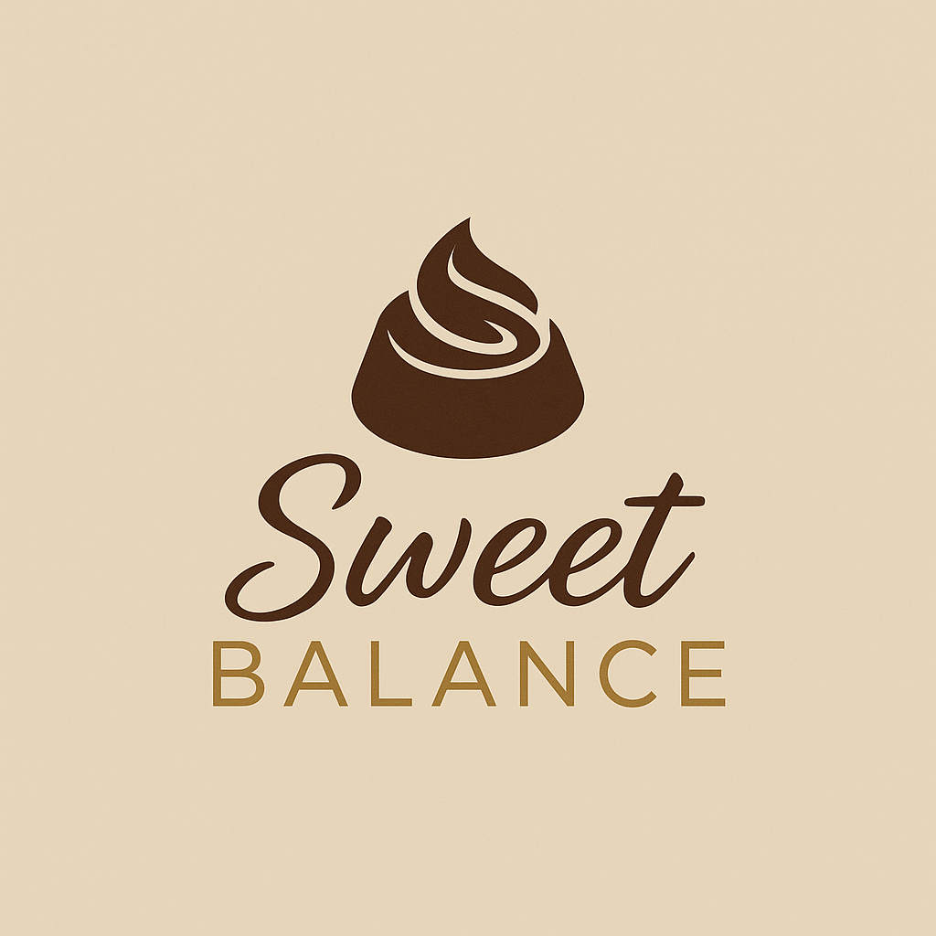
Business Proposition
Our mission is to create desserts that are both healthy and meaningful
Small business based in Swansea & online
Handmade chocolate & Arabic traditional sweets (e.g., low-sugar Baklava)
USP: Inclusive, healthy desserts using natural ingredients (Barringer and Ireland, 2022).
The products are designed for people with diabetes, health-conscious customers, and people who enjoy cultural desserts.
Year 1 goals: Sell 10 products, Reach 100 customers, social media growth.
The legal structure is a sole trader, which gives me full control of the business (Whittington et al., 2023)
(Canva,2025)

Slide 4
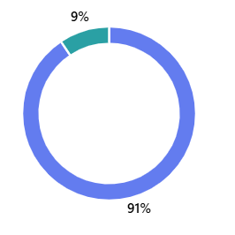
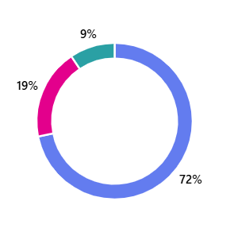
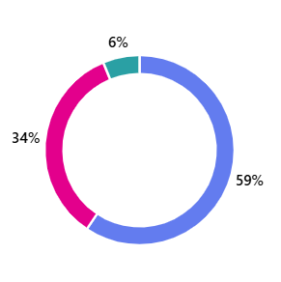
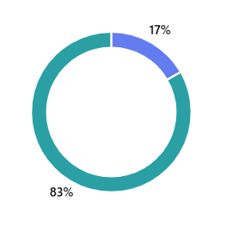
Market Research – Understanding People
I used Microsoft Forms to collect 17-question survey data. Key insights:
90% want handmade desserts
71% prefer
low-sugar
options
58% support using natural sweeteners
Like dates
Attention- question
83% answered correctly
According to Statista (2024), online dessert orders are growing fast, especially after COVID-19. People care more about what they eat and want healthier options (British Nutrition Foundation, 2023) (Microsoft forms,2025).

Slide 5
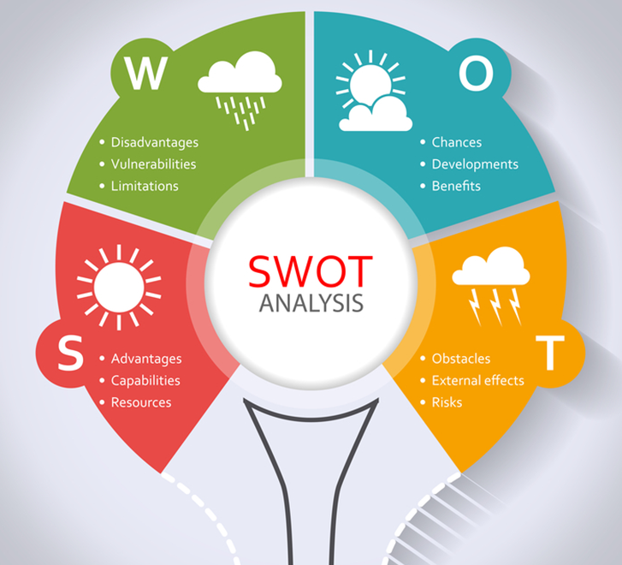
SWOT Analysis & Action Plan
Weaknesses
Opportunities
Strengths
threats
starting alone with a small budget.
limits production & promotion.
more people now prefer low-sugar and natural foods
small businesses are popular in local communities
based on a personal story
offers healthy options and respects culture.
competition from bigger dessert brands (Jones et al., 2019)
Action Plan
Hire kitchen assistant & digital marketer
Partner with local diabetic support groups
Keep prices affordable and Launch loyalty program
(Meeting & Incentive Group, 2023)

Slide 6
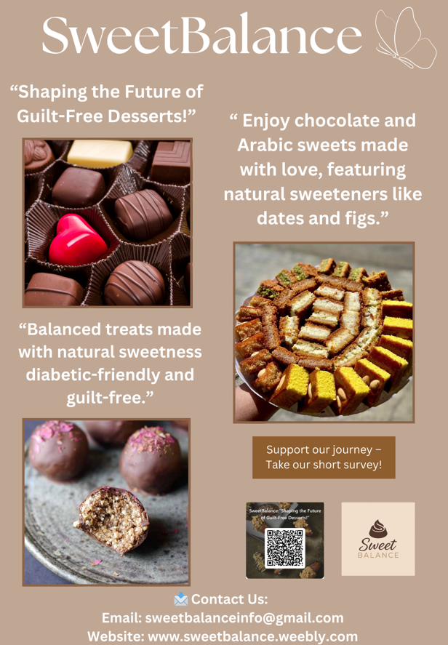
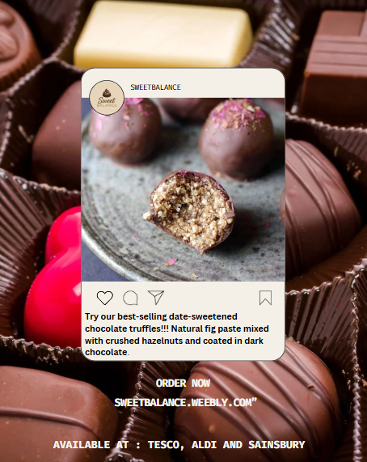
12-Month Marketing Strategy
My marketing plan includes both digital and local ideas
Post weekly on Instagram and Facebook .
used Canva to make flyers and business cards that show brand colours and logo
10% discounts to customers who follow or share our pages
Give free samples to local food markets
Help grow trust and sales
(Tuten and Solomon, 2020). (Canva,2025) (Chaffey and Ellis-Chadwick, 2019).

Slide 7
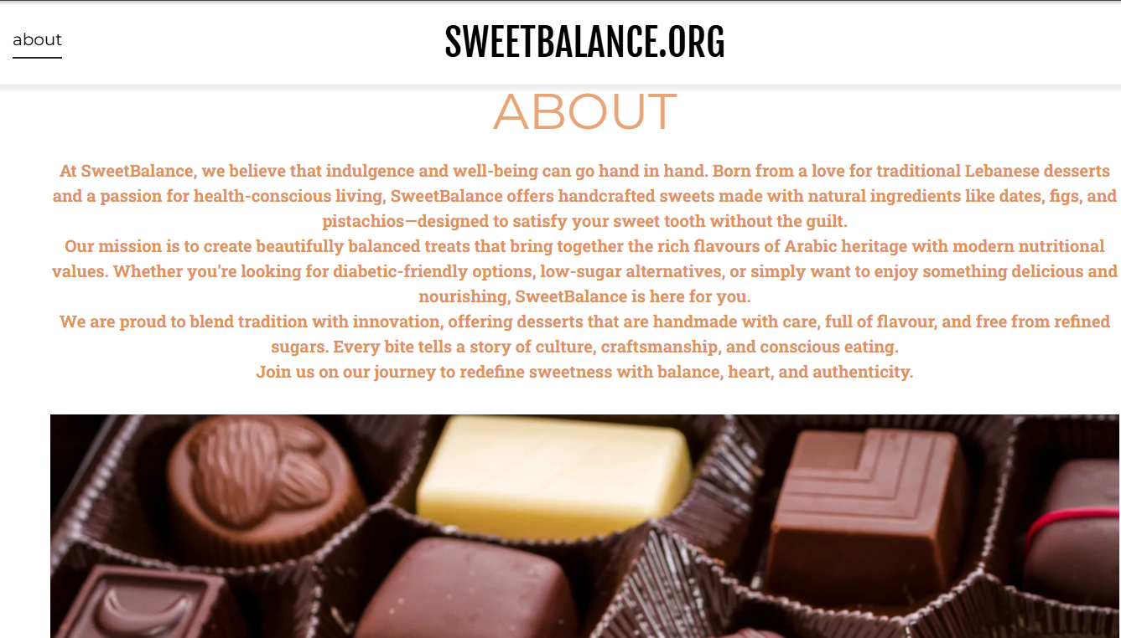
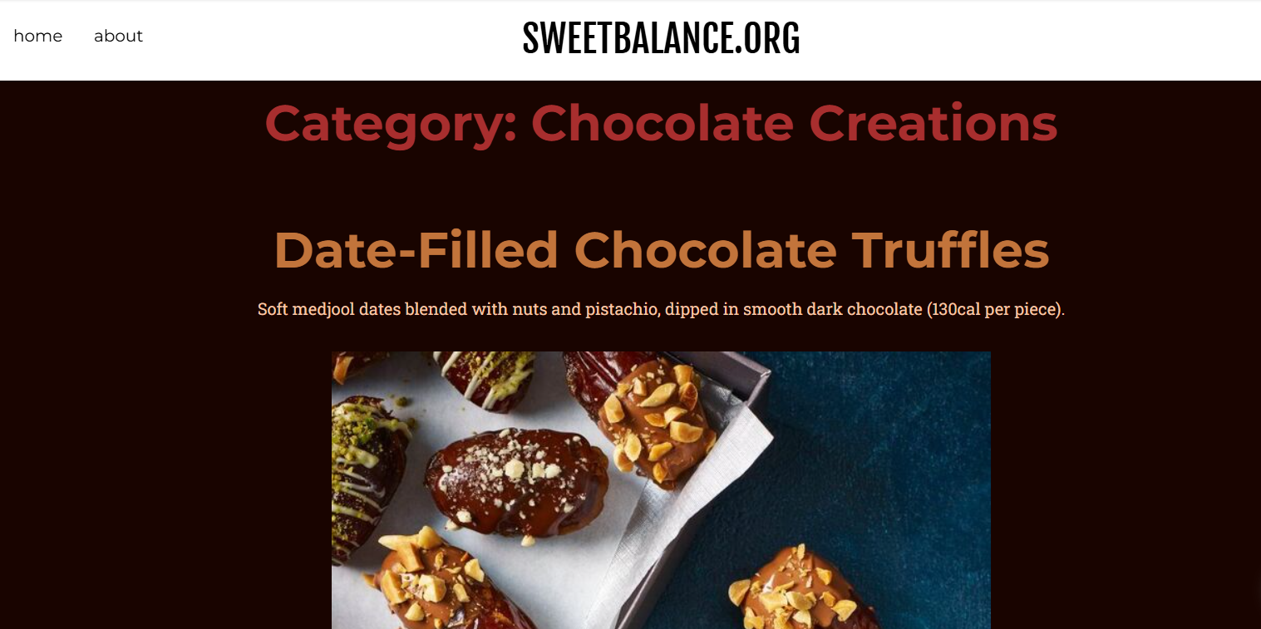
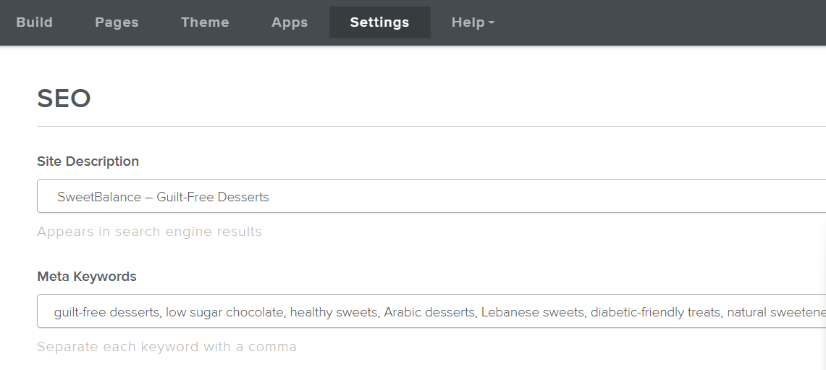
Website and SEO – Being Seen Online
Built using Weebly with three pages
SEO
Diabetic-friendly chocolate.
Alt-text on images
ABOUT
Homepage shares origin story and ingredients
Category
Product page shows full menu
This design makes my business look professional and trustworthy (Baines, Fill and Page, 2019).
(Weebly,2025)

Slide 8
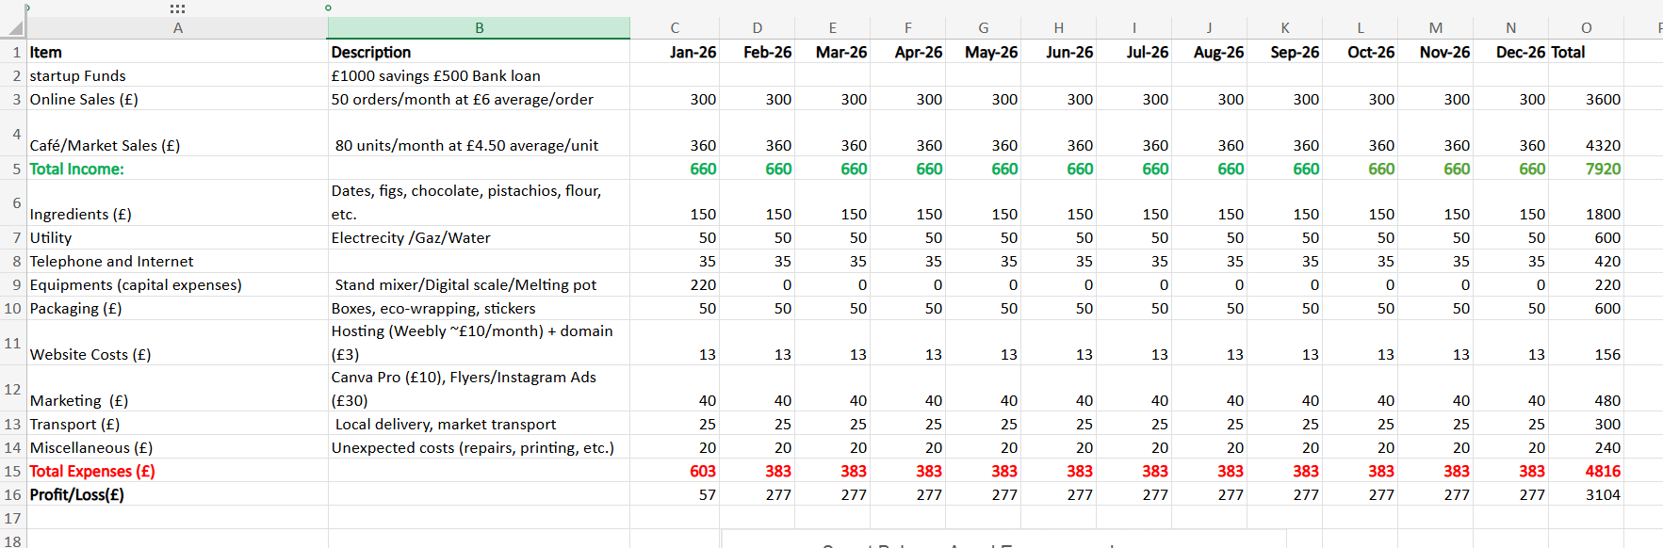
Excel and Bar Chart – Financial Planning
Microsoft Excel to build a 12-month cash flow forecast.
Break-Even Forecast:
Sell 20–25 boxes a month
Break even within 8 to 10 months
Applying the break-even analysis method described by Alvarez (2018)”.
Used Excel for income/expenses and profit tracking.
(Microsoft Excel,2025)

Slide 9
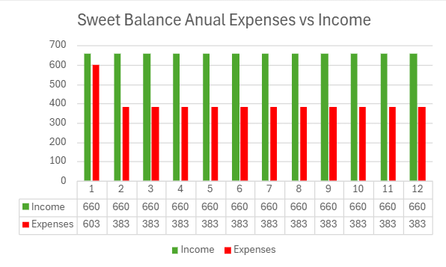
Excel and Bar Chart – Financial Planning
Microsoft Excel to build a 12-month cash flow forecast.
With the £50,000 investment
Rent a small kitchen, buy equipment, improve packaging,
Hire a part-time helper and build a professional online shop.
use some of the money to develop a new line: Beirut Chocolate similar to Dubai chocolate
Created bar chart comparing monthly income vs expenses.
(Microsoft Excel,2025)

Slide 10
Time to watch!

Slide 11
Video Advertisement – Communicating the Brand
SweetBalance
Video created with TikTok:
Starts with me introducing the brand
It reflects love, culture, and health - key insights from the survey.
https://youtube.com/shorts/oz9GEbJRtWg?si=KtX3yUvu-Q1Cn3ar
(YouTube, 2024)

Slide 12


Why Invest in Me
01
02
04
Real need, real experience
Skilled in digital tools & enterprise
03
Strong customer insight
Unique product with social value
(Virginia Commonwealth University, 2023)
I can grow SweetBalance and make it a successful business in the UK and beyond.

Slide 13
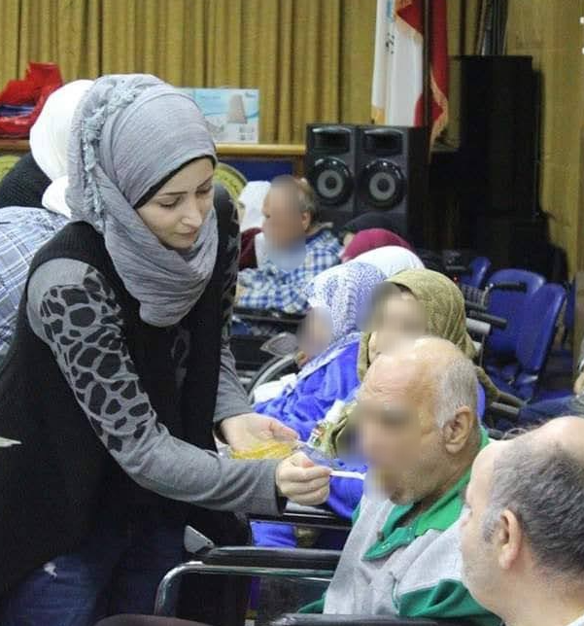
Conclusion
"Why SweetBalance Matters“
I believe in SweetBalance not just because I love dessert
but because I’ve seen what food can mean to people.
I’ve stood beside children who couldn’t enjoy cake like others. I’ve cooked for people who felt forgotten. And I’ve seen how a small, beautiful thing like a piece of chocolate can offer comfort, love, and connection .
(Farache, 2025)

Slide 14
—Salma Farache-
“Thank you so much for listening!”

Slide 15
References
Statista (2024) Online food delivery & dessert consumption in the UK. Available at: https://www.statista.com/
SweetBalance (2025) Financial Table for SweetBalance. Microsoft Excel Spreadsheet. Unpublished internal document.
SweetBalance (2025) Promotional Image for SweetBalance. Created using Canva. Unpublished internal document.
SweetBalance (2025) Promotional Image for SweetBalance. Created using Weebly. Unpublished internal document.
The Tasty Spoonful (n.d.) Healthy fig and banana rolls. Available at: https://thetastyspoonful.com/healthy-fig-and-banana-rolls/ (Accessed 5 June 2025).
Tuten, T.L. and Solomon, M.R. (2020) Social Media Marketing. London: Sage.
Virginia Commonwealth University (2023) VCU launches ‘Invest in Me’ initiative. Available at: https://www.support.vcu.edu/donors/giving-news/vcu-launches-invest-in-me-initiative/ (Accessed: 26 June 2025).
Whittington, R., Regnér, P., Angwin, D., Johnson, G. and Scholes, K. (2023) Exploring Strategy: Text and Cases. 13th edn. Harlow: Pearson.
YouTube (2024) [Short video: Sweet Balance: Naturally Sweet, Handmade with Care]. YouTube Shorts. Available at:https://youtube.com/shorts/oz9GEbJRtWg?si=KtX3yUvu-Q1Cn3ar (Accessed: 28 June 2025).
Alvarez, S.A. (2018) What entrepreneurs need to know before they start. London: Henry Stewart Talks Ltd.
Baines, P., Fill, C. and Page, K. (2019) Essentials of Marketing. Oxford: Oxford University Press
Barringer, B.R. and Ireland, R.D. (2022) Entrepreneurship: Successfully Launching New Ventures. 6th edn. Harlow: Pearson.
British Nutrition Foundation (2023) Consumer attitudes to healthy eating. Available at: https://www.nutrition.org.uk/
Chaffey, D. and Ellis-Chadwick, F. (2019) Digital Marketing. Harlow: Pearson.
Delicious Magazine (n.d.) Chocolate‑dipped stuffed dates. Available at: https://www.deliciousmagazine.co.uk/recipes/chocolate-dipped-stuffed-dates/ (Accessed 5 June 2025).
Etsy (2024) Lebanese Sfouf SweetFamous Arabic cake – listing 1210255312. Available at: https://www.etsy.com/uk/listing/1210255312/lebanese-sfouf-sweetfamous-arabic (Accessed 3 June 2025).
Farache, S. (2025) SweetBalance promotional image. Personal photograph.
Jones, P. et al. (2019) ‘Digital marketing in micro-businesses’, Journal of Small Business and Enterprise Development, 26(3), pp. 310–326.
Meeting & Incentive Group (2023) How to conduct a SWOT analysis for your events: 8 useful tips. Available at: https://mig.cc/blog/how-to-conduct-a-swot-analysis-for-your-events-8-useful-tips/ (Accessed: 29 June 2025).
New Atlas (2024) Chocolate can now be made from cocoa jelly: new type of chocolate explained. Available at: https://newatlas.com/good-thinking/chocolate-new-type-cocoa-jelly/ (Accessed 7 June 2025).

